Slide 1
Day 3 5 June, 2024

Slide 2
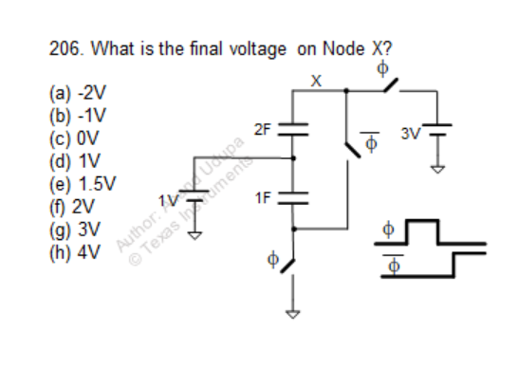
Question

Slide 3
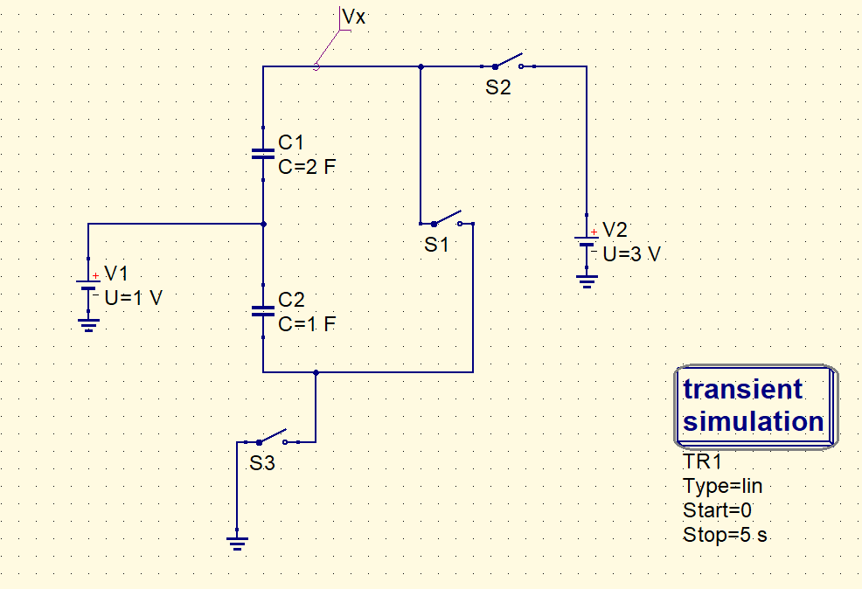
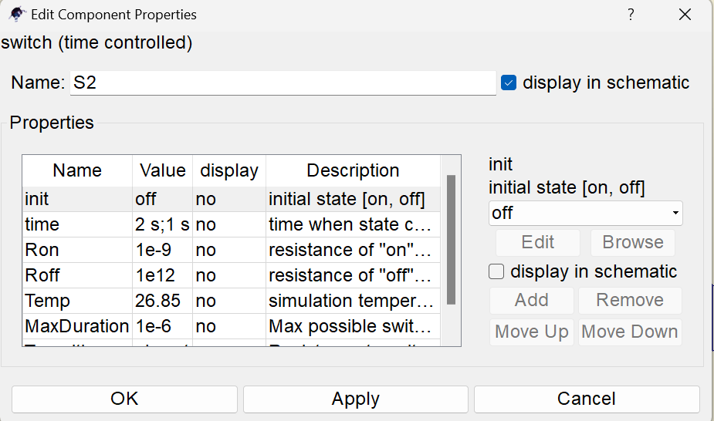
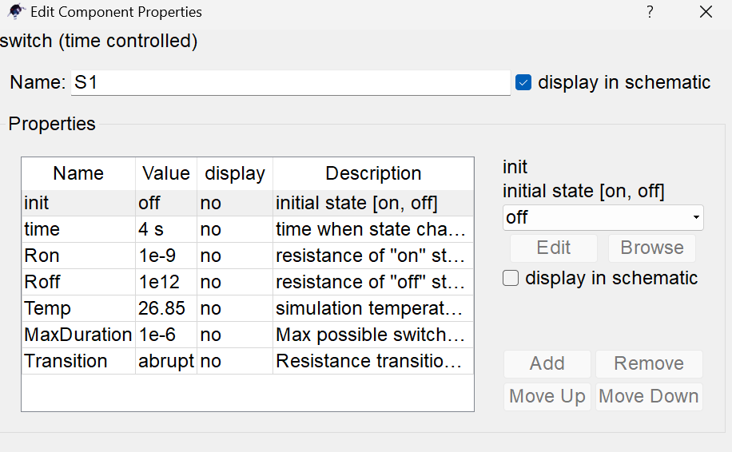
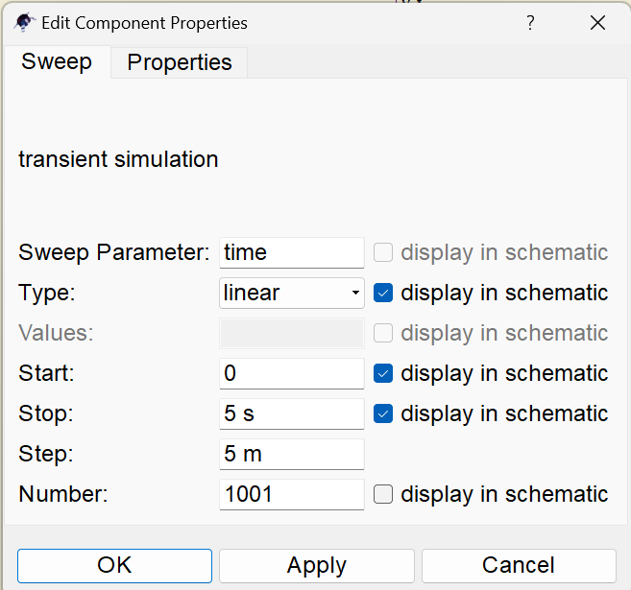
QUCS circuit
S2, S3
S1

Slide 4
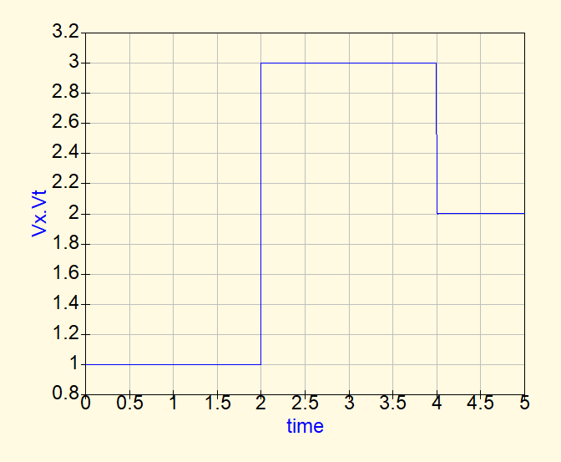
QUCS result
Conclusion:
In the phase when all switches are off, the caps are floating. Hence, there is no charging/discharging happening, and node X will stay at 1V.
When S2 and S3 are turned on, 1F cap charges to 1V , and 2F charges to 2V.
Later when S1 turns on , and other two switches go off, the 1F, 2F caps come in parallel. We then apply charge conservation.
(Vx-1)3 = -1*1 + 2*2 = 3, So Vx = 2V

Slide 5
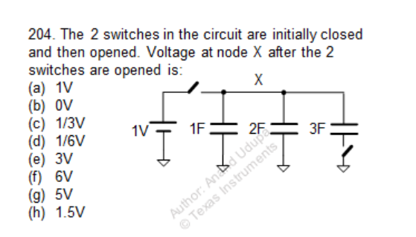
Question

Slide 6
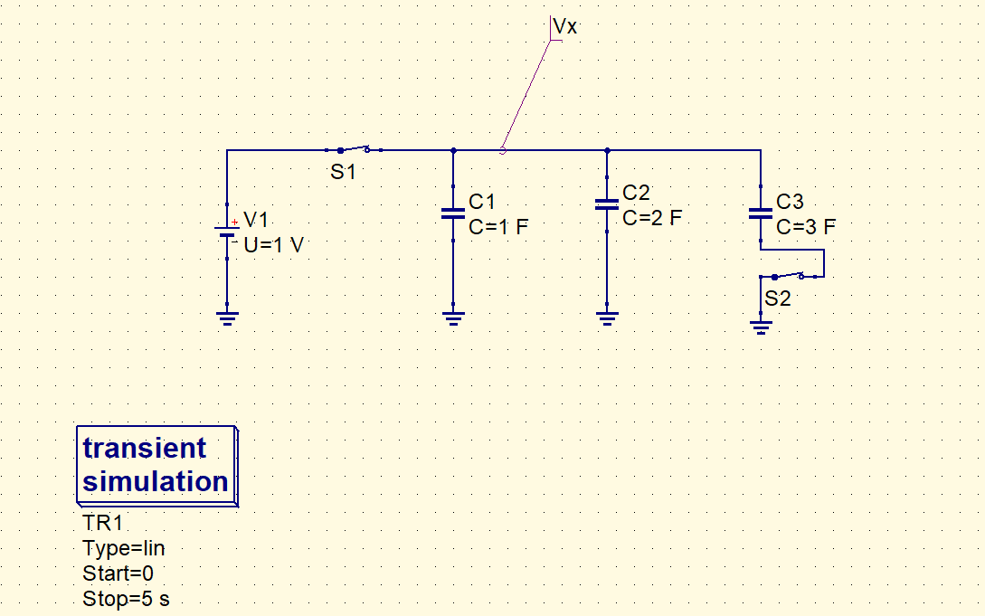
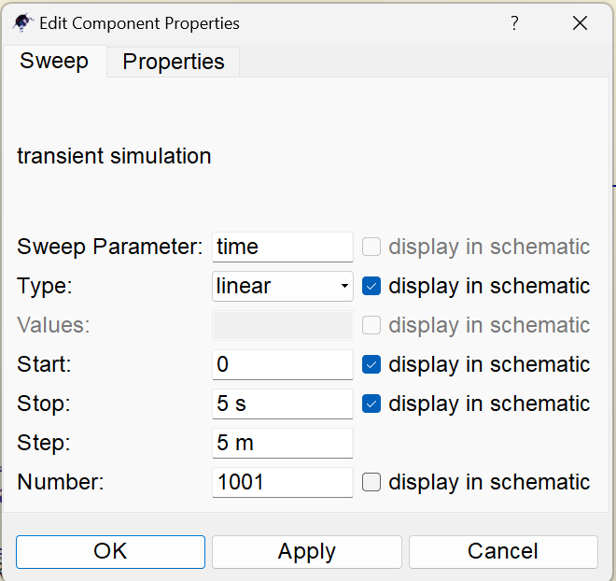
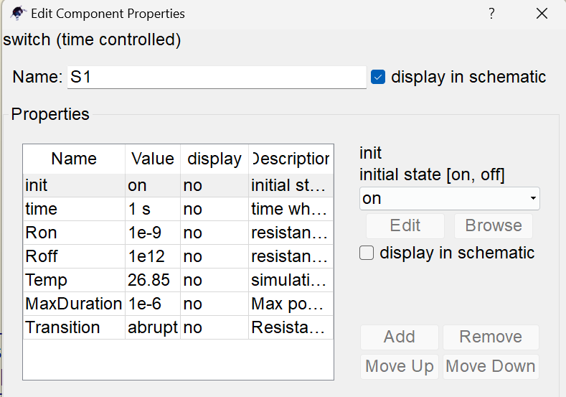
QUCS circuit

Slide 7
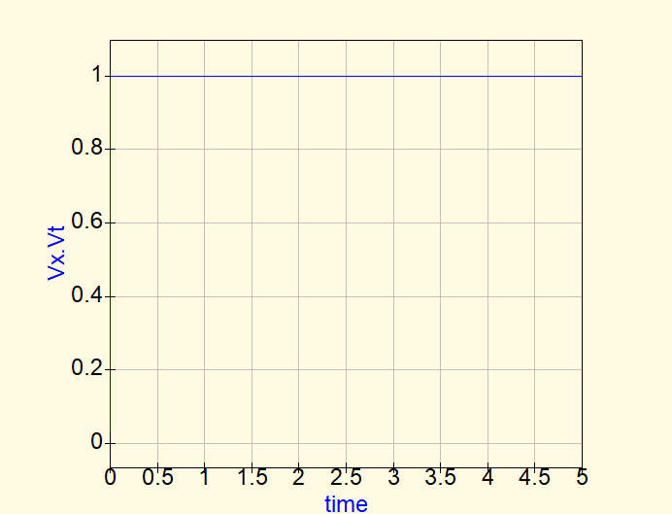
QUCS Result
Conclusion
- All the caps are charged to 1V initially.
- When the switches are opened, the 3F cap is open, it maintains the 1V across it. The 1F and 2F caps, share charge among themselves , and the Voltage at node X stays at 1V.

Slide 8
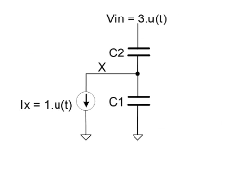
Question
Rate of change of voltage at node X , C1 = 1F, C2 = 3F

Slide 9
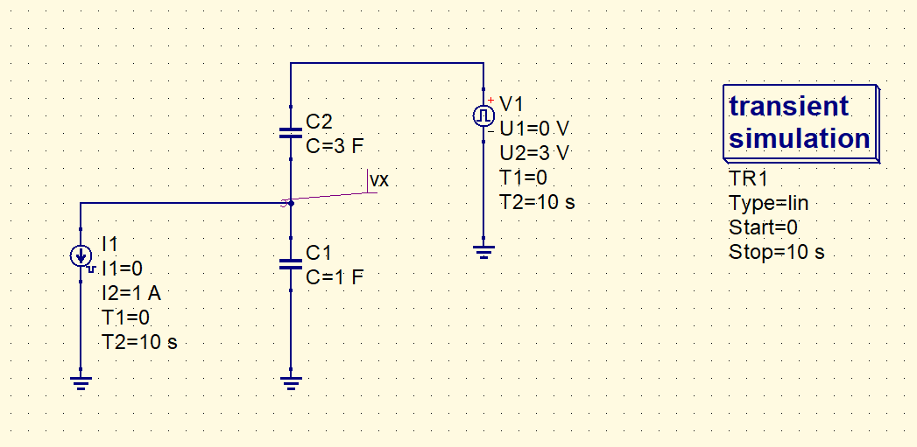
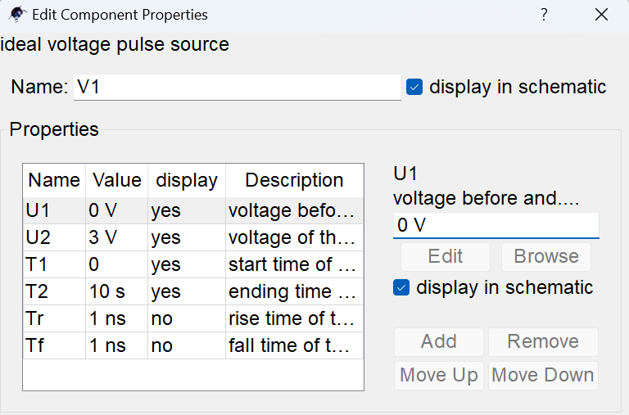
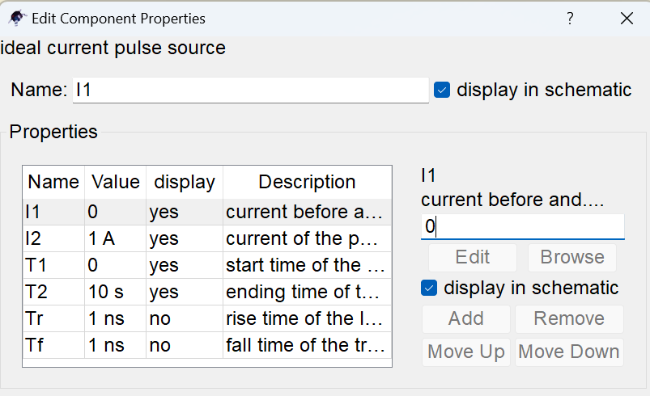
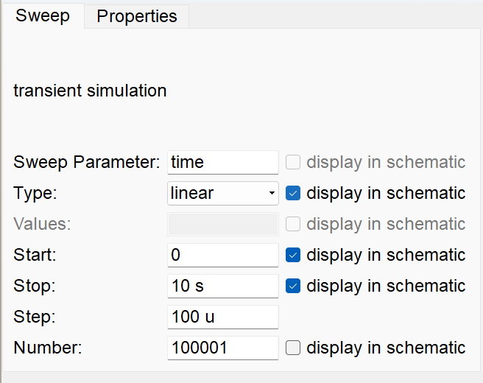
QUCS circuit

Slide 10
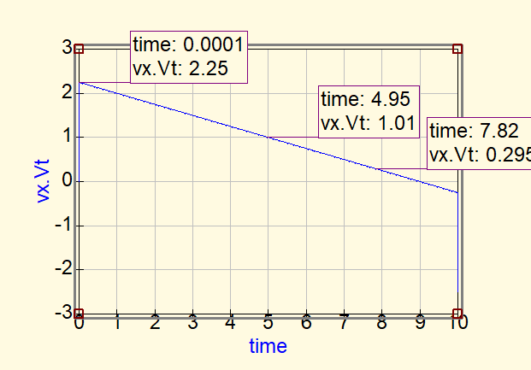
QUCS Result
Slope can be found by marking two points in the graph
(0.295-1.01)/(7.82-4.95) = -0.25
Conclusion
No charge accumulation should take place at any node.
Hence, charge into X = charge out of X:
3.[3-Vx(t)] = 1.Vx(t) + 1.t
On solving, we get dVx(t) / dt = -0.25

