Slide 1
Day 4 6 June, 2024

Slide 2
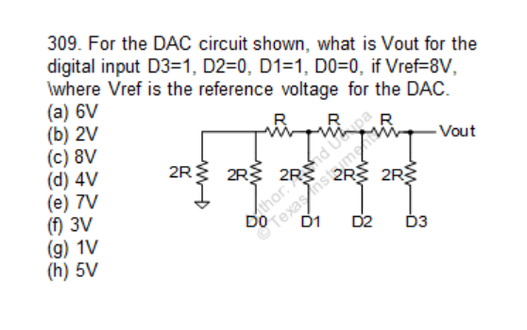
Question

Slide 3
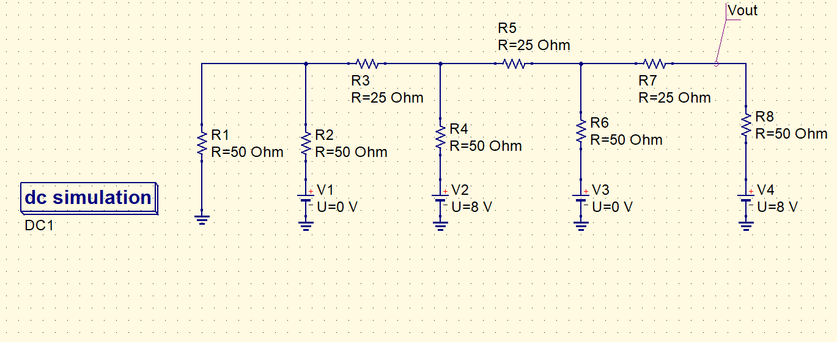
QUCS circuit
So, what will be the input code for generating Vout = 5.5 ?

Slide 4
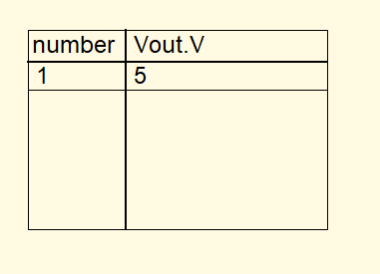
QUCS result
Conclusion:
Use superposition to calculate Vout in terms on D3, D2, D1, D0.
Vout = (( D0 + 2D1 + 4D2 + 8D3 )/16) * Vref (Vref = 8V)
For Vout= 5.5 V, the input code will be : D3= 1 , D2= 0 , D1= 1 , D0= 1 , try on simulator!

Slide 5
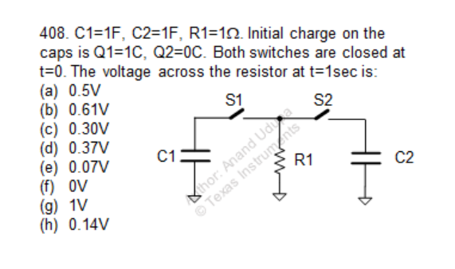
Question

Slide 6
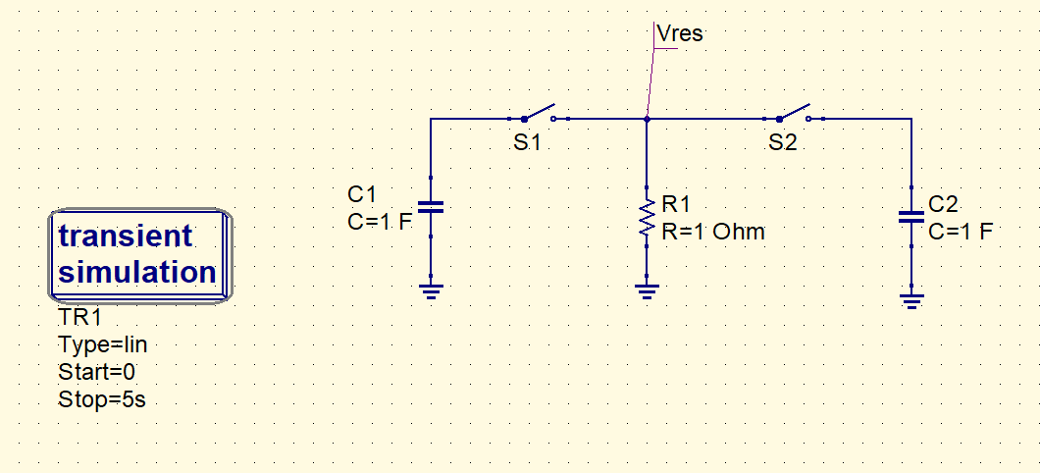
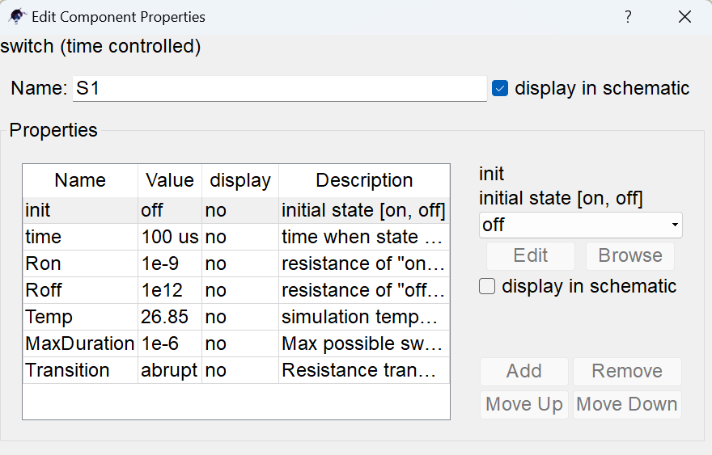
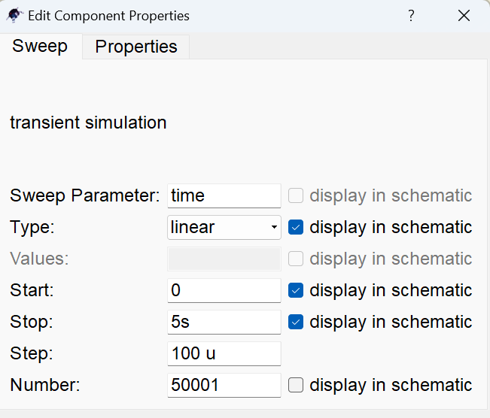
QUCS circuit

Slide 7
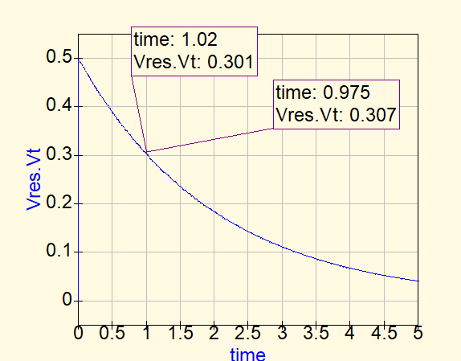
QUCS Result
Conclusion
The instant when the two switches are turned on, C1 and C2 come in parallel , and instantaneous charge transfer takes place between them.
They circuit reduces to a 2F capacitor with 0.5 V on it, in parallel with 1 ohm resistor.
The 2F capacitor then discharges through the resistor with a time constant of RC= 2 s.
At t=1 s, V(t) = 0.5 e^ (-1/2) = 0.3V

Slide 8
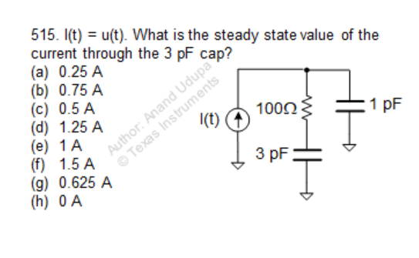
Question

Slide 9
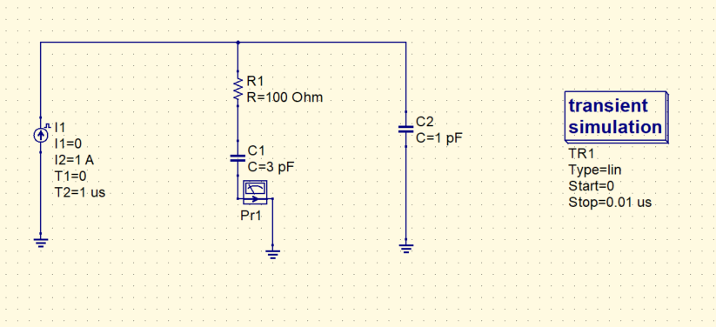
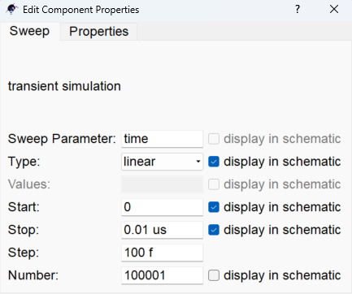
QUCS circuit

Slide 10
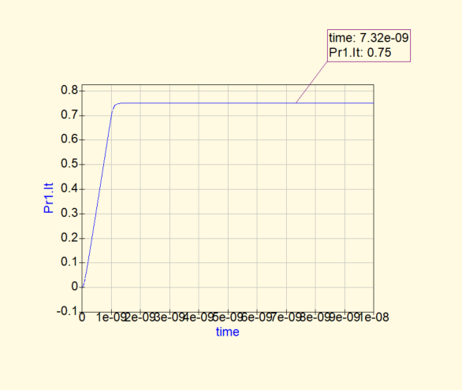
QUCS Result
Conclusion
- Initially all the current goes in the 1 pF capacitor, in steady state the current gets divided between the two capacitors.
- Current in 3 pF capacitor in steady state = ¾ * I(t)

