Slide 1
Day 6 10 June, 2024

Slide 2
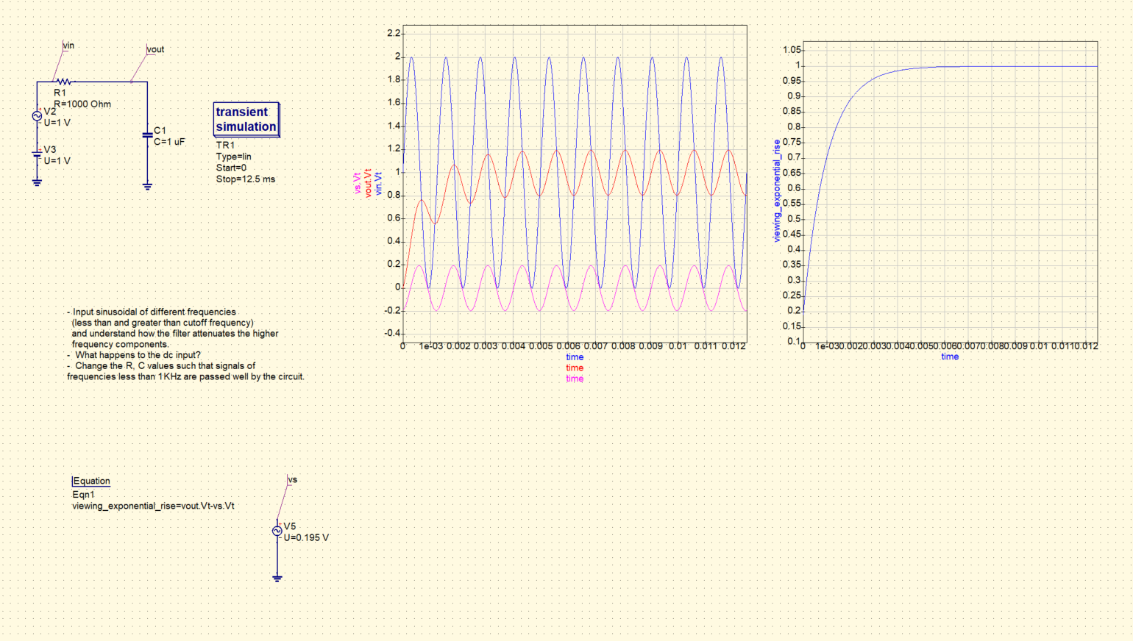
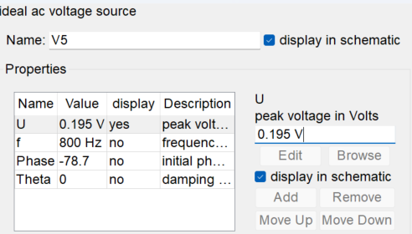
Circuit from last class…

Slide 3
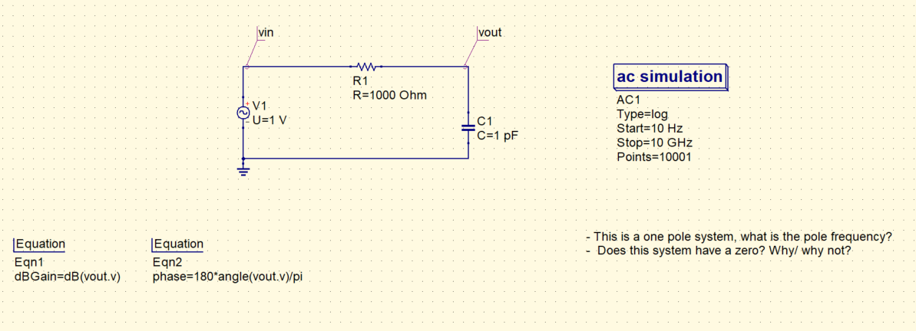
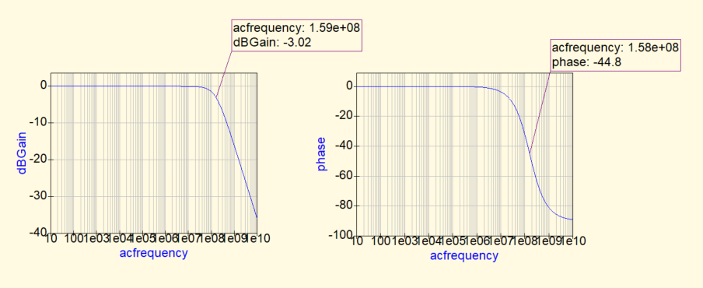
Understanding about poles and zeros
1) System with one pole:
What is the transfer function of this circuit?
What is the dc gain of this circuit?
How will you see the 20 dB/decade roll-off?
H(s) = 1/(1+sRC)

Slide 4
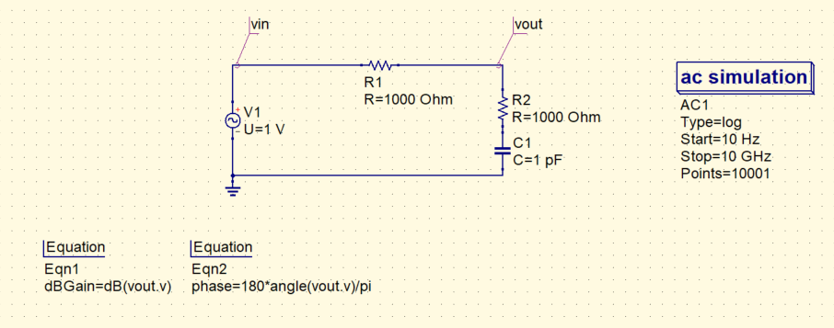
2) System with one pole and one zero
Transfer function of this circuit?
Dc gain of this circuit?
How many poles and zeros does this system have?
How did the series R help in creating a zero frequency?
What’s the zero and pole frequency?
Expected gain, phase at zero and pole frequency?

Slide 5
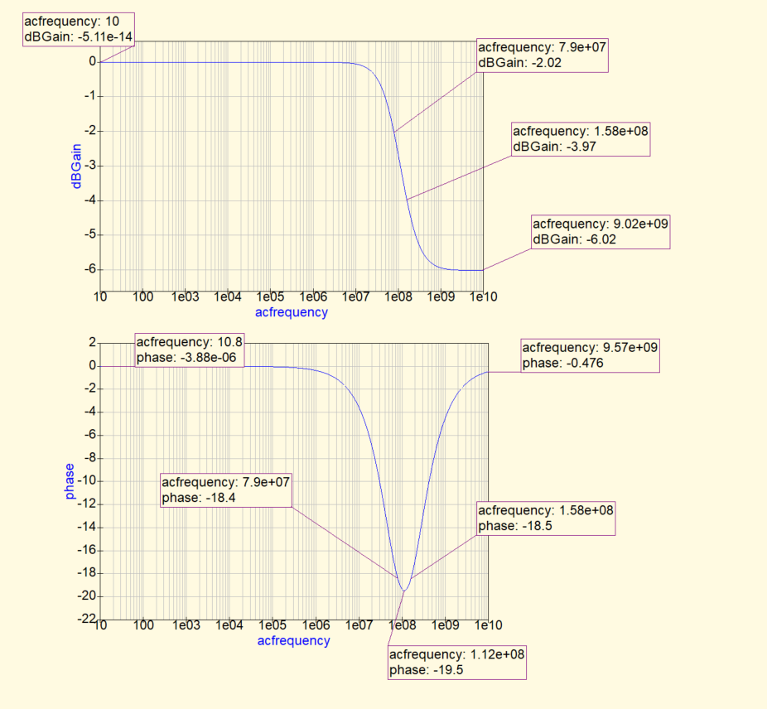
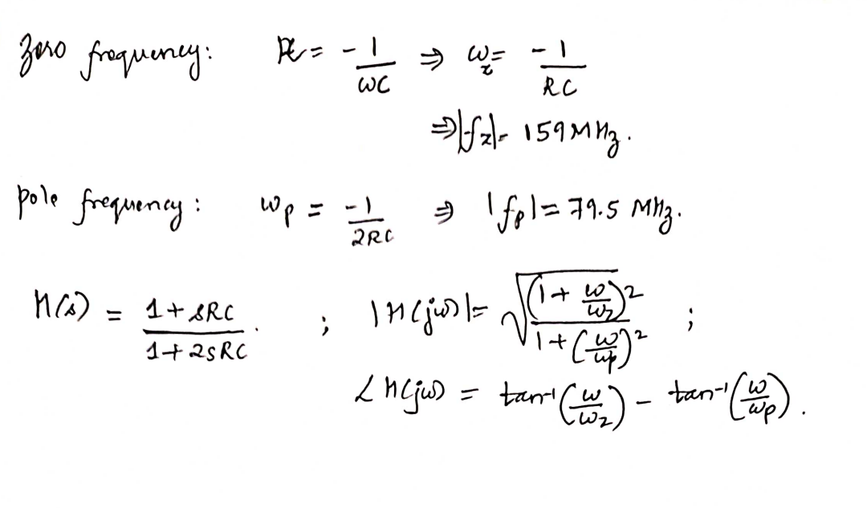
- Calculate the gain and phase of the system at the marked points, and match your calculations, with the values obtained through simulations.

Slide 6
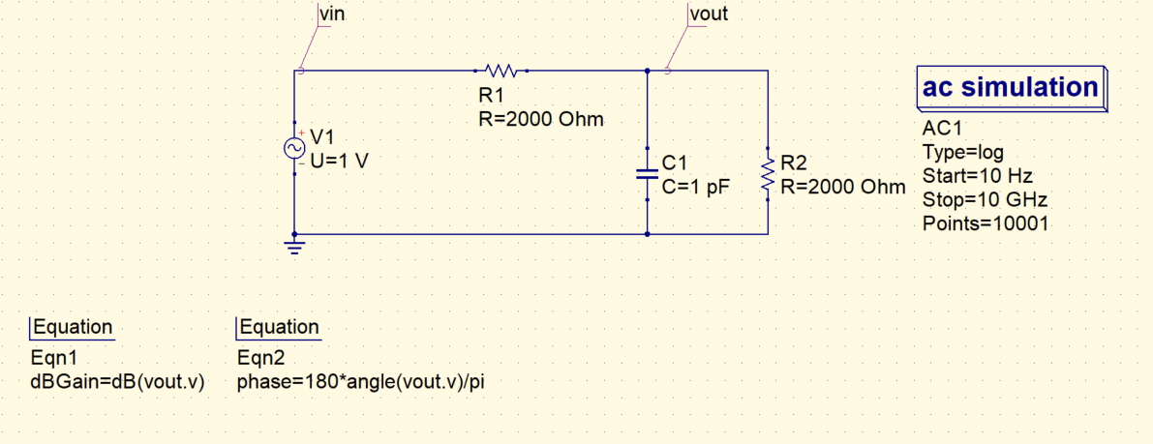
3) Another example
Transfer function of this circuit?
Dc gain of this circuit?
How many poles and zeros does this system have?
Expected gain, phase plots?

Slide 7
