Slide 1
Day 7 11 June, 2024

Slide 2
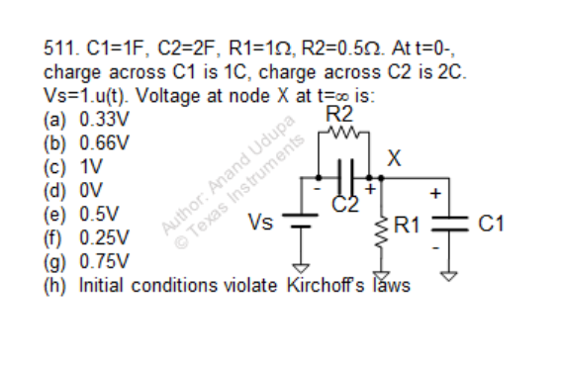
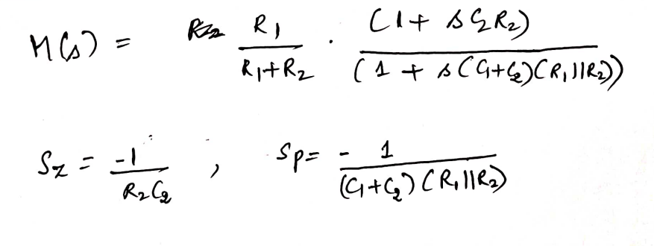
Question
Instructions for simulation:
First start with initial condition of 0C for both caps:
a) R1= 1 ohm, C1= 1F, R2= 0.5 ohm, C2= 2F
b) R1= 1 ohm, C1= 4F, R2= 0.5 ohm, C2= 2F
c) R1= 1 ohm, C1= 1F, R2= 8 ohm, C2= 2F
2) Apply the initial conditions as given in the question.
- What is the transfer function of this circuit?

Slide 3
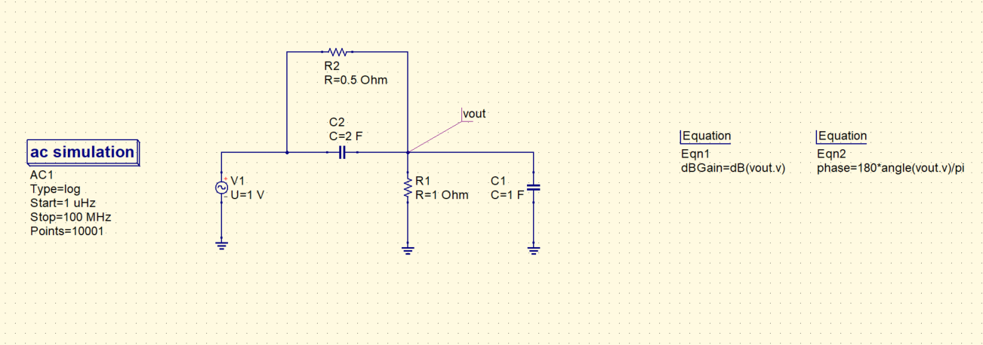
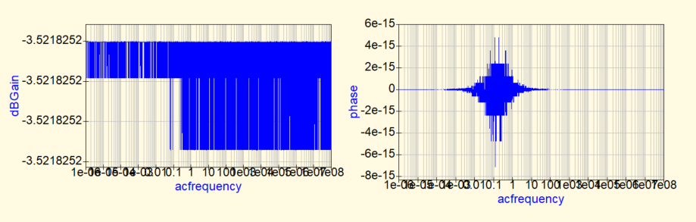
Circuit 1: Analyzing in frequency domain

Slide 4
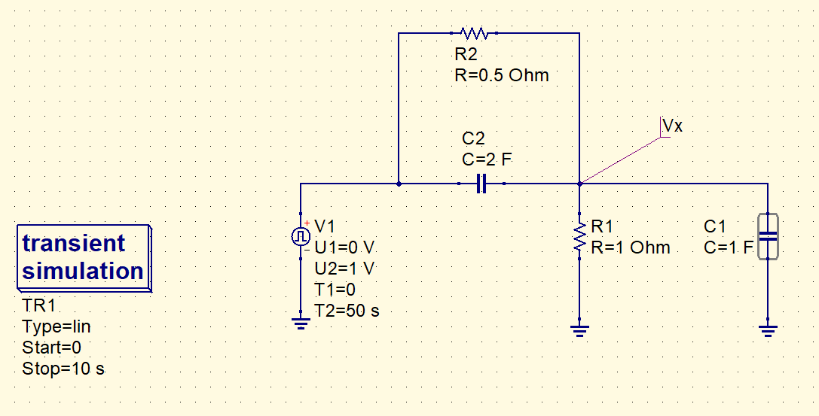
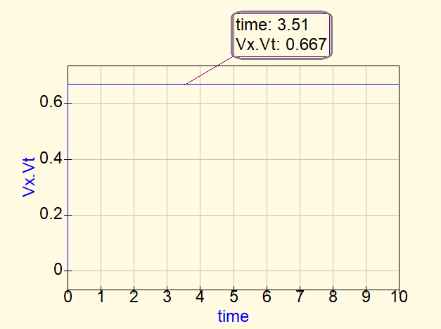
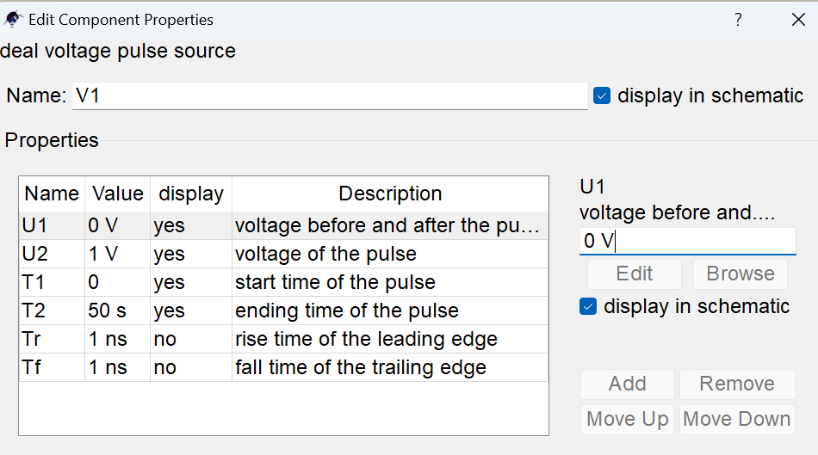
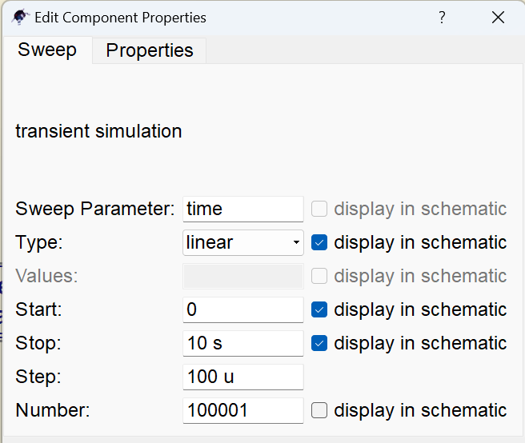
QUCS circuit 1 in time domain
QUCS Result
No initial conditions are given.
Conclusion:
Expected Vx(0) = C2/C1+C2; Expected Vx(∞) = R1/R1+R2
When R1C1 = R2C2 , pole-zero cancellation occurs, and the output instantly rises to the final value in the beginning itself.

Slide 5
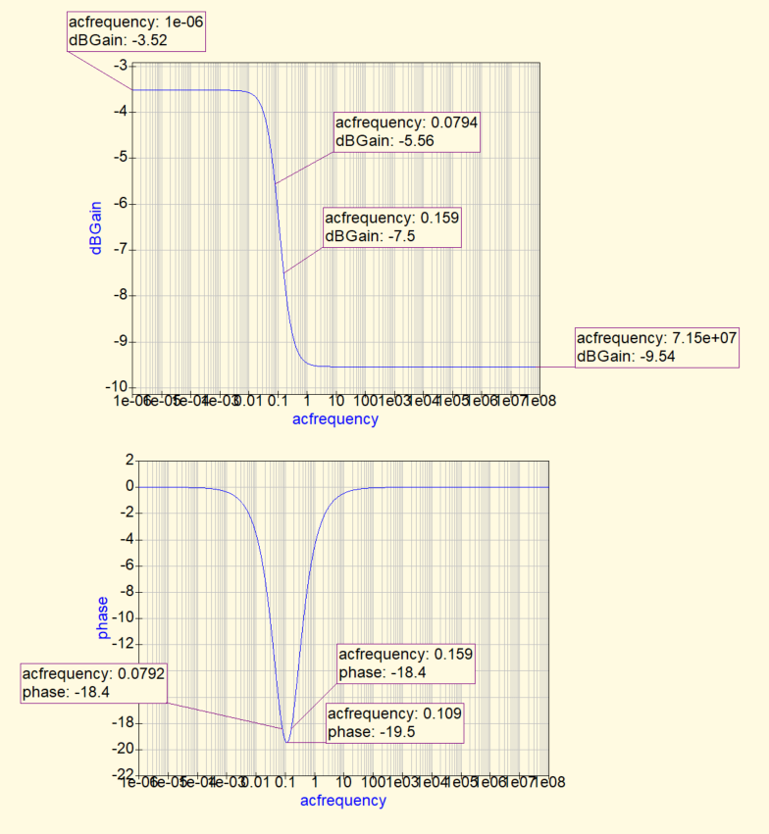
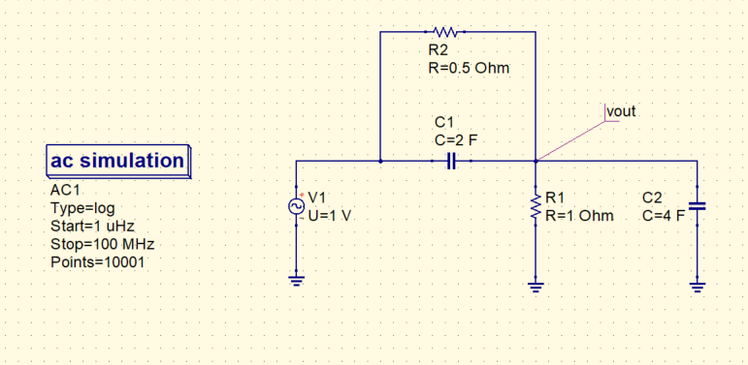
Circuit 2: Analyzing in frequency domain
- Calculate the gain and phase of the system at the marked points, and match your calculations, with the values obtained through simulations.

Slide 6
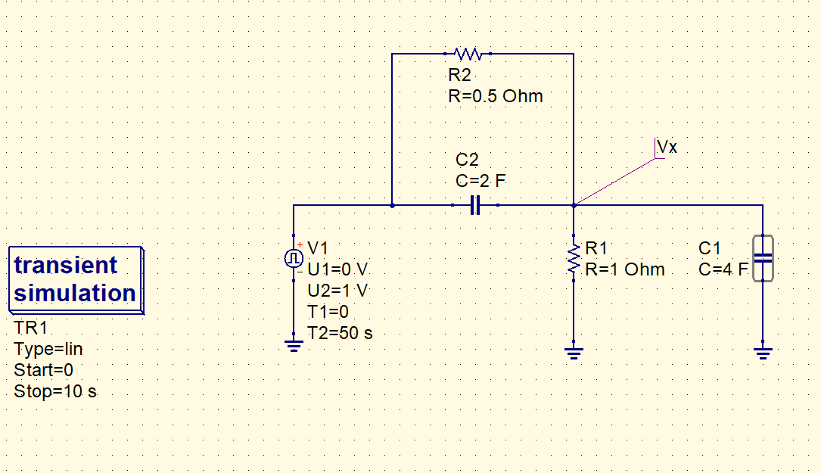
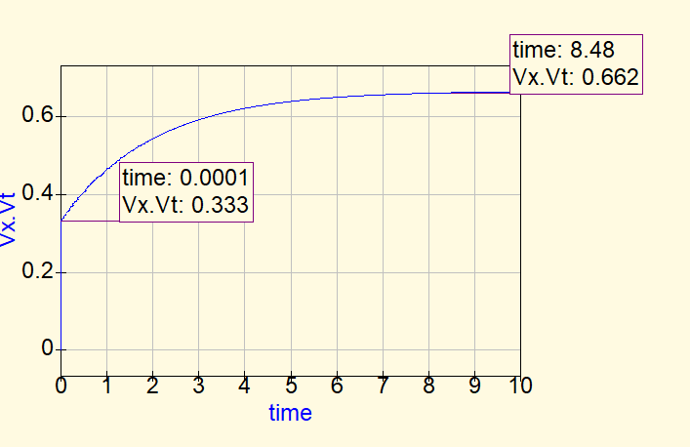
QUCS circuit 2 in time domain
QUCS Result
No initial conditions are given.
Looking at the transient response, is it possible to tell if pole frequency is greater or lesser than zero frequency?
Conclusion:
Expected Vx(0) = C2/C1+C2; Expected Vx(∞) = R1/R1+R2
Here, R1C1 > R2C2 , so Vx(0) > Vx(∞), and the output rises exponentially (first order circuit).

Slide 7
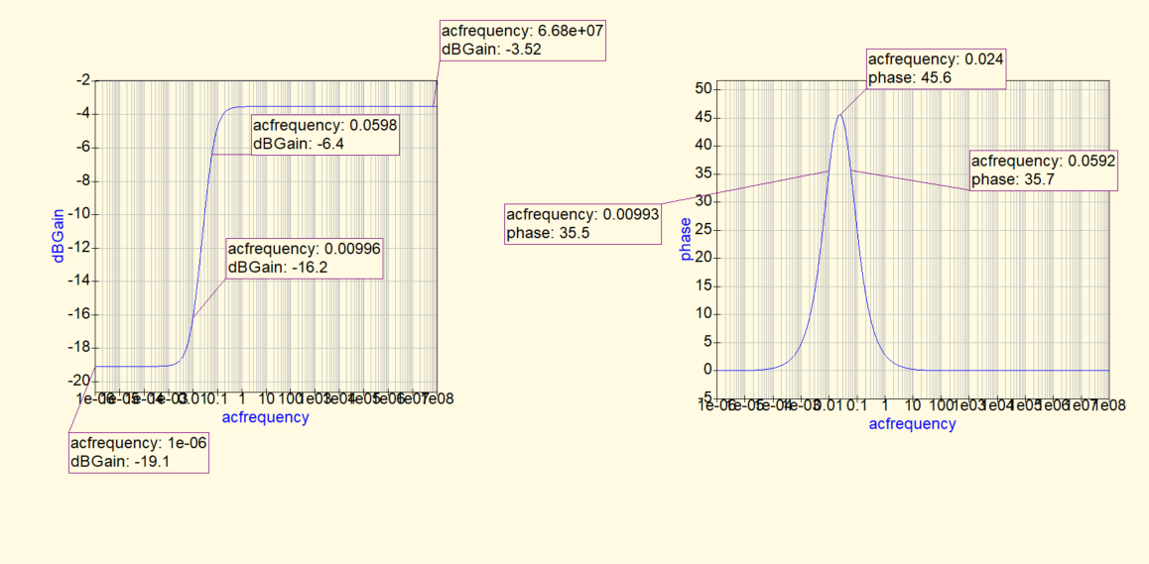
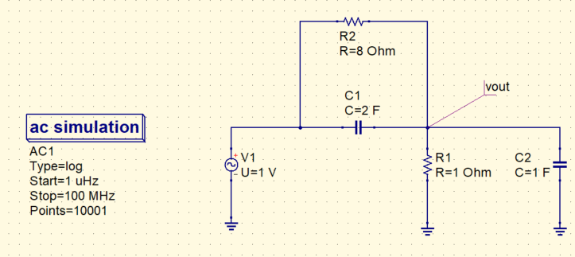
Circuit 3: Analyzing in frequency domain
- Calculate the gain and phase of the system at the marked points, and match your calculations, with the values obtained through simulations.

Slide 8
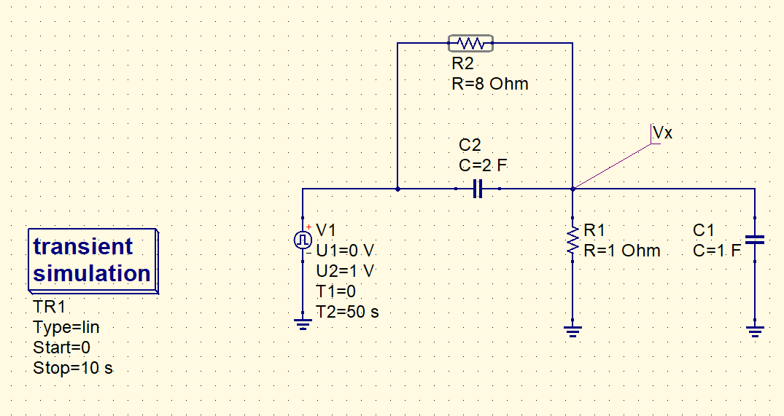
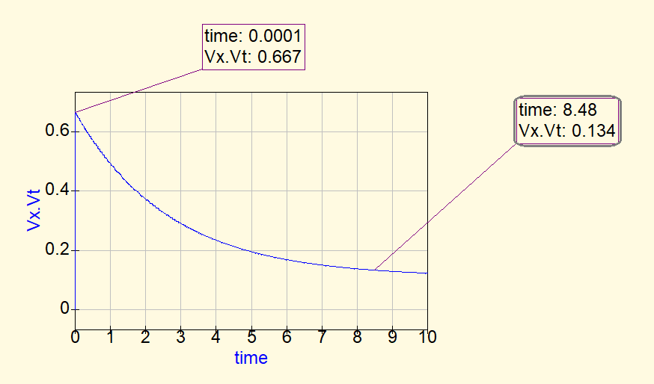
QUCS circuit 3 in time domain
QUCS Result
No initial conditions are given.
Conclusion:
Expected Vx(0) = C2/C1+C2; Expected Vx(∞) = R1/R1+R2
Here, R1C1 < R2C2 , so Vx(0) < Vx(∞), and the output falls exponentially (first order circuit).

Slide 9
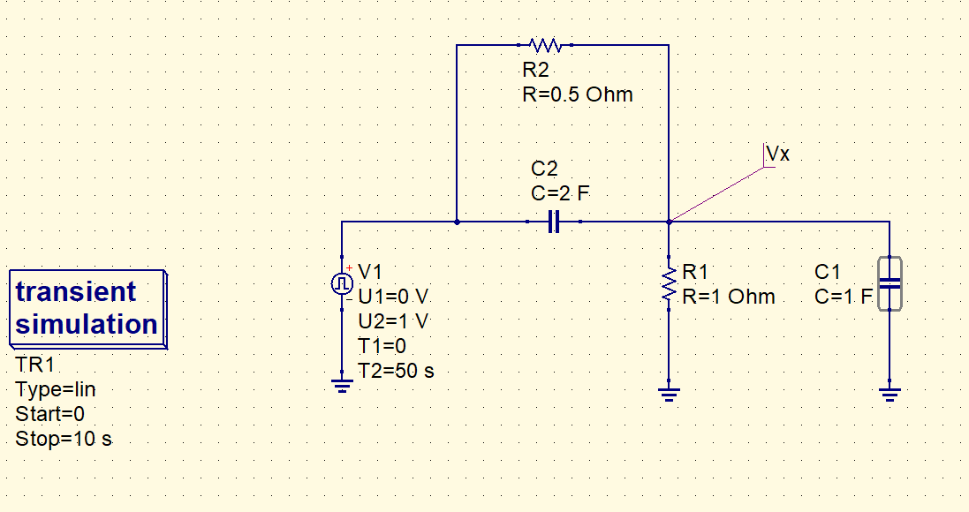
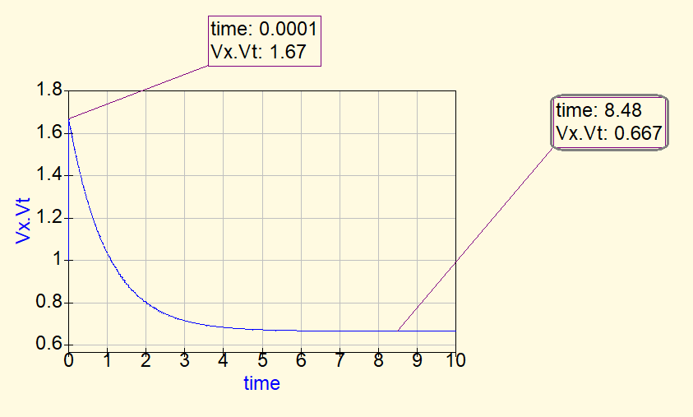
QUCS circuit 4
QUCS Result
Initial conditions are given.
Conclusion:
We can apply superposition theorem. First case can be taken as when there is no initial charge on the capacitors. In that case, R1C1 = R2C2, hence the output will be a constant voltage [ Vx1(t) ] = 0.67 V (as seen in previous slide).
Then, in case 2 we short the voltage source V1, the circuit is equivalent to a 3F cap with voltage 1V, in parallel with 0.33 ohms resistor. The cap gets discharged through the resistor, Vx2(t) = 1e^(-t/1)
Total Vx = Vx1 + Vx2

Slide 10
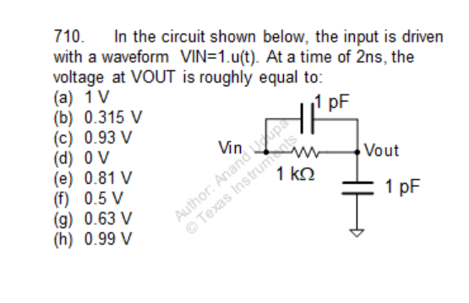
Question

Slide 11
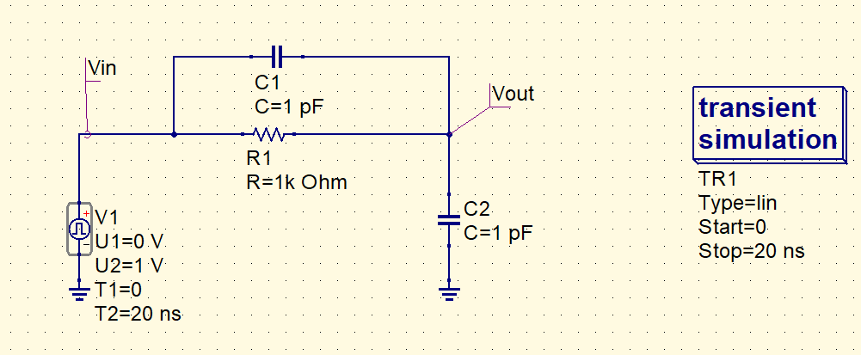
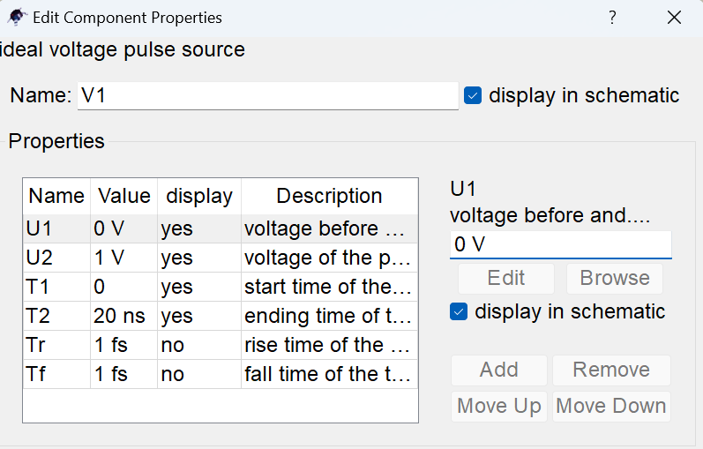

QUCS circuit

Slide 12
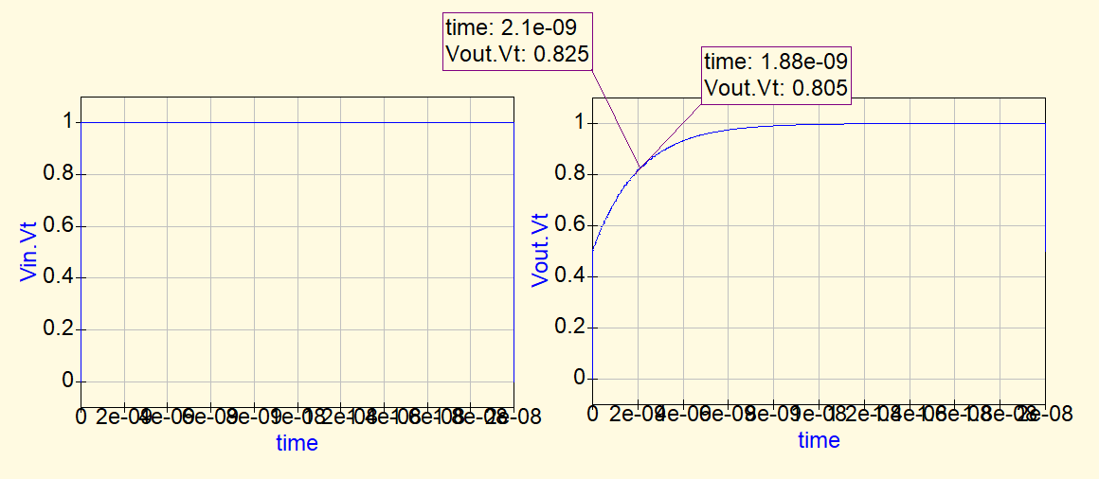
QUCS result
Conclusion:
At t=0, the input voltage gets divided in between the two capacitors.
The steady state voltage will be 1V.
We are asked to find value of output at t = 2ns (time constant). The equation of voltage at output node comes out to be: 0.5(1-e^(-t/2ns)) + 0.5

