Slide 1
Day 9 13 June, 2024

Slide 2
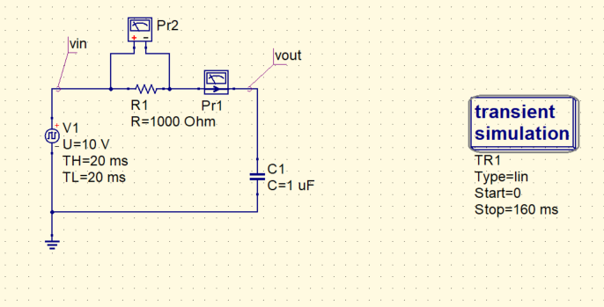
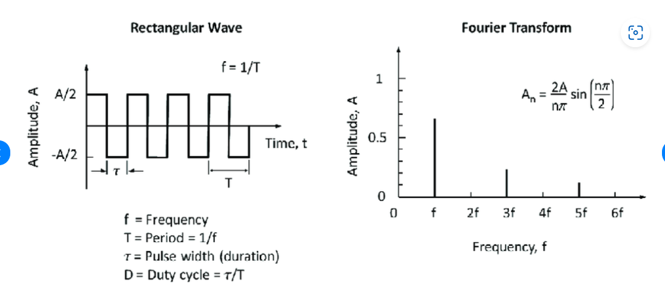
Revision of yesterday’s session
RC Circuit response to pulse inputs
1) Case 1: T (of the pulse) >> time constant of the RC network
The time constant of the RC network is quite small compared to the time period of the input pulse, hence it quickly charges to 10 V in the on cycle of the pulse, and discharges to 0 V in the off cycle of the pulse.
Since it’s a low pass filter, sharp transitions in the input are rejected by the filter.
Here, T>>RC → 1/T << 1/RC → Most of the harmonic components appear below the cutoff frequency of the LPF, hence, the output resembles the input quite well. (1/1+sRC is 1 for most of frequencies)
Across the resistor, the TF is sRC/1+sRC. It acts like a differentiator.

Slide 3
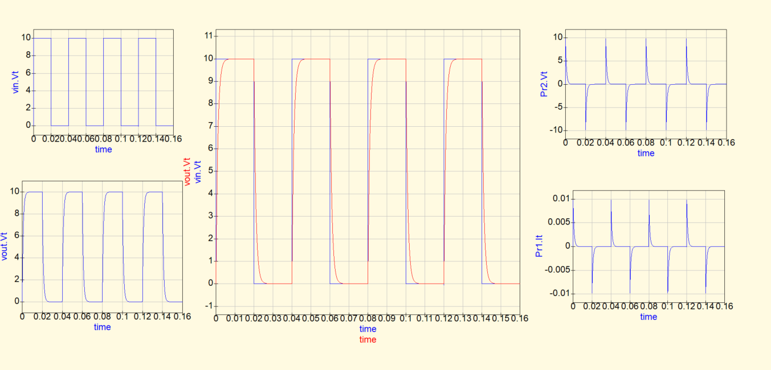
Result obtained:

Slide 4
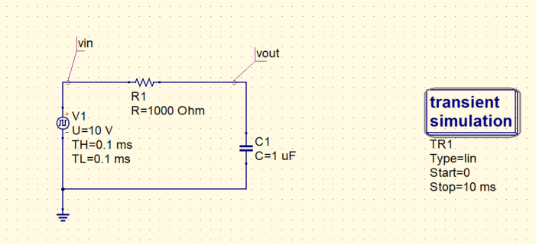
2) Case 2: T (of the pulse) << time constant of the RC network
Here, the time constant of the RC network is quite higher than the time period of the pulse, Hence complete charging to 10 V, or discharging to 0 V doesn’t happen.
Let’s calculate the expected values for first 2 cycles:
First half cycle , it rises to : 10(1 – e^(-0.1)) = 0.95 V.
Then, cap discharges from 0.95 V to 0.85 V in next 0.1ms.
This then acts as initial voltage on cap, it charges to 1.72 V.
Rate of charging keeps decreasing, rate of discharging keeps increasing, and the two become equal in steady state.
Here, 1/T >> 1/RC, so in steady state, only the dc component should be passed well. (integrator for other freq. components)

Slide 5
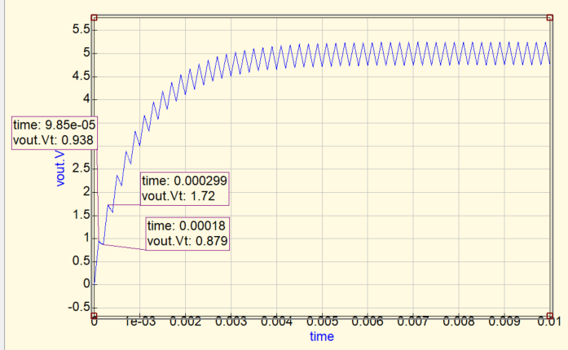
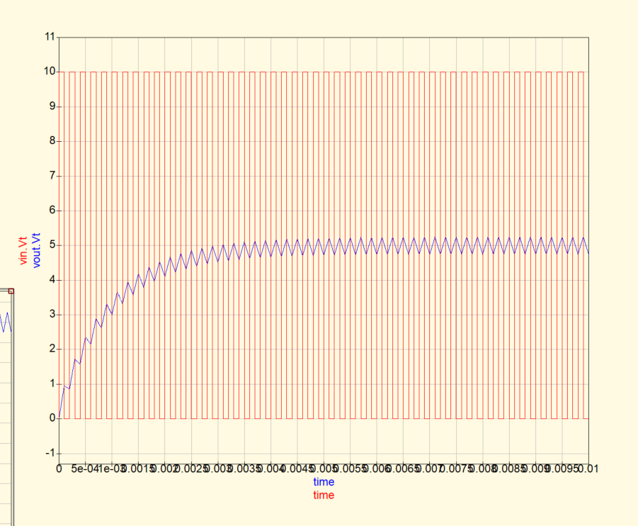
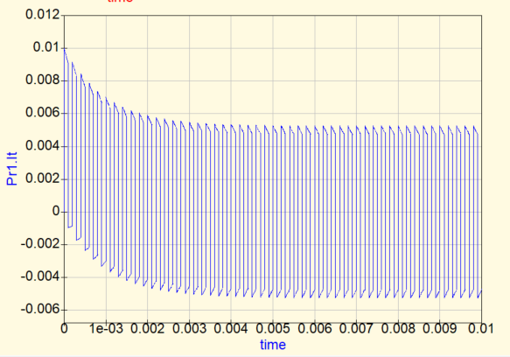
Result:

Slide 6
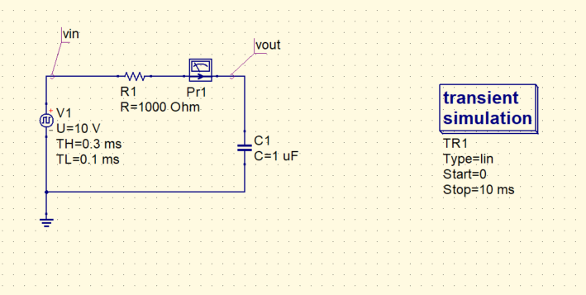
What happens on changing the duty cycle of the waveform?

Slide 7
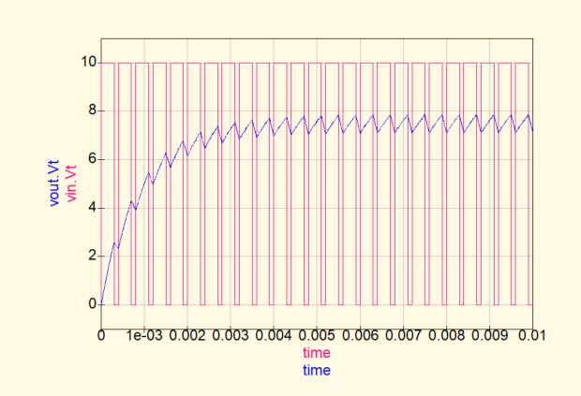
Steady state average value changes!

Slide 8
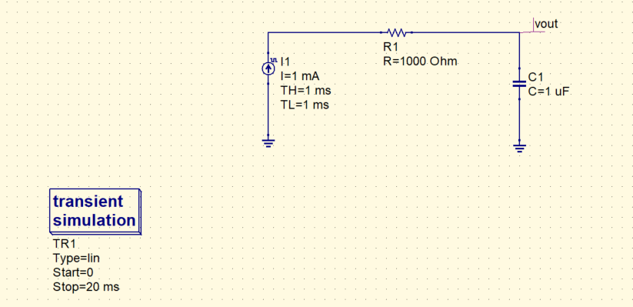
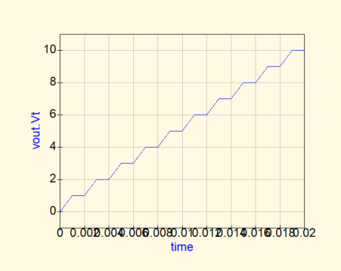
How will you analyze the circuit given below?
Cap behaving like an ideal integrator.

Slide 9
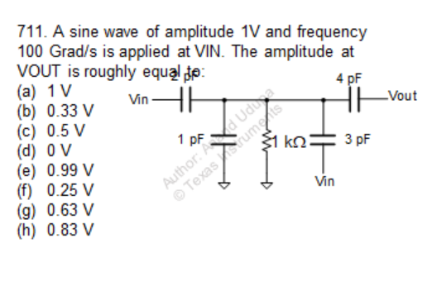
Question

Slide 10
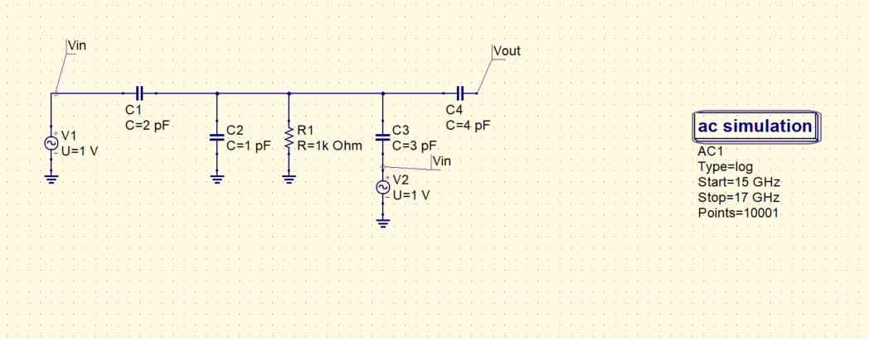
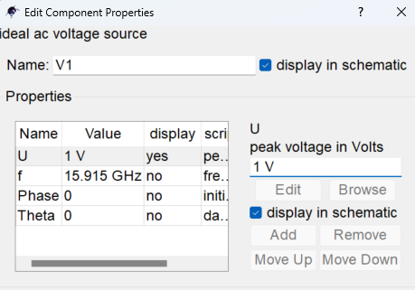
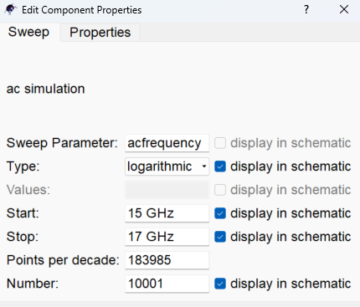
QUCS circuit
- Since we are required to see the value of the output waveform at 15.9 GHz, we input a small range of frequencies around that point.

Slide 11
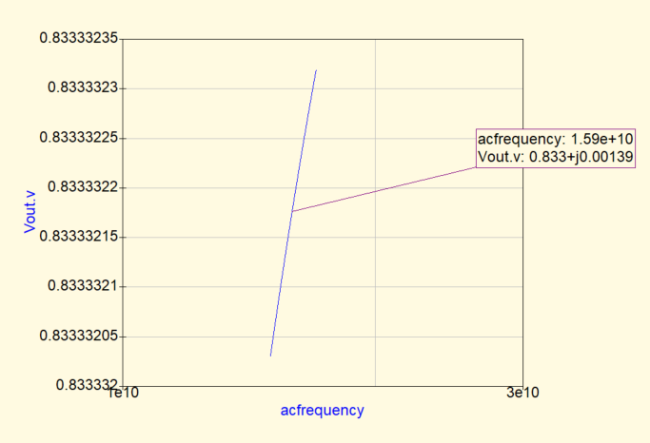
QUCS Result
Conclusion
As seen from the graph, the amplitude of the output is 0.83 V at 100 Grad/s.
This can be seen using superposition of the two voltage sources.

Slide 12
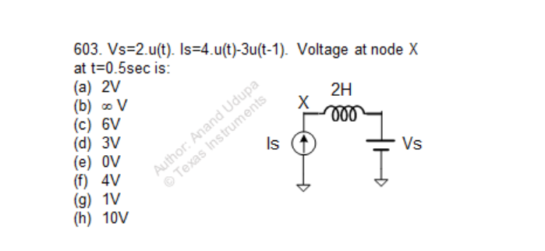
Question

Slide 13
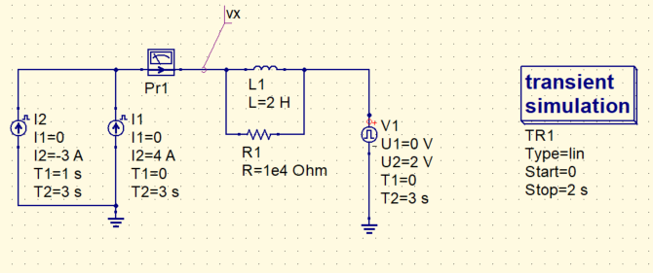
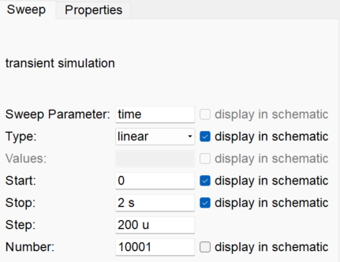
QUCS circuit
Why did we put R1 in parallel with the inductor?

Slide 14
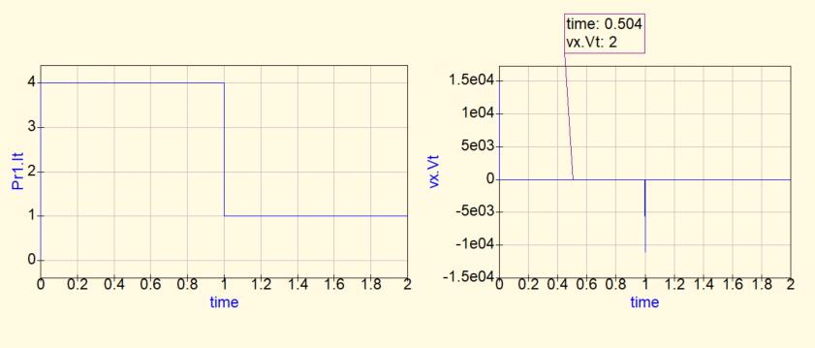
QUCS result
Conclusion:
At t = 0.5 s, voltage across the inductor = 0, because of no change in current, and Vs directly appears on Vx node.
Vx = 2 V at t = 2 V

Slide 15
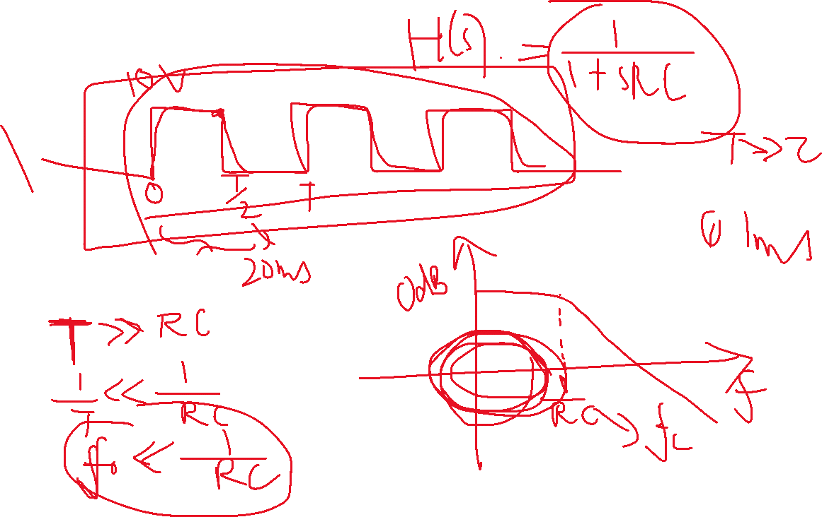

Slide 16
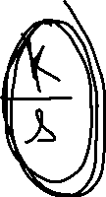
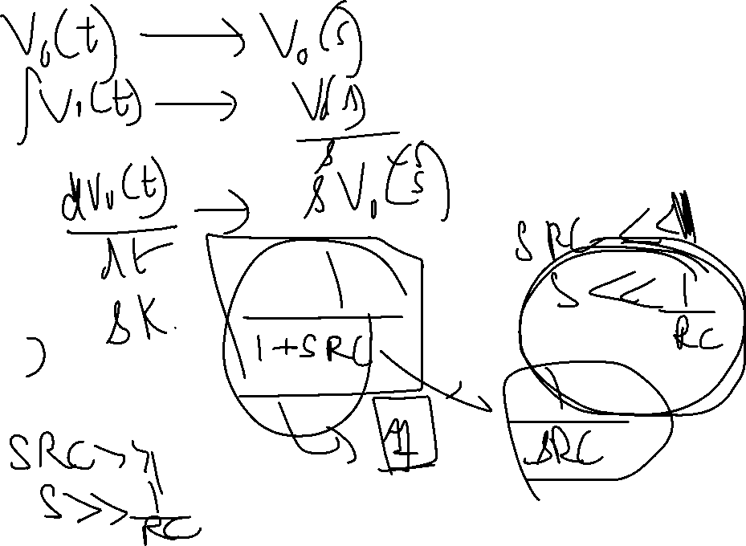

Slide 17
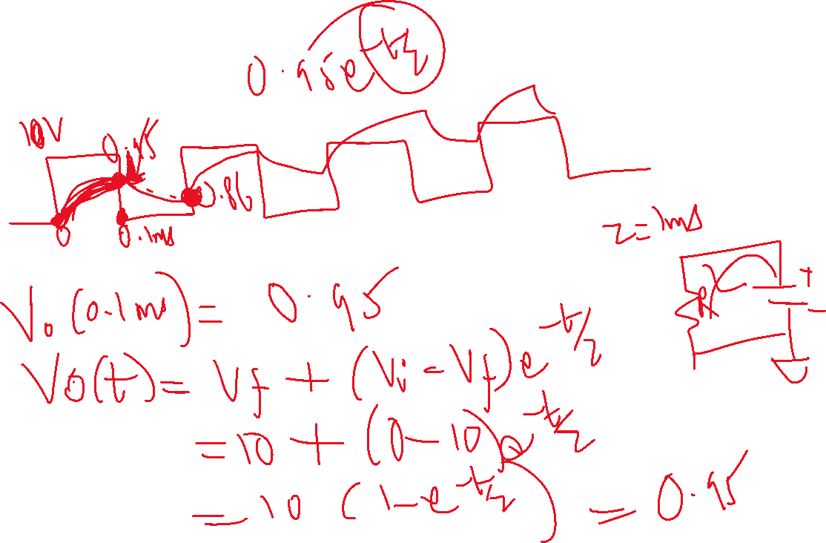

Slide 18
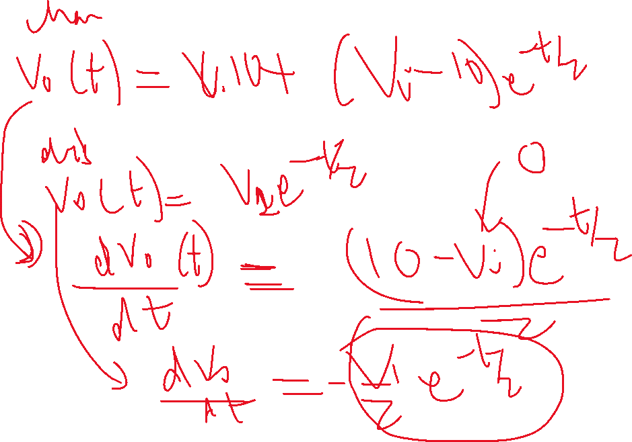

Slide 19
