Slide 1
Secure data hiding in images using steganography
CAPSTONE PROJECT
Presented By: Sukhandeep Singh
Student Name : Sukhandeep Singh
College Name & Department : Department of Computer Science and Engineering, Guru Nanak Dev University, Amritsar

Slide 2
OUTLINE
Problem Statement
Technology used
Wow factor
End users
Result
Conclusion
Git-hub Link
Future scope

Slide 3
Problem Statement
In today's digital world, everything is stored digitally. As a result, the need for privacy is more critical than ever. The ability to protect data is a fundamental requirement of Individuals as well as organizations. This project demonstrates the basic concept of hiding data, specifically text, within digital images.

Slide 4
Technology used
Python v3.13.2 – easy to learn language with libraries to help in various tasks.
OpenCV – cv2 – a python library to help in image manipulation.

Slide 5
Wow factors
Steganography: Demonstrating the code concept of Steganography, without any complex code
Hidden messages: allows to hide text inside any image.
Password protection: allows to set a password so that hidden message can only be extracted with correct password.
Visual secrecy: the idea that data can be hidden in plain sight without anyone knowing, unless someone analyses it with special tools.

Slide 6
End users
The project can be used for personal and professional use. Based on the requirements, it may need to be modified. The original code, demonstrating only the core idea can be used following mainly for learning-
Individuals, Students and Educational institutions
Programmers and Tech Enthusiasts
For professional use, it can be modified and improved according to use and used by the following-
Organizations
Businesses
Cybersecurity experts
Various improvements and future scope has been discussed in upcoming slides.

Slide 7
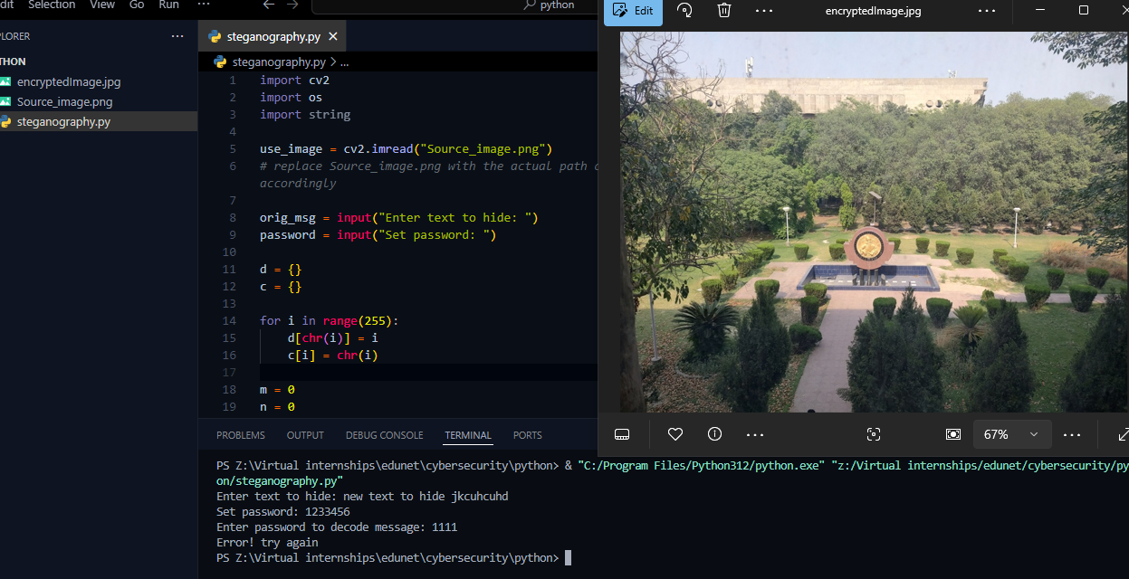
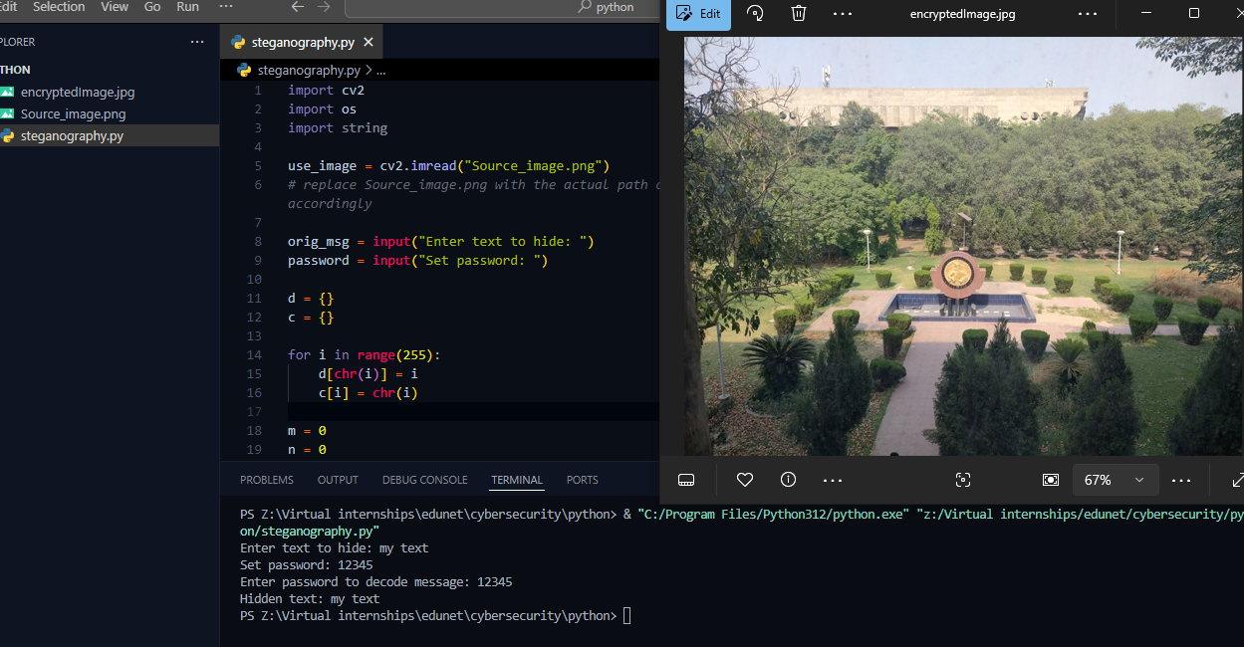
Results
Hiding and extracting data unsuccessful
Reason: incorrect password
Hiding and extracting data successfully

Slide 8
Conclusion
This project successfully addressed the core problem of hiding text inside digital images. By implementing a basic steganography technique using Python and OpenCV, we showed that it is possible to hide text within images by manipulating the Least Significant Bit of each RGB color, which in turn affects the color as less as possible, which can’t be easily identifies by naked eye.
While this implementation is a basic implementation of the concept, and doesn’t not used any cryptographic measures to encrypt the data or image.
It acts as a simple, educational tool for understanding how information can be hidden in plain sight, especially in digital media, like images.

Slide 9
GitHub Link
Click below to open GitHub repository containing various files of the project
https://github.com/sukhandeepsingh/edunet-ibm-cybersec-proj.git

Slide 10
Future scope(optional)
Since, as discussed in previous slides, the project is the simplest implementation, it can be improved in a lot of ways. Some of which are discussed below-
Improved user experience – it can be developed into a web-application which provides GUI for easy of use by common individuals.
Improved security – Cryptographic measures can be implemented at various levels, such as encrypting the text, storing password after hashing, to improve the overall security.
Expanding functionality – Currently, this implementation is limited to images only. It can be modified to support more file types.
Checking file size for capacity – current implementation limits the message length by the dimensions of image. On top of that, no checks are placed to counter cases where the text size is large or if the size of resulting image isn’t too large.

Slide 11
THANK YOU

