Slide 1

Name : Sukhdeep Singh, Suraj Sohal Branch: Btech(CSE)
Roll No : 24303416,24303426
College Name : SBSSU GURDASPUR

Slide 2
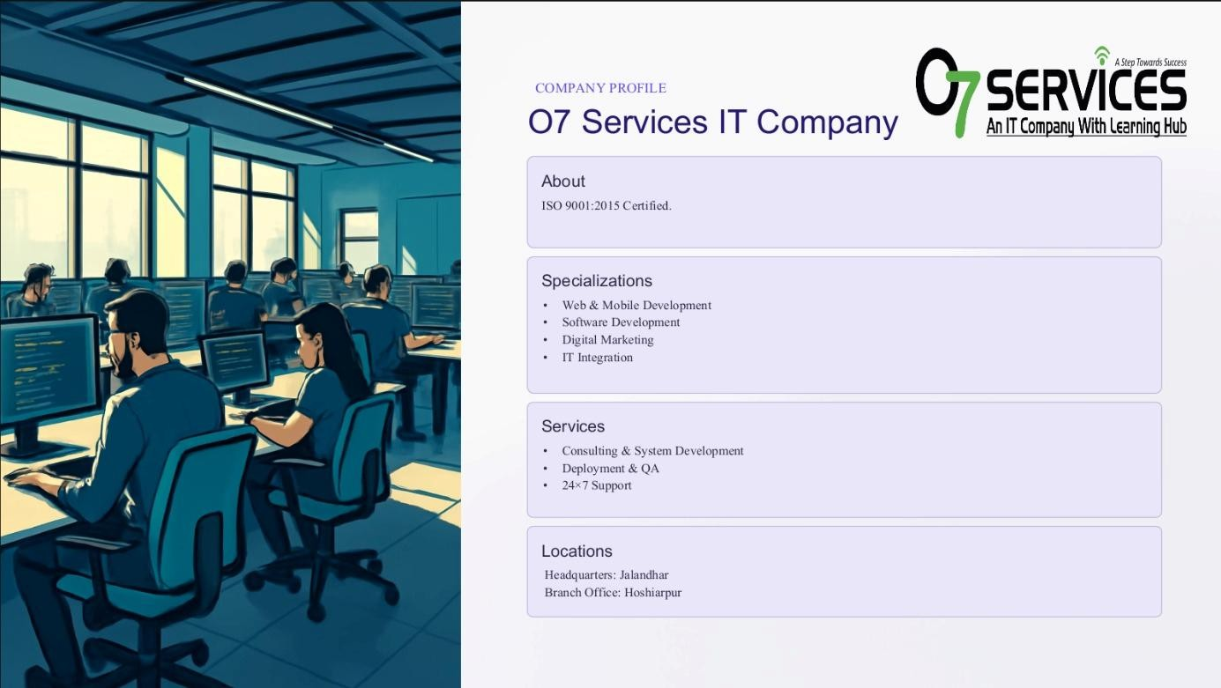

Slide 3
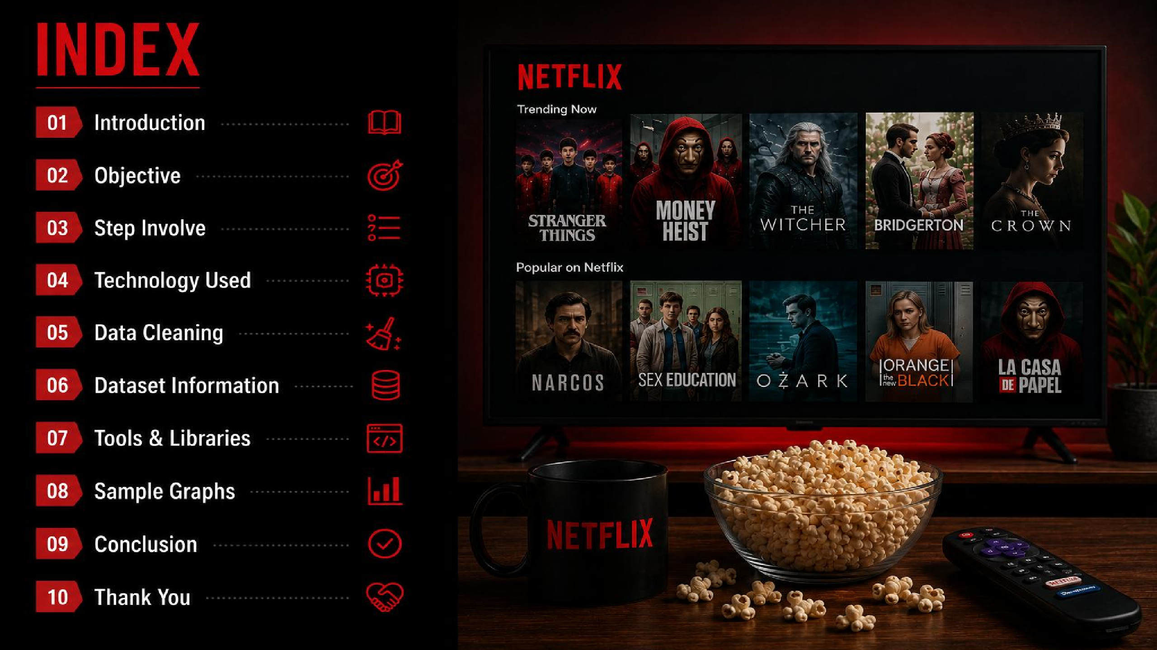
Future Work
Graphs

Slide 4
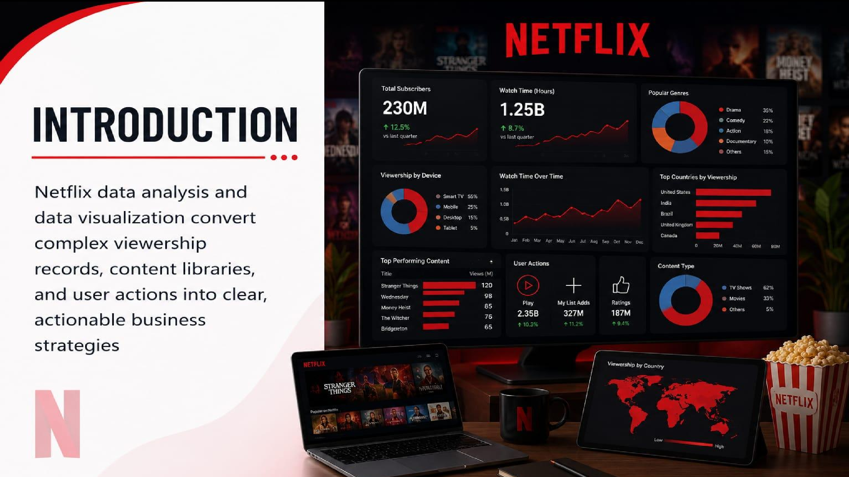

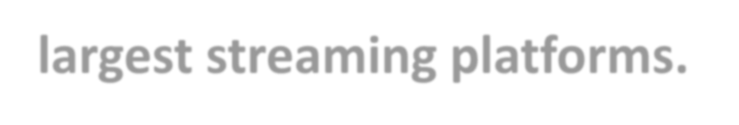
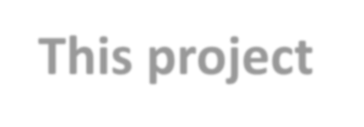
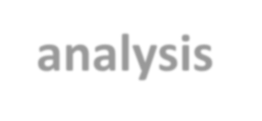

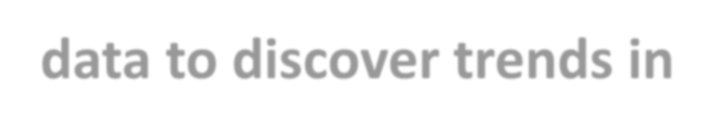


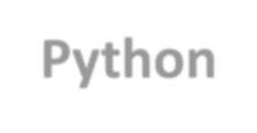
Netflix is one of the world's largest streaming platforms. This project analysis Netflix data to discover trends in content, genres, countries, and release years using Python.

Slide 5
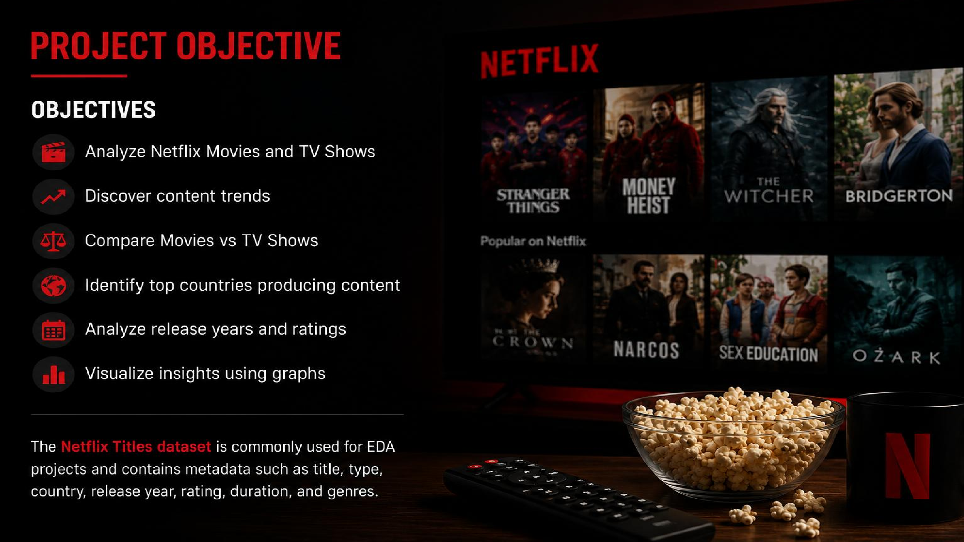

Slide 6
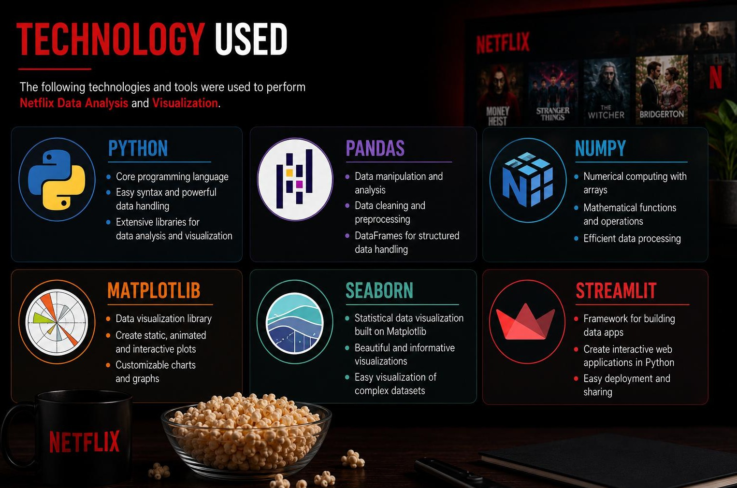

Slide 7
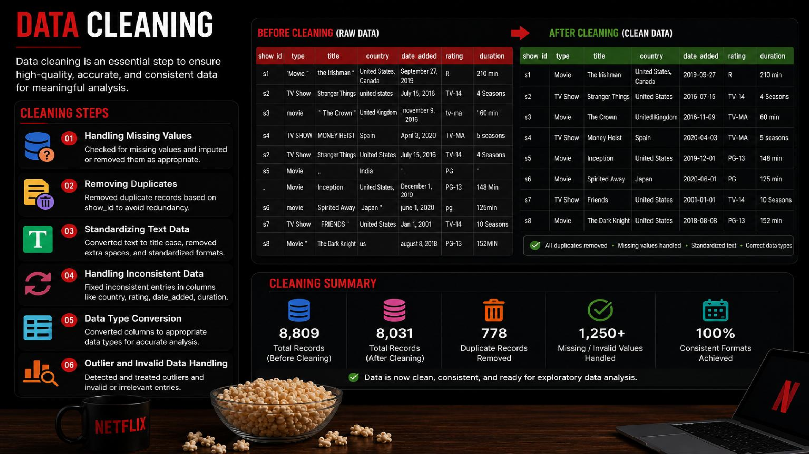
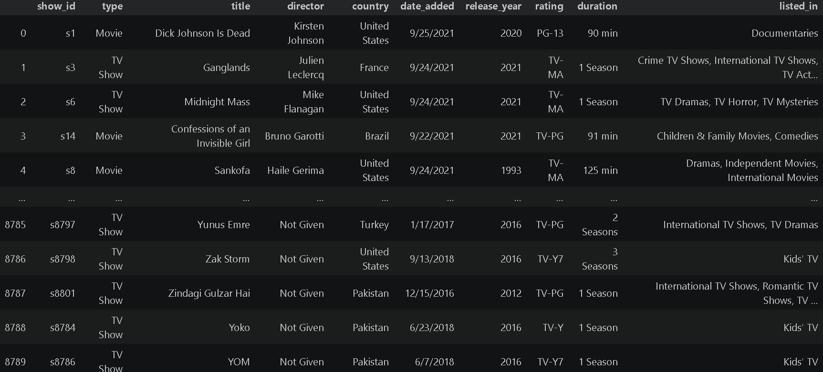
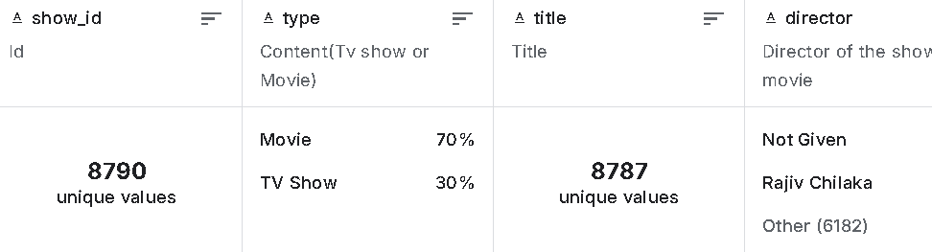

Slide 8

Problem statements
Which content type is more common?
Which country produces the most content?
Which genres are most popular?
How has Netflix content changed over time?

Slide 9
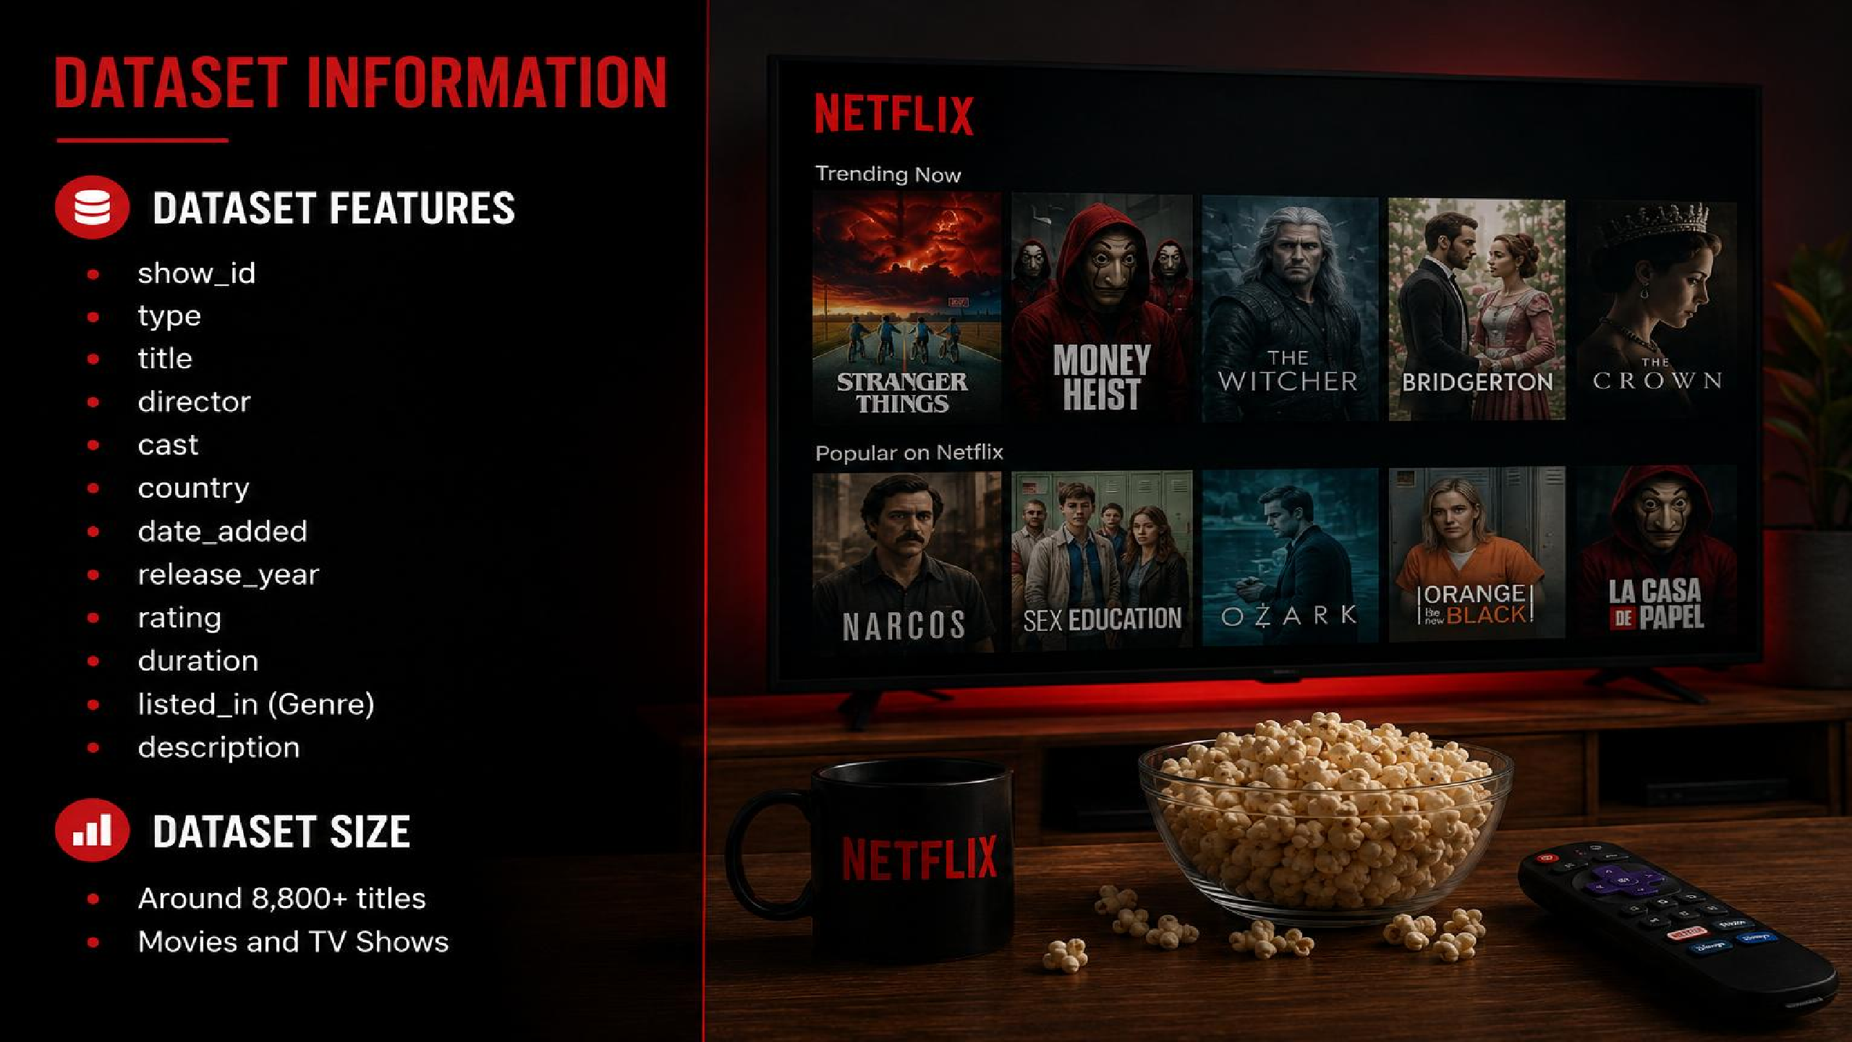

Slide 10
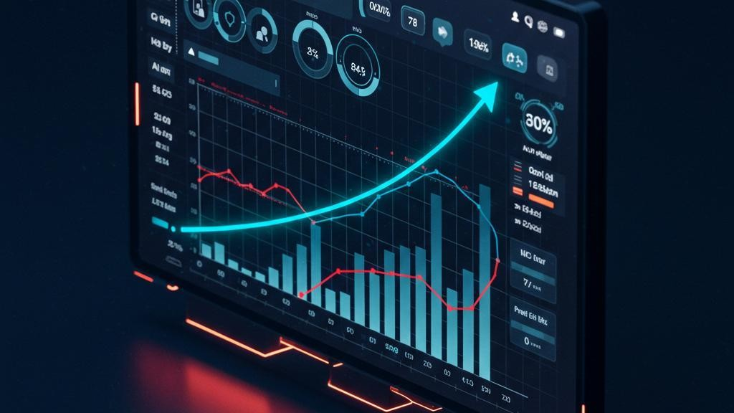
Future Work
→Develop an interactive dashboard using Streamlit or Power BI.
→ Apply Machine Learning to
build a Netflix
→ Analysis user ratings and viewing patterns for deeper insights.
→ Use real-time or updated Netflix datasets for continuous analysis.
→ Create predictive models to forecast future content trends.

Slide 11
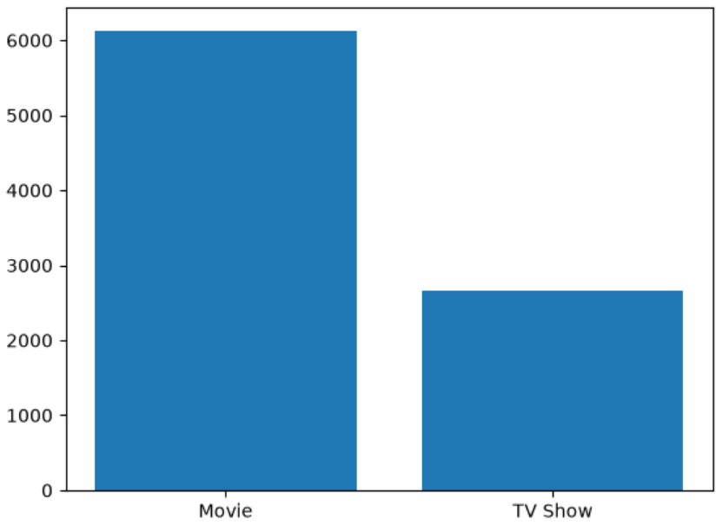
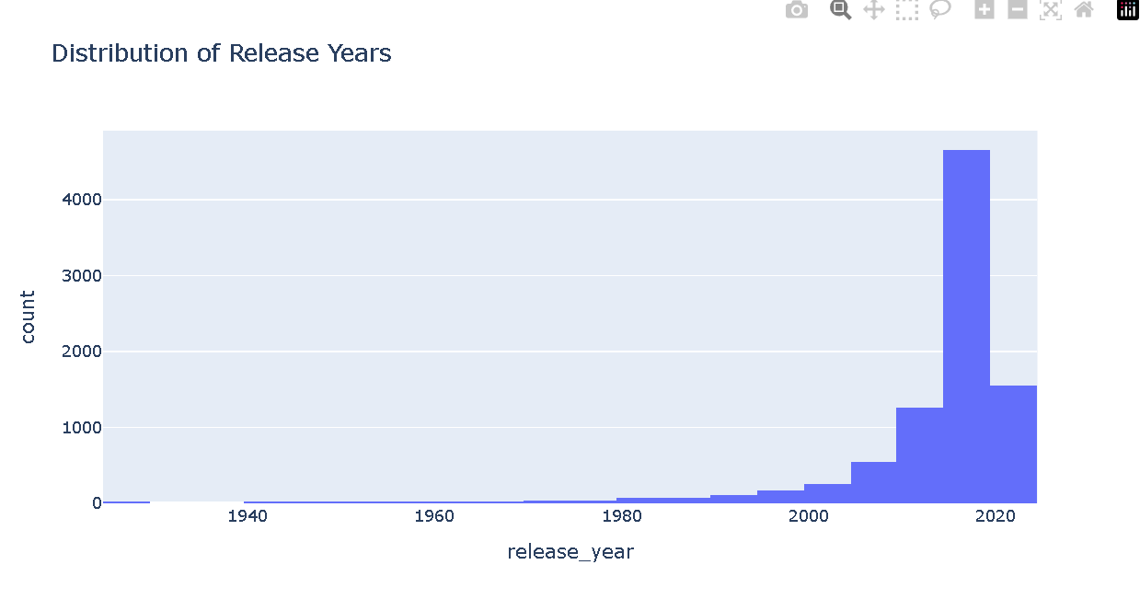
Graphs

Slide 12
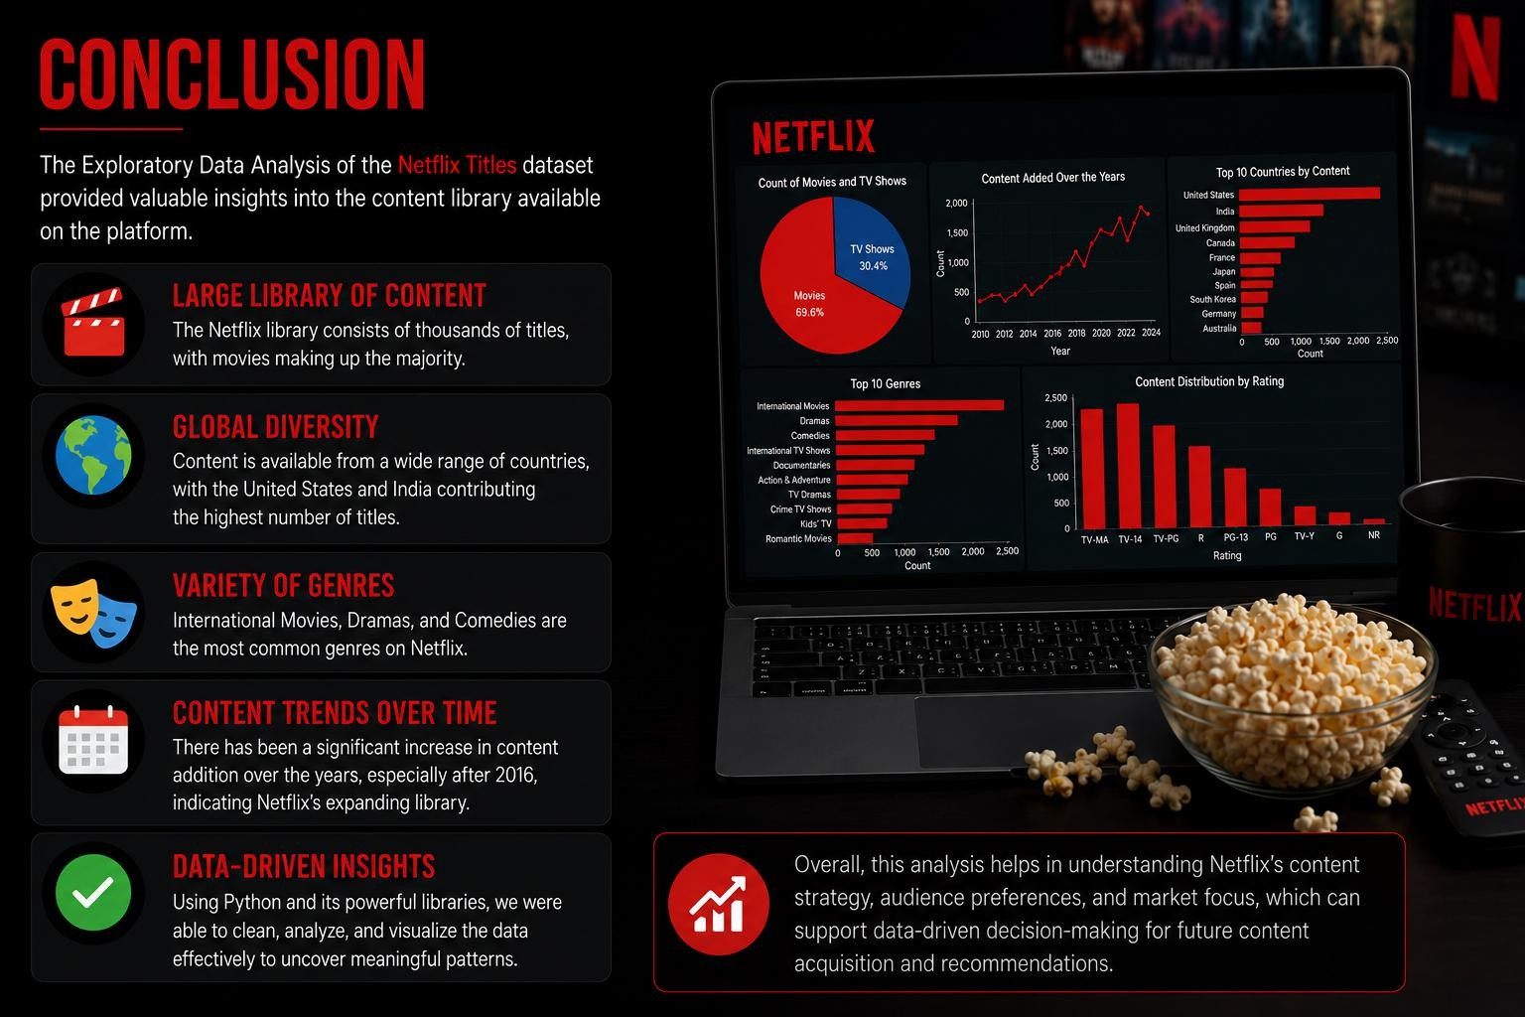

Slide 13
