Slide 1
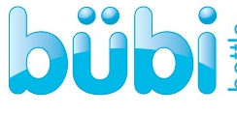

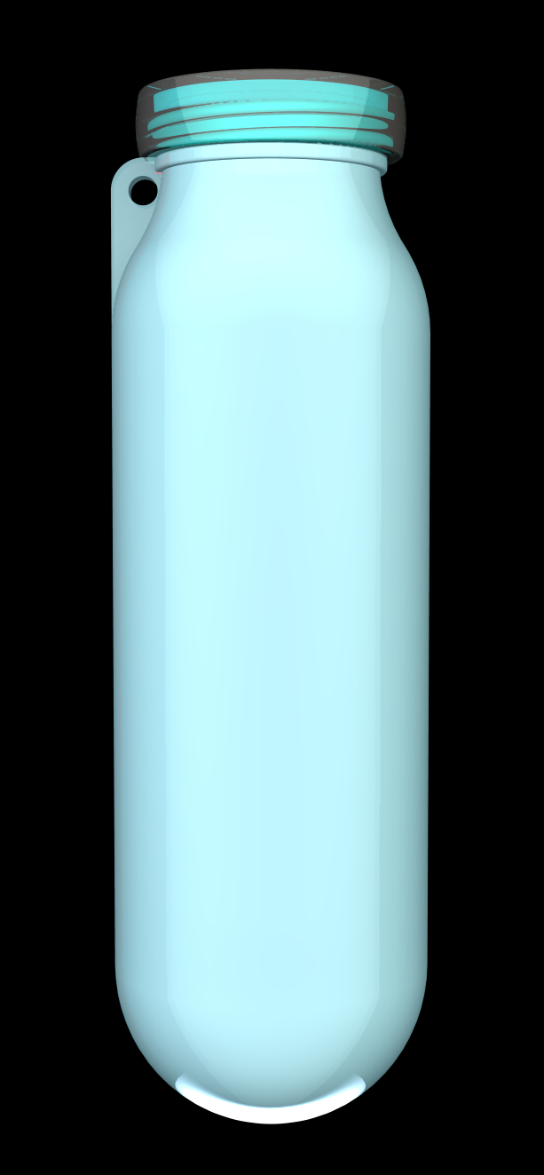
why bübi? | care & use | faq | testimonials
inventor bio | customize
Introducing the bübi bottle; the world’s first scrunchable water bottle.
Specially designed for active lifestyles, 22oz bottle when full, collapses to a fraction of it’s size when empty.
Perfect for work, school, gym, running, hiking, biking boating…
http://www.youtube.com/watch?v=3bcH3DxPjV0
Buy Now!

Slide 2
why bübi? | care & use | faq | testimonials
inventor bio | customize
Lightweight – 3.5oz
BPA Free
Microwave* & Freezer safe (can be used as cold & hot compress)
Great for hot and cold beverages, you can freeze or microwave it. It retains its shape and never releases harmful chemicals
Dishwasher safe
why bübi?
Buy Now!
*Microwave safe when the lid and carabineer are removed

Slide 3
why bübi? | care & use | faq | testimonials
inventor bio | customize
Instructions for use :
To begin using your bübi bottle, rinse and fill with your favorite beverage, hot or cold!
Using and cleaning your bübi bottle
Cleaning
Whether you are obsessed with scrubbing your bübi or a casual scrubber, your bübi is made from material that does not create germs.
Strip down your bübi, twist off the cap, use your fingernail and place under the inside retainer lip and pry up, and take off the thread ring, it is now ready for the dishwasher or liquid detergent.
Now that you have a clean bübi, reassemble, the threads first, then the retainer ring (it is best to wet the retainer) be sure it fits below the lip as the lip is your seal.
Fill it with your favorite beverage and twist on the cap.
Use
The convenience of the bübi bottle is its scrunchibility, as you consume your favorite beverage, and the need for a smaller bübi becomes evident (you will know) squeeze out the air and pack it away.
When depleting by bübi of all my beverage, I use my palm gently collapse my bübi against something, leg, body or table, making sure the carabineer is parallel to the crease.
To conveniently store your bübi, roll it up, starting at the base, with the cap off to get all the air out, now place the coiled portion inside the carabineer, replace the cap.
Care & Use
Buy Now!

Slide 4
why bübi? | care & use | faq | testimonials
inventor bio | customize
What is BPA and why it is important the bübi is BPA free?
BPA is a chemical used in hard plastics and epoxy resins. BPA is a hormone-disrupting chemical, which means that it can mimic or block hormones and disrupt the body's normal functions. Scientists have found that it can alter brain development in babies, even at extremely low levels, causing problems ranging from infertility to heart disease
BPA can be found in baby bottles, toys, canned foods, paper receipts, and other common products.
The bübi bottle is BPA free and does not contain any harmful chemicals that may be found in other water bottles
How do I clean my bübi?
The bübi bottle is dishwasher safe; the bottle is totally spherical and can be cleaned easily with a brush as well.
What is the bübi made of?
The bübi is made from Eco-friendly high grade silicone, BPA free, RoHS & FDA approved for food contact
Where can I buy a bübi bottle?
Currently the bübi bottle is only available online at www.bübibottle.com; look for it in specialty retail stores in the coming months
FAQ
Buy Now!
Have a question? Contact us at questions@bübibottle.com

Slide 5
Why bübi? | Care & Use | FAQ | Testimonials
Inventor Bio | Customize
“My son is required to take his own water bottle to school each day. The bübi bottle works perfectly as he can take it full in the morning; use it during classes and scrunch it up at the end of the day without taking up room in his backpack. Bonus is he loves the bottle, he likes to scrunch it so it never gets lost!” Lisa – Little Elm Texas
“The bübi is perfect for my crazy schedule. I take mine with me each day to work and then to gym… Space in my gym and office bags are always at a premium so being able to scrunch it up at the end of the day is perfect. The retainer at the mouth makes it easier to drink without spilling (this is usually a problem for me).” Kristen - Boston MA
“I was introduced to the bübi this summer… it is great for travel and long days touring; freezing the bottle made for cold drinking water all day exploring different sites. After a long day of walking, heating the bübi in the microwave for a few seconds created a great hot compress for my aching legs.” Lori – Boston MA
“My son is a hockey player and as hockey moms know… the hockey bag doesn’t need to be any bigger! The space saving principles of the bübi bottle makes it great for my son’s hockey kit. I use mine it for hot coffee in the rink; it retains the heat and keeps my hands warm at the same time! Love my bübi bottles.” Yolanda – Woburn, MA
Testimonials
Buy Now!
Have a story to tell or picture to share? feedback@bübibottle.com

Slide 6
Why bübi? | Care & Use | FAQ | Testimonials
Inventor Bio | Customize
Athlete, entrepreneur and principal of Ocean Sailing Consulting LLC, Craig Madaus has traveled the world in search of new trails to run and mountains to climb. The single most frustrating challenge he’s found has been hydration.
Store-bought bottles were environmentally inexcusable. Conventional, refillable bottles took up as much space empty as they did full.
On January 4, 2011, Craig had his “Eureka” moment. He envisioned a refillable water bottle that would scrunch up flat or coil up to fit easily in the small spaces of pocket, pack, briefcase or gym bag.
He began working with a designer and a manufacturing facility to produce a collapsible, refillable water bottle made from BPA-free materials that would be anti-microbial and resistant to both heat and cold. He got what he was looking for … and more.
Inventor Bio
Buy Now!
Contact Craig at craig@bübibottle.com

Slide 7
why bübi? | care & use | faq | testimonials
inventor bio | customize
Customizable for
Events
Corporations
Sports Teams
Get Your Message Out
Promote Team Spirit
Get your logo seen and create custom color combinations to match your logo.
Customize
Buy Now!

Slide 8
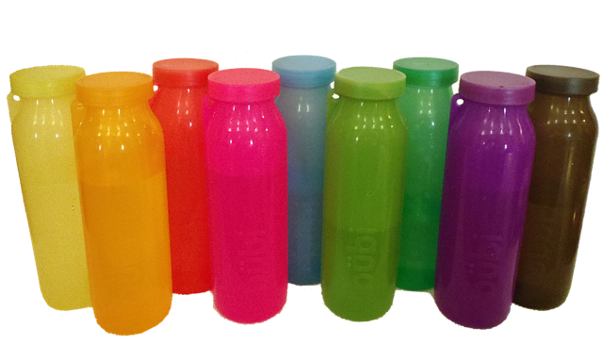
Buy Now!
Red $29.99 | Blue $29.99 | Pink $29.99
Green $29.99 | Orange $29.99 | Yellow $29.99
Teal $29.99 | Purple $29.99 | Smoke $29.99
Buy Now!
Will supply single images of each color; can we also add drop box for each bottle to add quantity?

