Slide 1

RouteLLM: Building Multi-Point Navigation Mobile Application with Large Language Models
Sai Shreesh Josyula
235813880

Slide 2

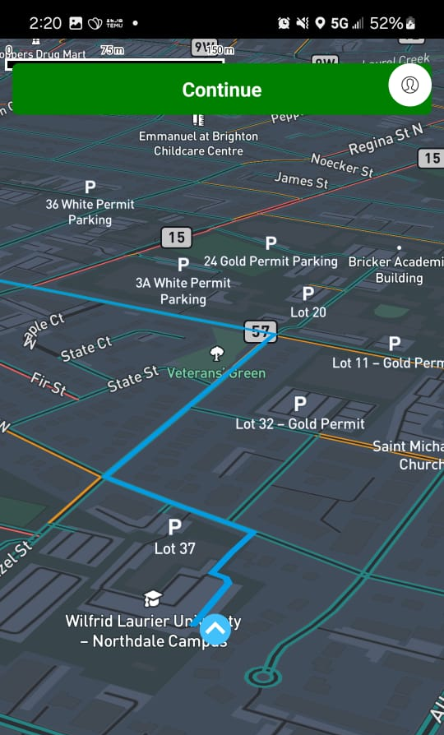
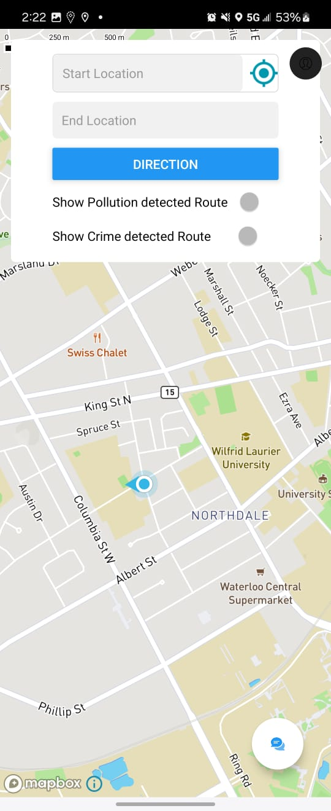
Introduction
Project Overview:
RouteLLM app is an innovative navigation app that integrates AI with real-time navigation data.
The app enhances user experience by providing personalized route options based on pollution and crime data.
It leverages the power of OpenAI's GPT-4, along with other APIs, to deliver a comprehensive navigation solution.

Slide 3
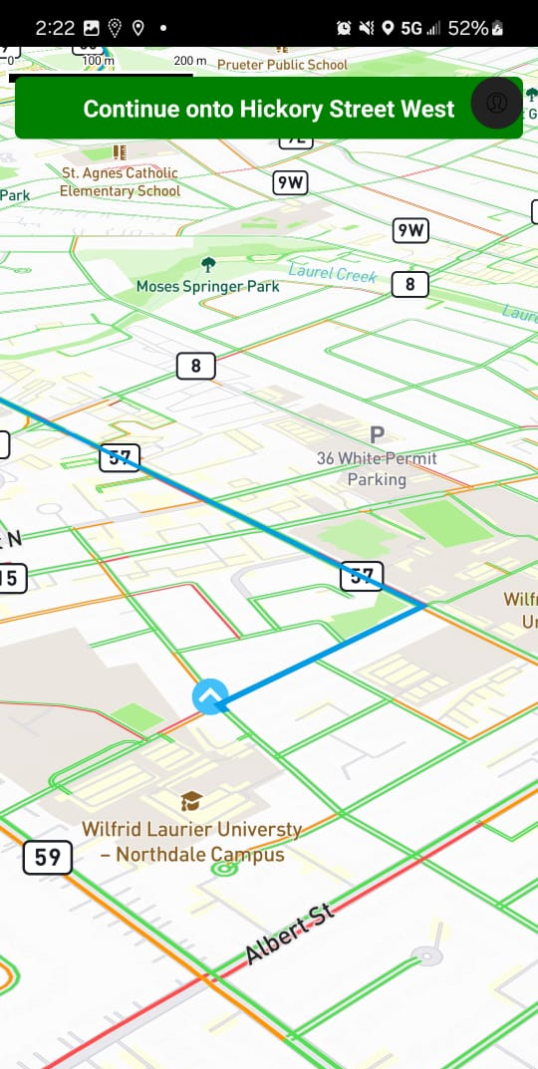
Objectives
Project Goals:
Goal 1: Develop a navigation app that integrates AI for personalized assistance.
Goal 2: Provide users with route options based on pollution and crime data to enhance safety and environmental awareness.
Goal 3: Implement a user-friendly interface with both light and dark modes.

Slide 4
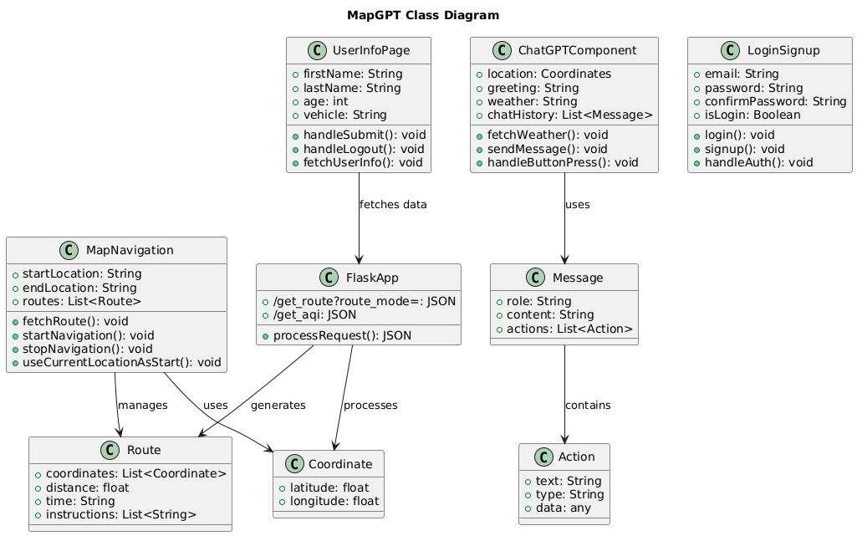
Architecture Overview
System Architecture:The App's architecture is composed of multiple key components:
Client-Side: The user interface developed with React Native.
Server-Side: Python backend hosted on Render, handling data processing and API calls.
APIs: Integration with GraphHopper, WeatherAPI, OpenAI GPT-4, and Firebase.
These components work together to deliver personalized navigation experiences.

Slide 5
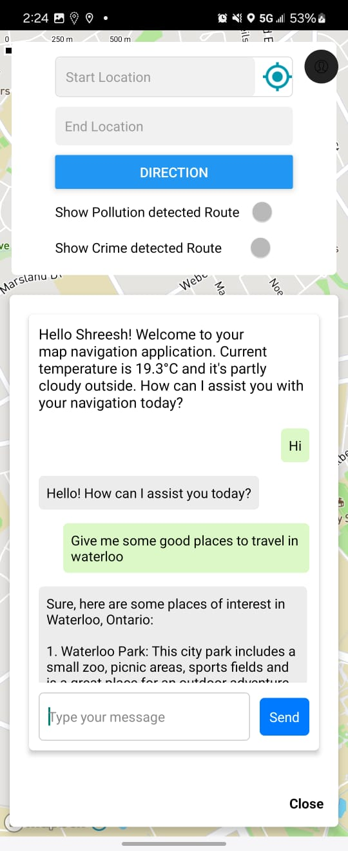
Implementation - User Interface Development
User Interface Development: The UI includes a login/signup screen, a map screen, and a chat interface.
Key Features:
Login/Signup: Secure authentication using Firebase.
Map Screen: Allows users to input start and end locations and choose routes based on pollution and crime data.
Chat Interface: Integrated with GPT-4 to provide personalized navigation assistance.
The app supports both light and dark themes, adapting to the user's system settings.

Slide 6
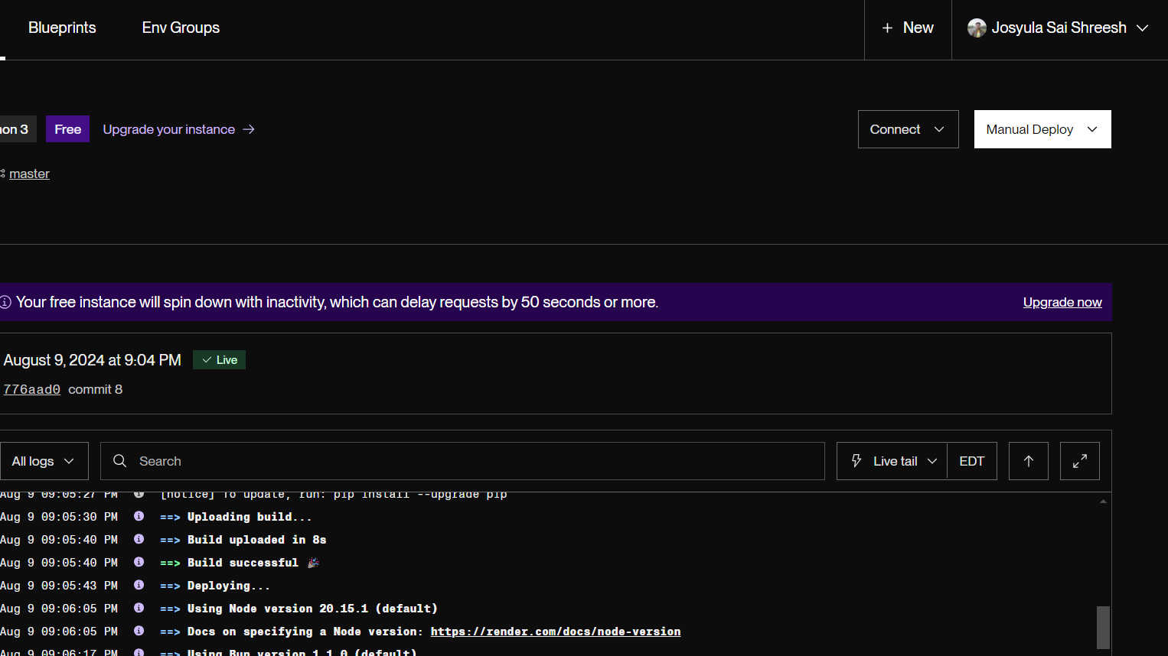
Implementation - API Integration
API Integrations:
RouteLLM integrates several APIs to fetch and process real-time data:
GraphHopper API: Retrieves the shortest route between points.
WeatherAPI: Provides real-time weather updates, which are integrated into the user greeting.
OpenAI GPT-4: Delivers personalized responses in the chat interface based on user queries.
Firebase: Stores user data securely, enabling personalized experiences.
The app can fetch different types of routes by calling /route_mode=pollutionroute or /route_mode=crimeroute.
PollutionGPT and CrimeGPT running on Render

Slide 7
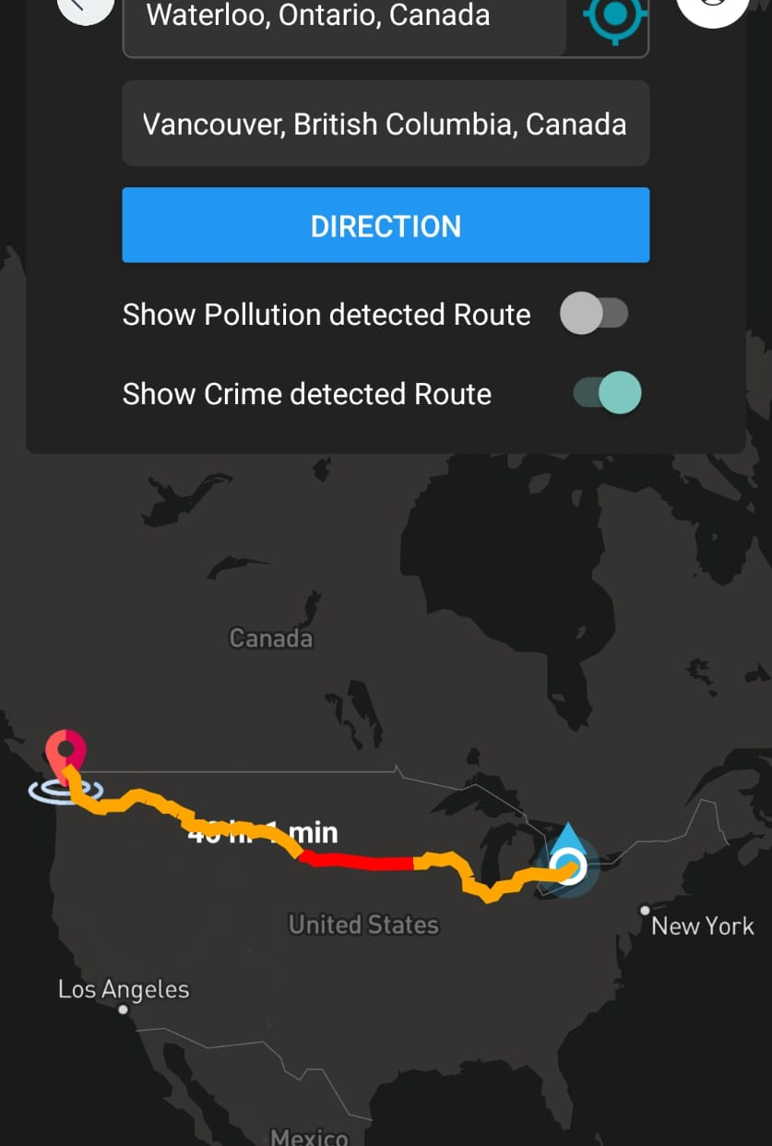
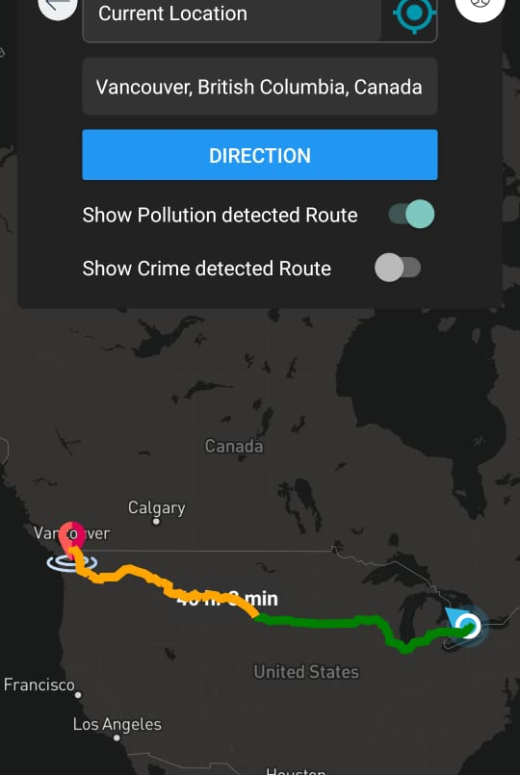
Implementation - Server-Side Processing
Server-Side Logic:
The Python backend, hosted on Render, processes route data and integrates pollution and crime data.
The backend is designed to handle requests for both pollution and crime route data, providing different responses based on the /route_mode argument.
Code modifications were made to ensure that the server can serve both types of data efficiently.
Route Classification are done using AQI (Air Quality Index) for pollution and (Crime Severity Index) CSI for crime route.

Slide 8

Future Work
Future Enhancements:
Voice Assistant Integration: Add voice command functionality, leveraging GPT-4’s capabilities.
Multi-Route Fetching: Modify the Python backend to fetch and process multiple route options simultaneously.
Route Suggestions: Suggest routes based on pollution and crime indexes, allowing users to choose safer and cleaner routes.
Future-Proof Design: The code is designed to be extendable, allowing for easy integration of future features.

Slide 9

Thank You

