Slide 1
République Algérienne Démocratique et Populaire Ministère de l’Enseignement Supérieure et de la Recherche Scientifique Université Tahri Mohamed de Béchar Faculté des Sciences Exactes Département de Mathématique et Informatique
Image Watermarking Based On Deep Neural Networks
Presented by :
- Mendja Wadie
- Zeghamri Salah Eddine
Supervised By: Dr. Daham A

Slide 2
Workplan:
Introduction
Problematic
What is a watermark and why it’s needed
Watermarking techniques
Overall watermarking process
Deep Neural Networks and digital watermarking
Requirements for DNN watermarking
Development process (embedding, training and extraction models)
Experiments
Conclusion

Slide 3
Introduction:
Digital watermarking is recognized as an innovative technique developed to deal with the problem of copyright protection of digital content distributed on the Internet. Such a technique can address the problem of asserting authorship but cannot directly solve the problem of determining accountability when piracy occurs. Therefore, it is necessary to implement watermarking protocols to determine whether a user illegally possesses content distributed by content providers as well as to protect the entire digital asset of the web-based distribution and of the associated rights.
Notes:
In the last two decades, watermarking technology has been applied to protect multimedia documents, Digital watermarking basically is a technique of embedding pieces of information into digital data such as text, audio, video, and still images that can be detected or extracted later to show authentication about the data

Slide 4
Problematic:
While Deep Neural Networks (DNN) watermarking is receiving increasing attention, and several works have been published leveraging on digital watermarking to address intellectual property protection in the DL domain.
With all that been said :
How can we use DNN in digital watermarking ?
Notes:
Someone might ask. Well, what’s the relationship between DNN and digital watermarking

Slide 5
What is a watermark?
A digital watermark is a kind of marker covertly embedded in a noise-tolerant signal such as audio, video or image data and is so designed that it does not degrade/distort the quality of the image, there are two types of watermarks: visible and invisible watermark.
Why watermark is needed?
Watermarks serve to protect content and to claim ownership of an asset. Without watermarks, valuable digital assets are vulnerable to content theft or unauthorized use and distributions.
Notes:
Watermark is a hidden information in an image

Slide 6
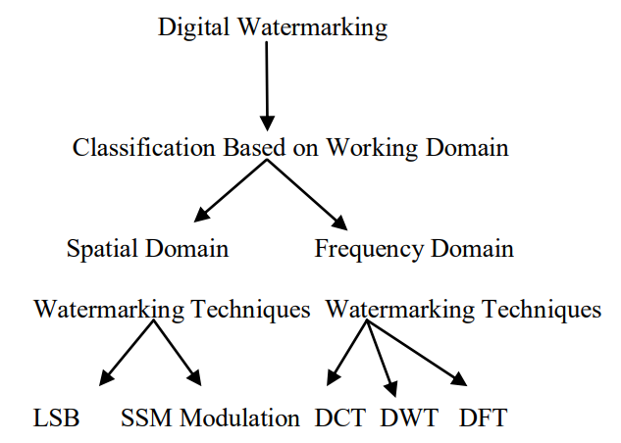
Watermarking techniques:
Digital watermarking consists of several different techniques for protection of digital content. The digital image watermarking falls in two main broad categories:
Spatial Domain.
- Frequency domain.

Slide 7
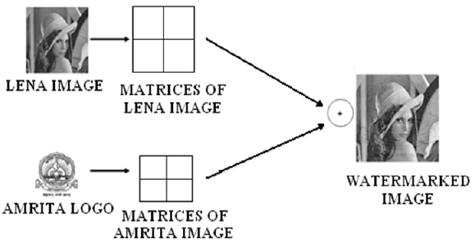
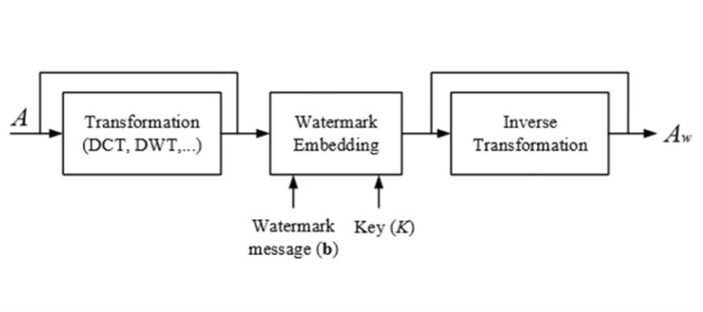
Spatial domain techniques works on pixels and pixel value are modified for embedding the watermark. The commonly used spatial domain technique is LSB. Whereas frequency domain coefficient are modified by Frequency domain techniques for embedding watermark. DCT, DWT and DFT are commonly used frequency domain technique.
Spatial domain watermarking
Frequency domain watermarking

Slide 8
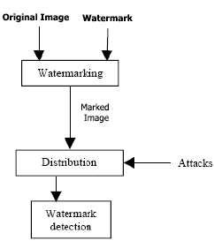
Overall watermarking process:
Distribution:
The action of sharing something out among a number of recipients.
Attacks :
Algorithms that attempt to separate and remove the watermark, The attack is successful if the watermark cannot be detected anymore, but the image is still intelligible and can be used for a particular determined purpose. Many such attack operations have been proposed:
• Lossy image compression (JPEG, JPEG 2000)
• Addition of Gaussian noise
• Denoising
• Filtering
• Median filtering and blurring
• Signal enhancement (sharpening, contrast enhancement)

Slide 9
Deep neural networks and digital watermarking:

Slide 10
Requirements for DNN watermarking:

Slide 11
Development process:
1) Embedding :

Slide 12
2) Training:

Slide 13
3) Extraction:

Slide 14
Experiments:
1) Compression:

Slide 15
2) Brightness:

Slide 16
3) Cropping:

Slide 17
Conclusion:
Although we got great results on the experiments that we applied, however there are some cases were the marked-image gets damaged by some strong attacks or compression algorithms in a way that even a well-trained deep neural network cannot be able to detect the embedded watermark or even if it did it will be with a low confidence score (accuracy) which means a higher error, and the higher the error goes, the less we are sure about whether a certain watermark exists in an image or not.

