Slide 1

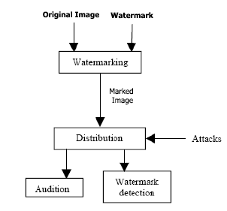
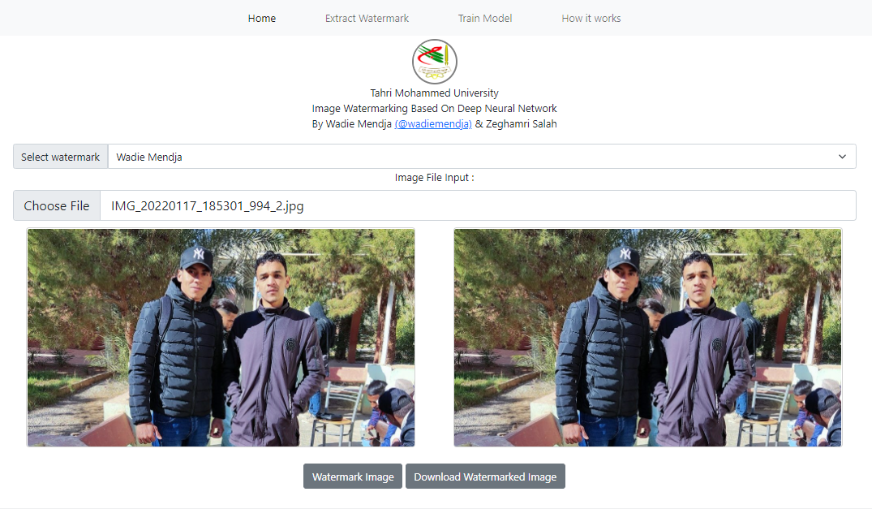
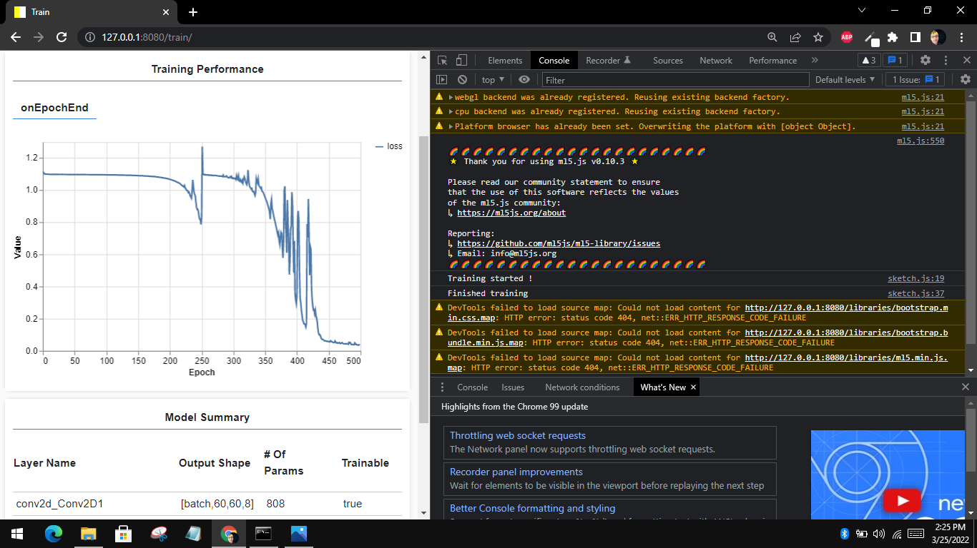
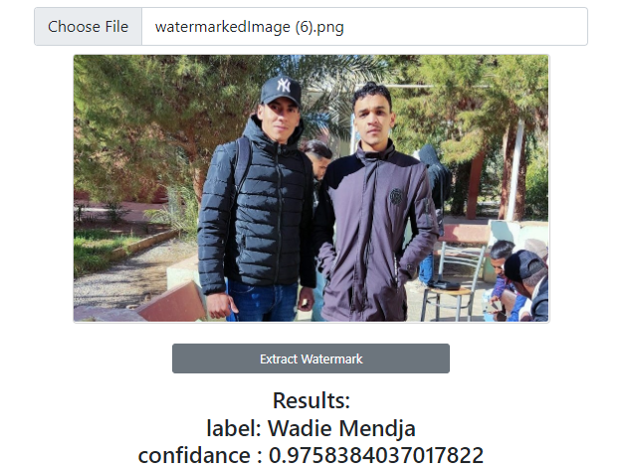

République Algérienne Démocratique et Populaire
Ministère de l’Enseignement Supérieure et de la Recherche Scientifique
Université Tahri Mohamed de Béchar
Faculté des Sciences Exactes
Département des Mathématiques et Informatique
Projet de fin d’études
En vue de l’obtention du diplôme de Master en Informatique
Option: Intelligence Artificielle
Supervised by: Theme : Authors:
Dr. Daham Abderrahmane. Image Watermarking Based On Deep Neural Networks - Wadie Mendja.
- Salah Zeghamri
Introduction :
With the general use of digital data and the widespread use of the Internet, there are frequent acts of infringement of intellectual property rights, such as illegal use, copying, and digital content theft. Digital images are high value-added contents such that their intellectual property rights must be protected. A recent technique for this is digital watermarking. Watermarking embeds the owner’s information (watermark (WM)) into the content, and the result is stored or distributed. This technology is to claim ownership by extracting the embedded WM information when it is necessary.
Theme presentation :
Problematic :
Goal :
Development tools and languages:
Digital watermarking has been widely studied as a method of protecting the intellectual property rights of digital images, which are high value-added contents, recent studies implementing these techniques with neural networks have been conducted.
How can we embed, train and use a deep neural network to detect whether or not a digital image has a specific watermark on it in which this last doesn’t appear (invisible watermark) ?
Our goal is to find a way to embed the owner’s information (watermark) which are basically the first and the last name of the owner in away where they can not be visible, in addition to that we’re going to train our neural network to able to recognize and detect whether or not those information exist in a specific image.
We developed our application using HTML & CSS for the UI, JavaScript for data manipulation, Processing to auto-generate a dataset and for training and detection purposes we used a library called ml5.js which has a predefined neural network class that will allow to train a model and do the classification after the training process.
The concept of digital watermarking using deep neural network:
A watermarking system is usually divided into three distinct steps, embedding, attack, and detection. In embedding, an algorithm accepts the host and the data to be embedded, and produces a watermarked image. Then the watermarked digital image is transmitted or stored. If this person makes a modification, this is called an attack. Detection (often called extraction) is an algorithm which is applied to the attacked image to attempt to extract the watermark from it. If the image was unmodified during transmission, then the watermark still is present and it may be extracted. In robust digital watermarking applications, the extraction algorithm should be able to produce the watermark correctly, even if the modifications were strong. In fragile digital watermarking, the extraction algorithm should fail if any change is made to the image.
Concept Diagram :
Realization :
Watermark embedding
Watermark Extraction
Generated dataset
Training Performance
Conclusion :
Although we got great results on the example above that we applied, however there are some cases were the image get damaged by some attack or compression algorithms in a way that even a well-trained neural network cannot be able to detect the embedded watermark or even if it did it will be with a low confidence score which means a higher error, and the higher the error goes the less we are sure about whether a certain watermark exists in an image or not.
2021/2022

