Slide 1
République Algérienne Démocratique et Populaire Ministère de l’Enseignement Supérieure et de la Recherche Scientifique Université Tahri Mohamed de Béchar Faculté des Sciences Exactes Département de Mathématique et Informatique
Image Watermarking Based On Deep Neural Networks
Presented by :
- Mendja Wadie
- Zeghamri Salah Eddine
Supervised By: Dr. Daham A

Slide 2
Workplan:
Introduction
Problematic
What is a watermark and why it’s needed
Watermarking techniques
Overall watermarking process
Deep Neural Networks and digital watermarking
Requirements for DNN watermarking
Development process (embedding, training and extraction models)
Conclusion

Slide 3
Introduction:
Digital watermarking is recognized as an innovative technique developed to deal with the problem of copyright protection of digital content distributed on the Internet. Such a technique can address the problem of asserting authorship but cannot directly solve the problem of determining accountability when piracy occurs. Therefore, it is necessary to implement watermarking protocols to determine whether a user illegally possesses content distributed by content providers as well as to protect the entire digital asset of the web-based distribution and of the associated rights.
Notes:
In the last two decades, watermarking technology has been applied to protect multimedia documents, Digital watermarking basically is a technique of embedding pieces of information into digital data such as text, audio, video, and still images that can be detected or extracted later to show authentication about the data

Slide 4
Problematic:
While Deep Neural Networks (DNN) watermarking is receiving increasing attention, and several works have been published leveraging on digital watermarking to address intellectual property protection in the DL domain.
With all that been said :
How can we use DNN in digital watermarking ?
Notes:
Someone might ask. Well, what’s the relationship between DNN and digital watermarking

Slide 5
What is a watermark?
A digital watermark is a kind of marker covertly embedded in a noise-tolerant signal such as audio, video or image data and is so designed that it does not degrade/distort the quality of the image, there are two types of watermarks: visible and invisible watermark.
Why watermark is needed?
Watermarks serve to protect content and to claim ownership of an asset. Without watermarks, valuable digital assets are vulnerable to content theft or unauthorized use and distributions.
Notes:
Watermark is a hidden information in an image

Slide 6
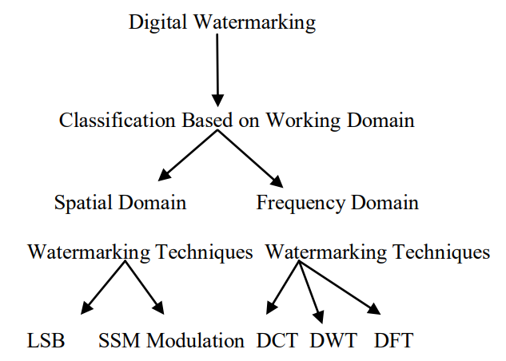
Watermarking techniques:
Digital watermarking consists of several different techniques for protection of digital content. The digital image watermarking falls in two main broad categories:
Spatial Domain.
- Frequency domain.

Slide 7
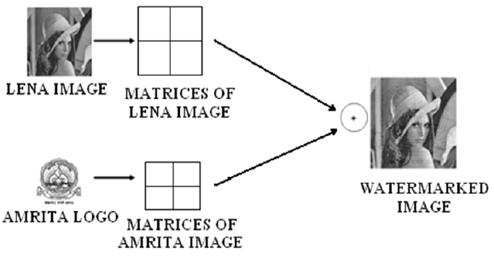
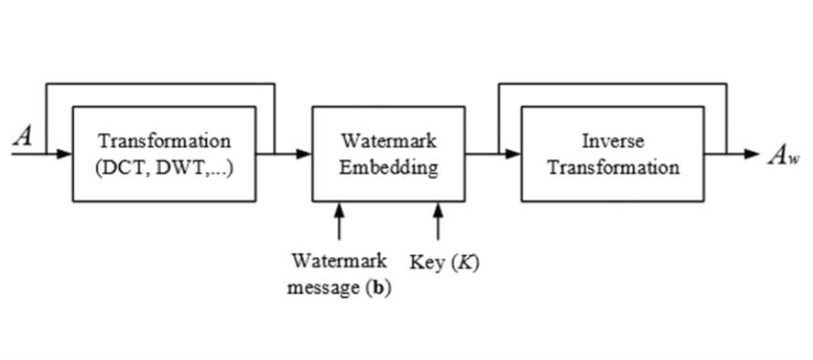
Spatial domain techniques works on pixels and pixel value are modified for embedding the watermark. The commonly used spatial domain technique is LSB. Whereas frequency domain coefficient are modified by Frequency domain techniques for embedding watermark. DCT, DWT and DFT are commonly used frequency domain technique.
Spatial domain watermarking
Frequency domain watermarking

Slide 8
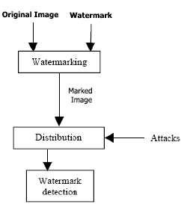
Overall watermarking process:
Distribution:
The action of sharing something out among a number of recipients.
Attacks :
Algorithms that attempt to separate and remove the watermark, The attack is successful if the watermark cannot be detected anymore, but the image is still intelligible and can be used for a particular determined purpose. Many such attack operations have been proposed:
• Lossy image compression (JPEG, JPEG 2000)
• Addition of Gaussian noise
• Denoising
• Filtering
• Median filtering and blurring
• Signal enhancement (sharpening, contrast enhancement)

Slide 9
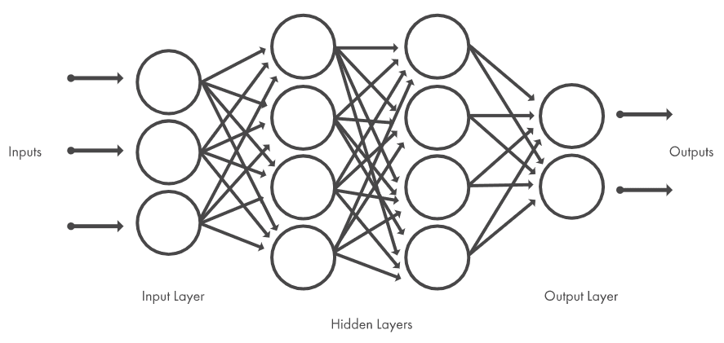
Deep neural networks and digital watermarking:
DNNs can be used within several types of data, like text, images, audio and video. Since digital watermarking deal with images we can get use of DNN to help us recognize patterns, Here is a simple DNN architecture:

Slide 10
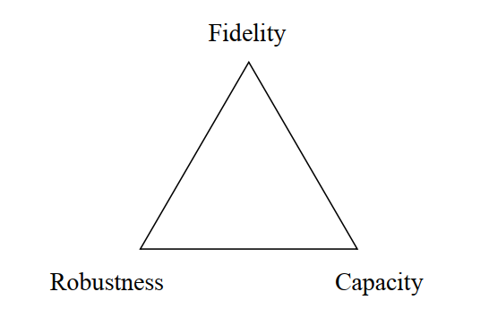
Requirements for DNN watermarking:
a) Capacity: Refers to the number of bits encoded by the watermark. Despite the fact that a large payload is good for watermarking algorithms, it conflicts directly with robustness.
b) Fidelity: Models containing watermarks should receive performance levels similar to those of models trained without watermarks.
c) Robustness: Ability to extract the watermark correctly even when it has been modified

Slide 11
Development process:
Overall architecture:
Watermarking procedure is usually divided into two steps: embedding and verification. In the embedding process, an embedding algorithm E embeds pre-defined watermarks W into the carrier data C, which is the data to be protected. After the embedding, the embedded data (e = E(W, C)) are stored or transmitted. During the watermark verification process, a decryption algorithm D attempts to extract.

Slide 12
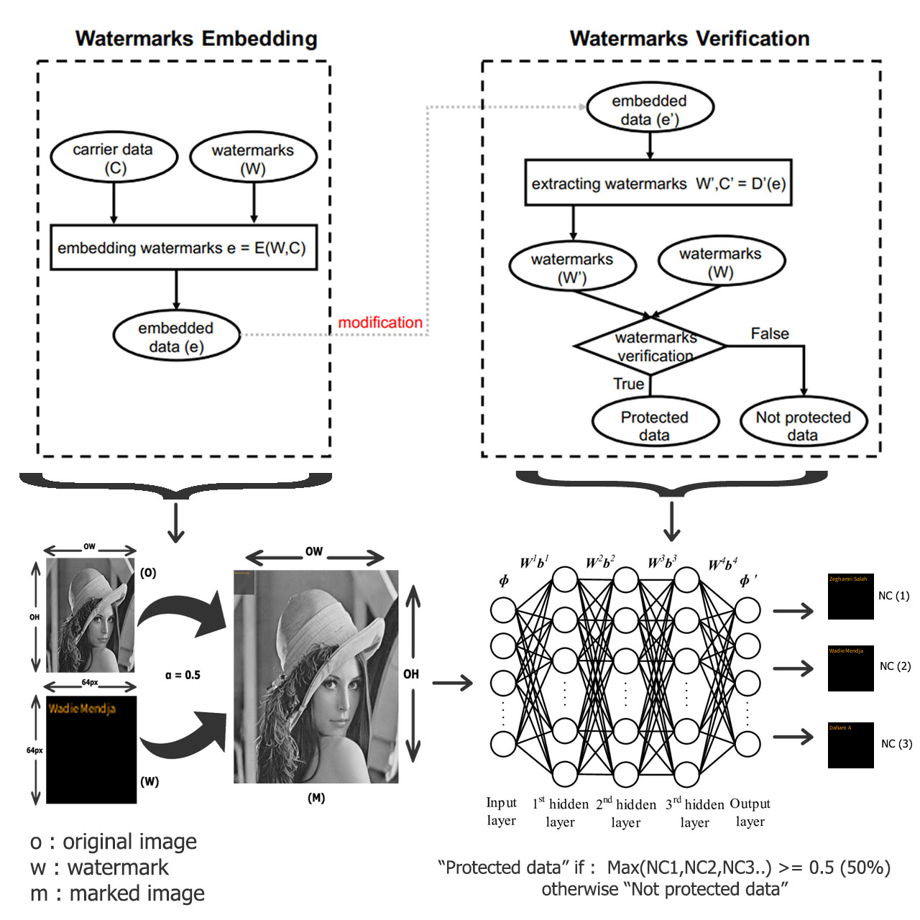

Slide 13
1) Embedding :
Let us assume that an original image O has a width of OW and a height of OH and the watermark W is which is basically a 64x64 frame filled with text that is going to be overlapped on O with a predefined opacity α which varies between (0.1 to 1), and with all that being performed a marked image M is going to be produced as given in Eq. 1
m = O + αW ……………. (1)

Slide 14
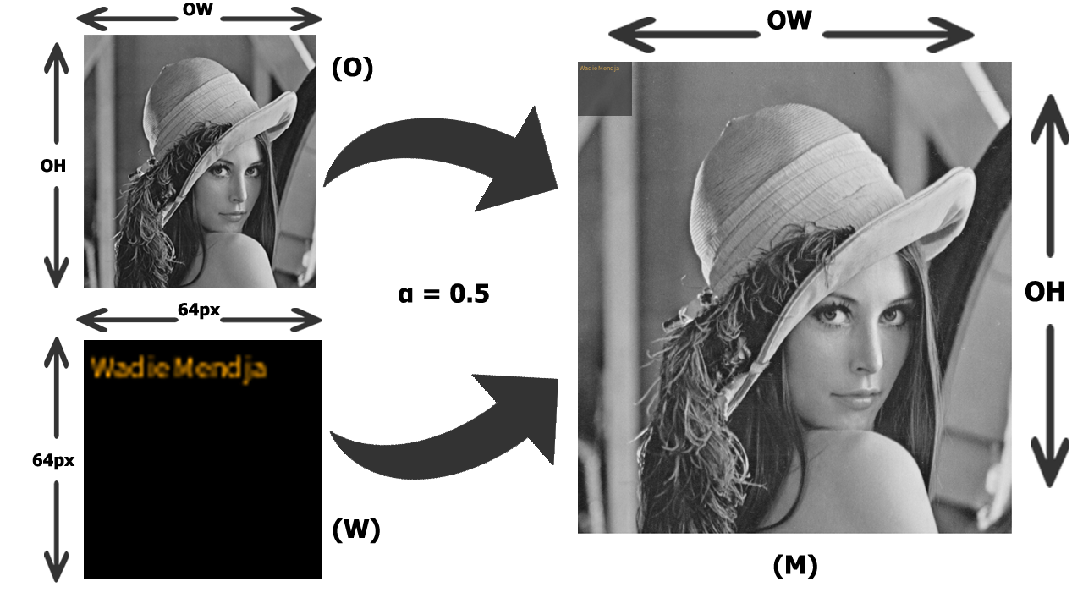

Slide 15



2) Training:
In this case we’re using three different watermarks, basically images that are filled with the following texts “Wadie Mendja”, “Zeghamri Salah” and “Daham A” which they look like this:
A dataset is generated by creating different versions of the above watermarks by changing the text position, size, background color and its opacity (strength α).

Slide 16

This is how our dataset looks like:

Slide 17
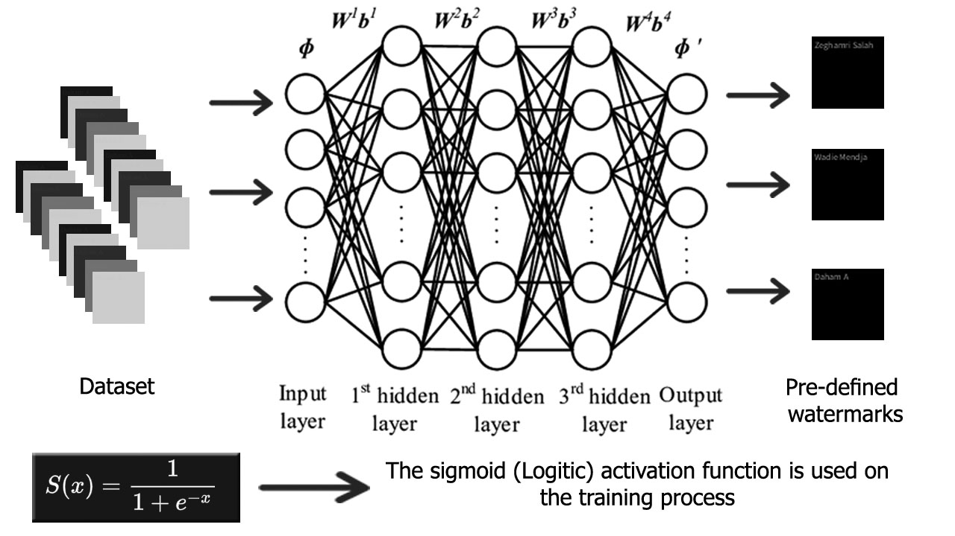
The DNN is going to take each image’s individual pixel (RGBA) value as an input to the first layer, the total number of inputs should be 64*64*4 which is 16384 inputs and 3 outputs since we have three pre-defined watermarks:

Slide 18
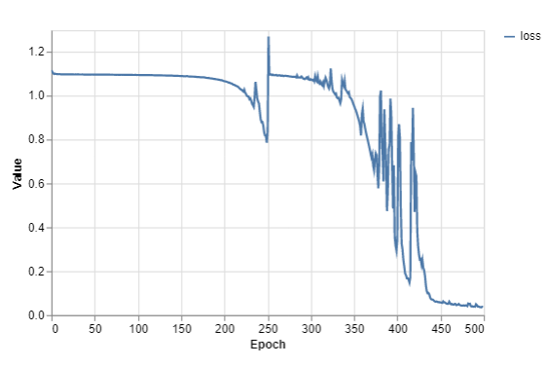
Training performance:

Slide 19
3) Extraction:
The extraction phase is divided into two steps:
Cropping the watermark area (64x64 pixel) where it’s expected to be;
The pre-trained DNN is going to take marked image as an input (pixels matrix), and in the other hand we got 3 output nodes which will give the results that depend on the NC factor (confidence score) as given in Eq. 2:
NC(i) = AN / TNN …... (Eq. 2)
i : index of pre-defined watermark
AN: activated neurons
TNN: total number of neurons

Slide 20
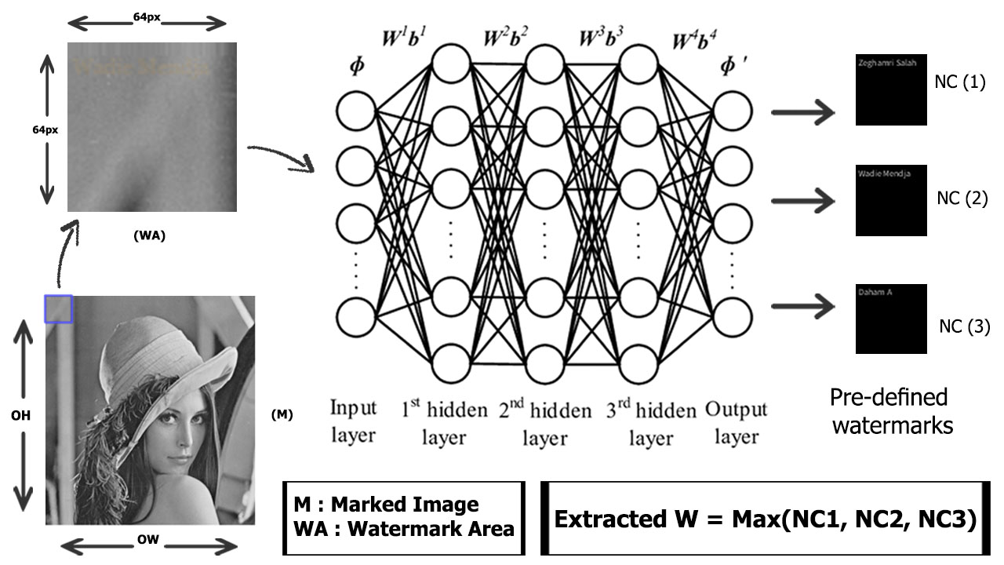

Slide 21
Conclusion:
DNN watermarking is immune to vulnerabilities in the same way that any other watermarking solution is.
DNNs are becoming increasingly popular with its human-like capabilities and considering the resources invested in its making, it is important that these advancements be protected, and from our reading we can be quite confident that watermarking is one of the reliable ways to achieve this goal.

Slide 22
Thank you :)

