Slide 1

CONSUMER GOODS

Slide 2
Objectives
This projects involved using available data to provide data-driven insights to present to the executive management on the performance of the hardware store by answering a series of questions. As a data analyst, Peter Pandey saw this as an opportunity to expand his skills and show his work on a bigger scale.

Slide 3
Guiding Questions
How will the store Maintain and increase the number of customers?
The strategies that the store will use to drive revenue growth?
Can you explain the store's specific tactics or approaches to implement its pricing strategy and achieve optimal profit margins effectively?

Slide 4
Data And Tools
Using SQL to analyze data
The dataset consists of 6 tables, namely:
dim_customer: contains customer-related data
dim_product: contains product-related data
fact_gross_price: contains gross price information for each product
fact_manufacturing_cost: contains the cost incurred in the production of each product
fact_pre_invoice_deductions: contains pre-invoice deductions information for each product
fact_sales_monthly: contains monthly sales data for each product.

Slide 5
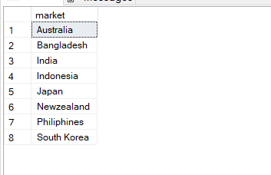
Q1. Provide the list of markets in which customer "Atliq Exclusive" operates its business in the APAC region.
Insight:-
Customer Atliq Exclusive operates in 8 countries in the Asia Pacific.

Slide 6

Q2. What is the percentage of unique product increase in 2021 vs. 2020?
Insight:-
The total percentage change in the sales of products between 2021 and 2020 is 35.9%.

Slide 7
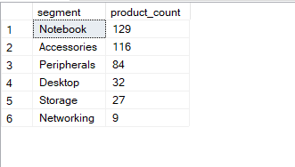
Q3. Provide a report with all the unique product counts for each segment and sort them in descending order of product counts.
Insight :-
The Notebook segment had a highly unique product count of 129 unique products. This could imply that notebooks are a popular product category followed by Accessories. The networking segment with the least number of unique products is networking.

Slide 8
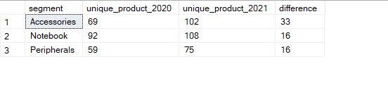
Q4. Which segment had the most increase in unique products in 2021 vs 2020?
Insights:
The accessories segment had the highest difference in unique product counts between 2020 and 2021, with a difference of 33.

Slide 9

Q5. Get the products that have the highest and lowest manufacturing costs.
Insights : -
AQ HOME Allin1 Gen 2 had the highest manufacturing cost of 240.5364, while AQ Master wired x1 Ms had the lowest cost of 0.892.

Slide 10
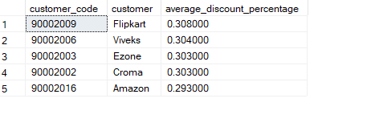
Q6. Generate a report which contains the top 5 customers who received an average high pre_invoice_discount_pct for the fiscal year 2021 and in the Indian market
Insights : -
Flipkart customers received the highest average discount of 31% approx, Viveks, Croma, and Ezone received an average discount of 30% approx, while Amazon received a 29% discount.

Slide 11
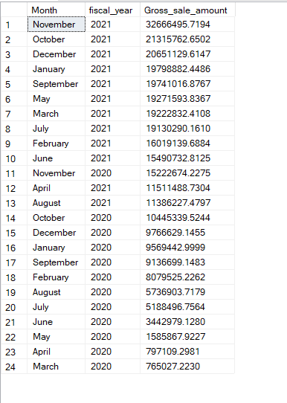
Q7. Get the complete report of the Gross sales amount for the customer “Atliq Exclusive” for each month. This analysis helps to get an idea of low and high-performing months and take strategic decisions.
Insights :-
For Customer “Atliq Exclusive”, In the month Novemeber 2021 has the highest Gross_sale_amount followed by October 2021 and December 2021. March 2020 has the least gross sale.

Slide 12
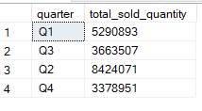
Q8. In which quarter of 2020, got the maximum total_sold_quantity?
Insights:-
The first quarter recorded a high quantity of goods sold, followed by the fourth quarter.

Slide 13
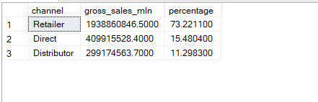
Q9. Which channel helped to bring more gross sales in the fiscal year 2021 and the percentage of contribution?
Insights :-
Retailer channel generated more sales in 2021 with 73.22% followed by Direct which, generated 15.5% sales.

Slide 14
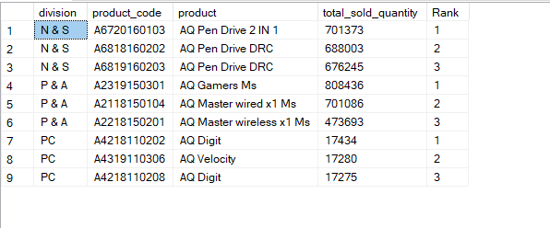
Q10. Get the Top 3 products in each division that have a high total_sold_quantity in the fiscal_year 2021?
Insights : -
N & S division recorded a high total quantity sold among the divisions, with AQ PEn Drive 2 IN 1 leading.
P & A division recorded a high total quantity sold among the divisions, with AQ Games MS.

Slide 15
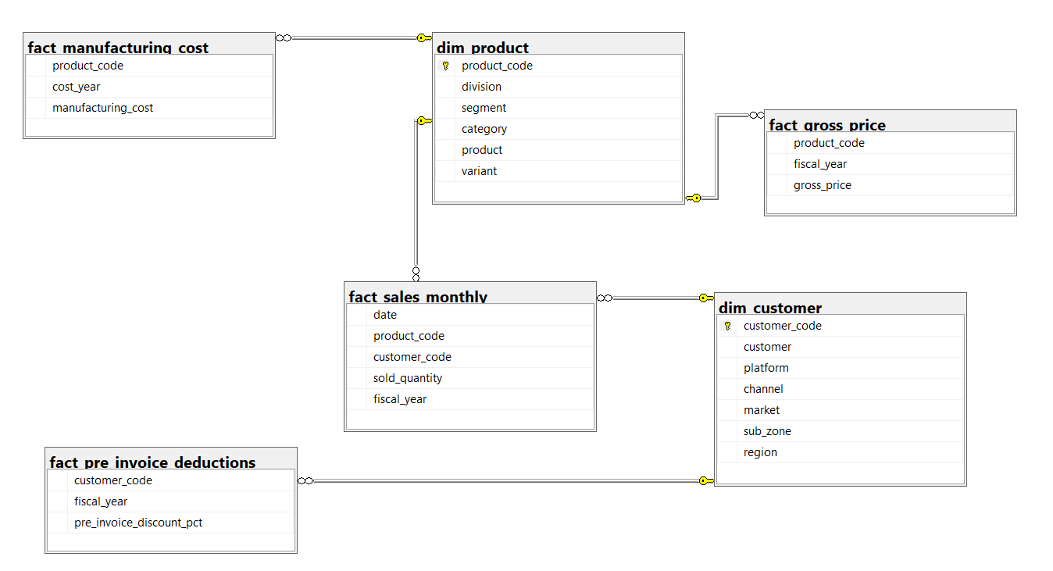
ERD

Slide 16
THANK YOU
Sukhpaldeep Kaur

