Slide 1

Project: Go Auto Vehicle Transmission Classifier Driving Insights: Predictive Modeling for vehicle sales optimization Course: CMPT 3830 - Machine Learning Work Integrated Learning-1
Sukhvir kaur
Waryam Kaur
Michaela Goud
Manjot kaur

Slide 2
Problem Statement and Business Objectives
Predict vehicle transmission type (Automatic or Manual)
1
Optimize inventory management & marketing
2
Improve dealership operations
3

Slide 3
Description of Machine Learning Models
A Machine Learning Model is a system that learns from data to make predictions.
It identifies patterns in historical data and applies them to new information.
The model continuously improves through training and parameter tuning.
Types of Machine Learning Models Used
XGBoost: High accuracy, efficient with large datasets, handles imbalanced data.
Random Forest: Uses multiple decision trees, robust to noise.
Decision Tree: Simple and interpretable, useful for explaining decisions.

Slide 4
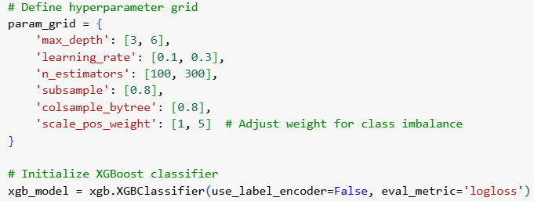
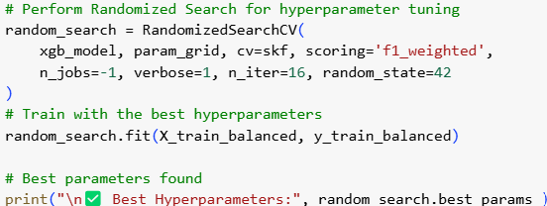
Model Optimization
Used RandomizedSearchCV for hyperparameter tuning
Improved accuracy and reduced overfitting

Slide 5
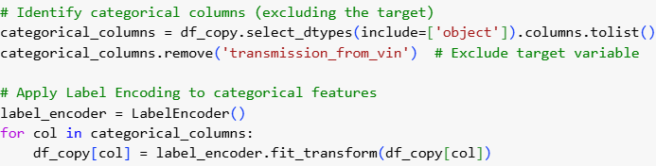
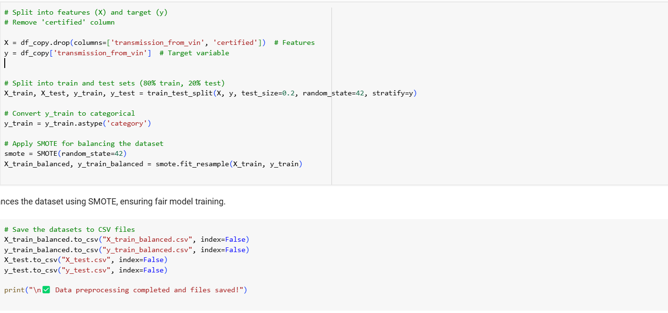
Data Preprocessing & Balancing the Dataset
Handled missing values and categorical variables
Used Label Encoding for categorical features
Applied SMOTE for class imbalance correction
Split dataset into training and testing sets

Slide 6
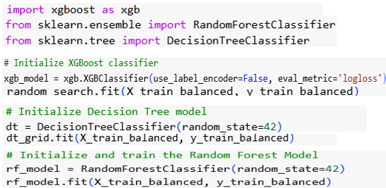

Model Development & Justification
Implemented three models: Decision Tree, Random Forest, XGBoost
Evaluated using accuracy, F1-score, and confusion matrix

Slide 7
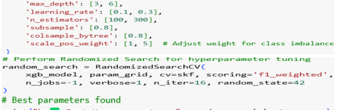
Model Optimization
Used RandomizedSearchCV for hyperparameter tuning
Improved accuracy and reduced overfitting

Slide 8
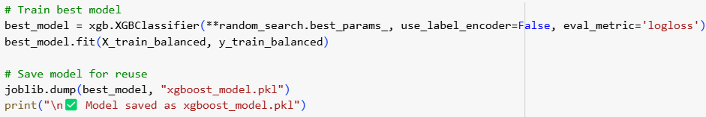
Why XGBoost for Transmission Classification?
Handles Large Datasets Efficiently
Performs Well on Imbalanced Data (Due to scale_pos_weight)
Boosting Technique Reduces Overfitting
Highly Interpretable with Feature Importance Analysis

Slide 9
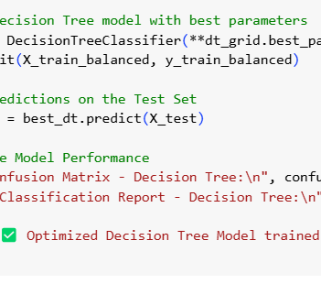
Why We Also Tested Decision Tree
Simple & Fast Model for Classification
Works Well for Structured Data
Easy to Interpret, But Prone to Overfitting

Slide 10
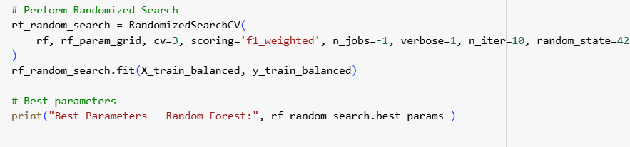
Tested Random Forest
Ensemble Model: Uses Multiple Decision Trees
Reduces Overfitting, Handles Missing Data Well
Good Generalization But Computationally Expensive
Code Snippet: Training Random Forest

Slide 11
Model Performance & Results
Model | Accuracy | F1 | Precision | Recall
XGBoost | 99.5% | 0.995 | 0.99 | 0.99
Random Forest | 99.1% | 0.991 | 0.98 | 0.99
Decision Tree | 98.7% | 0.987 | 0.97 | 0.98
XG Boost was chosen as the final model because:
It had the highest accuracy (99.5%).
It performed well on both Precision and Recall, reducing false positives and false negatives.
It handled imbalanced data better compared to the other models.
It provided robust predictions with lower overfitting compared to Decision Tree.

Slide 12
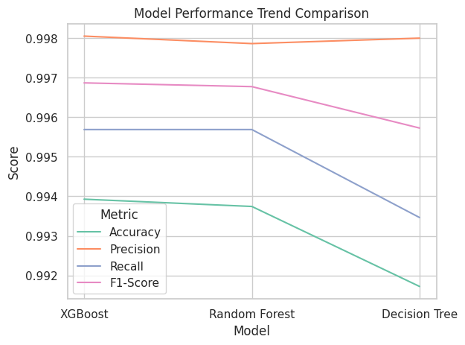
Model Performance Trend Comparison
Comparison of Accuracy, Precision, Recall, and F1-score
XG Boost consistently outperformed other models across all key metrics
Random Forest performed well but had slightly lower precision compared to XG Boost
Decision Tree, while interpretable, had the lowest performance due to overfitting

Slide 13
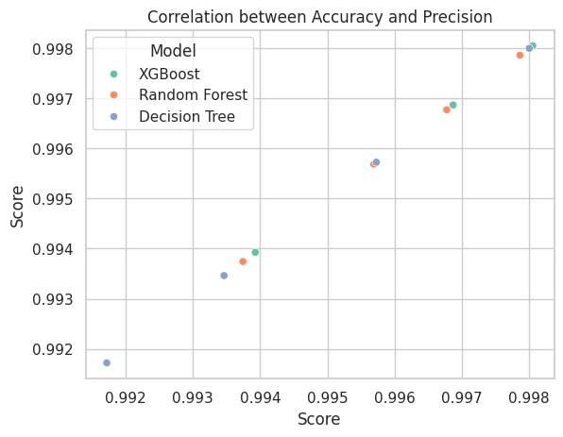
Correlation between Accuracy and Precision
Understanding Correlation in Model Performance
This scatter plot shows how accuracy and precision are related for different models
XGBoost maintains both high accuracy and precision, making it a well-balanced model
Decision Tree shows more variability, suggesting lower consistency
Random Forest performs well but slightly lower than XGBoost

Slide 14
Conclusion
The machine learning model effectively classifies automatic vs. manual transmission vehicles with high precision.
XGBoost performed the best, making it the optimal model for deployment due to its accuracy and ability to handle imbalanced data.
The insights gained from this model will help Go Auto optimize its sales, pricing, and marketing strategies.
Future improvements include integrating more features like drivetrain type, fuel efficiency, and real-time deployment.
This project demonstrates the value of machine learning in enhancing dealership operations and boosting customer engagement.

Slide 15
Next Steps
Extend model features to include fuel type and drivetrain analysis.
Deploy the model for real-time classification in dealership systems.
Improve accuracy using deep learning techniques.
Integrate sales forecasting for better demand prediction.

