Slide 1

Go Auto and Transmission Types: Demo 1
Data Dreamers: ​Michaela Goud , Waryam Kaur, Manjot Kaur, and Sukhvir Kaur​
COURSE NAME : CMPT 3830​
INSTRUCTOR NAME: Md Mahbub Mishu

Slide 2




Problem statement: Vehicle Transmission Identifier (Classification)
Transmission Types
📌 Automatic – Self-shifting, preferred for convenience.
📌 Manual – Driver-controlled, popular in performance cars.
📌 Objective: Automate transmission classification to improve inventory management. 📌 Business Impact: Reduces manual errors, enhances customer experience, and streamlines dealership operations.
Data Source
📌 Collected from: Go Auto’s Business Intelligence Team 📌 Dataset Includes: Vehicle listings from Edmonton dealerships

Slide 3
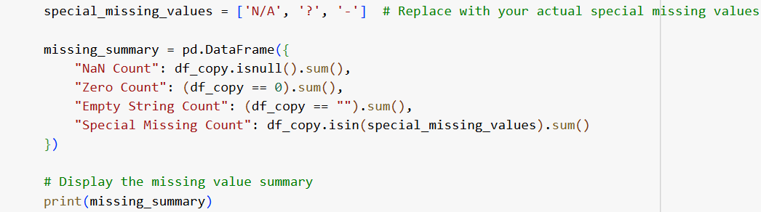
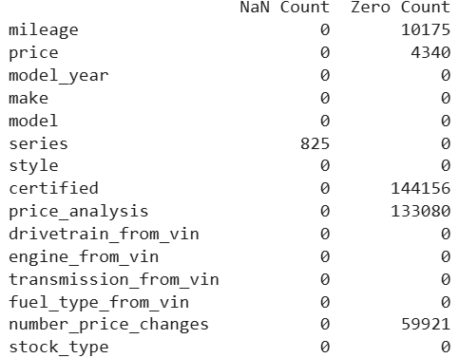
Key Features for Prediction
Identifying Missing Data
📌 Checked missing values in dataset using Pandas.
Selected Features
🔹 Mileage – Indicates wear & potential transmission impact. 🔹 Price – High-end cars often use automatic transmissions. 🔹 Model Year – Newer vehicles are predominantly automatic. 🔹 Make & Model – Certain brands favor specific transmission types. 🔹 Engine Type – Some engines are designed for specific transmissions. 🔹 Drivetrain – AWD, FWD, RWD influence transmission choice. 🔹 Fuel Type – Efficiency and performance affect transmission selection.
Notes:
Why These Features?
✅ Directly impact transmission classification. ✅ Improve model accuracy and efficiency. ✅ Business relevance for dealership optimization.

Slide 4
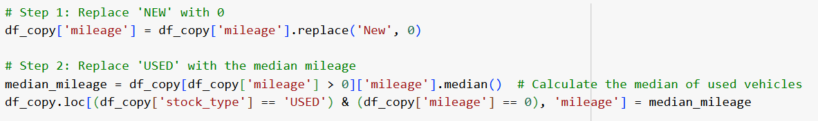
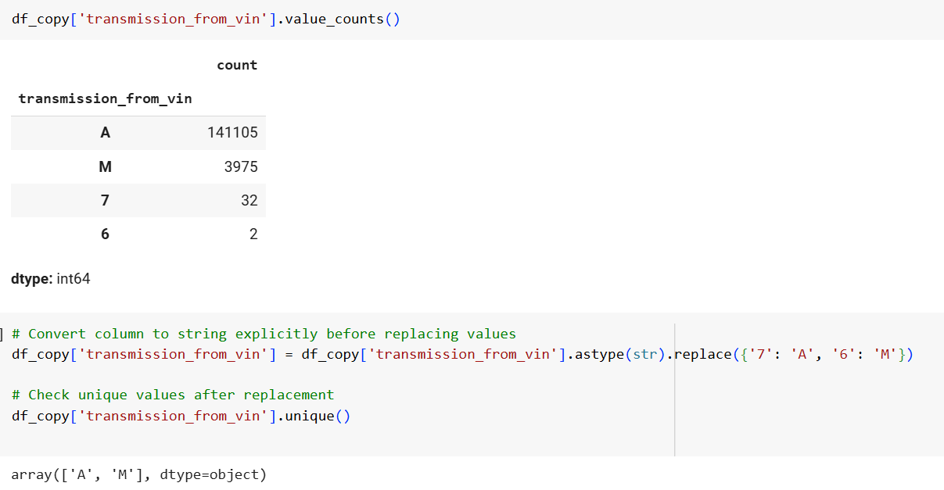
Handling Missing Values
Step 1: Replace 'NEW' in mileage with 0.
Step 2: Replace 'USED' vehicles' missing mileage with the median mileage of used vehicles.
Handling Transmission Data: Convert values like '7' and '6' in transmission_from_vin to appropriate labels ('A' for automatic, 'M' for manual).

Slide 5
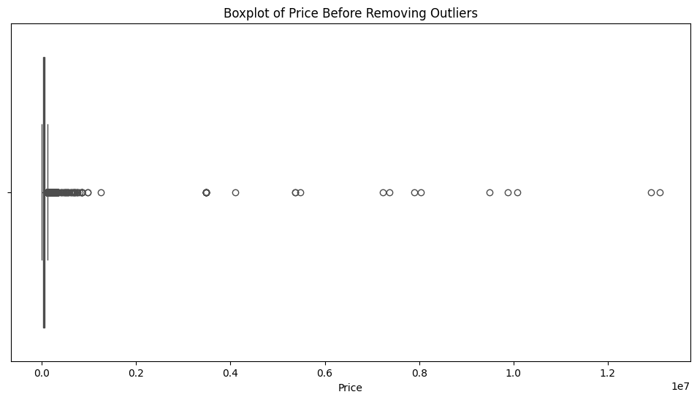
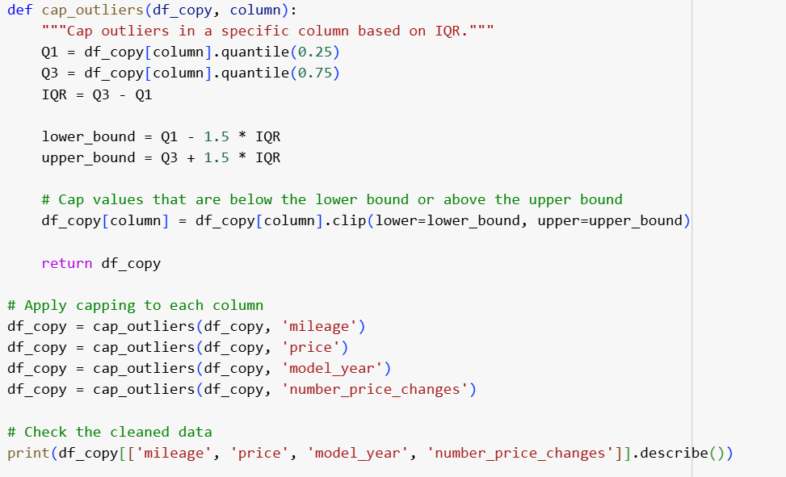
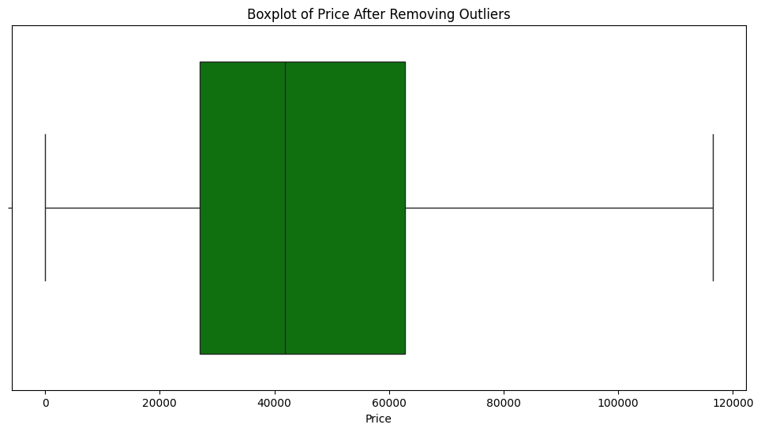
Removing outliers from price column
Removing Outliers from Price Column
Before Removal: Boxplot shows extreme price values affecting data quality.
After Removal: Distribution becomes cleaner and more reliable.
Method Used: Interquartile Range (IQR) to detect and cap outliers.
Importance: Enhances accuracy, improves model performance, and ensures realistic pricing trends.

Slide 6
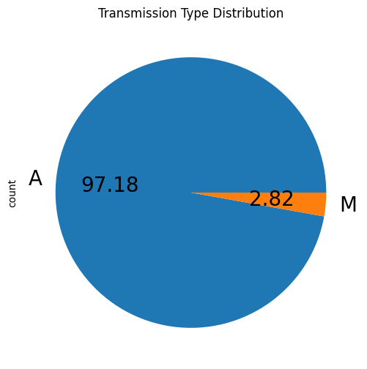
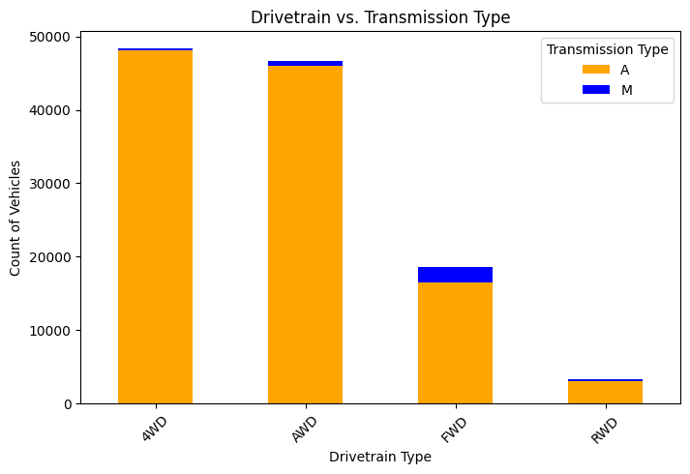
Transmission Type Analysis
Transmission Type Distribution:
Majority of vehicles have Automatic (A) transmissions.
Only a small percentage use Manual (M) transmissions.
Drivetrain vs. Transmission Type:
Automatic transmissions are dominant across all drivetrain types.
Manual transmissions appear more in FWD and some RWD vehicles.
Insights:
Helps understand transmission trends across different drivetrain types.
Useful for inventory analysis and market demand prediction.

Slide 7
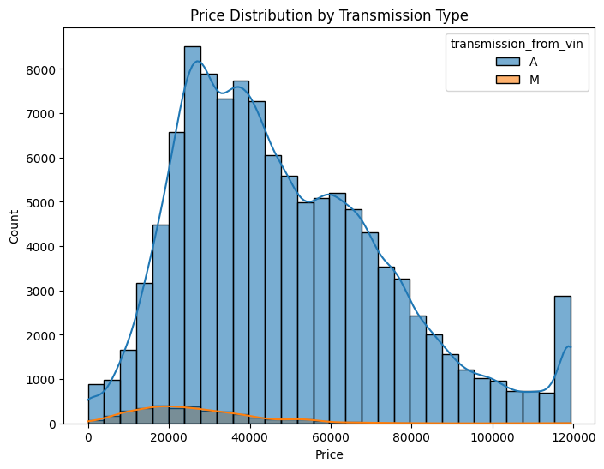
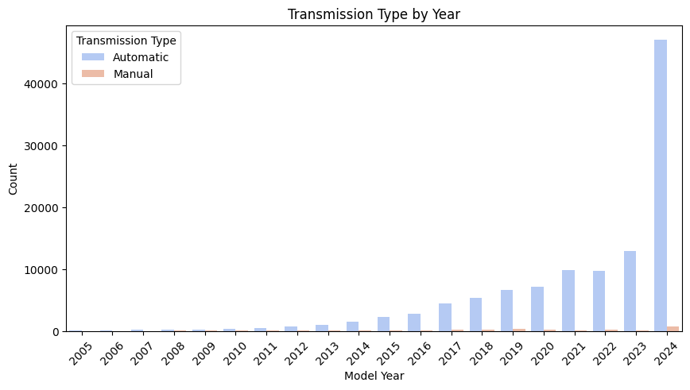
Transmission & Price Analysis
Price Distribution by Transmission Type:
Majority of Automatic (A) transmission vehicles have a wider price range.
Manual (M) transmission vehicles are fewer and concentrated in lower price ranges.
Transmission Type by Year:
Automatic transmissions have become more dominant in recent years.
Manual transmissions are declining, with very few models in recent years.
Insights:
Automatic cars have a broader price distribution, indicating higher market demand.
Useful for predicting pricing trends and understanding shifts in transmission preferences.

Slide 8
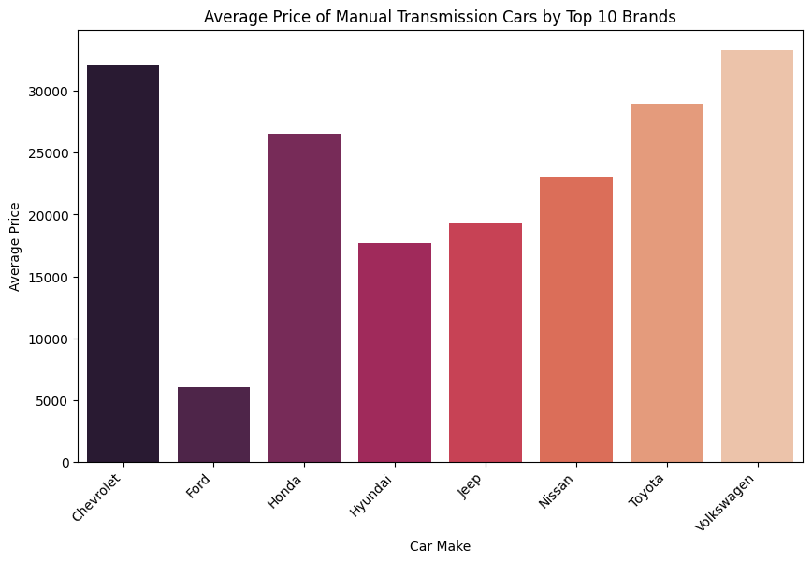
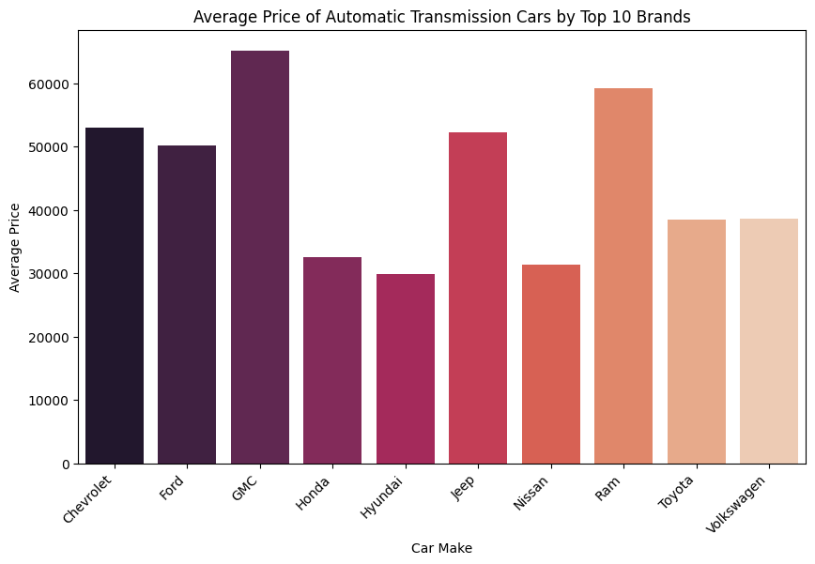
Transmission & Price Analysis
Manual vs Automatic Prices:
Automatic cars generally have higher prices than manual ones.
Chevrolet and Volkswagen lead in manual car prices, while GMC and Ram top automatic ones.
Insights:
Helps understand market demand and pricing strategies.

Slide 9
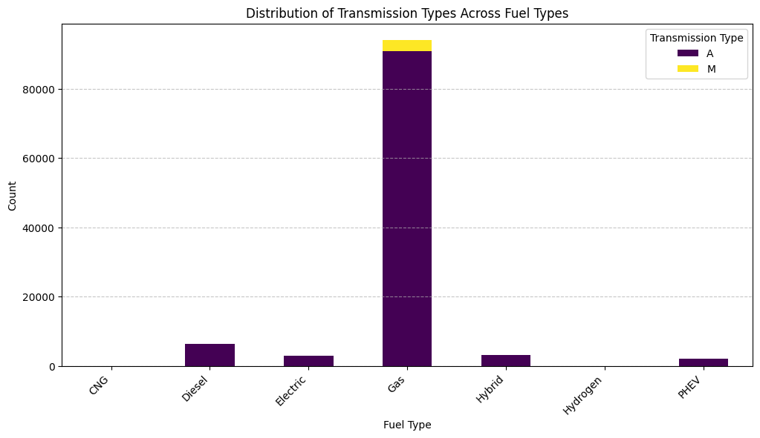
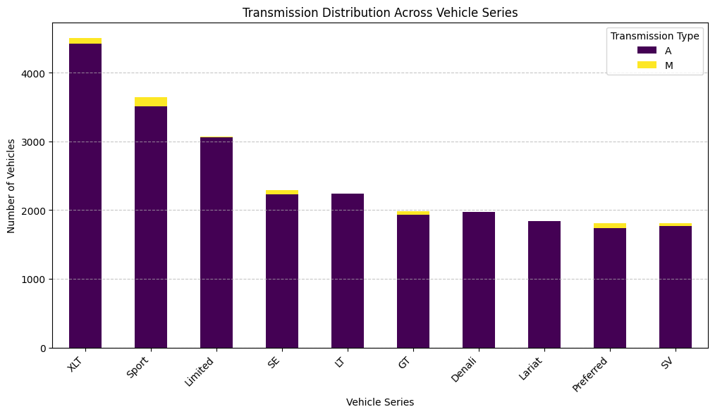
Transmission & Fuel Type Analysis
Transmission Across Fuel Types:
Gas-powered vehicles dominate both manual and automatic transmissions.
Electric, hybrid, and hydrogen vehicles have almost exclusively automatic transmissions.
Transmission Distribution Across Vehicle Series:
Automatic transmissions are common across all series.
Manual transmissions appear in a small fraction of certain models like Sport and XLT.
Insights:
Gasoline vehicles continue to be the most popular.
Manual transmission is rare, aligning with industry trends toward automation.

Slide 10
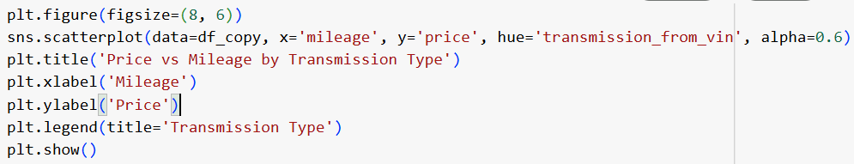
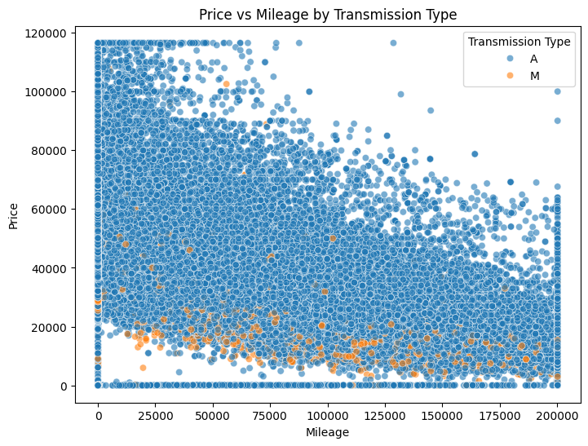
Price vs Mileage by Transmission Type
Scatter Plot Analysis:
Automatic (A) cars are widely distributed across all price and mileage ranges.
Manual (M) cars are concentrated in the lower price and mileage range.
Trends Observed:
Vehicles with higher mileage tend to have lower prices.
Few high-priced cars have high mileage, indicating luxury or premium models.
Insights:
Useful for pricing strategies based on mileage.
Confirms the declining presence of manual transmission vehicles in higher price segments.

Slide 11
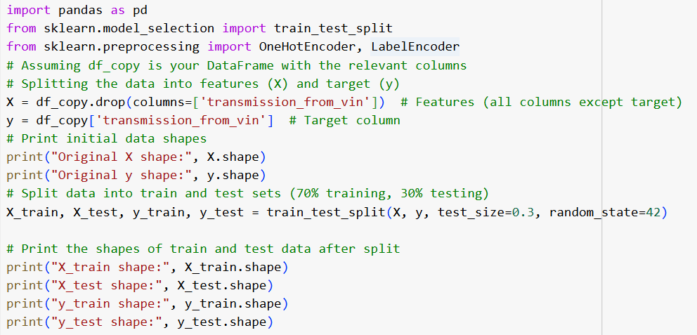
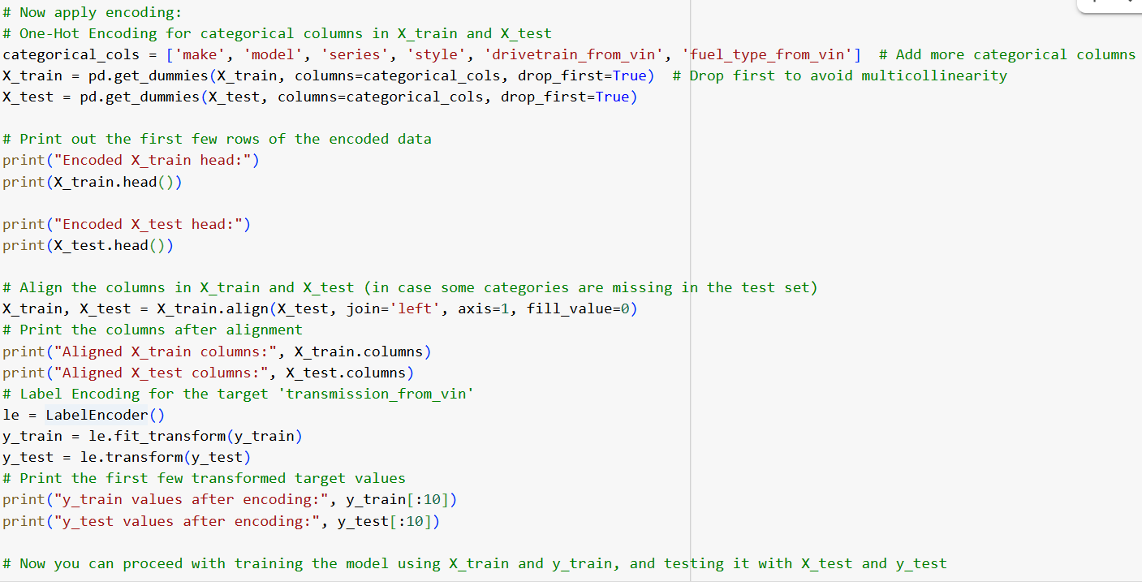
The code prepares the data for machine learning by:
Splitting the data into input features (X) and the target variable (y). Dividing the data into training and testing sets. Converting categorical data (like car make, model) into numbers using one-hot encoding. Transforming the target variable (transmission type) into numeric values using label encoding. Aligning the columns between training and testing data to ensure consistency. Then, you can use this processed data to train and test a machine learning model.

Slide 12


THANK YOU

