Slide 1

Group 3
Gurleen Kaur Michaela Goud Sukhvir kaur
Celine Panicker Tanish Dhawan

Slide 2


Problem statement
Banff experiences recurring traffic congestion due to high tourist inflow.
Limited parking capacity creates bottlenecks in key zones.
Peak hours lead to delays on major routes and visitor frustration.
Lack of predictive insights makes it difficult to plan and manage traffic effectively.

Slide 3

Project Objective
Analyze Banff traffic and parking datasets to find patterns of congestion.
Identify peak hours, busy zones, and frequent delay routes.
Use dashboards to visualize traffic flow clearly .
Provide insights that help planners reduce congestion and improve mobility.

Slide 4
Screenshot of team charter

Slide 5
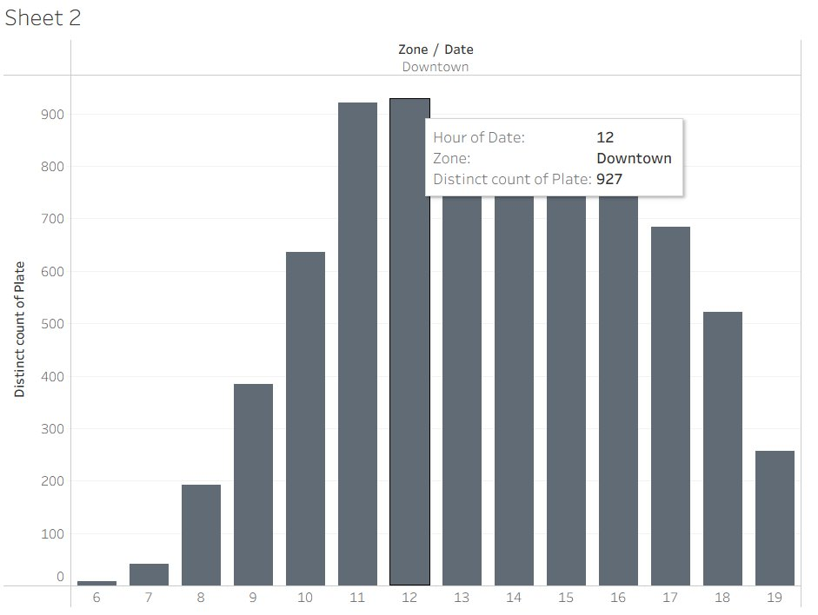
Sukhvir Kaur
This week I worked on Worked on Tableau this week platform. One thing I learned was to visualize parking data (e.g., peak hours &congestion zones).​
​
My objective as a project team member is to analyze our datasets and provide insights for smarter traffic management.

Slide 6
Celine Panicker
This week I worked on_____ platform. One thingI learned was ______.​
My objective as ______ isto do _______.

Slide 7
Gurleen kaur
This week I worked on_____ platform. One thingI learned was ______.​
My objective as ______ isto do _______.

Slide 8
Michaela goud
This week I worked on_____ platform. One thingI learned was ______.​
My objective as ______ isto do _______.

Slide 9
Tanish Dhawan
This week I worked on_____ platform. One thingI learned was ______.​
My objective as ______ isto do _______.

Slide 10




Thank you

