Slide 1

Project: Go Auto Vehicle Transmission Classifier
Driving Insights: Predictive modeling for vehicle sales optimization
Course: CMPT 3830 - Machine Learning Work Integrated Learning-1
EFFORT BY :
Sukhvir Kaur

Slide 2
Problem Overview: Why Transmission Type Prediction Matters
Industry Challenge: Manual labeling of transmission types (Automatic vs. Manual) is time-consuming and error-prone.
Our Goal: Build a binary classifier that automates the process of identifying the transmission type using vehicle features.
Business Impact:
  Reduces manual input errors
  Improves marketing targeting
  Enhances inventory classification
Dataset sourced from Go Auto’s business intelligence team, focused on Edmonton vehicle listings.

Slide 3
Objectives, Goals, and Scope
Build a binary classification model to predict vehicle transmission type
Integrate into a user-facing stream-lit app.
Support business decisions with a dashboard in power BI.
Achieve high accuracy and recall and precision.
Enable real-time classification.
Provide interpretability for decision-making.
Focused on dealership inventory from Edmonton (both sold and available vehicles) for comprehensive training data.
Included features like: year, make, model, mileage, stock type, fuel type
Excluded: electric vehicles and hybrid types due to low volume

Slide 4
Dataset Overview
Features used:
Mileage, price, model_year, make, model, series, style, certified, price_analysis, drivetrain_from_vin, engine_from_vin, fuel_type_from_vin, number_price_changes, stock_type
Label Encoding used for categorical features.

Slide 5
EDA & Feature Engineering
Handled null values and cleaned categorical features.
Label Encoded columns like make, model, drivetrain, etc.
Scaled numerical values for mileage, price, and model_year.
Removed highly correlated features to reduce overfitting.

Slide 6
Client Feedback From Demo 1
Positive Feedback: praised the thoroughness of the data analysis, specifically:
  Handling of missing values
  Addressing data inconsistencies
Key Question: Raised concerns about class imbalance and its potential impact on model evaluation.
Action Taken: Explored SMOTE to address class imbalance.

Slide 7
Model Selection & Evaluation
A Machine Learning Model is a system that learns from data to make predictions.
Tried Logistic Regression, Decision Tree, Random Forest, and KNN.
Final Model: Logistic Regression with RandomizedSearchCV for hyperparameter tuning
Reason for selection:
Logistic Regression performed consistently well for binary classification.
RandomizedSearchCV was chosen over GridSearchCV as both gave similar F1 scores, but RandomizedSearchCV was more efficient and faster.
Metrics: Accuracy, Precision, Recall, F1-Score (evaluated using confusion matrix).
.

Slide 8
Client Feedback From Demo 2
Feature Importance: Client questioned the importance of key features.
Metric Inconsistency (Random Forest): Client identified discrepancies in recall (0.92 vs. 0.99) and precision (0.95 vs. 0.98) across different Random Forest charts.
Metric Recommendation: Client reiterated that accuracy is a less reliable metric and suggested using the F1-score.
ROC Curve: While recommended, it was noted as outside the current learning focus.
Action Taken:
  Shifted focus to the F1-score as the primary evaluation metric.
  Utilized Logistic Regression as the model for this focus.

Slide 9
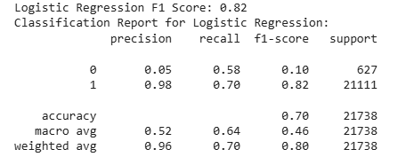
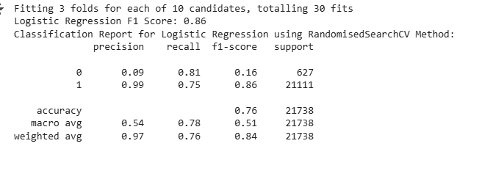
Logistic Regression – Modeling & Optimization
Model used: Logistic Regression (max_intr =100).
Initial F1- score= 0.82.
High precision(0.98) for automatic class.
Low recall (0.58) for manual class.
Issue: Class imbalance impacting performance
Model Tuning
Used Randomized-Search-CV and Grid-Search-CV for hyperparameter tuning.
Final F1-score: 0.86 after tuning
Better balance in precision and recall.
Increased recall for minority class(manual).
Faster convergence and better generalization.

Slide 10
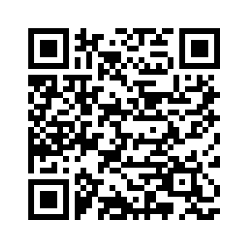
Streamlit App
Simple Interface: Easy for users to input data and get instant predictions.
Rapid Prototyping: Quickly built using Python, no need for frontend expertise.
Accessible Anywhere: Runs as a web app—accessible on any browser or device.
Real-World Ready: Transforms our ML model into a usable product for decision-makers.
2 Key Tabs:
Home: Introduction and branding
Predictions: Input form for real-time model predictions.
https://mlmodelapp-gfhd5grs24r778su6phmnh.streamlit.app/

Slide 11
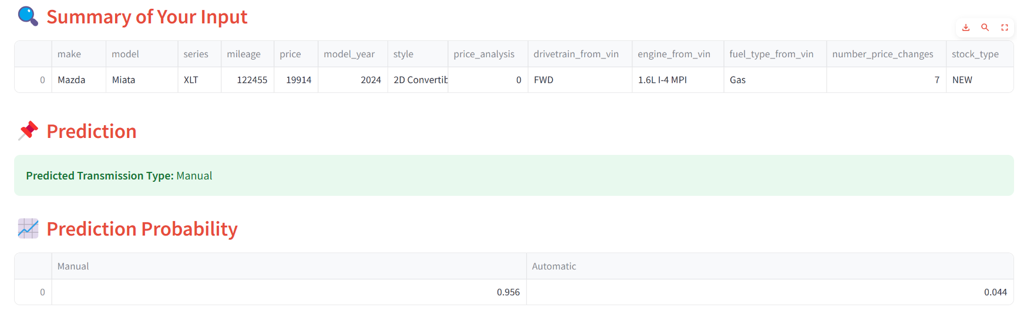
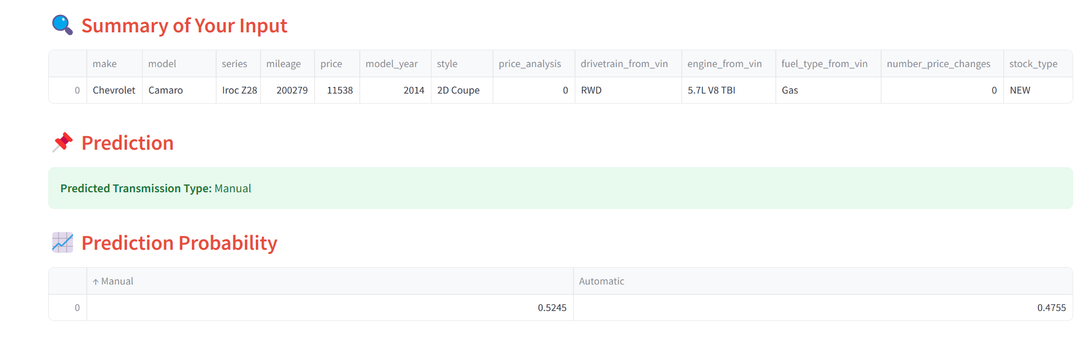
App Demo Preview

Slide 12
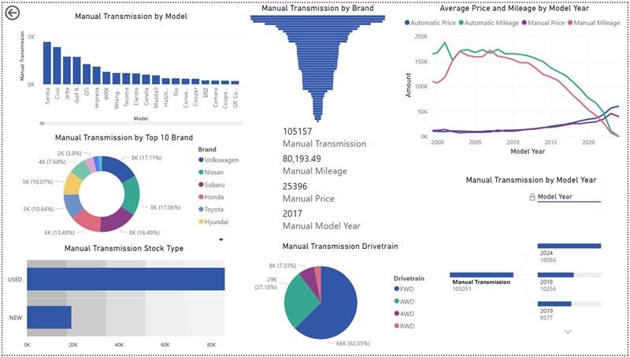
Dashboard after balancing dataset

Slide 13
Marketing & Business Strategy
Supports Go Auto in targeting listings based on transmission type
Design better pricing strategies using transmission insights
Understand customer trends by fuel type, style, and transmission.
Reduce manual labor by automating inventory labeling.

Slide 14
Challenges Faced
Difficulty with environment setup and module installation(joblib, scikit-learn, streamlit)
Encoding mismatch between training & prediction.
Fixed feature mismatch by using model.feature_names_in_.
Streamlit app styling and restructuring tabs for improved user experience(UX).

Slide 15

Conclusion
Built a reliable machine learning model to predict transmission type with high accuracy.
1
Developed a Streamlit app for real-time predictions.
2
Linked insights to Power BI dashboard for business decision-making.
3
Helped Go Auto improve inventory classification and marketing strategies.
4

Slide 16


