Slide 1
Building Construction Practice
Section A

Slide 2
Structures
In civil engineering, "structures" refer to engineered systems designed to support loads, resist forces, and provide stability. They include buildings, bridges, dams, towers, tunnels, and other infrastructure components, constructed using materials like concrete, steel, timber, or composites to ensure safety, functionality, and durability.

Slide 3
Load Transfer Mechanism
Load transfer mechanism refers to the method by which forces and loads acting on a structure, such as gravity, wind, seismic, or live loads, are transmitted through its various components to the foundation and ultimately to the ground. It involves how structural elements (beams, columns, slabs, walls, etc.) distribute and resist these forces to maintain stability and ensure safety.

Slide 4
Types of structures
From the viewpoint of load transfer mechanisms, are categorized based on how they handle and transfer loads to their foundations. The main types are:
1. Load-Bearing Structures
Transfer loads directly through walls to the foundation.
Common in traditional construction, such as brick masonry buildings.
2. Framed Structures
Use a skeleton of beams, columns, and slabs to transfer loads.
Types:
Rigid Frame: Beam-column joints resist bending (e.g., steel or reinforced concrete frames).
Pin-Jointed Frame: Joints allow rotation, transfer axial forces only (e.g., trusses).

Slide 5
3. Truss Structures
Composed of interconnected triangular units.
Transfer loads through axial forces in members, efficient for large spans (e.g., roofs, bridges).
4. Shell Structures
Curved surfaces (e.g., domes, vaults) transfer loads through compression and tension.
Used in large-span enclosures.
5. Cable Structures
Use tensioned cables to support loads (e.g., suspension bridges, cable-stayed roofs).

Slide 6
6. Arch Structures
Transfer loads through compression along the curved profile, redirecting forces to supports.
7. Plate Structures
Flat, thin structures like slabs transfer loads primarily in bending.
8. Grid or Space Frame Structures
Three-dimensional frameworks transferring loads in multiple directions, offering high stiffness.

Slide 7
9. Tensile Structures
Rely on pre-stressed tensile elements (e.g., membranes or fabric) to resist loads.
10. Hybrid Structures
Combine multiple load transfer mechanisms for optimized performance (e.g., cable-supported domes, arch-supported frames).

Slide 8
Load Bearing Structure
Load-bearing structures are systems in which the walls bear the weight of the building's roof, floors, and other loads, transmitting these forces directly to the foundation. These structures rely on vertical elements (such as walls) to support and transfer loads, without the need for a separate skeletal framework of beams and columns.

Slide 9
Key Features:
Walls as Load-Carrying Elements:
Walls serve dual purposes: supporting structural loads and enclosing spaces.
Both vertical (dead and live loads) and lateral (wind and seismic) forces are carried primarily by the walls.
Material Use:
Typically constructed using materials with high compressive strength, such as:
Brick masonry
Stone masonry
Concrete blocks
Adobe or rammed earth (in traditional construction)

Slide 10
Absence of a Skeleton Framework:
Unlike framed structures, there is no independent beam-column arrangement. The walls directly transmit the loads to the foundation.
Foundation:
Usually wider and shallower than framed structures, designed to distribute the loads effectively.

Slide 11
Applications:
Residential Buildings:
Commonly used for low-rise residential buildings.
Traditional Structures:
Heritage buildings, rural construction, and areas with limited access to advanced construction technologies.
Economic Solutions:
Popular in regions with low labor and material costs for masonry.

Slide 12
Advantages:
Cost-Effective:
Fewer materials required compared to framed structures (no beams or columns).
Simple Construction:
Does not require advanced technology or skilled labor.
Thermal Insulation:
Thick walls provide better insulation against heat and cold.
Durability:
Materials like stone and masonry are long-lasting.

Slide 13
Disadvantages:
Limited Height:
Not suitable for high-rise buildings due to the excessive weight of load-bearing walls.
Less Flexible Layout:
Wall placement is fixed for structural reasons, limiting interior space design.
Large Wall Thickness:
Reduces usable floor area, especially for taller buildings.
Vulnerability to Earthquakes:
Poor performance under seismic loads due to brittleness and lack of ductility.

Slide 14
Framed Structure
A framed structure is a construction system in which a skeletal framework of beams and columns carries the building’s loads. These structural members transfer the loads to the foundation, ensuring stability, durability, and flexibility in design.

Slide 15
Key Features:
Skeletal Framework:
Composed of vertical (columns) and horizontal (beams) members interconnected to form a rigid framework.
Walls serve as partitions, not load-bearing elements.
Load Transfer Mechanism:
Loads from slabs, walls, and roofs are transferred to beams, then to columns, and finally to the foundation.

Slide 16
Material Use:
Common materials include:
Reinforced concrete (RCC)
Steel
Timber (for smaller structures)
Composite materials (e.g., steel and concrete)
Flexibility in Design:
Allows for open floor plans and larger spans, suitable for modern architectural needs.
Foundation:
Can be shallow (isolated or strip footings) or deep (pile or raft foundations) depending on soil conditions and structural loads.

Slide 17
Types of Framed Structures
Based on Material:
Reinforced Concrete Frame: Most common in buildings due to its strength and fire resistance.
Steel Frame: Used for high-rise buildings and bridges, offering high strength and flexibility.
Timber Frame: Common in residential or light commercial construction.
Composite Frame: Combines materials like steel and concrete for optimized performance.

Slide 18
Types of Structural Systems in High Rise Buildings
Moment Resisting Frames
Core and Outrigger System
Shear Wall System
Braced Frame System
Tube in Tube System
Hybrid System

Slide 19
Moment Resisting Frames
A structural system where beams and columns are rigidly connected to resist bending and shear forces.
Function: Both vertical and lateral loads are carried by the rigid frame.
Applications: Primarily used in mid-rise buildings but can also be employed in high-rises with careful design.
Advantages: Provides flexibility, good for open floor plans.
Disadvantages: Less efficient in resisting lateral forces compared to other systems like shear walls or tube systems.

Slide 20
Core and Outrigger System
Central Core System: A solid vertical central core (typically made of reinforced concrete) acts as the main structural component, providing stability and resistance to lateral loads.
Core with Outriggers: A central core reinforced with horizontal outriggers to improve stability, especially in very tall buildings.

Slide 21
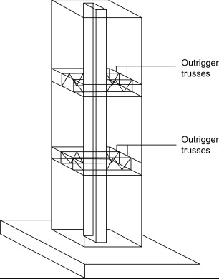
Core and Outrigger System

Slide 22
Shear Wall System
Description: Reinforced concrete or masonry walls are distributed throughout the building to resist lateral forces such as wind or earthquakes.
Function: The walls transfer lateral forces to the foundation, while the floor system distributes vertical loads.
Applications: Common in buildings requiring high lateral stiffness, especially in seismic-prone areas.
Advantages: Very effective for resisting lateral loads.
Disadvantages: Can limit flexibility of interior layouts; may require large, thick walls in lower levels.

Slide 23
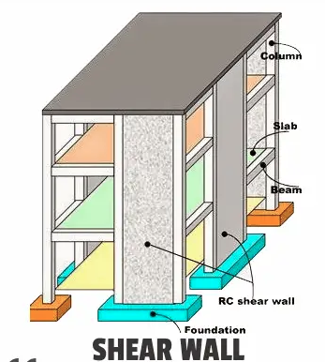

Slide 24
Braced Frame System
A system using diagonal braces (either in X or V patterns) to resist lateral loads.
Function: The braces act like trusses, transferring lateral loads to the foundation.
Applications: Common in steel-frame buildings where lateral load resistance is needed.
Advantages: Provides a lightweight and effective solution for lateral stability.
Disadvantages: Can obstruct interior floor plans; may require additional structural elements to integrate with the overall design.

Slide 25
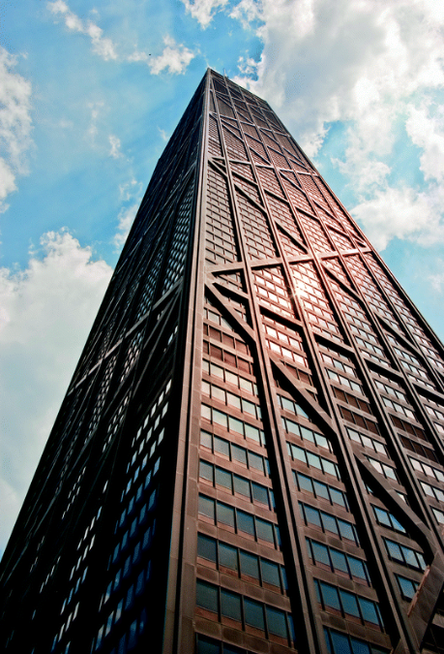
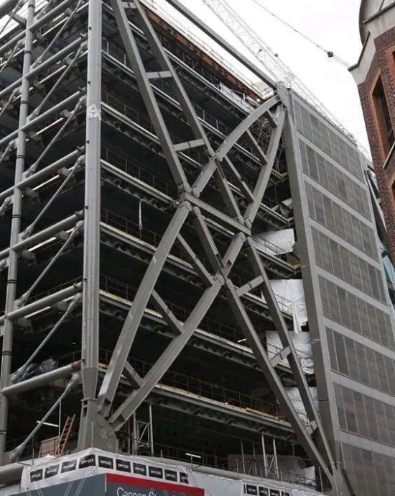
Braced Frame System

Slide 26
Tube System
Framed Tube System: A tube-like framework where the exterior columns form a "tube" to resist lateral forces. Example: John Hancock Center.
Bundled Tube System: Multiple tube-like structures bundled together, as in the Willis Tower (formerly Sears Tower), to create a rigid framework for very tall buildings.
Tube in Tube System: An outer tube that resists lateral forces, combined with a central core that supports vertical loads.

Slide 27
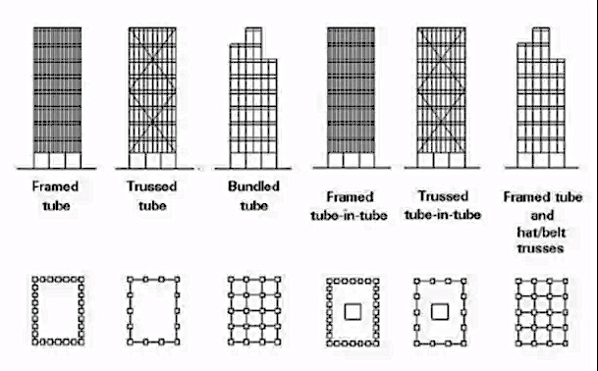
Tube Systems

Slide 28
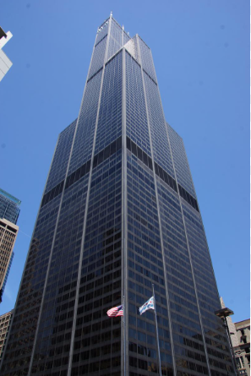
Bundled Tube System:

Slide 29
Hybrid System
Dual Systems: A combination of moment-resisting frames and shear walls or braced frames to provide enhanced resistance to both vertical and lateral forces.
Combination of Core and Braced Frames: A hybrid of core systems and external braced frames for added stability and flexibility in tall buildings.

