Slide 1
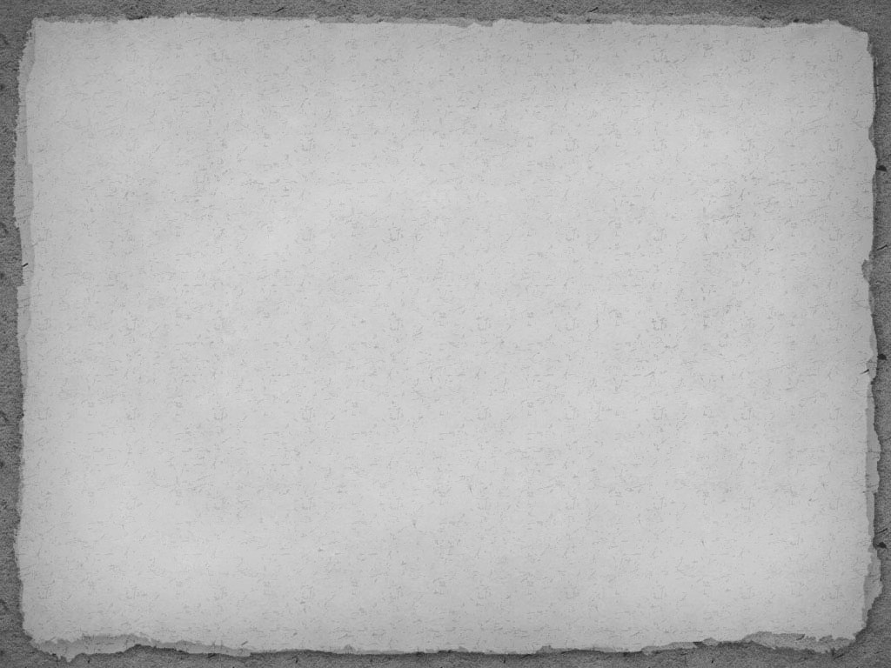
GNDEC SOA, GILL PARK
LUDHIANA
TOPIC : TILE FLOORING S
SUBMITED TO:
SUBMITED BY:
MOHD. AAMIR
ROLL. NO. :2299012

Slide 2
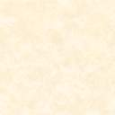
TILES
Tiles are often used to form wall or floor coverings, and can range from simple square complex mosaic.
Tiles are most often made from ceramic with a hard glaze finish, but other materials are also commonly used, such as glass,
A tile is a thin object usually square or rectangular in shape. Tile is a manufactured piece of hard wearing material such as ceramic, stone, metal, baked clay or even glass, generally used for covering roofs, floors, walls, or other objects such as tabletops.

Slide 3
FLOORING
Floor covering is a term to generally describe any finish material applied over a floor structure to provide a walking surface.
Flooring is the general term for a permanent covering of a floor, or for the work of installing such a floor covering both terms are used interchangeably but floor covering refers more to loose-laid materials.
Material is classified as floor covering include carpet, rugs and resilient flooring such as linoleum or vinyl flooring Materials commonly called flooring include wood flooring,tile,stone,

Slide 4
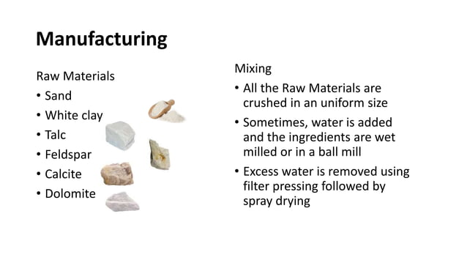
Manufacturing Of Tile

Slide 5
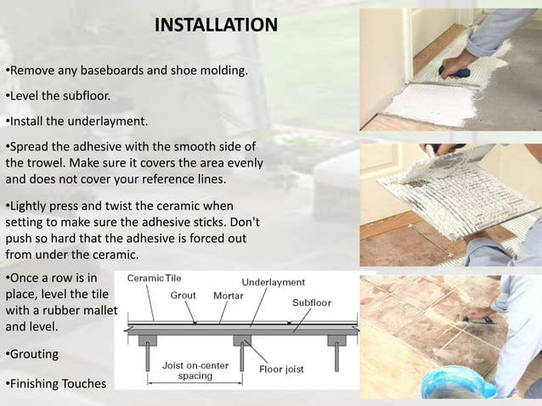

Slide 6
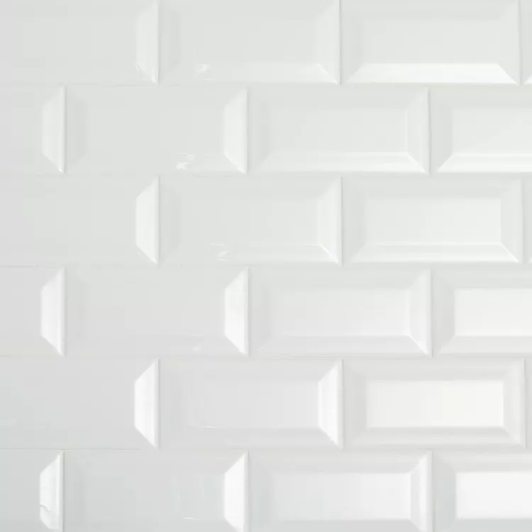
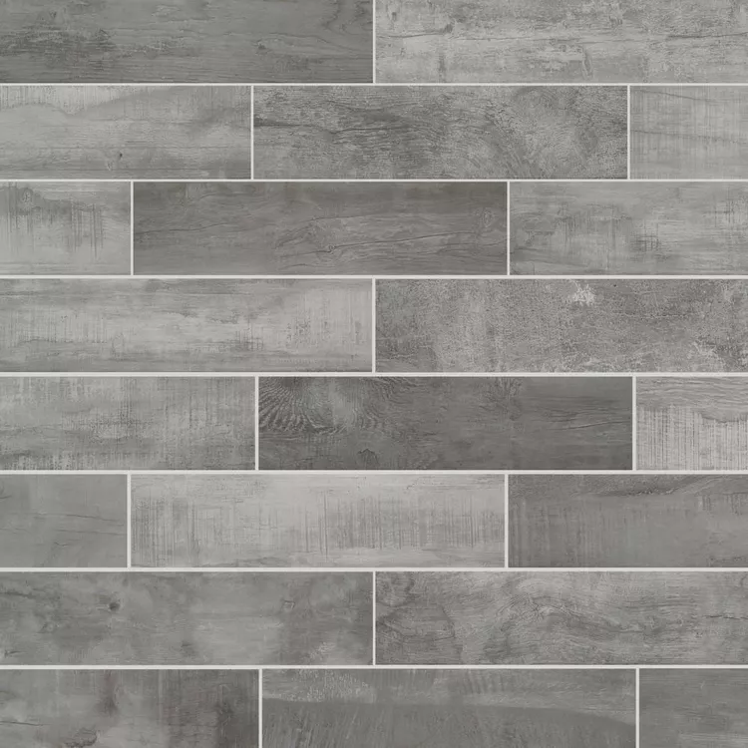
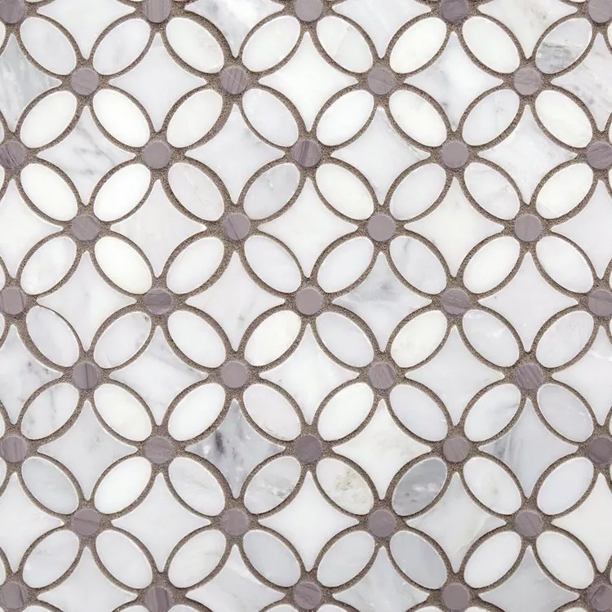
TYPES OF FLOORING TILES
CERAMIC
PORCELAIN
MOSAIC

Slide 7
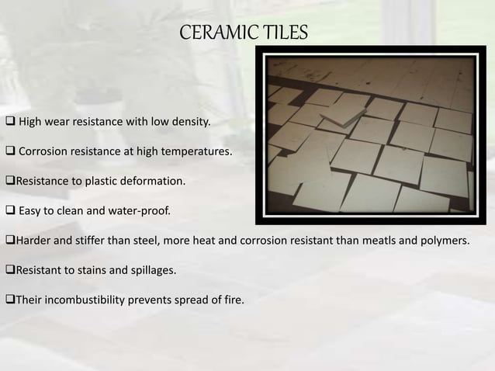

Slide 8
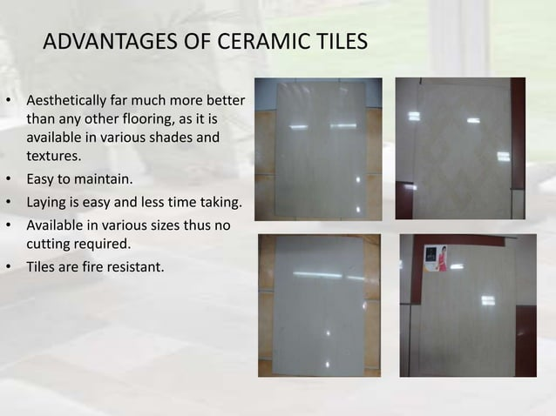

Slide 9
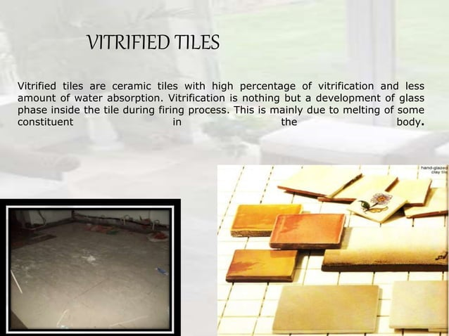

Slide 10
