Slide 1
Foundations
Building Construction Practices

Slide 2
Foundations
A foundation is the lowest structural part of a building that transfers the entire load safely to the ground. It provides stability, prevents settlement, and protects against soil movement.

Slide 3
Functions of a Foundation
Distributes load evenly to prevent excessive settlement.
Provides stability against wind, earthquake, and soil movement.
Prevents lateral movement due to soil pressure.
Protects against moisture and dampness from the ground.
Increases building lifespan by preventing structural failure.
Choosing the right foundation type depends on soil conditions, building load, and environmental factors.

Slide 4
Types of Foundations
Shallow Foundations (Depth ≤ 3m)
Deep Foundations (Depth > 3m)

Slide 5
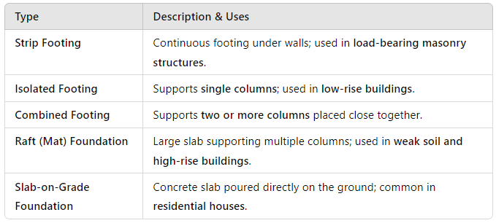
Shallow Foundation

Slide 6
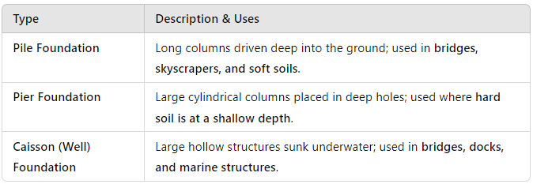
Deep Foundation

Slide 7
Selection Criteria for Foundations
Soil Bearing Capacity (SBC) – Stronger soils allow shallow foundations, while weaker soils require deep foundations.
Load of the Structure – Heavier buildings need deep foundations for stability.
Water Table Level – High water table conditions require waterproofing measures or special foundations.
Environmental Factors – Flood-prone or earthquake-prone areas need reinforced or flexible foundations.

Slide 8
Centering and Shuttering
Centering and shuttering are temporary structures used in reinforced concrete construction to support fresh concrete until it gains sufficient strength. These structures ensure the correct shape, alignment, and dimensions of concrete elements such as slabs, beams, columns, and foundations.

Slide 9
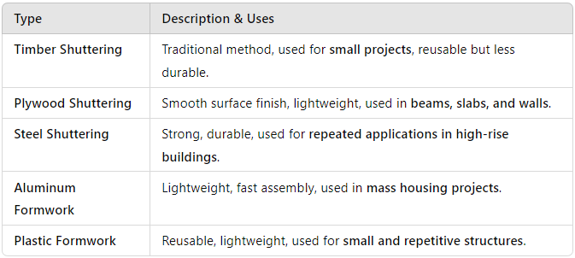
Shuttering (Formwork)
Shuttering is the mold or form used to shape concrete until it hardens. It supports the vertical components of a structure.
Types of Shuttering:

Slide 10
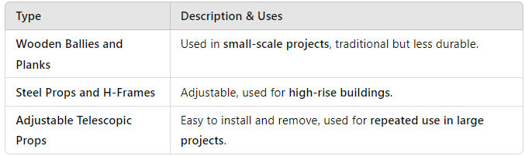
Centering
Centering refers to the temporary support framework for horizontal structural elements like slabs and beams.
Types of Centering Supports:

Slide 11
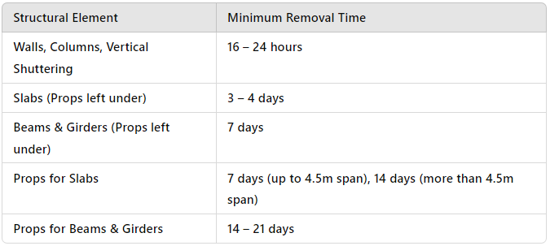
Stripping Time for Shuttering and Centering (As per IS 456: 2000)

Slide 12
Importance of Centering and Shuttering
Ensures proper shape and dimensions of concrete elements.
Provides temporary support for the fresh concrete load.
Prevents honeycombing, cracks, and deformation in concrete.
Increases construction speed and efficiency.
Ensures safety of workers and structure during construction.

Slide 13
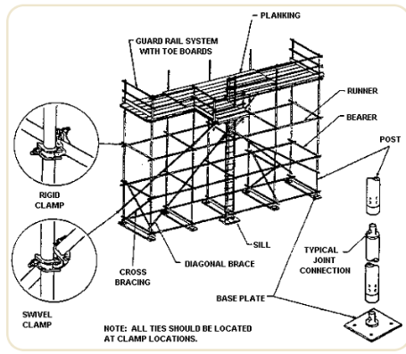
Scaffolding

Slide 14
Scaffolding is a temporary framework used to support workers, materials, and tools during construction, maintenance, or repair of buildings and structures. It provides safety, accessibility, and stability for working at heights.

Slide 15
Components of Scaffolding
Standards – Vertical supports that transfer the load to the ground.
Ledgers – Horizontal members connecting the standards.
Braces – Diagonal supports for stability.
Putlogs – Horizontal supports connecting the scaffold to the building.
Planks (Decking) – Walking surface for workers.
Toe Boards – Protective barriers to prevent materials from falling.

Slide 16
Types of Scaffolding
Brick Layer’s Scaffolding
Mason’s Scaffolding
Tubular Scaffolding
Ladder Scaffolding
Needle or Cantilever Scaffolding
Suspended Scaffolding

Slide 17
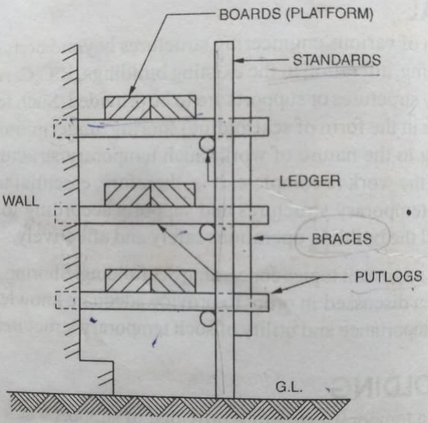
Brick Layer’s Scaffolding
Simple structure with single row of standards, used for brick masonry. Also known as Single Scaffolding. Most of the members of this type of scaffolding are made of bamboos.

Slide 18
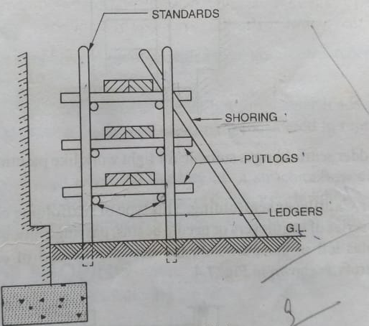
Mason’s Scaffolding
Mason’s scaffolding, also known as double scaffolding, is a type of scaffolding used primarily in stone masonry work where fixing putlogs into the wall is difficult or impractical. Unlike single scaffolding, which has only one row of standards, double scaffolding consists of two parallel rows of vertical supports (standards) for additional stability.

Slide 19
Features of Mason’s Scaffolding
Two rows of vertical standards – Provides extra strength and stability.
Putlogs are supported by ledgers, rather than being inserted into the wall.
Used for stone masonry where wall fixings are not feasible.
Provides better load-bearing capacity than single scaffolding.
Can be adjusted in height based on construction requirements.

Slide 20
Advantages of Mason’s Scaffolding
More stable and stronger than single scaffolding.
Suitable for heavy masonry work like stone construction.
Safer for workers due to double support system.
Provides better load distribution, reducing the risk of collapse.
Disadvantages of Mason’s Scaffolding
More material required (double standards increase costs).
Takes more time to erect compared to single scaffolding.
Less flexible in congested construction sites.

Slide 21
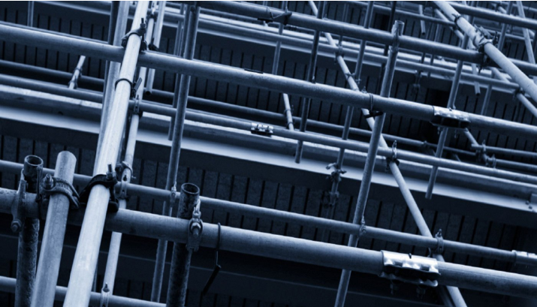
Tubular Scaffolding
Tubular scaffolding is a type of steel scaffolding made using hollow steel tubes that are connected with clamps and couplers. It is widely used for high-rise buildings, bridges, and heavy construction projects due to its strength, durability, and ease of assembly.

Slide 22
Features of Tubular Scaffolding
Made of steel tubes instead of wooden poles. Connected using couplers and fittings, making it adjustable and flexible.
High strength and durability compared to traditional scaffolding.
Resistant to fire, weather, and decay, making it suitable for long-term use.
Easy to assemble and dismantle, reducing labor costs.

Slide 23
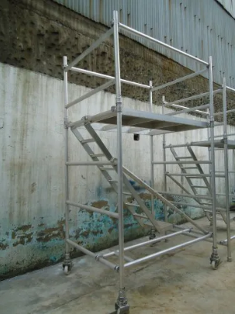
Ladder Scaffolding
Ladder scaffolding is a type of scaffolding that consists of ladders used as vertical supports (standards), with horizontal planks or platforms fixed between them. It is commonly used for light construction, maintenance, and repair work where frequent movement is needed.

Slide 24
Needle or Cantilever Scaffolding
Cantilever scaffolding, also known as needle scaffolding, is a type of scaffolding where the working platform is supported by cantilevered beams (needles) projecting out from a building. It is used when ground support is not feasible due to obstacles like streets, rivers, or when scaffolding cannot rest on the ground.

Slide 25
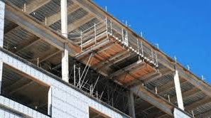
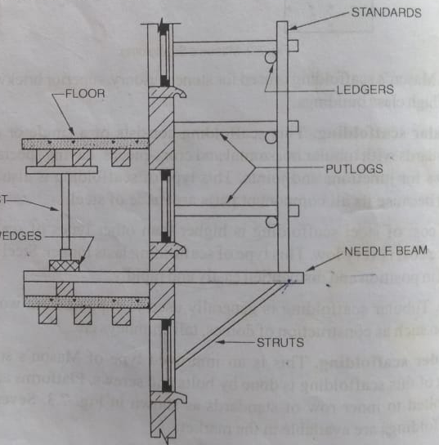

Slide 26
Suspended Scaffolding
Suspended scaffolding is a type of scaffolding in which the working platform is hung from the top of a building or structure using ropes, chains, or wires. It is primarily used for high-rise building maintenance, painting, and window cleaning.

