Slide 1
Project Fletcher
Sukeerthi Varadarajan

Slide 2
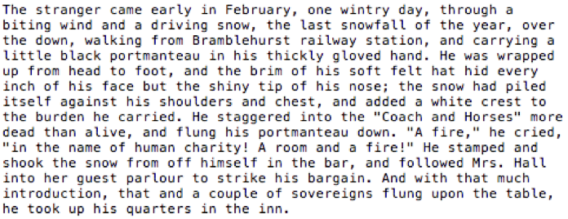
Who wrote this?
To identify the author of an excerpt by training on the author’s corpus

Slide 3

Overview
Project Gutenberg
3036 novels
142 authors
Novels broken down to paragraphs
Final dataset-
~3.5 million paragraphs

Slide 4
Methodology
TF-IDF Vectorizer
Multi-class Classification
SGD Classifier
Hinge loss function (SVM)
Cross Validation- Stratified Kfold
Accuracy – 61.6%

Slide 5
Predictions
"Home!" exclaimed Mrs. Dallam. "What can you be thinking of, my dear? Nobody ever goes home after the Banbury match. The fun has just begun, and we're all to stay here for dinner and dance afterwards. And Trixy Brent promised me faithfully he'd' come here for tea, as soon as he dressed."
Actual- Winston Churchill
Prediction- Winston Churchill
The Psychologist recovered from his stupor, and suddenly looked under the table. At that the Time Traveller laughed cheerfully. 'Well?' he said, with a reminiscence of the Psychologist. Then, getting up, he went to the tobacco jar on the mantel, and with his back to us began to fill his pipe.
Actual- H.G. Wells
Prediction- William Dean Howells

Slide 6
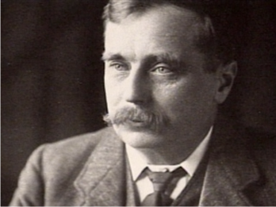
Who wrote this?
H.G. Wells
The Invisible Man

Slide 7
Next Steps
Effect of lemmatization on predictions
More features
Scale up
Excerpts to novels
Cluster documents based on type
Poetry and prose
Non-fiction and fiction

Slide 8

Thank You!
Questions?

