Slide 1
Email List Analysis
Sukeerthi Varadarajan

Slide 2
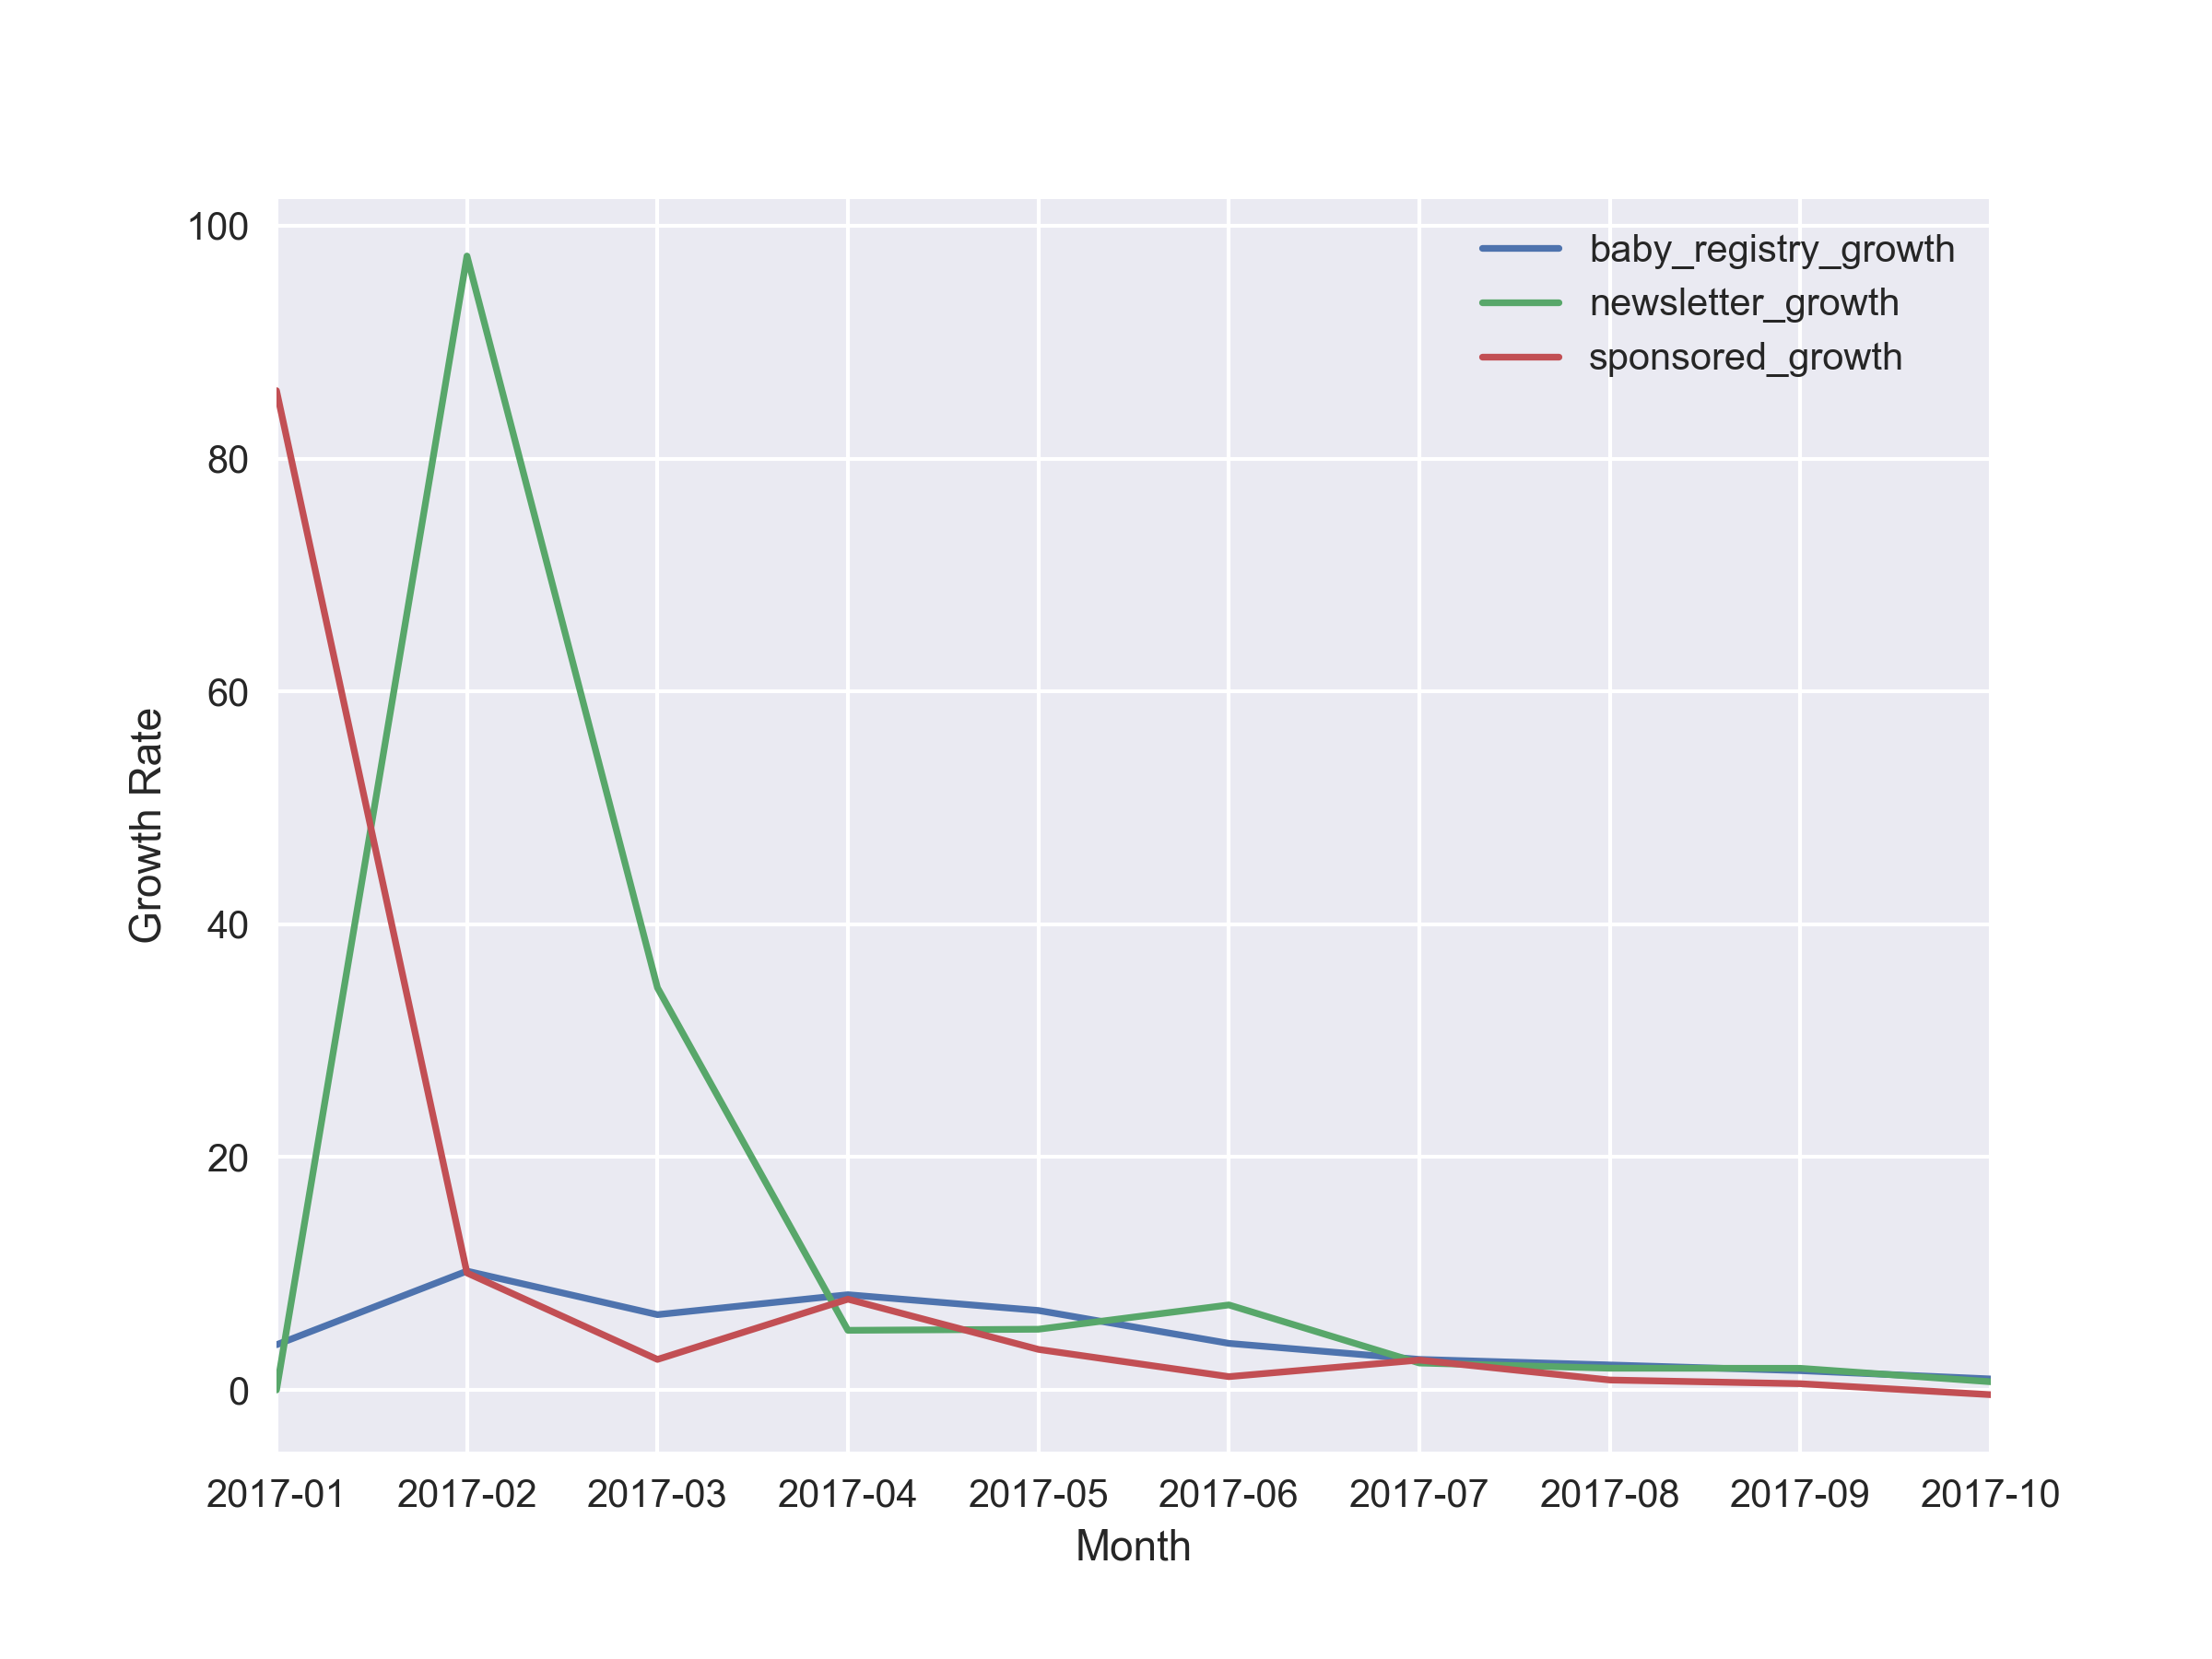
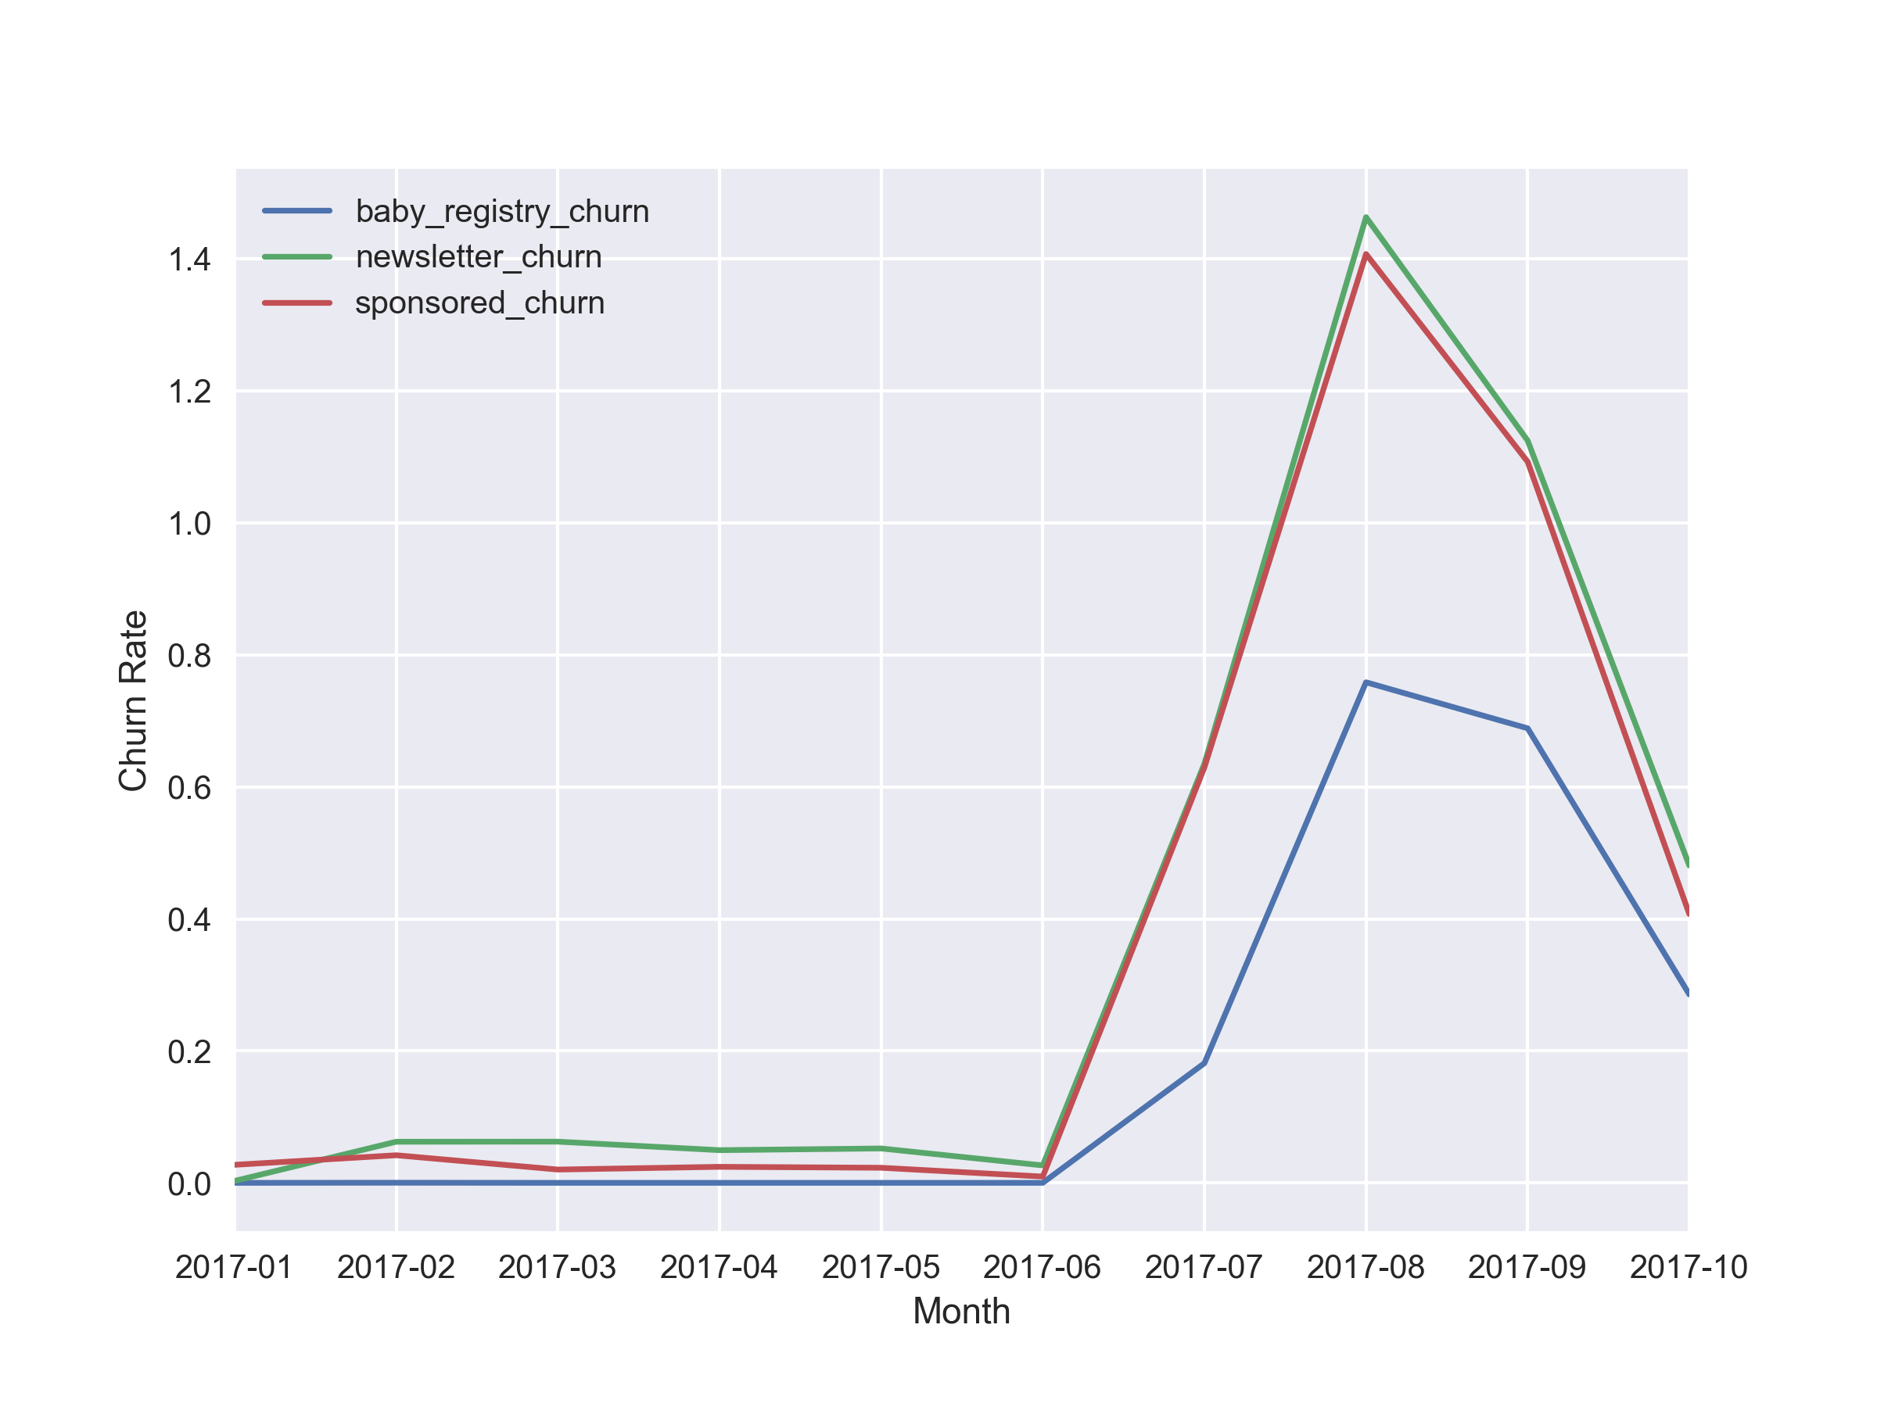
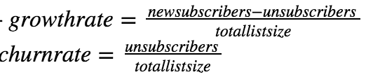
Growth and Churn
Growth rate is declining (June- Oct 2017)
Churn rate is high from Jul- Oct 2017
Highest churn is in Aug 2017 for all lists
Notes:
Point out system logging- newsletter and sponsored

Slide 3
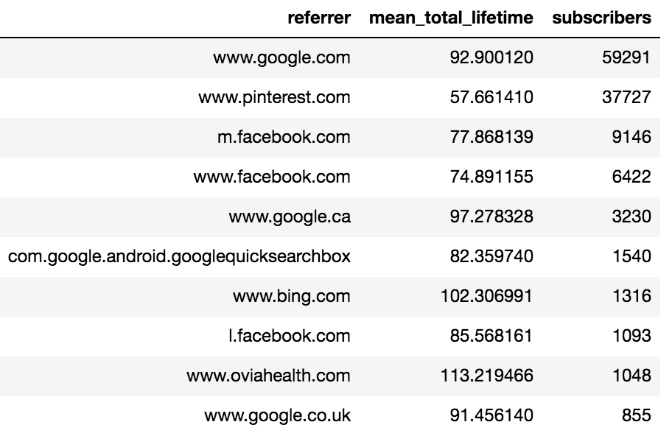
Average Lifetime
For each email cohort
Overall average lifetime- 208 days
The average lifetime varies with referrers
Users from referrers like google.com had lower than average lifetime
Baby registry | 143 days
Newsletter | 200 days
Pregnancy weekly | 90 days
Sponsored | 220 days

Slide 4
Cohorts
Best Email List-
Worst Email List-
Open rate | Pregnancy Weekly 32%
CTR | Pregnancy Weekly 7.5%
Average Lifetime | Sponsored 220 days
Open rate | Newsletter 16%
CTR | Sponsored 0.9%
Average Lifetime | Baby Registry 143 days

Slide 5
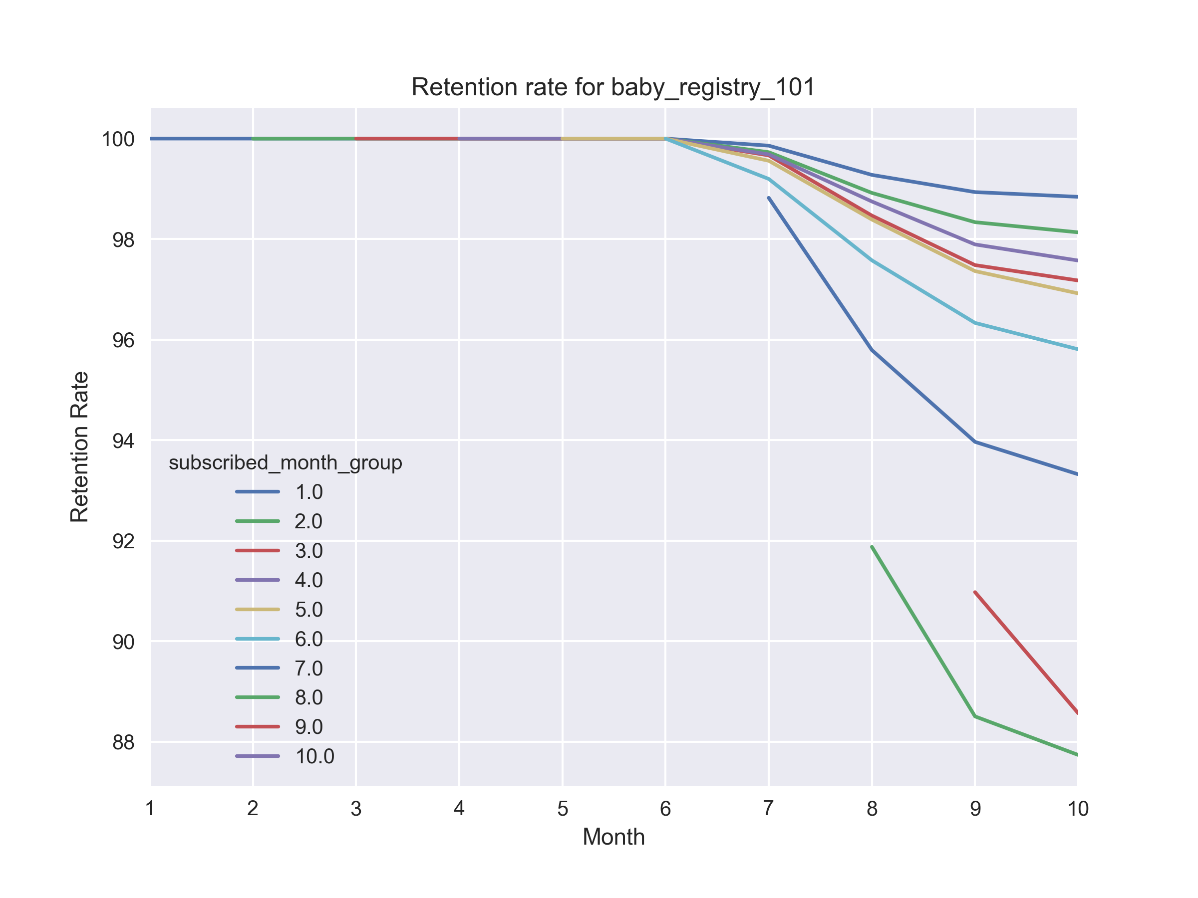
Monthly Cohort Analysis
January cohort- best retention rate
Open rate and CTR were high for the Summer months
But retention rates were low
User engagement-
CTR-
Best in- Mar (Baby Registry), Sep (Newsletter)
Open Rate-
Best in- Feb (Baby Registry), May (Newsletter)
Notes:
Cohort here means- the behaviour of users that came in during a month- till the end of time

Slide 6
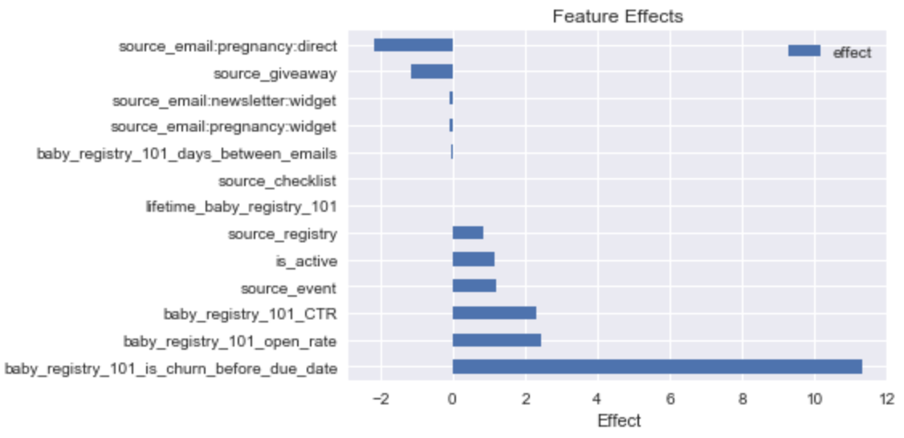
Churn Analysis
What drove users to unsubscribe?
Positive Effect on Churn-
Left before Due Date-
Open Rate
CTR
Sources- registry, checklist
Active users
Negative Effect on Churn-
Days between Emails
Baby Registry

Slide 7
Retention Strategy
Analysis of Email Content in months of high churn
Analyze months where retention rate and user engagement is high
Decrease email frequency
Push to retain subscribers 3- 5 months before due date
Engage users coming in through the checklist and registry acquisition source

