Slide 1

Sukitha Kondagurle
Web Design and Development Intern @TheSparksFoundation

Slide 2
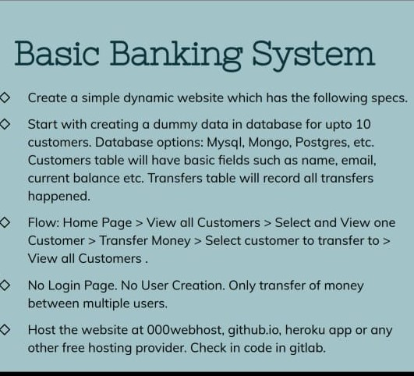
Task 1
Technologies Involved :
HTML, CSS, JavaScript [ For front end ]
PHP, MySQL [ For Back End ]
Awardspace [ For Hosting ]
Website link: BasicBanking
Development Process:
Identification
Requirements
Design
Walk Through Evaluation and Deployment.

Slide 3
Deployment process:
Registering account @awardspace.
Creating a sub-domain for website.
Creating a database as well table in it.
Modifying existing website files.
Uploading website files to awardspace environment.
Verifying website.
Thank You

