Slide 1
Capstone Project
Segmenting and Clustering
Affordable Housing Projects
in San Francisco
By Suki Zuo
2019-02-19

Slide 2
Content Page
1 - Introduction: Business Problem
2 - Data
2.1 - Source of Data
2.2 - Download and Explore Dataset
3 - Methodology
4 - Analysis
4.1 - Analyze Project
4.2 - Cluster Projects
4.3 - Examine Clusters
5 - Results and Discussion
6 - Conclusion

Slide 3
1. Introduction Business problem
Lots of people in San Francisco still can not afford their own houses.
Hundreds of affordable housing pipeline projects were published by Mayor’s Office of Housing and Community Development (MOHCD).
Since there are over hundreds of projects in San Francisco, which one will be the right one.
In this project, I will try to find a category of optimal affordable housing projects with better living facilities. This report will be targeted to individuals who want to have their own home but can not afford commodity housing in San Francisco.

Slide 4
2. Data 2.1 Source of Data
Based on the business problem, factors that will influence individuals to make the first-step decision are:
Number of existing facilities around each project
Type of existing facilities around each project
Following data sources will be needed to generate the proper decision:
Basic information(project name/location/housing tenure ) of all the affordable housing programs, which can be get from open data website of San Francisco GOV (https://data.sfgov.org/)
Number of existing facilities and their type and location in every neighborhood will be obtained using Foursquare API

Slide 5
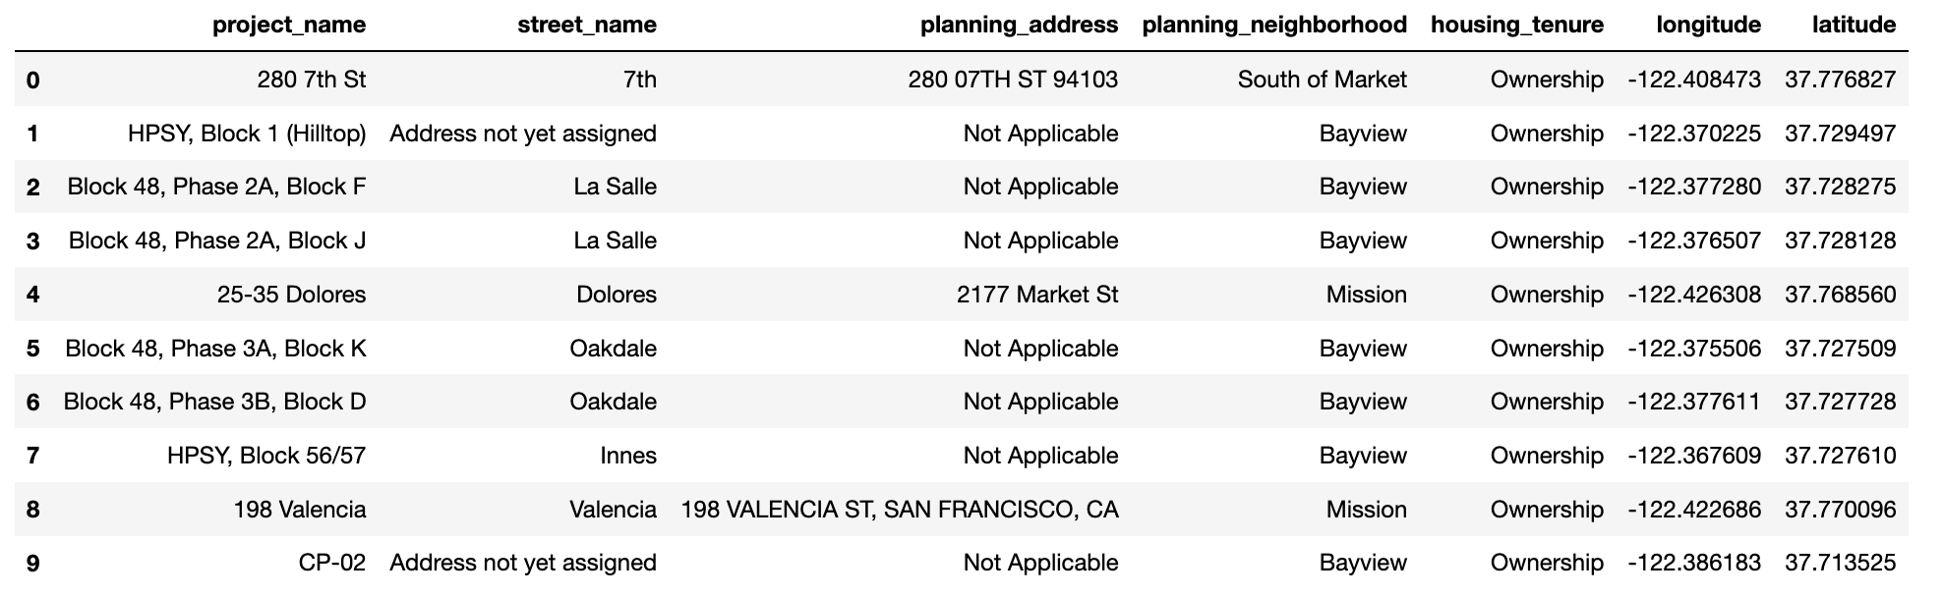
2. Data 2.2 Download and Explore Dataset
Basic information data of ‘Affordable Housing Projects’

Slide 6
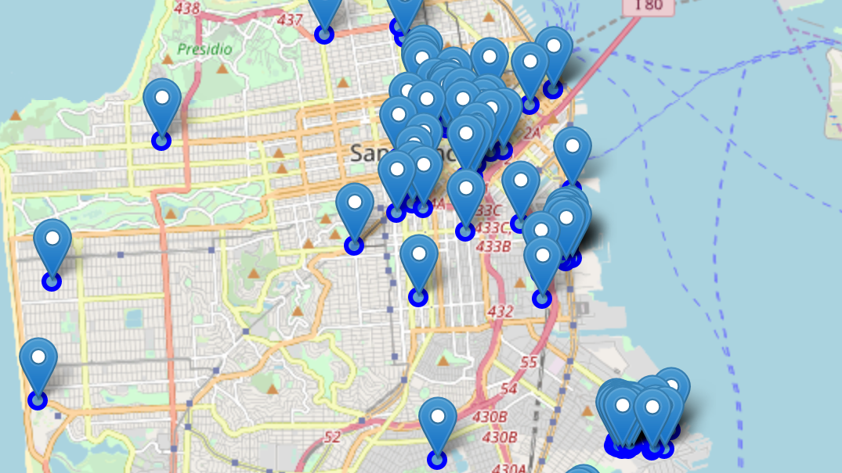
2. Data 2.2 Download and Explore Dataset
Geographic visual of ‘Affordable Housing Projects’

Slide 7
3. Methodology
The first step should be defined the business problem, we already have done that in Introduction
The second step should be downloaded the data and explore it, as we have done in Data
The Third step is to explore neighborhoods of each affordable housing projects in San Francisco with Foursquare API
The final step, cluster the all the affordable housing projects with K-means & visualize geographic details of each cluster

Slide 8
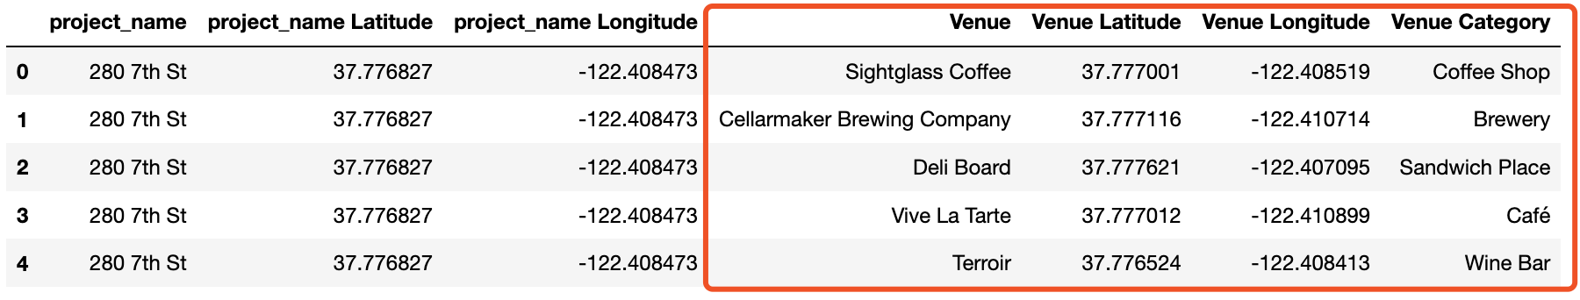
4. Analysis 4.1 Analyze Each Project
Venues around ‘Affordable Housing Projects’

Slide 9
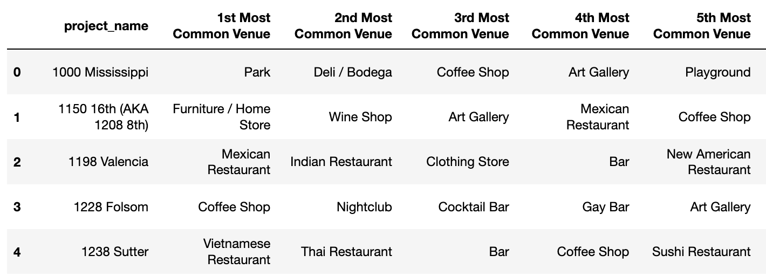
4. Analysis 4.1 Analyze Each Project
Most common venues around each project

Slide 10
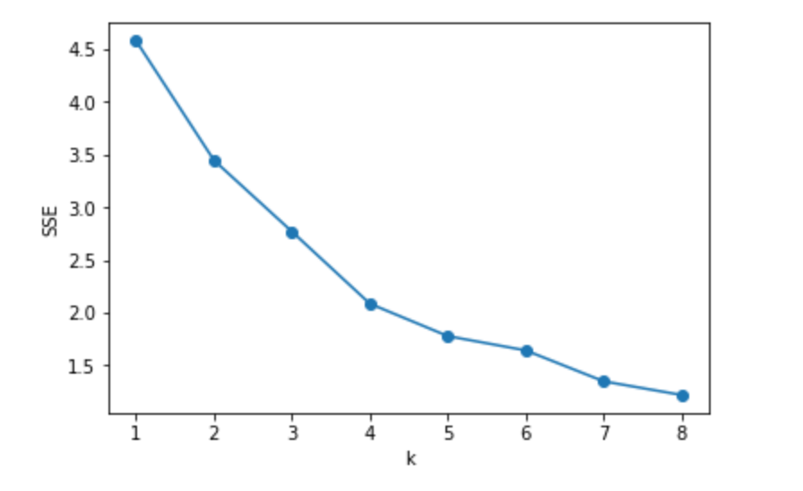
4. Analysis 4.2 Cluster Projects
Best K with
Elbow criterion

Slide 11
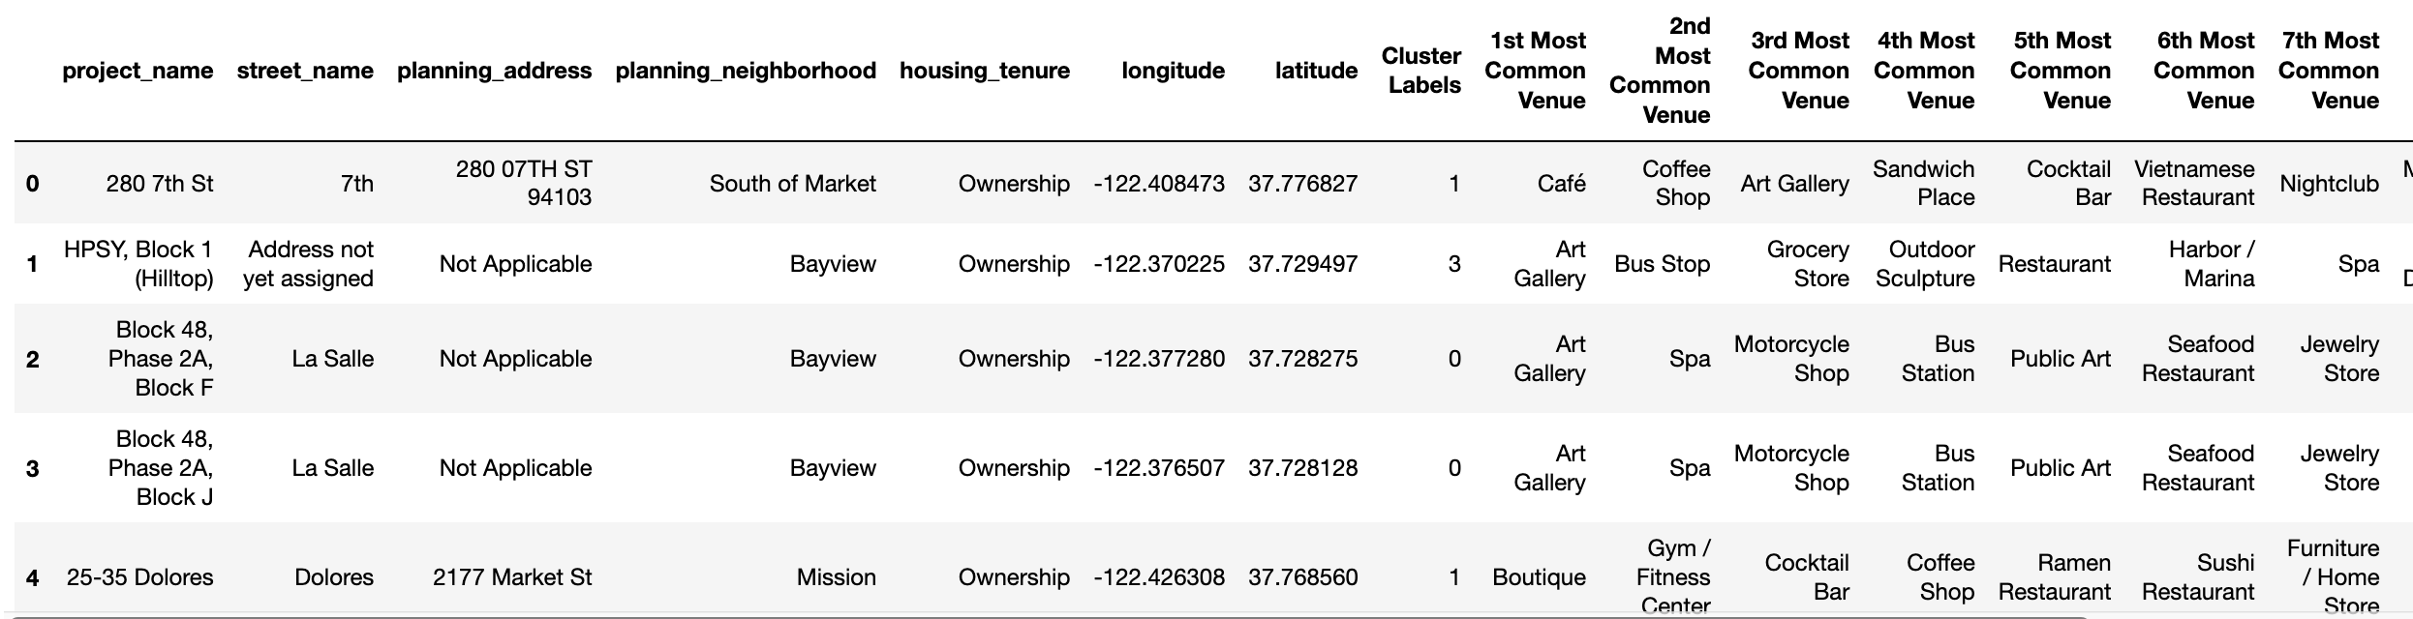
4. Analysis 4.2 Cluster Projects
Merged table with cluster labels

Slide 12
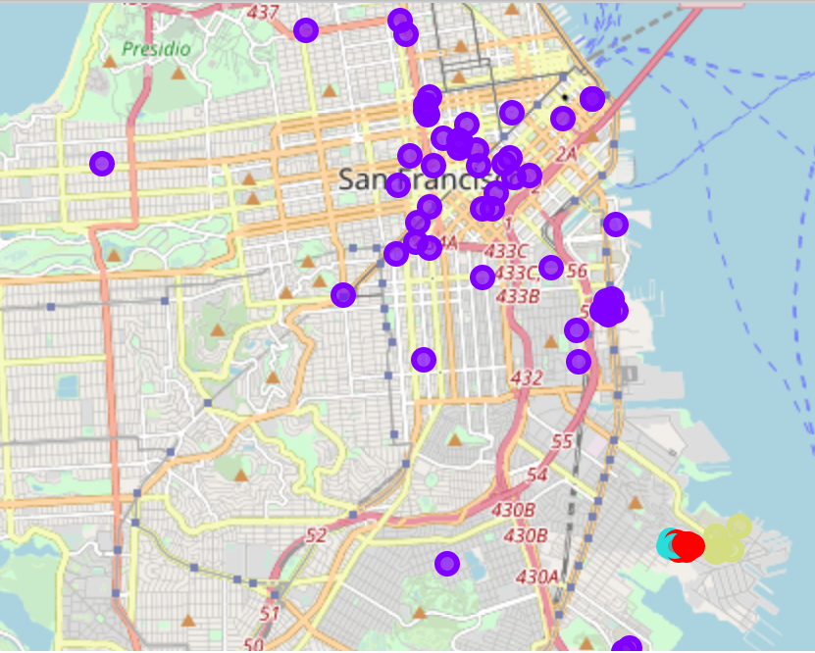
4. Analysis 4.2 Cluster Projects
Geographic details of each cluster

Slide 13
Results and Discussion
Cluster 1 contains 12 affordable housing pipeline projects, top 10 Most Common Venue mainly contains Art Gallery /Spa /Bus Station /Public Art /Jewelry Store /Flower Shop, if the individual is an artist or have great interest in art, these areas will be quite good.
Cluster 2 contains 53 affordable housing pipeline projects, this cluster contains most projects, top 10 Most Common Venue mainly contains Coffee Shop /Gym /Bar /Sandwich Place /Art Gallery /all kinds of Restaurants /Spa /Park /Theater etc.., almost cover every aspect of our daily life, obviously, it will be very convenient to live in these areas.
Cluster 3 contains 5 affordable housing pipeline projects, top 10 Most Common Venue mainly contains Spa /Factory /Food & Drink Shop /Motorcycle Shop /Brewery /Food Truck /Food Stand /Food Service, it seems like these are food producing areas, living facilities are too simple here, but it may be good for those who work here.
Cluster 4 contains 5 affordable housing pipeline projects, top 10 Most Common Venue mainly contains Art Gallery /Bus Stop /Grocery Store /Outdoor Sculpture /Restaurant /Harbor / Marina /Spa, another cluster closely relate to art, as we can see from the map, this cluster is not far from cluster 1, people who are interest in art can also take these projects into consideration.

Slide 14
Conclusion
Purpose of this project is trying to find a category of optimal affordable housing projects with better living facilities.
Target to provide first-step suggestions to individuals who want to have their own home but can not afford commodity housing in San Francisco.
The Foursquare location data was leveraged to compare each project to provide reliable suggestions for individuals who need a place to live.
With unsupervised learning K-means algorithm, all the affordable housing projects were clustered in to 4 categories, the advantages of each category were expressed to help individuals make their first-step decisions.
This Project simply processed the ownership affordable housing programs data, and cluster them into four categories based one the living facilities data, the results can only help individuals make their first-step decisions. Further analysis can be done base on these four clusters, which can help provide more detail information to clarify the advantages of each category.

