Slide 1

An Analysis of Thermal Waves
Outline:
Introduction to Investigation
Fourier Theory
Experimental setup
plane slab approximation – fourier analysis
cylindrical model – Bessel analysis

Slide 2
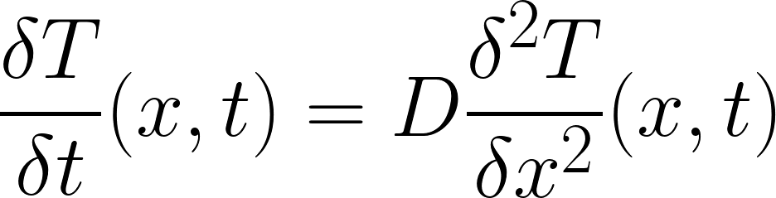
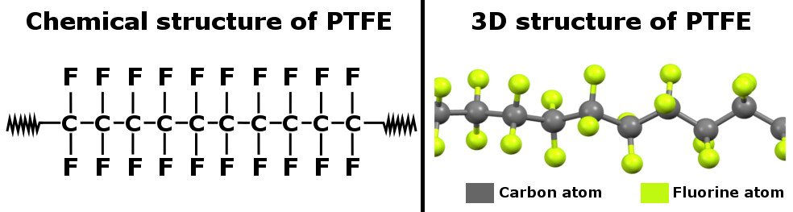
1. WAVE PROPAGATION THROUGH PTFE
Movement of energy through a solid by thermal conduction is modelled in one direction by the heat equation [1]:
Comparison of an input temperature function and output temperature function, particularly attenuation of phase and amplitude, indicates rate at which thermal energy propagates through material (characterized quantitatively by thermal diffusivity, expected value 0.124 mm/s [2]) and how much energy is absorbed by bonds in the solid
This is investigated for polytetrafluoroethylene (PTFE) i.e. Teflon
Highly ordered macroscopic structure gives PTFE its low thermal conductivity, therefore low thermal diffusivity - creates barriers to heat flow and reduces ability of phonons (quantized vibrational energy) to travel through the material [3]
Irregularity at molecular level also contributes by providing resistance against phonons trans- ferring through material, as they can get scattered or absorbed by energy barriers formed by high-strength polar C-Fl bonds [4]:

Slide 3
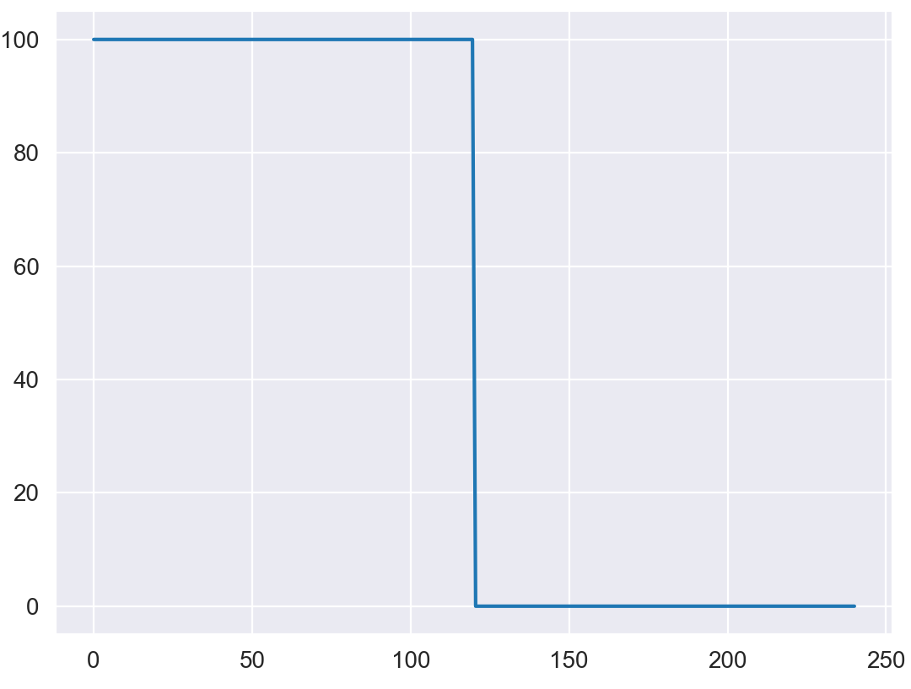
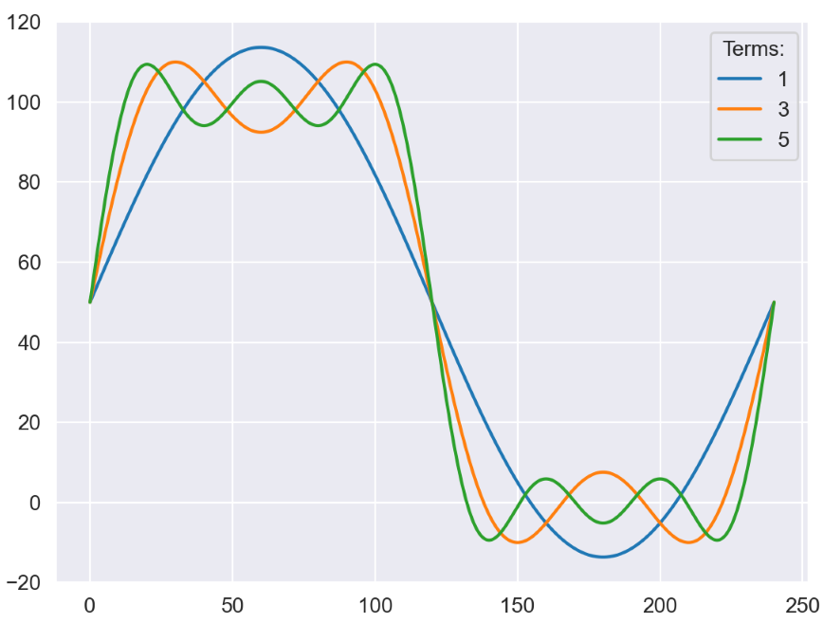
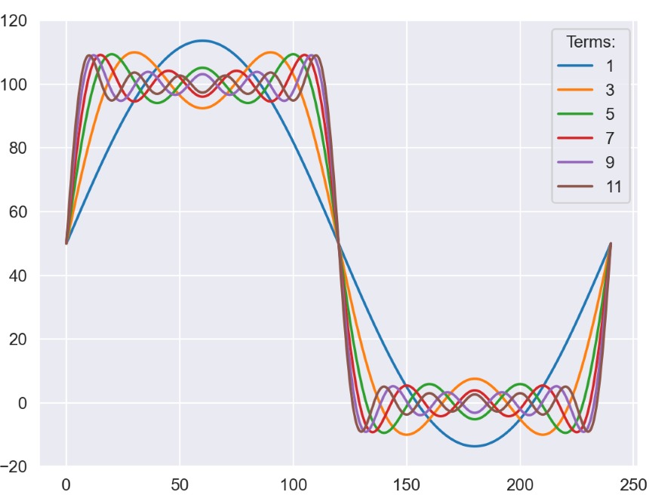
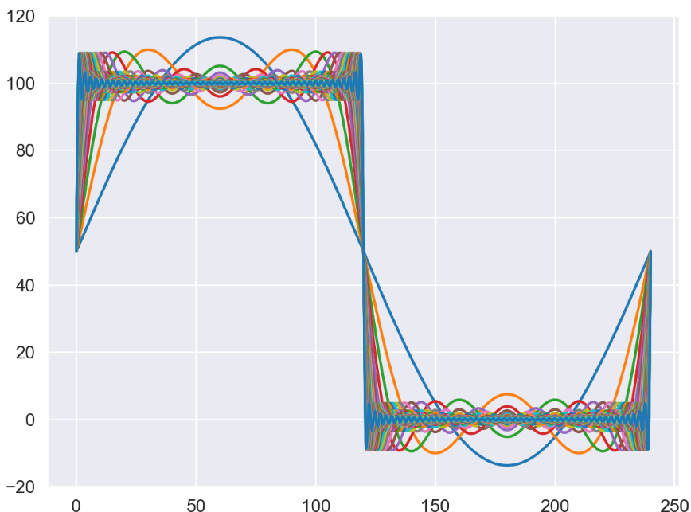
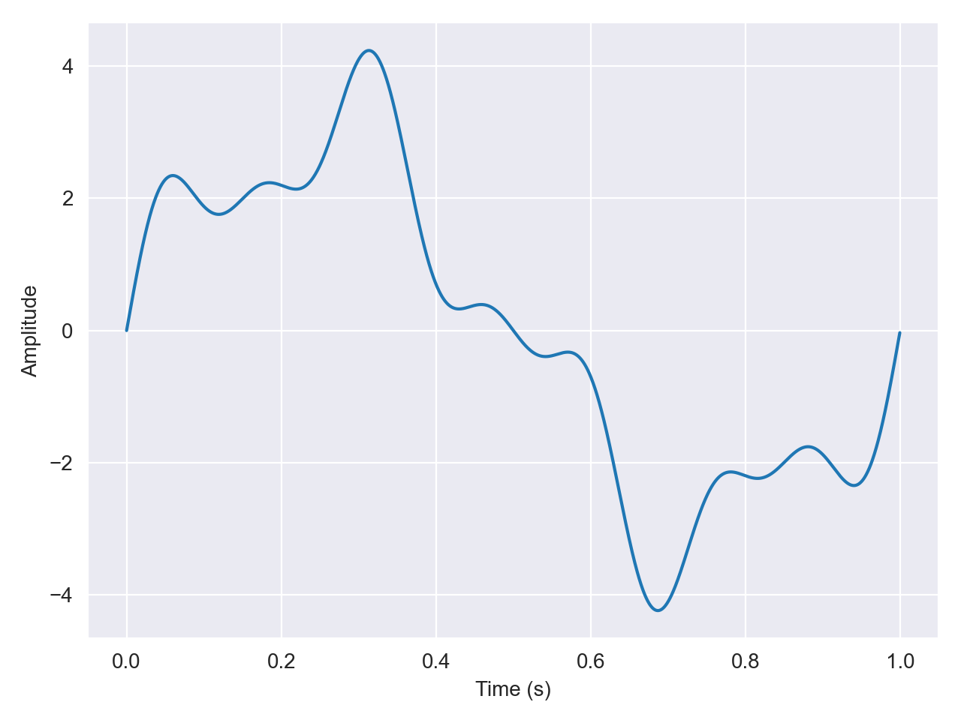
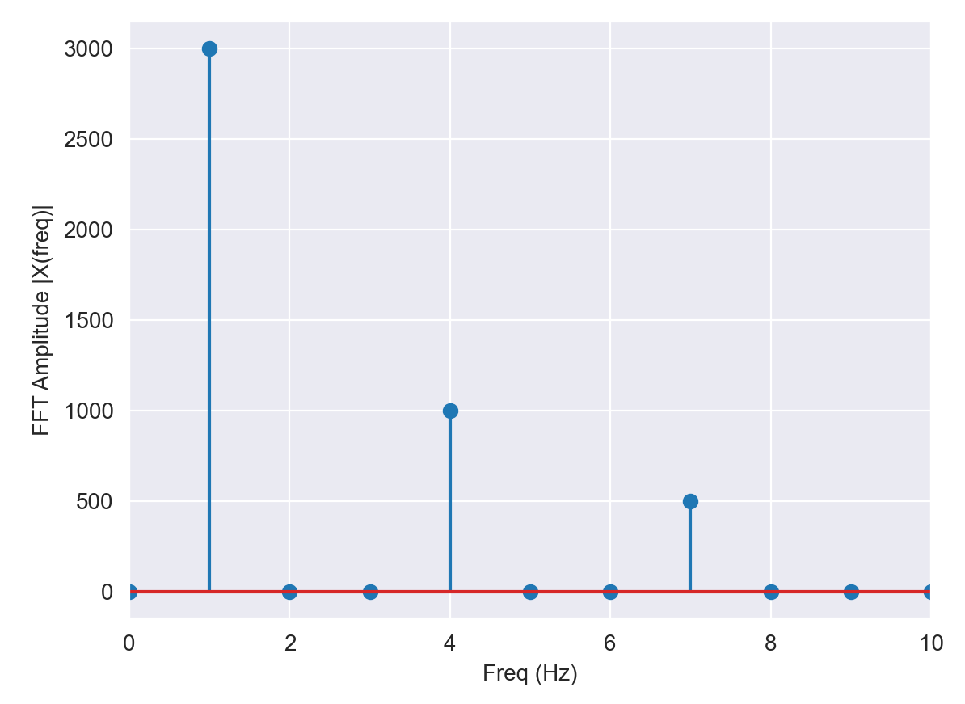
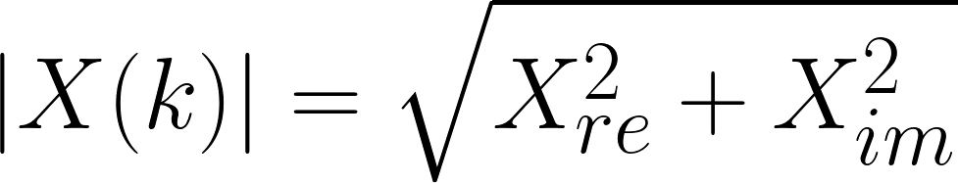
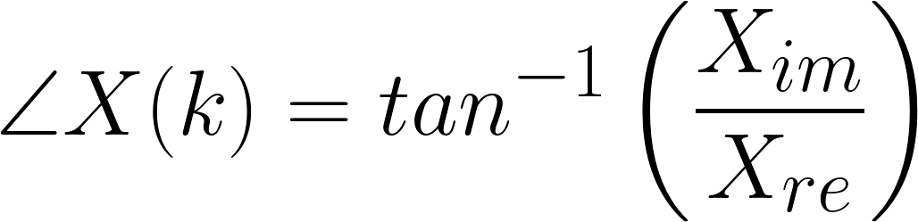
2. Fourier Theory
Amplitude-phase form of a wave can be extracted through Fourier decomposition:
- Firstly, through coefficients of a sum of trigonometric basis functions (a_{n} and b_{n})
Secondly, through Fourier transform; data is collected at equally-spaced intervals in the time domain which allows us to use FFT to obtain frequency domain of datasets
we extract complex coefficients for each complex frequency term in the sum for our function
Amplitude:
Phase:

Slide 4
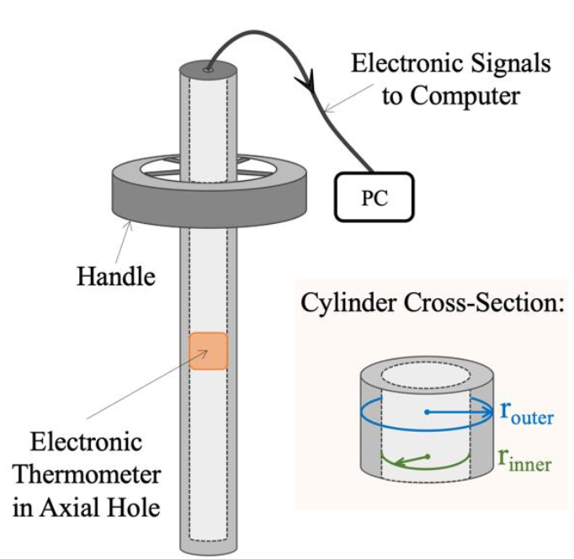
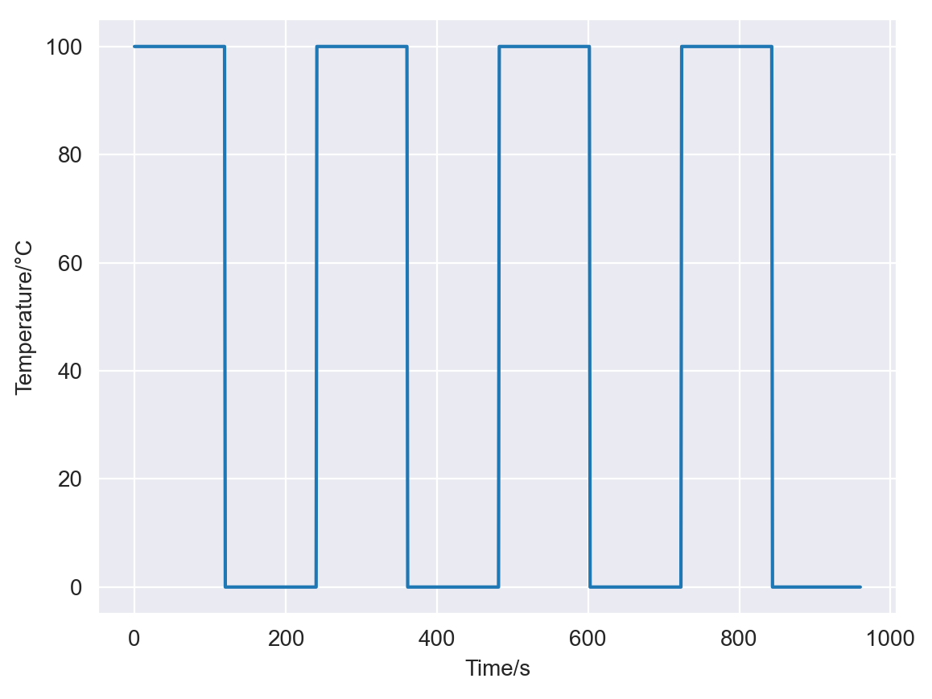
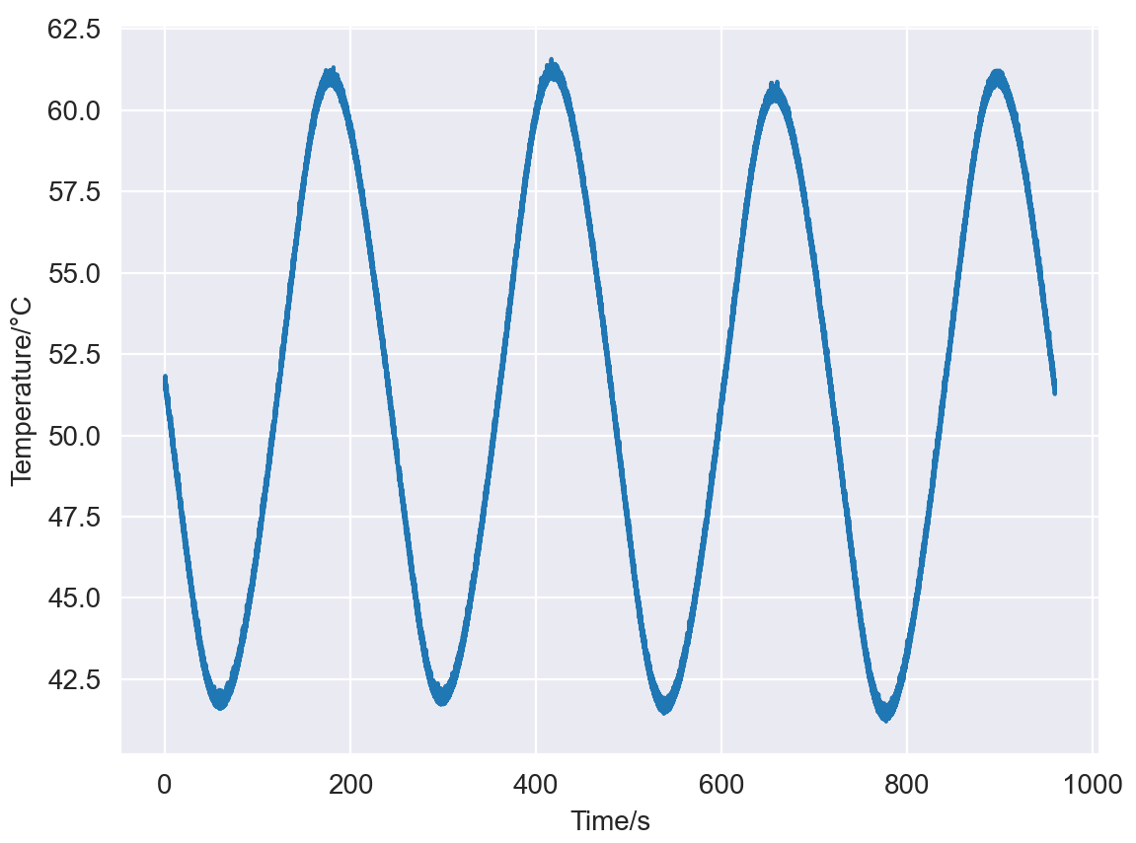
3. THE EXPERIMENTAL SETUP
Temperature wave is driven through a PTFE cylinder
Input wave created by placing apparatus in water baths alternating between 0°C and 100°C, repeated at various periods; can be modelled as square wave
Thermometer measures thermal energy received at inner tube
Time taken for thermal energy to propagate through solid, results in phase lag
and disrupts square wave shape
Example, period = 240s
Input wave (simulated)
Output wave (measured)
Apparatus used [3]

Slide 5
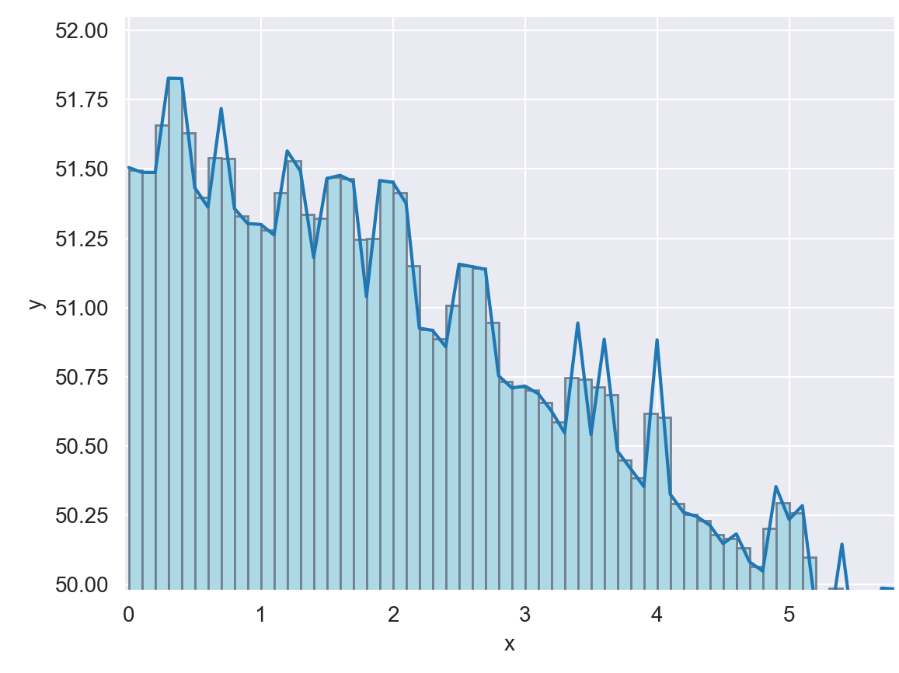
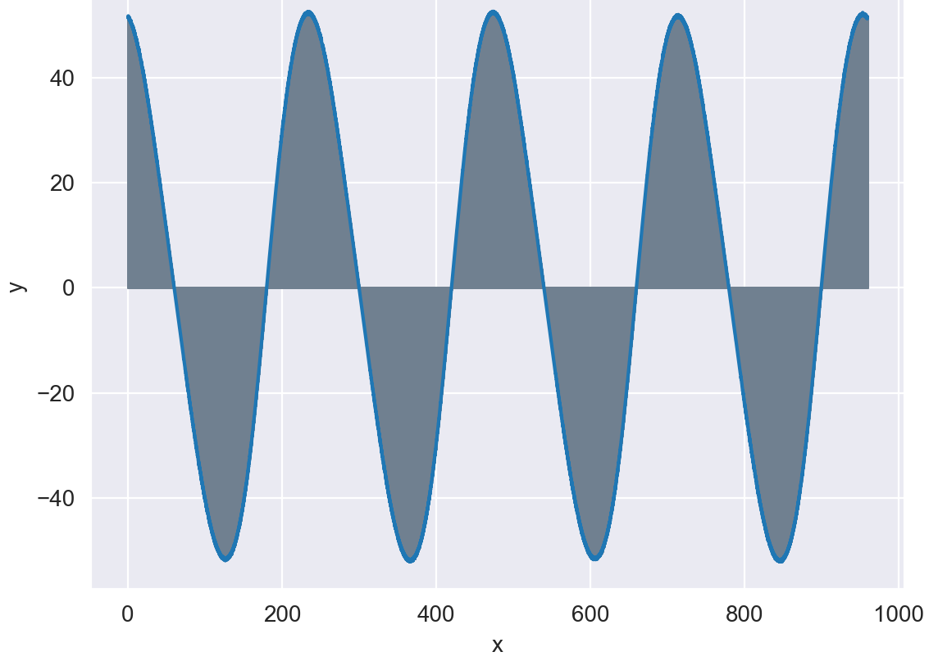
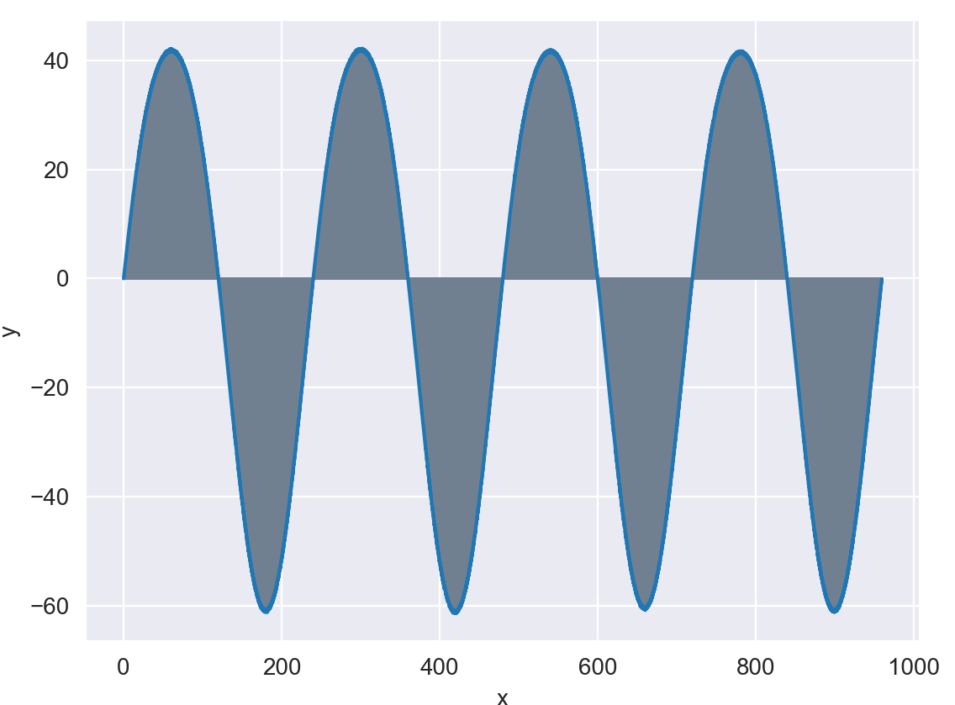
4. Plane-Slab Model (1-d approximation)
Numerical Integration
D calculated using either transmission factor Υ or phase lag ΔΦ; both are functions of a_{n} and b_{n}
Coefficients calculated with numerical integration; ”area under the curve” approach using series of rectangles, as an approximation of Reimann sum
Due to linearity of heat equation, can decompose dataset into sinusoidal harmonic modes; each mode in waveform is attenuated differently, therefore no longer superpose to a square wave
Can treat harmonics individually and compare to corresponding input square wave harmonics, to retrieve amplitude/phase values and calculate diffusivity:
Example, period = 240s
a_{n=1}
b_{n=1}
Rectangular numerical integration

Slide 6
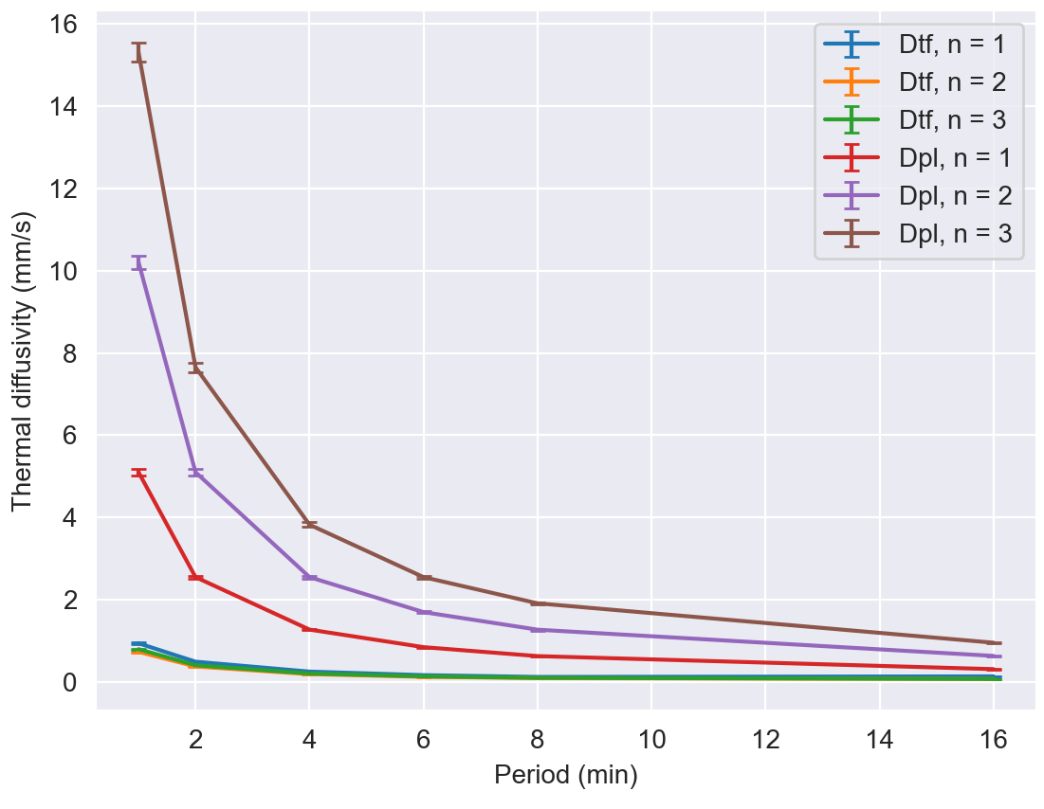
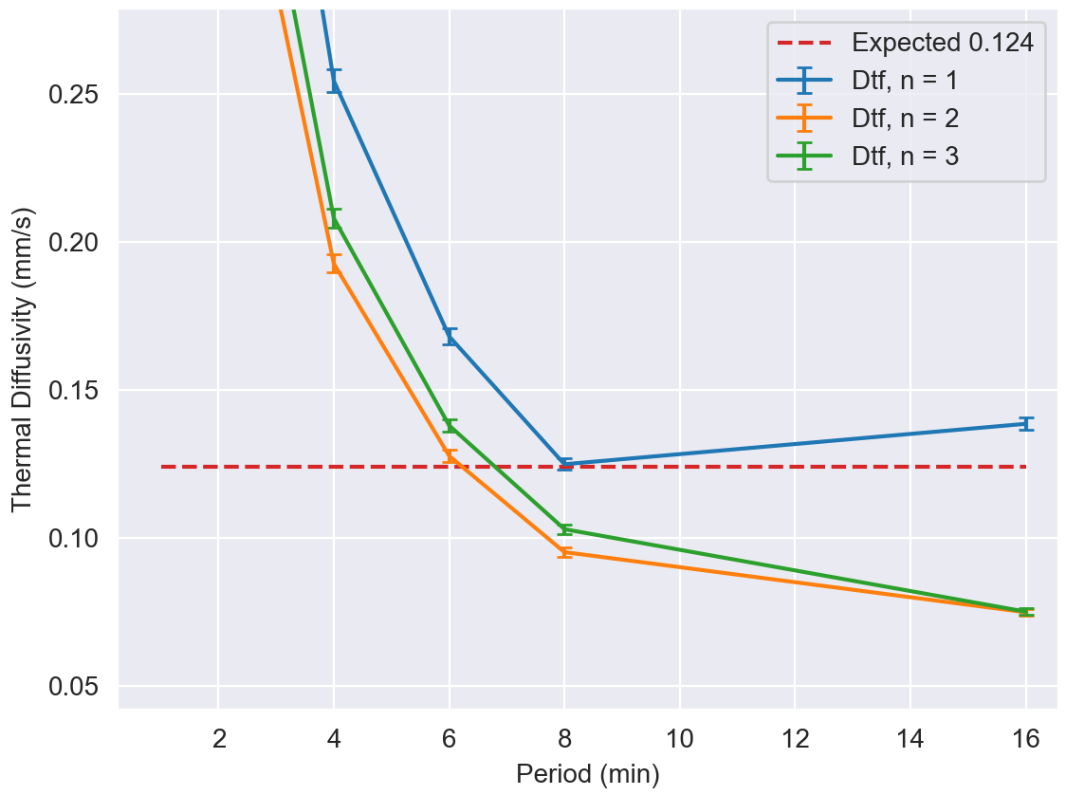
4. Plane-Slab Model (1-d approximation)
Numerical Integration
D_{TF} and D_{PL} values:
Transmission factor is the more accurate method; most likely due to non-zero nature of a_{n} and b_{n}, resulting in unreliable ratios when calculating phase
σ for amplitude visually estimated to be ~1°C, and r_{outer} measured repeatedly to give a value of 7.75 +/- 0.06mm. Uncertainties propagated in quadrature through partial derivatives. Overlap with expected value occurs only at D_{TF} for n = 1; a more accurate method required?
Values converge to the order of magnitude of expected value of 0.124 as period increases – more time allowed for thermal equilibrium to be reached in each harmonic, i.e. larger period, is most likely to be a factor for more accurate results
Mean value of D:
0.3035+/-0.0015 mm/s
D_{TF} zoomed in:

Slide 7
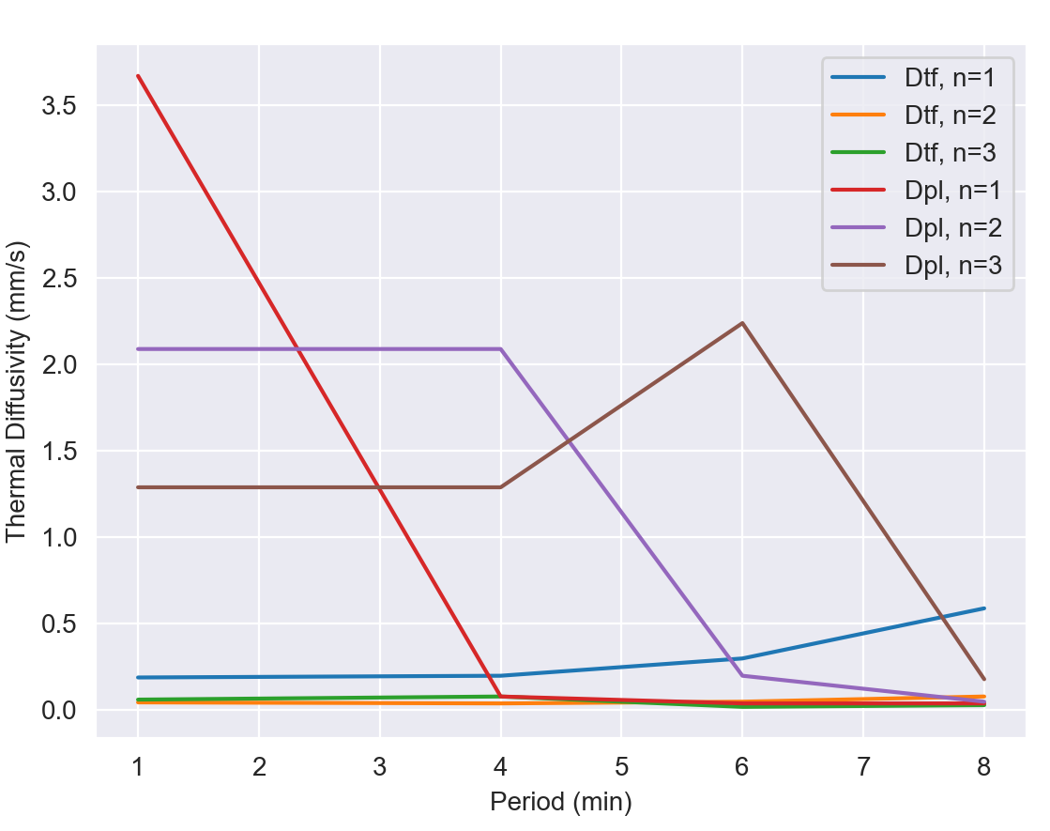
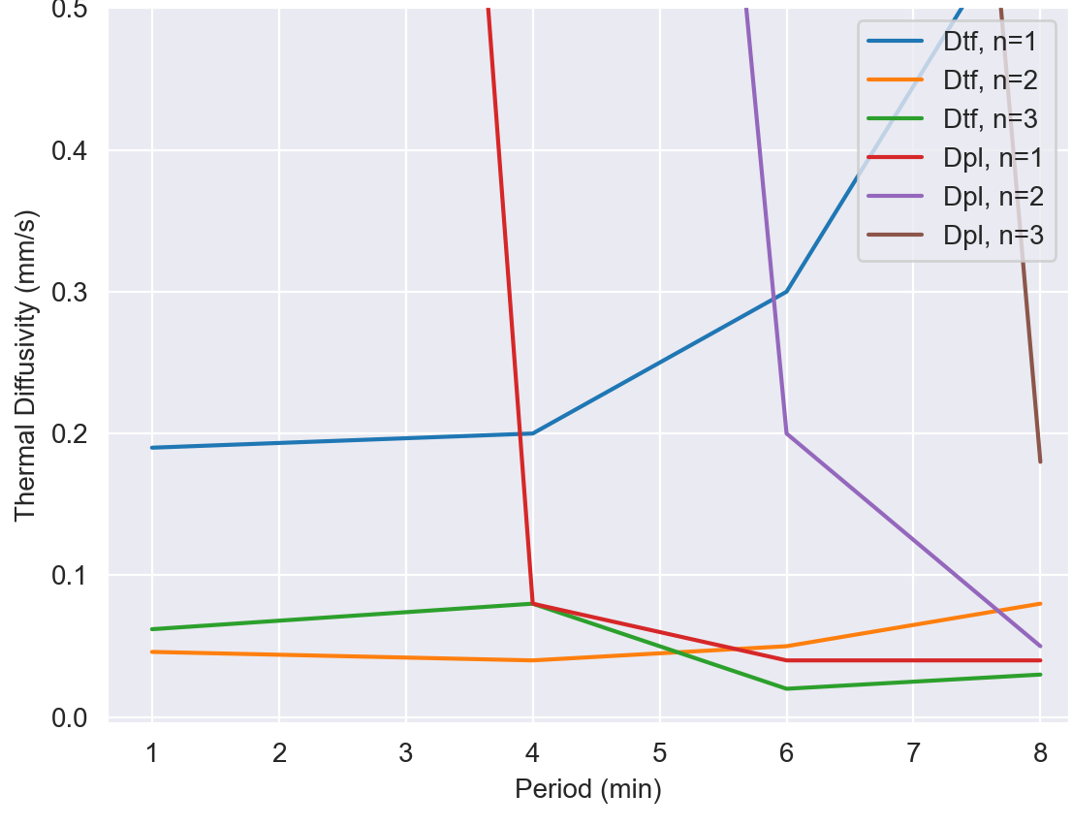
4. Plane-Slab Model (1-d approximation)
Different approach with potentially more accuracy than ”area under the curve” is FFT
Extract amplitudes of each frequency, corresponding to an nth harmonic of the waveform, as magnitudes of the complex coefficients of the FFT
Similarly, can extract phase of each harmonic mode via angle of complex coefficient in the complex plane
D_{TF} and D_{PL} values:
Can see that results are not much more accurate. Again, can see that values converge at higher periods. Mean value for D: 0.141 +/- 0.085 mm/s
Fast Fourier Transform
Zoomed in:

Slide 8
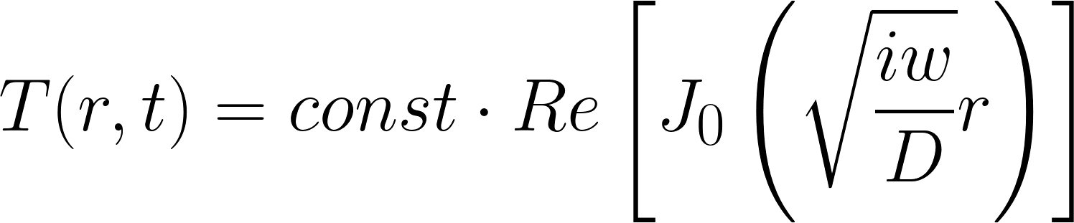
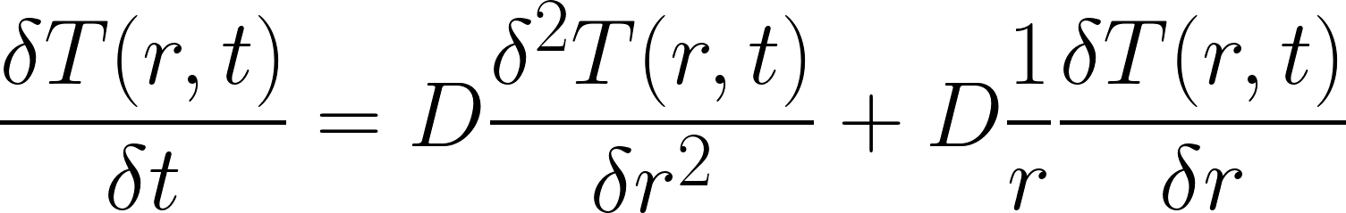
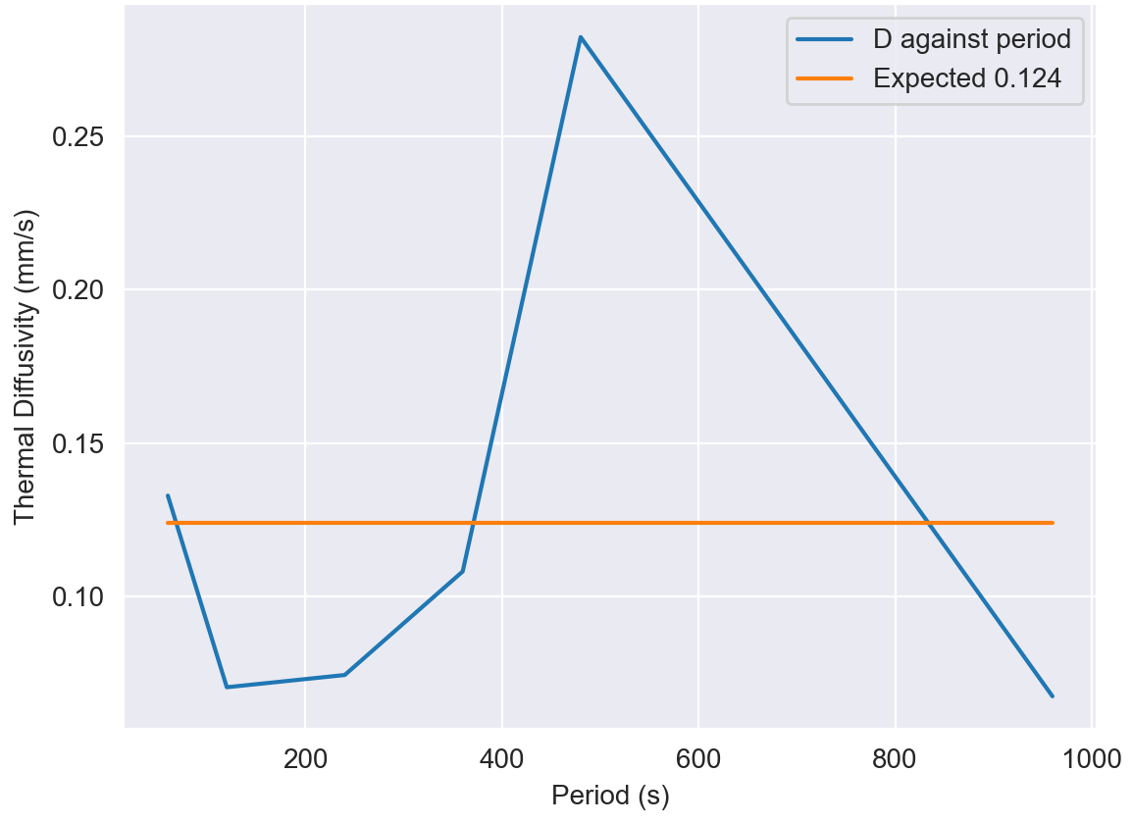
5. Cylindrical Model (Bessel Analysis)
More accurate method is cylindrical model in axisymmetric polar coordinates, whereby heat equation now includes radial terms:
Provided Bessel script receives inputs as transmission factor and phase lag. Outputs diffusivity values, based on solution with J₀(M₀,Φ₀) expressed with Bessel temperature amplitudes and phase factors
Due to unreliability of the phase values obtained through numerical integration, only D_{TF} values are calculated:
can see the range of values is surprisingly not much
more accurate. Mean D value: 0.123 +/- 0.075 mm/s
Provided Bessel script does not offer uncertainty
propagation; topic for further exploration
Without statistical uncertainty, cannot fully comment
on accuracy of results
Solution:

Slide 9
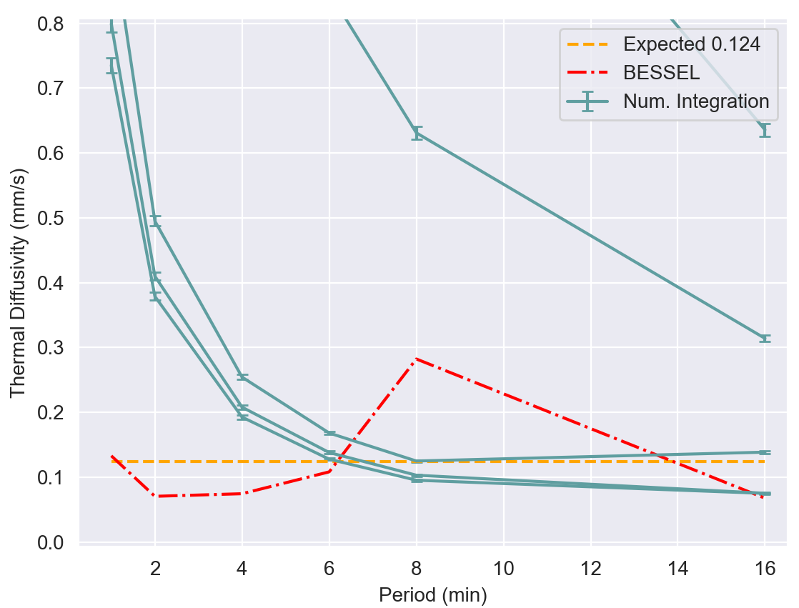
Summary
Performed primary analysis on measured thermal waveforms via Fourier decomposition to obtain estimates for thermal diffusivity; done using 1-D plane slab model. Limited accuracy, however, results still on the order of expected value
Further analysis performed via Bessel function approximation
Done using radial derivatives for heat equation based on a cylindrical model; results just as accurate, however further analysis required to obtain uncertainties to fully comment
Comparison:
Can form a solid understanding of how the periodic property of waves can be exploited to break a function into its harmonics to accurately solve for coefficients in differential equations
- Can see that BESSEL function actually
does not provide much more accuracy
than plane slab model for periods > 4 min
- Surprising result considering increased
complexity of cylindrical model
Perhaps suggests issue with the Bessel script;
another avenue for further exploration
Of course, must also consider possibility
of errors and approximations made during
actual experiment e.g. not enough preliminary
periods to fully remove transient effects

Slide 10
References
[1] “Thermal and Electrical Waves Experiment Script”, Imperial College London, London, pp. 12-14, 2022
[2] E. Edge, “Thermal diffusivity table,” Engineers Edge - Engineering, Design and Manufacturing Solutions, 2000. [Online]. Available: https://www.engineersedge.com/heat_transfer/thermal_diffusivity_table_13953.htm. [Accessed: 06-Feb-2023].
[3] Price, D.M. and Jarratt, M., 2002. Thermal conductivity of PTFE and PTFE composites. Thermochimica acta, 392, pp.231-236.
[4] “Structure & properties,” Polytetrafluoroethylene (PTFE), 07-Oct-2018. [Online]. Available: https://ptfe778851360.wordpress.com/structure-properties/. [Accessed: 07-Feb-2023].

