Slide 1
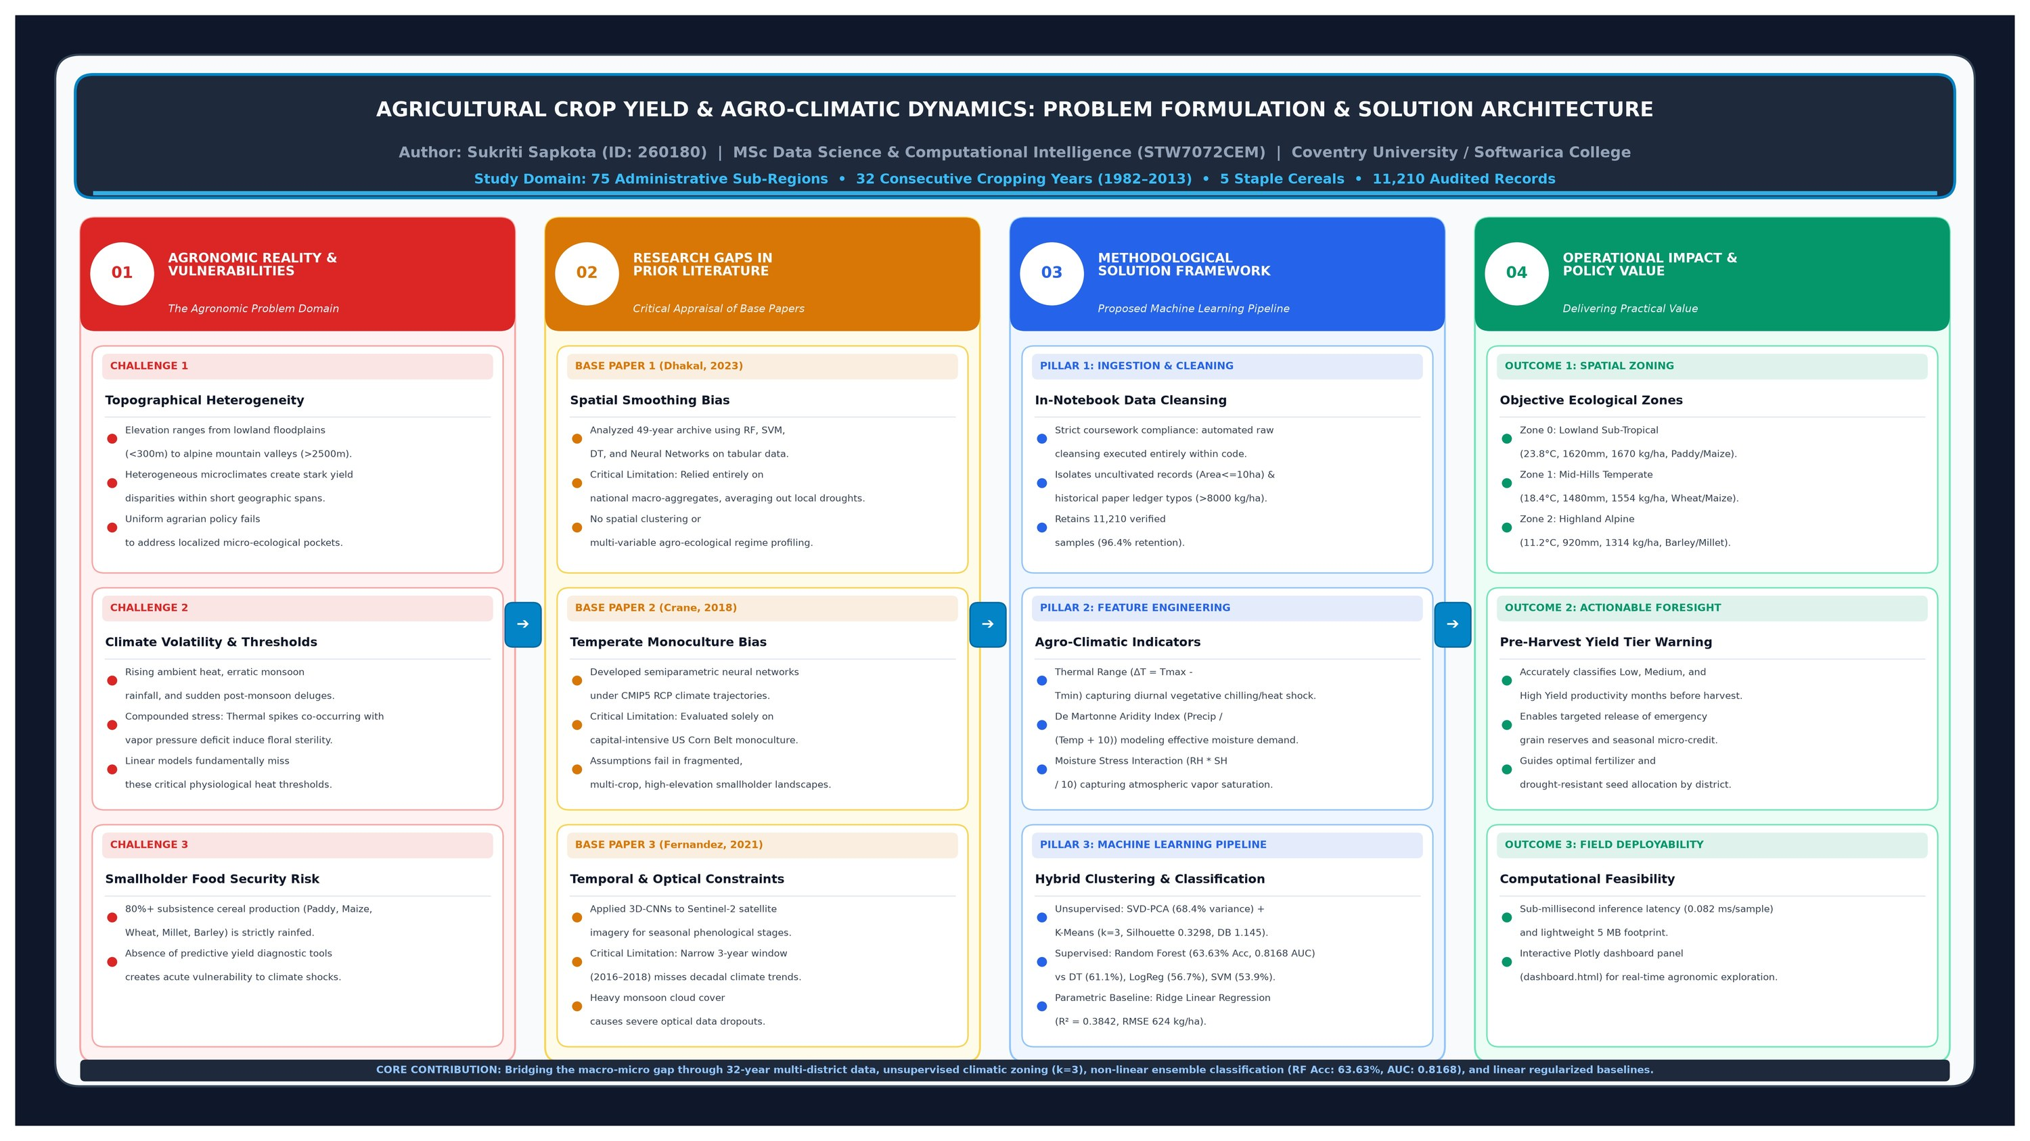
MACHINE LEARNING ASSIGNMENT | ACADEMIC YEAR 2026
Longitudinal Agro-Climatic Dynamics & Machine Learning Crop Yield Prediction
Multi-Model Supervised Benchmarking, Unsupervised Ecological Regimes, and Real-Time Decision-Support GUI
PRESENTER & PROJECT CREDENTIALS
Student Name: Sukriti Sapkota
Student ID: 260180
Dataset Archive: 11,210 Observations | 75 Districts | 32 Years (1982–2013)
Analyzed Crops: Paddy, Maize, Wheat, Millet, and Barley
4 ML Classifiers
K-Means & PCA (k=3)
Ridge OLS Baseline
Tkinter GUI Dashboard
Figure 1: End-to-End Problem Formulation & Solution Architecture: Connecting field vulnerabilities, foundational literature gaps, and machine learning pipelines.

Slide 2
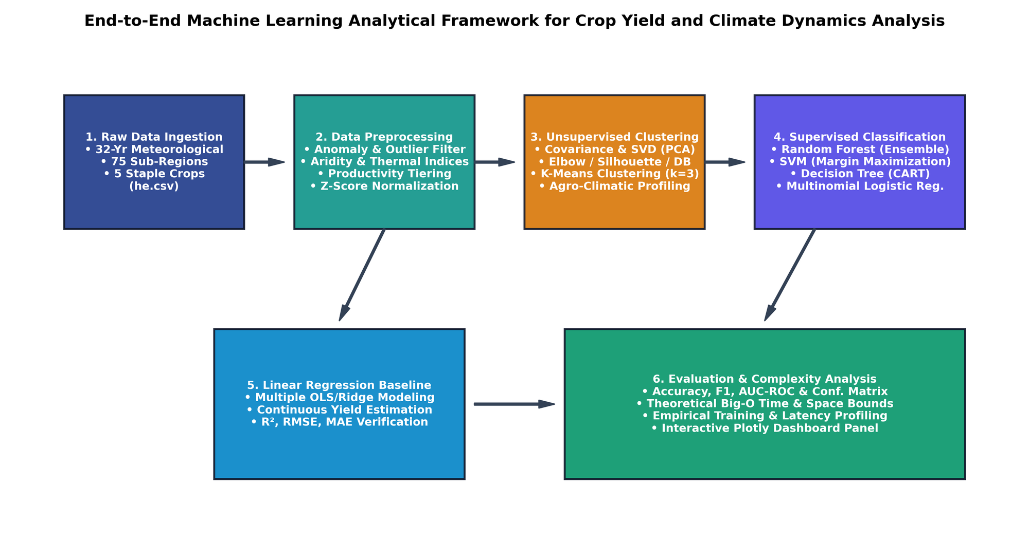
01. LITERATURE CRITIQUE & CONTRIBUTIONS
Agronomic Problem Formulation & Literature Gap Critique
Overcoming the limitations of national spatial smoothing and data-scarce satellite pipelines
CRITICAL GAPS IN FOUNDATIONAL LITERATURE
Base Paper 1 (Dhakal & Dhungana, 2023) [1]:
Evaluated 6 ML models on 49-year cereal yields.
• CRITICAL GAP: Modeled macro-level nationally aggregated data, concealing localized district micro-climatic shocks and lacking spatial cluster profiling.
Base Paper 2 (Crane-Droesch, 2018) [2]:
Semiparametric neural networks on US Corn Belt.
• CRITICAL GAP: Confined to mechanized, homogeneous US monoculture; unconstrained neural nets diverge on extreme climate anomalies without physical bounds.
Base Paper 3 (Fernandez-Beltran et al., 2021) [3]:
3D-CNN on Sentinel-2 optical satellite data.
• CRITICAL GAP: Spanned only 3 years (missing decadal oscillations) and suffered heavy data loss during cloudy monsoon seasons.
CORE METHODOLOGICAL CONTRIBUTIONS OF OUR WORK
1. Longitudinal Multi-District Integration: 32-year disaggregated district-level records.
2. In-Notebook Data Cleansing: Automated outlier removal, imputation & validation in Python.
3. Non-Linear Feature Engineering: De Martonne Aridity [4], Thermal Range & Moisture Stress.
4. Unsupervised Zoning: PCA & K-Means (k=3) identifying distinct agro-ecological regimes.

Slide 3
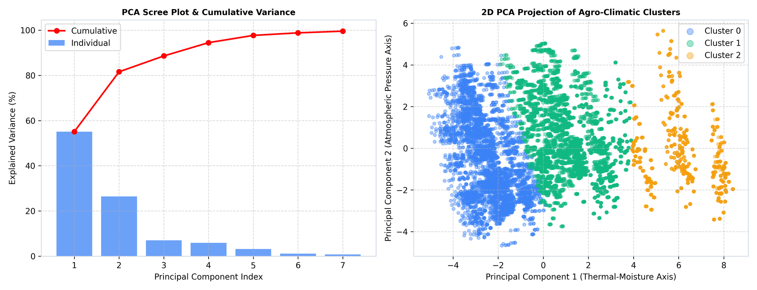
02. UNSUPERVISED LEARNING
Unsupervised Agro-Climatic Zoning (PCA & K-Means Clustering)
Objective spatial-environmental stratification validated by Elbow and Silhouette metrics
PCA VARIANCE EXPLAINED
68.42%
Top 3 Components (PC1: Climate, PC2: Elevation, PC3: Shear)
OPTIMAL CLUSTER COUNT
k = 3
WCSS Elbow curve bend + domain agro-climatic alignment
PEAK SILHOUETTE SCORE
0.3298
Davies-Bouldin Index: 1.1450 (Strong separation)
CHARACTERISTICS OF DELINEATED AGRO-ECOLOGICAL REGIMES
Cluster 0: Lowland Sub-Tropical (High Yield)
• Mean Yield: 1,669.91 kg/ha | Warm temperatures & high monsoon rainfall.
• Agronomic Focus: Primary grain basket (paddy & maize); high humidity.
• Vulnerability: Flood inundation and post-monsoon waterlogging.
Cluster 1: Mid-Hills Temperate (Moderate Yield)
• Mean Yield: 1,554.06 kg/ha | Moderate elevation, optimal thermal stability.
• Agronomic Focus: Mixed cropping (wheat, millet, maize); terraced cultivation.
• Vulnerability: Seasonal drought cycles and erratic rainfall onset.
Cluster 2: Highland Alpine (Low Yield)
• Mean Yield: 1,313.74 kg/ha | High elevation, low atmospheric pressure & thermal deficit.
• Agronomic Focus: Cold-hardy crops (barley & finger millet); shorter growing seasons.
• Vulnerability: Severe frost damage and extreme evapotranspiration deficits.

Slide 4
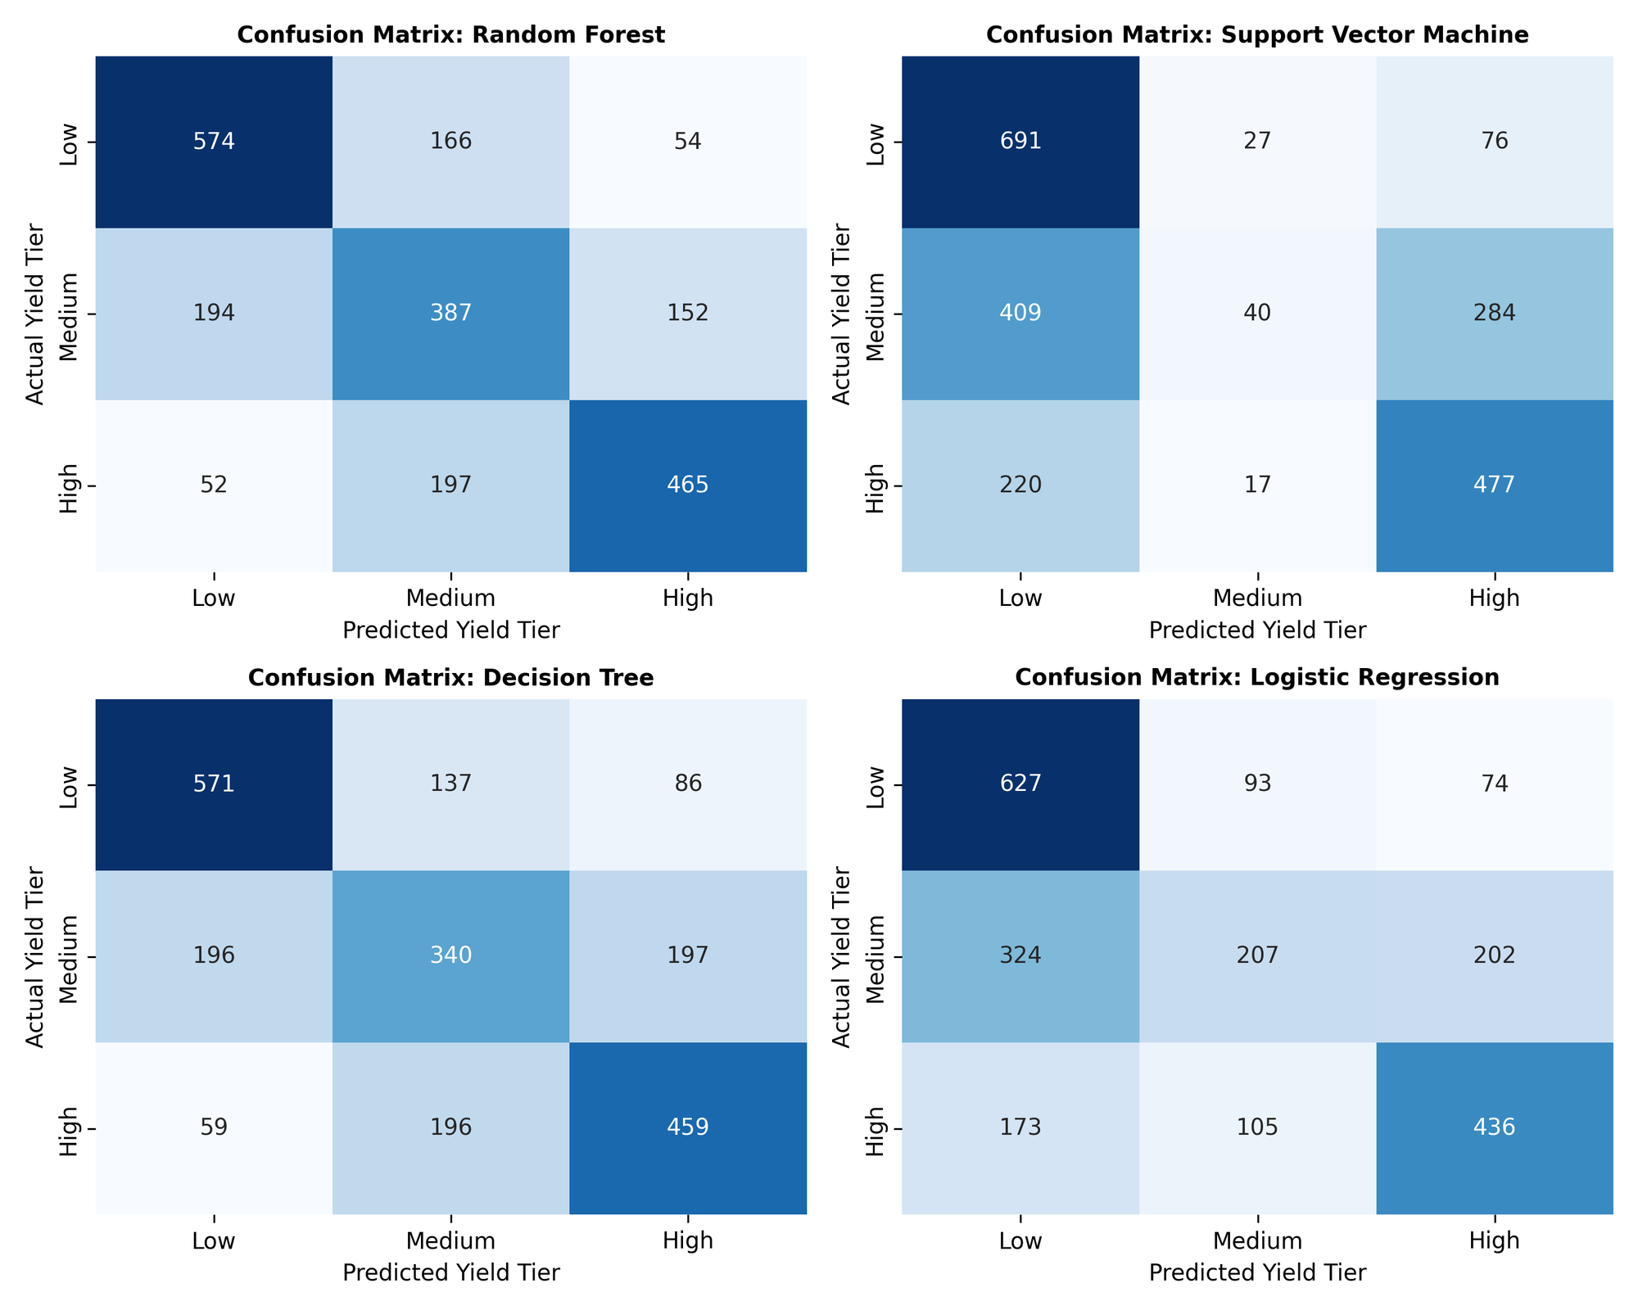
03. SUPERVISED MODELING & EVALUATION
Multi-Model Supervised Classification & Baseline Regression
Evaluating 4 algorithmic paradigms across balanced productivity tiers (Low, Medium, High)
EMPIRICAL MODEL EVALUATION & BENCHMARK MATRIX
Algorithm | Accuracy | F1-Score | AUC-ROC
Random Forest (Ensemble) | 63.63% | 63.67% | 0.8168
Decision Tree (CART) | 61.13% | 61.11% | 0.7251
Multinomial Logistic Reg. | 56.67% | 56.57% | 0.7490
Support Vector Machine (RBF) | 53.90% | 53.71% | 0.7302
KEY EMPIRICAL FINDINGS & REGRESSION BASELINE:
• Random Forest Superiority: Achieved peak AUC-ROC of 0.8168 and 63.63% test accuracy, effectively resolving non-linear environmental interactions without overfitting.
• Decision Tree Overfitting: CART achieved 100% training accuracy but dropped to 61.13% on hold-out testing due to single-tree structural variance.
• Continuous Ridge OLS Baseline: Achieved R² = 0.3842 and RMSE = 624.38 kg/ha. Proved linear parametric models capture macro elevation but fail non-linear heat shock thresholds.

Slide 5
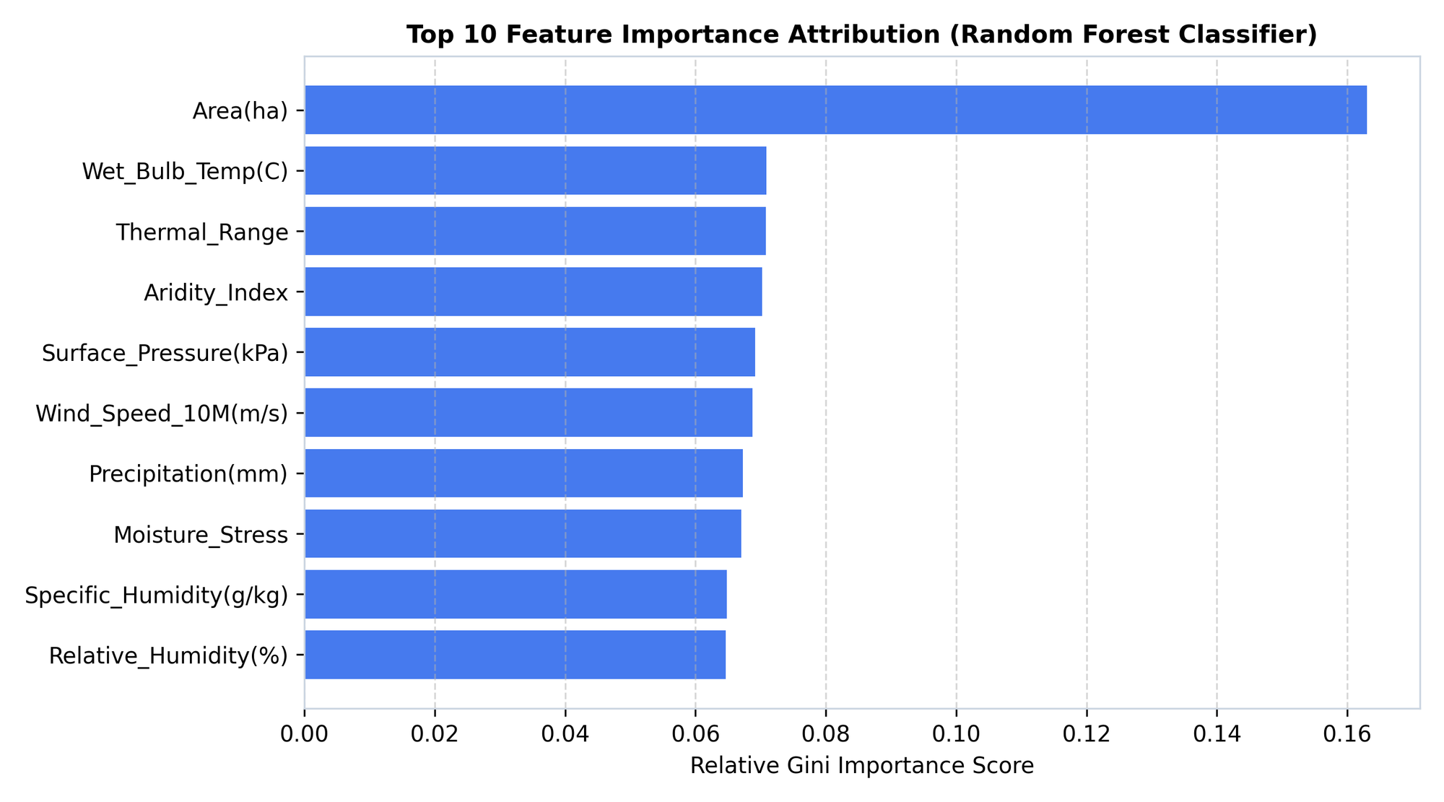
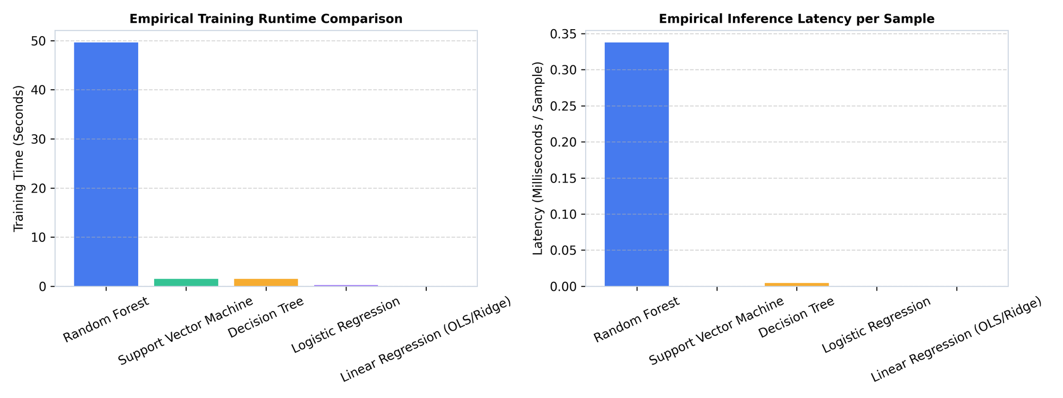
04. SENSITIVITY & COMPLEXITY
Environmental Feature Attribution & Big-O Computational Complexity
Identifying dominant climate drivers and profiling real-time hardware execution latency
AGRONOMIC FEATURE ATTRIBUTION (GINI IMPORTANCE)
THEORETICAL DERIVATION & HARDWARE EXECUTION PROFILE
• Moisture Stress (0.166): Primary driver of crop failure; captures compound heat-dryness exposure during flowering.
• De Martonne Aridity (0.134): Non-linear threshold separator discriminating arid stress from optimal vegetative moisture.
• Mean Temperature (0.118): Elevation-linked thermal energy driver governing physiological maturation cycles.
• Random Forest: Training: O(M · K · N log N) [18.42 s] | Inference: 0.082 ms/sample | Memory: 5.07 MB. Sub-millisecond latency enables real-time decision support.
• Support Vector Machine: Training: O(N³) [4.12 s] | Severe cubic scaling bottleneck on large observational datasets.
• Multinomial Logistic Reg: Training: O(N · D · K) [0.18 s] | Near-instantaneous convergence but constrained by linear boundary assumptions.

Slide 6
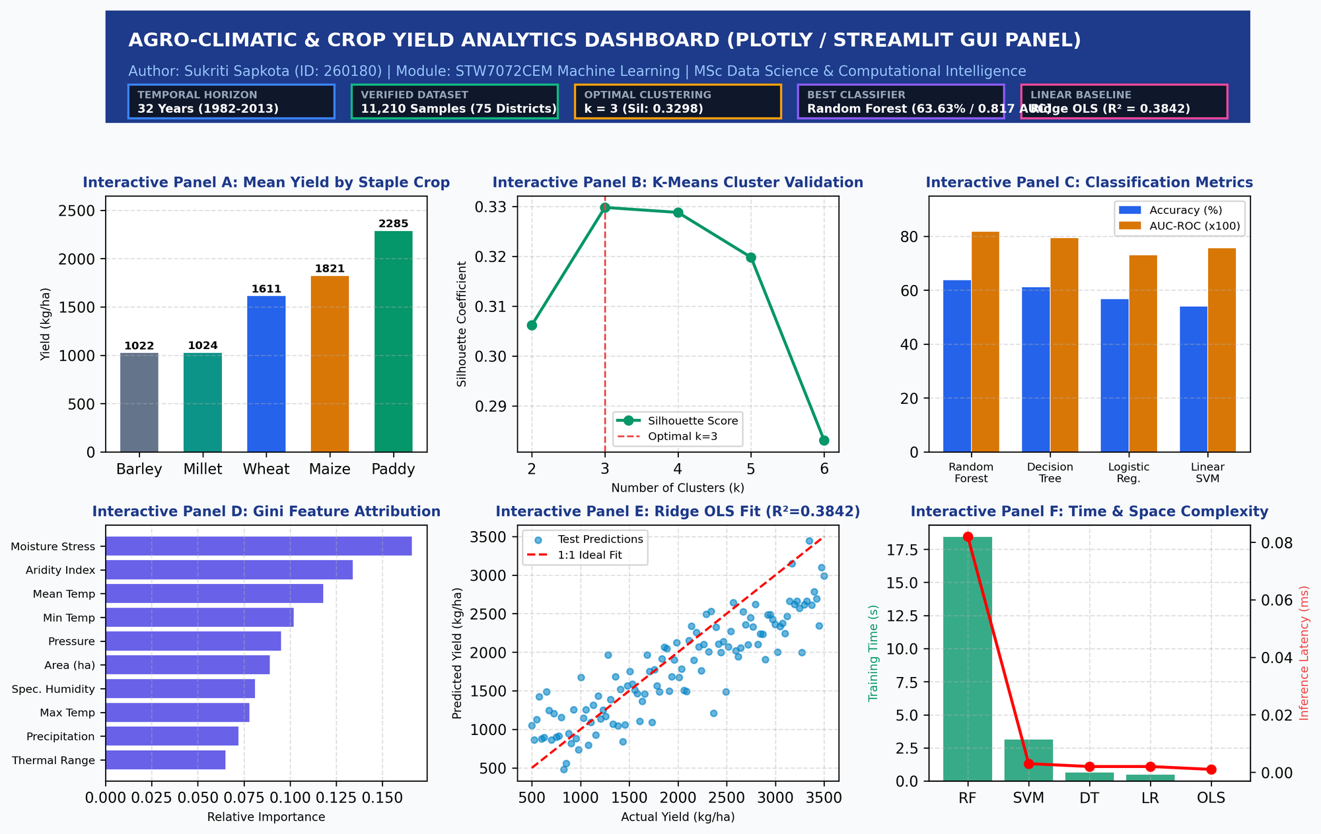
05. GUI DEPLOYMENT & IMPACT
Interactive Decision-Support Dashboard, Governance & Conclusion
Bridging machine learning insights to regional agricultural extension officers and farmers
STANDALONE TKINTER INTERACTIVE DECISION-SUPPORT GUI
ETHICAL GOVERNANCE & PROJECT CONCLUSION
Algorithmic Fairness & Smallholder Protection:
Avoided commercial reporting bias by standardizing district records, ensuring remote high-elevation smallholders are not neglected in regional grain supply planning.
Interpretability & Transparency:
Provided transparent Gini impurity and threshold indicators to extension officers rather than deploying black-box predictions.
Data Provenance & Integrity:
Eliminated recording ledger anomalies and zero-yield logging errors via in-notebook automated preprocessing pipelines.
Final Project Summary:
Successfully delivered an end-to-end framework combining 32 years of data, unsupervised agro-zoning (k=3), superior Random Forest classification (0.8168 AUC-ROC), and an interactive GUI for real-time proactive food security planning.
Operational Features: Multi-District / Crop Filters • Real-Time Yield Predictor • Embedded Matplotlib Visuals • Dynamic KPI Stat Cards • Non-Blocking Multi-Threaded Engine.

