Slide 1
ORIE 5740 STATISTICAL DATA MINING I Predicting Cryptocurrency Prices using Machine Learning
Sukriti Kumar (sk3335)
Niharika Dalsania (nd322)
Joel Dsouza (jnd74)

Slide 2
Executive Summary
GOAL
To forecast returns of bitcoin prices over changing crypto market regimes.
Classify the crash and rallies in the crypto markets.
ANALYSIS
Linear and non-linear models were used on macroeconomic as well as crypto specific predictors.
DATA LIMITATION
Because of absence of data for crypto features of Litecoin, Ripple, Ethereum and Dogecoin, we have only preceded with predicting the bitcoin prices.
RESULTS
The linear (barring the OLS model) as well as non-linear models performed better than the benchmark ARIMA (0,1) X GARCH (1,1) model
For the classification problem, we found that the KNN was able to correctly classify the crash and rally in the test data 98.7% of the times.

Slide 3
Why this project?
The complete U-turn of the financial institutions on crypto ...currencies from not investing in them at all to opening crypto arms for investment.
The recent popularity amongst retail investors and the ...twitter rallies of meme coins as well as crypto currencies.
Academic interest in crypto currencies

Slide 4
The main questions?
How the returns on cryptocurrency prices change with market regimes?
Can we correctly identify the crashes and rallies?
What predictors are most important?
Can macroeconomic indicators can be used to predict the very volatile and non-linear crypto markets?

Slide 5
Why these goals make sense?
Recent events: 1. Recent popularity of the crypto currencies
2. Complete U-turn of financial institutions
Huge Dataset: A lot of macroeconomic as well as the crypto specific features were explored.
Two aims: The aim of our project was not only to predict prices of bitcoin but also to identify the crashes and rallies so that a trader using our strategy could bet on the market appropriately and generate positive alpha.
Given that we are a three membered team, the scope suffices the members in the team.

Slide 6
Dataset and its Rationale
Regression Target Variable: Daily Returns on Bitcoin
Classification Target Variable: Up or Down moves in returns compared to previous time instance
Predictor Variables:
Lagged Returns and Realized Volatility of Returns
Bitcoin Specific Predictors
Macro Variables
Sentiment Predictors (Google trends, Twitter sentiments)

Slide 7
Alternative/Additional Data
Market Sentiment Data
Our belief : Cryptocurrency movements heavily depend on market sentiments
Unfortunately, limitation in extracting past tweets so insufficient data to validate/reject our belief (but this would have certainly been helpful, if available)
Data for more cryptocurrencies
Could have performed a comparative study

Slide 8
Dataset: Train-Validation-Test
Daily data used
Total data: January 2015 to March 2020 (avoid covid crash outlier time period)
Data Split – not random (avoid data leak in time series!)
Train data: 60%
Validation data: 15%
Test data: 25%

Slide 9
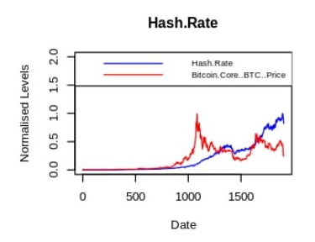
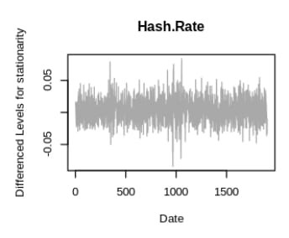
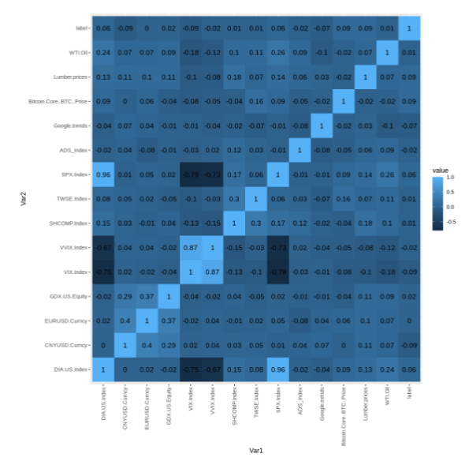
Data Analysis and its Rationale
Stationarity - remove trends
Multicollinearity - remove redundant features

Slide 10
Baseline ARIMA-GARCH model
ARIMA (0,0,1) X GARCH (1,1) model has been used.
Parameters for ARIMA model has been chosen using the auto.arima () function in R.
The parameters p and q for the GARCH model have been estimated using the Autocorrelation Function as well as the Partial Autocorrelation Function (PACF)
Test RMSE 3.4784

Slide 11
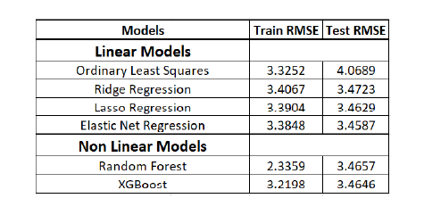
Regression on Daily Returns
Linear Models
OLS
Regularized
Ridge Regression
Lasso Regression
ElasticNet
Non-Linear Models
Random Forest
XGBoost
Table 1: Comparison of Test RMSE for all models considered

Slide 12
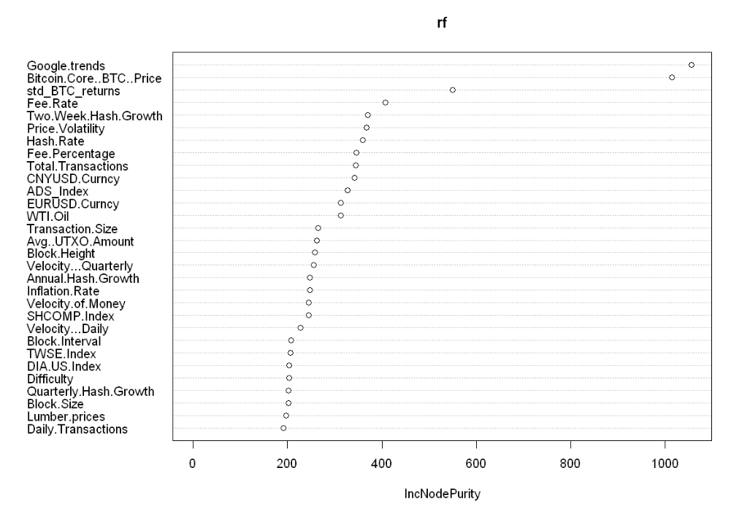
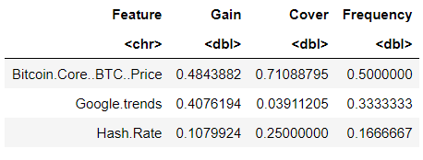
Regression: Variable Importance
Figure 1: Random Forest Feature Importance
XGBoost Feature Importance

Slide 13
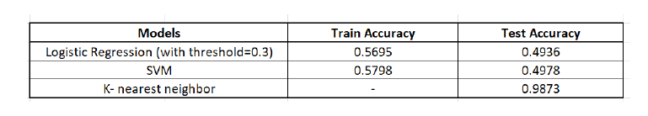
Classification of Daily movement
Labeled up movement as '+1' and down movement as '-1'
Used the same train, validation and test set from regression
Logistic
SVM
KNN
Table 2: Comparison of Test accuracy for all models considered

Slide 14
Conclusions
Comparison to baseline
All except simple OLS perform better than baseline
Regression models
Elastic Net best among linear models, Random Forest best overall
Classification models
KNN best
Variable Importance
Macroeconomic variables have very little predictive power
Market sentiment (reflected through Google Trends) has the most predictive power

Slide 15
Most surprising aspect
The superior results of our linear and non-linear model as ...compared to the baseline model might help the traders to build ...strategies using predictions from our models and use it to ...capture positive alpha.
The KNN classification model was able to classify the up and down moves 98.73% of the times. This result might be able to fetch very high returns on the trading strategies which uses our model.

Slide 16
Future Works
Correlation between different cryptocurrencies
Due to lack of data for other cryptocurrencies, find correlation of bitcoin with others and use predicted prices of bitcoin scaled by correlation factor as proxy for predicted prices of others
Sliding window validation
Better hyperparameter tuning if more data available
Regime based models
Account for different sentiments during bear and bull markets.

Slide 17
Thank you!
Sukriti Kumar (sk3335)
Niharika Dalsania (nd322)
Joel Dsouza (jnd74)

