Slide 1
CA3 | NLP Mini Project
The Onion (sarcastic)
Sarcasm Detection Model in News Headlines
Area Man Wins Argument With Thermostat
Building, Auditing and Explaining a classifier
HuffPost (real)
Senate Passes Bill To Expand Rural Broadband Access
Sukriti Singh | PRN 25030422121
Notes:
Hook: two headlines. One is from The Onion, one is real. Humans spot it instantly. Can a model? And more importantly: HOW does it decide? That is the whole project.

Slide 2
Sarcasm says one thing and means another
Meaning flips
Context is hidden
Labels can mislead
Positive words, negative meaning: "I absolutely love being stuck in traffic".
A joke needs tone and world knowledge that plain text rarely carries.
In our data, label = which outlet wrote it (The Onion or HuffPost).
Our goal
Build a sarcasm classifier, then audit it: does it understand sarcasm, or does it only recognise the newspaper?
Notes:
Sarcasm is hard because words and meaning disagree. Our dataset hides a shortcut though: the label is the newspaper, not a human judging sarcasm. So the real question is: does the model understand sarcasm, or recognise the newspaper?

Slide 3
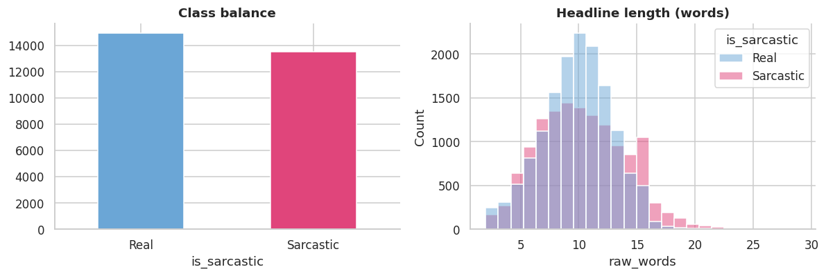
The dataset: 28,503 headlines from two newspapers
28,503
unique headlines
47.5%
sarcastic (balanced)
Real = blue, sarcastic = pink. Classes are balanced, so plain accuracy is a fair score. Onion headlines run slightly longer.
22,802 / 5,701
train / test split
The catch
Sarcastic = The Onion, real = HuffPost. The label is the outlet, not a human judgement.
Notes:
Misra News Headlines v2. Nearly balanced: 47.5% sarcastic. 80/20 split with a fixed seed, test set untouched until the end. The catch: sarcastic means The Onion, real means HuffPost.

Slide 4
From raw headline to a verdict: two model families
Clean text
>
Words to numbers
>
Train models
>
Test on unseen data
Baseline: TF-IDF + Logistic Reg.
Modern: fine-tuned DistilBERT
Lowercase, remove punctuation, lemmatize
TF-IDF: how special a word is to a headline
One readable weight per word, summed up
Naive Bayes and Linear SVC as extra baselines
C tuned by 5-fold CV on training data only
Small, fast BERT that already knows English
Reads the raw headline: word order and context
Fine-tuned for 2 epochs (about 1 minute on a T4 GPU)
A black box, so we explain it with LIME
Notes:
Walk the flow left to right. Baseline: TF-IDF counts how special each word is, Logistic Regression adds up one weight per word. DistilBERT is a small BERT that already knows English; fine-tuning is two short lessons on our headlines. The same split is used for both so the comparison is fair.

Slide 5
DistilBERT cut the errors by more than half
79.7% to 92.0%
accuracy
542 to 200
real headlines wrongly flagged
614 to 257
sarcastic headlines missed
Naive Bayes and Linear SVC tied the baseline at 79.7%, so the gain came from context, not a fancier classifier.
Notes:
Accuracy jumps from 79.7 to 92.0 percent. Note Naive Bayes and Linear SVC tied the baseline, so changing the classifier did not help. Adding context-aware language knowledge did. Errors: false alarms 542 to 200, missed sarcasm 614 to 257.

Slide 6
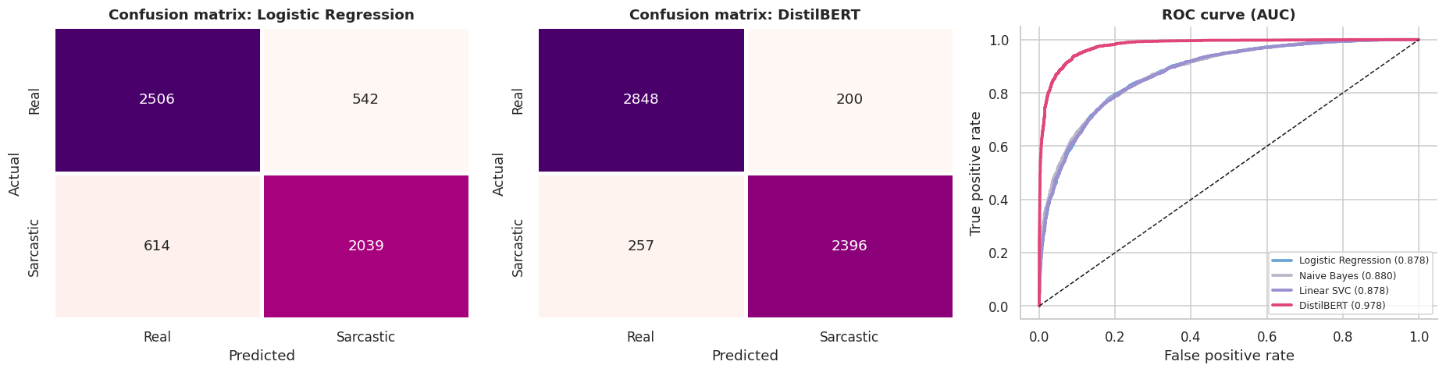
Reading the evaluation charts
Confusion matrix
ROC curve and AUC
A caution
Rows = truth, columns = guess. A dark diagonal means correct. DistilBERT has the darker diagonal.
Closer to the top-left is better. AUC 0.978 vs 0.878; 0.5 would be a coin flip.
DistilBERT is very confident, usually near 0 or 1. Confident is not the same as understanding.
Notes:
Confusion matrix: rows are the truth, columns the guess, the diagonal is correct. ROC: top-left corner is better, the diagonal is a coin flip. DistilBERT is much more confident, but confident is not the same as understanding. We test that next.

Slide 7
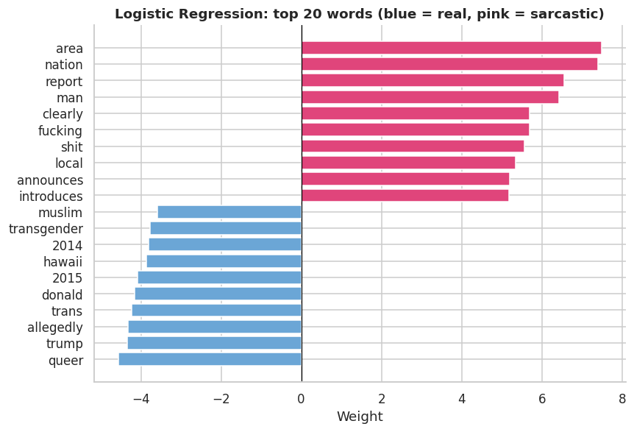
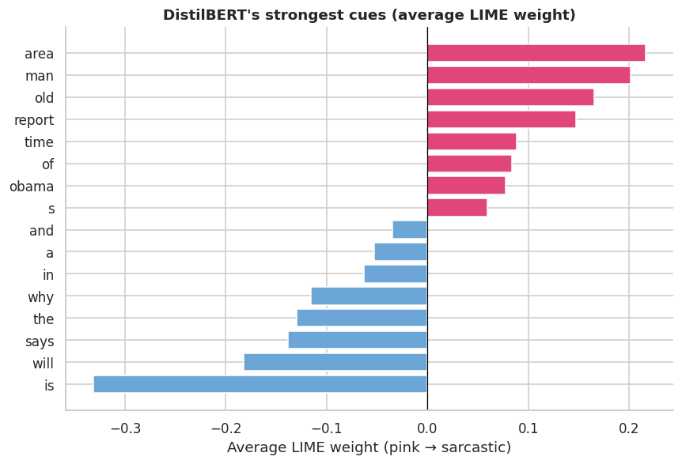
Explainability: it learned the newspaper's habits
Logistic Regression (exact weights): area, nation, report, man vs queer, trump, allegedly.
LIME on DistilBERT (approximate): area, man, old, report push toward sarcastic.
Ablation proof: remove the 49 top words: accuracy falls 3.5 points. Remove 49 random words: only 0.2.
Notes:
Left: Logistic Regression weights are exact, one number per word. Sarcastic cues are Onion templates: area, nation, report, man. Right: LIME on DistilBERT gives a similar picture. The ablation is the proof: removing the 49 strongest words costs 3.5 points, removing 49 random words costs 0.2.

Slide 8
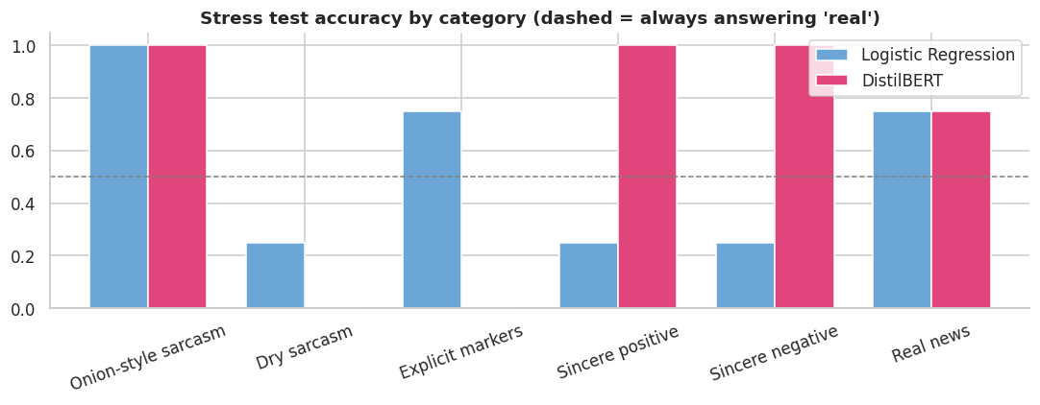
Audit: Onion style is easy, everyday sarcasm is not
Subgroup audit
Long headlines: 92.7% vs 91.0% for short (real, small gap)
First-person: accuracy 94.8%, but sarcasm recall 80.4% (only 46 examples)
Questions: recall just 52% (23 examples)
Small groups are warnings, not conclusions
It wrongly flagged "Study finds regular exercise improves heart health": an Onion template
4/4
0/8
4/12
Onion style
Everyday sarcasm
Sarcasm caught
DistilBERT on 24 hand-written texts. Logistic Regression caught 8/12 sarcastic texts, but also flagged many sincere ones.
Notes:
Stress test: 24 hand-written texts. Both models get Onion-style 4 of 4. DistilBERT gets 0 of 8 on everyday sarcasm, and it is sure about it, with probabilities near 0.00. It also flagged a real headline, "Study finds...", as sarcastic because that is an Onion template. Subgroup gaps with few examples are warnings only.

Slide 9
Best score is not the same as best understanding
Criterion | Logistic Reg. | DistilBERT
Test accuracy | 79.7% | 92.0%
Explainability | Exact weights | LIME (approximate)
Everyday sarcasm caught | 8/12, many false alarms | 4/12
Cost to train | Seconds, CPU | About 1 min, GPU
Limitations
Labels come from the publication, not human judgement
Stress test is only 24 texts, mostly not headlines
Some audit groups are small (n = 23 to 93)
One split, one seed, English only
LIME is an approximation, and noisy
Verdict
DistilBERT is best on this benchmark. Logistic Regression is best for explaining why. Neither understands everyday sarcasm.
Notes:
DistilBERT wins the benchmark, so it is the best model for this dataset. Logistic Regression wins on explainability and cost. The limitations list is what makes the project honest: labels from the publication, a tiny stress test, small subgroups, one split and one seed.

Slide 10
Future work
Conclusion
Train on human-labelled sarcasm (social media, e.g. Reddit SARC)
Add conversation context, not just one line
Larger stress test and several random seeds with confidence intervals
Try bigger models and remove outlet cues during training
Let the model say "not sure" instead of guessing
DistilBERT beats the baseline: 92.0% vs 79.7% accuracy
But its top cues are Onion templates (area, man, report)
On everyday sarcasm it scored 0 of 8
The audit, not the accuracy, is the real finding
Accuracy is not understanding.
Notes:
Close with the one sentence: accuracy is not understanding. Future work is mostly about better data: human-labelled sarcasm from real conversations, and a bigger audit.

Slide 11
Thank You

