Slide 1
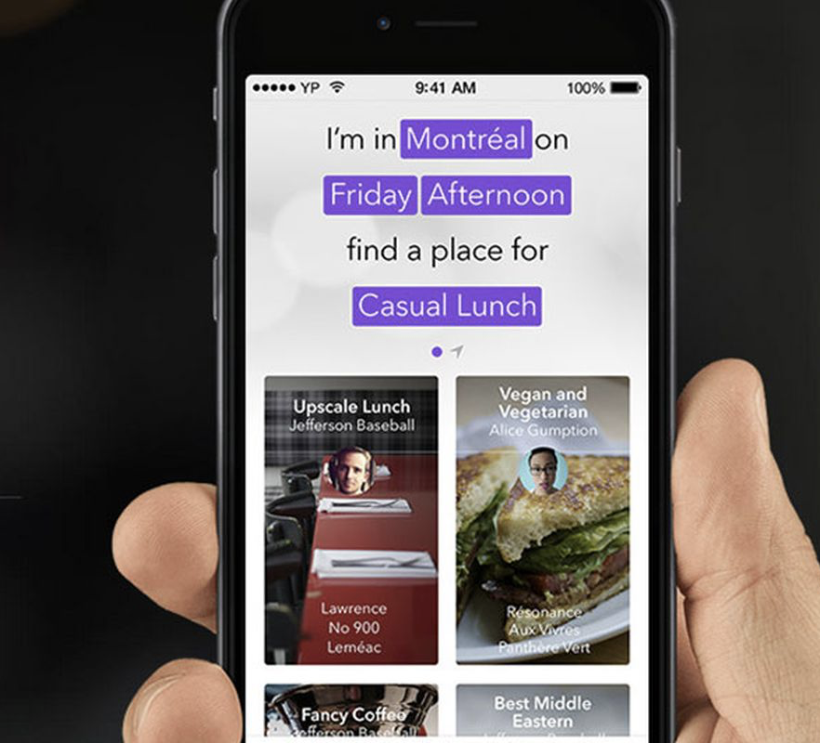
Restaurant Recommendation System
-Sukruth H V

Slide 2
Sneak peak into dataset
The Recommendation system data has been provided by Yelp, where they have collected 2 flavors of data (User and Business/restaurant). There have been around 1,92,609 records for restaurant details and around 26,606 records for user details. However, we are interested in 4 different features in our model.
Some of the important data fields in the dataset are as follows :
User_id :- unique user_id for each user, who has rated the restaurant.
Business_id :- unique id given to every restaurant
Date :- when the rating was provided
Stars :- Rating provided by users (5 – highest ; 0 – Lowest/No rating)
Text :- Review comments from various users for a give restaurant

Slide 3
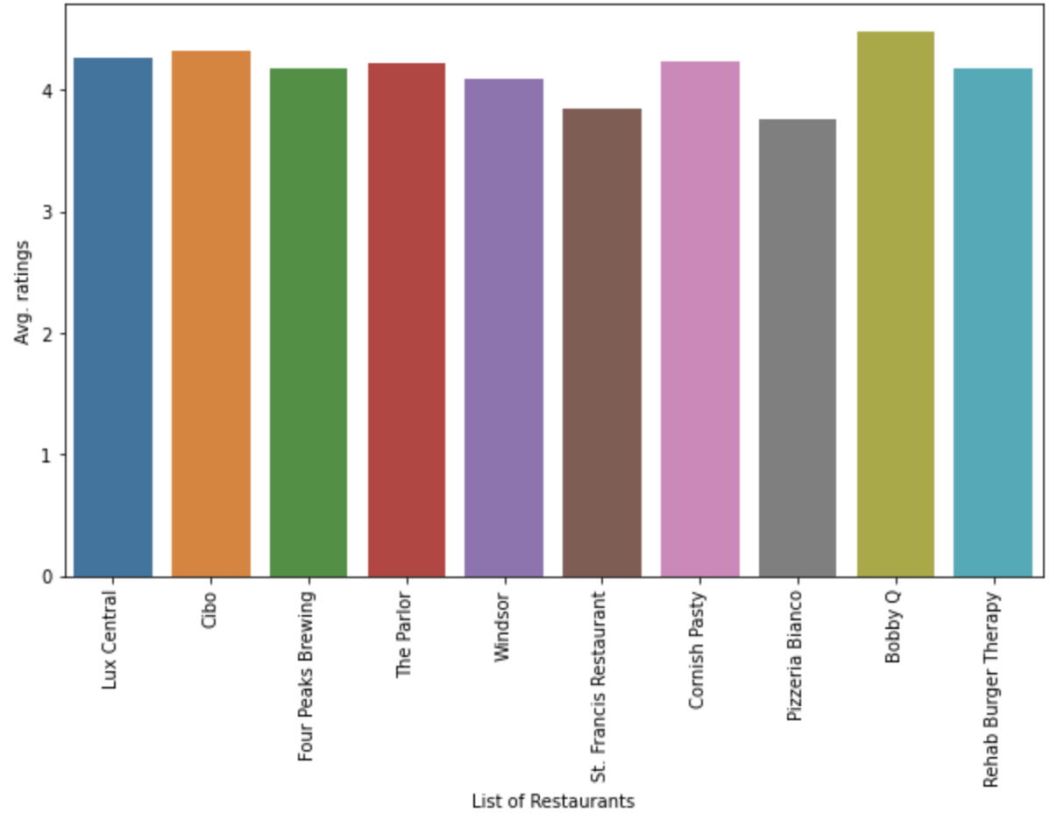
Exploratory Data Analysis(EDA)
Restaurant | Avg. Rating
Bobby Q | 4.47
Cibo | 4.31
Lux Central | 4.25
The Parlor | 4.22
Cornish Pasty | 4.22
Rehab Burger Therapy | 4.18
Four Peaks Brewing | 4.17
Windsor | 4.08
St. Francis Restaurant | 3.84
Pizzeria Bianco | 3.75
Above are the list of Top 10 restaurants based on Avg. User rating for a given restaurant :

Slide 4
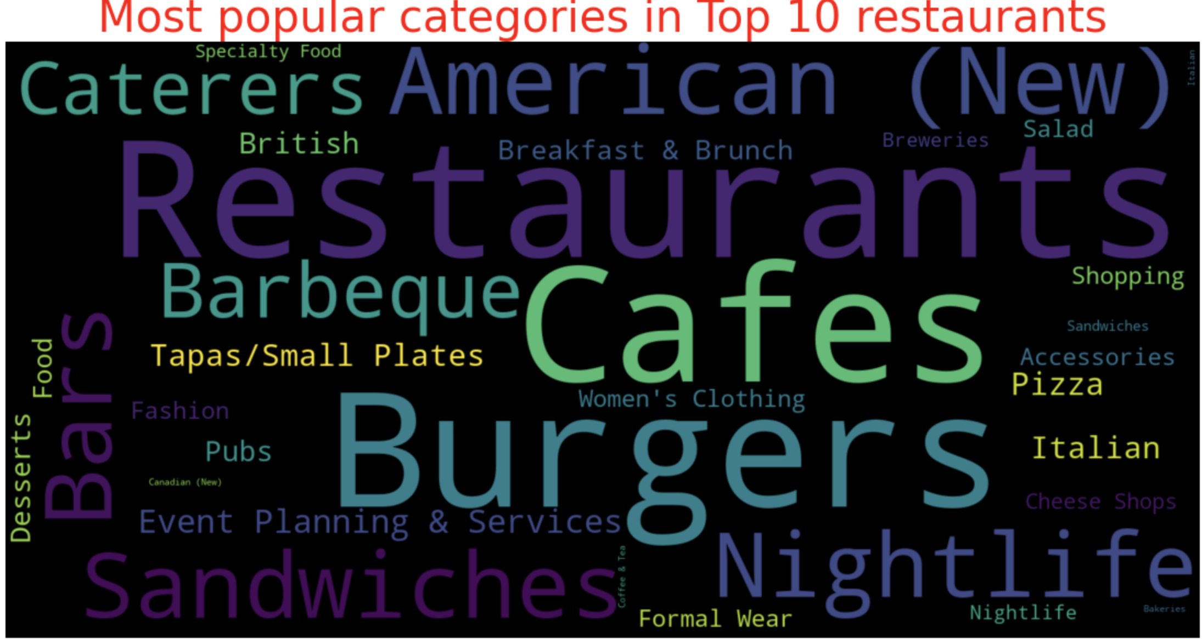
Categories famous across Top 10 restaurants
We further went ahead and check the popular categories across top 10 restaurants and found the following :

Slide 5
Model – 1(SVD)
In this model, we would recommend a specific user a set of restaurants based on the list of restaurants, he had already visited.
In this model, we have used SVD (Singular Value Decomposition) and would recommend the restaurant for a given user based on the ratings provided.
To demonstrate the way this model works, we have taken a user with user_id “d_TBs6J3twMy9GChqUEXkg” as an example and demonstrated the list of Top 10 recommendations for him/her based on their previous ratings.

Slide 6
Model – 2(Matrix Factorization)
In this model, we would recommend a specific user a set of restaurants based on the preferences that he/her provides.
In this model, we would take the preferences from the user in layman language and decode them using tfidf vectors and then recommend based on the keywords being input.
For instance, user can input the following sentence to the Model “I want to check on the Indian restaurants” and the model would basically convert this to tfidf vectors and then recommend the Indian restaurants.

