Slide 1
Human Activity Recognition -Sukruth H V

Slide 2
Sneak peak into dataset
The Human Activity Recognition database was built from the recordings of 30 study participants performing activities of daily living (ADL) while carrying a waist-mounted smartphone with embedded inertial sensors. The objective is to classify activities into one of the six activities performed.
The experiments have been carried out with a group of 30 volunteers within an age bracket of 19-48 years. Each person performed six activities (WALKING, WALKING_UPSTAIRS, WALKING_DOWNSTAIRS, SITTING, STANDING, LAYING) wearing a smartphone (Samsung Galaxy S II) on the waist.
For each record in the dataset the following is provided:
- Triaxial acceleration from the accelerometer (total acceleration) and the estimated body acceleration.
- Triaxial Angular velocity from the gyroscope.
- A 561-feature vector with time and frequency domain variables.
- Its activity label. (Target variable)
- An identifier of the subject who carried out the experiment.
Data set has 10299 entries and 563 features

Slide 3
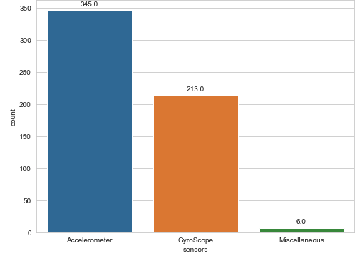
Metrics about the Dataset
Ratio of metrics based on the sensors used in the study :

Slide 4
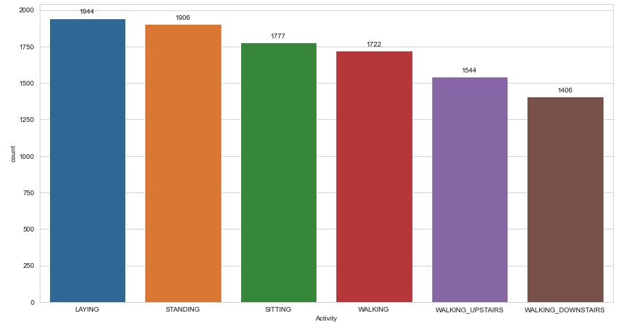
Balanced dataset
From the graph we could see that the dataset target variable “ACTIVITY” is more or less balanced.

Slide 5
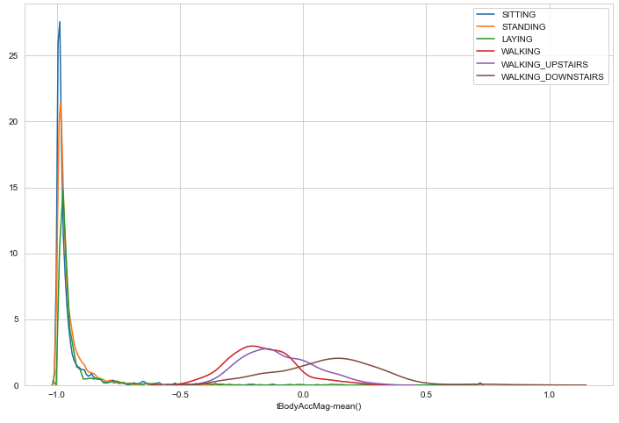
Categorizing the activities
From the graph, we could infer that using the “Body Acceleration Magnitude – Mean()” metric, there is a clear distinction between the Static (SITTING, STANDING and LAYING) and Dynamic (WALKING, UPSTAIRS, DOWNSTAIRS) activities.

Slide 6
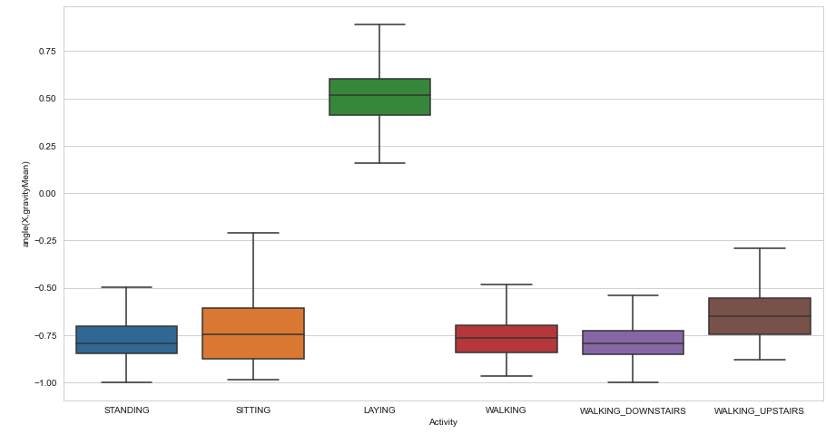
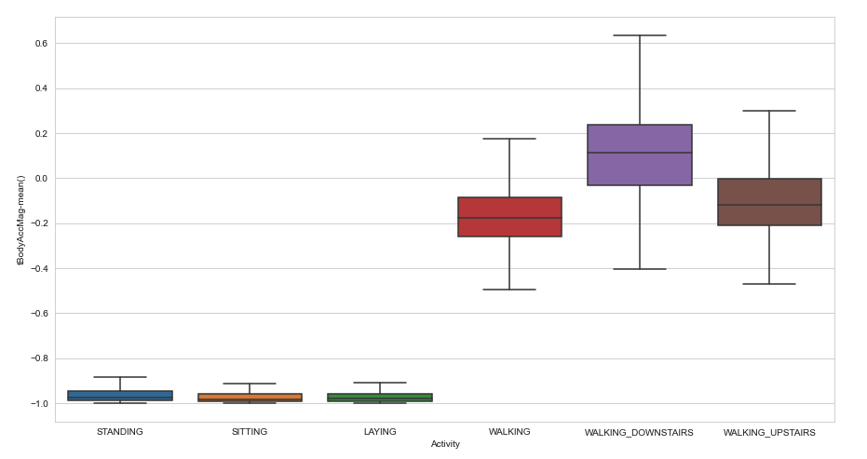
Distinguish the activity
In order to distinguish one among various activities, we have picked up the metrics, which can help distinguish the activity as shown below :

Slide 7
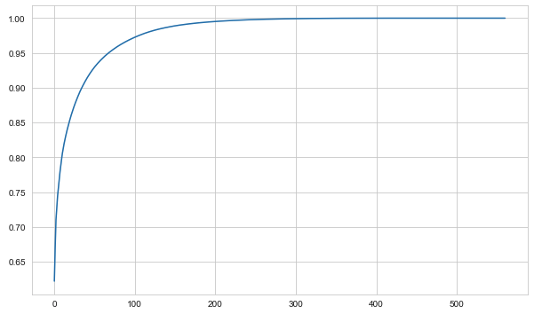
Dimensionality reduction
We know that there are 562 features to predict the Activity, its been quite huge number of parameters and hence we have done dimensionality reduction using PCA and reduce the features to finally 69 having 95% of variance explained.

Slide 8
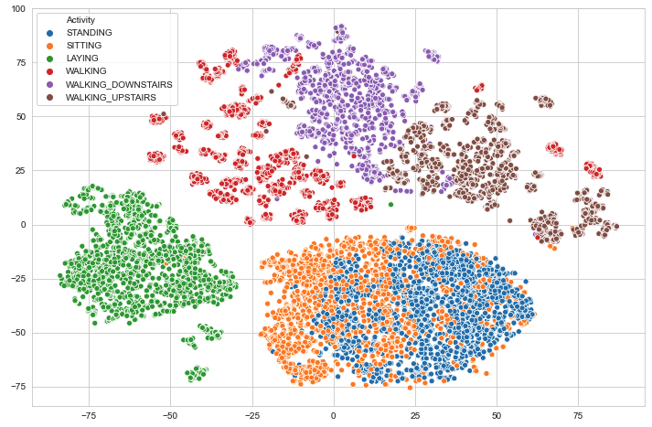
Visualizing the Activity clusters
We have used TSNE model to visualize the >3D features in 2D space. Here are the activity clusters
Notes:
TSNE – t-stochastic Neighbor Encoding

Slide 9
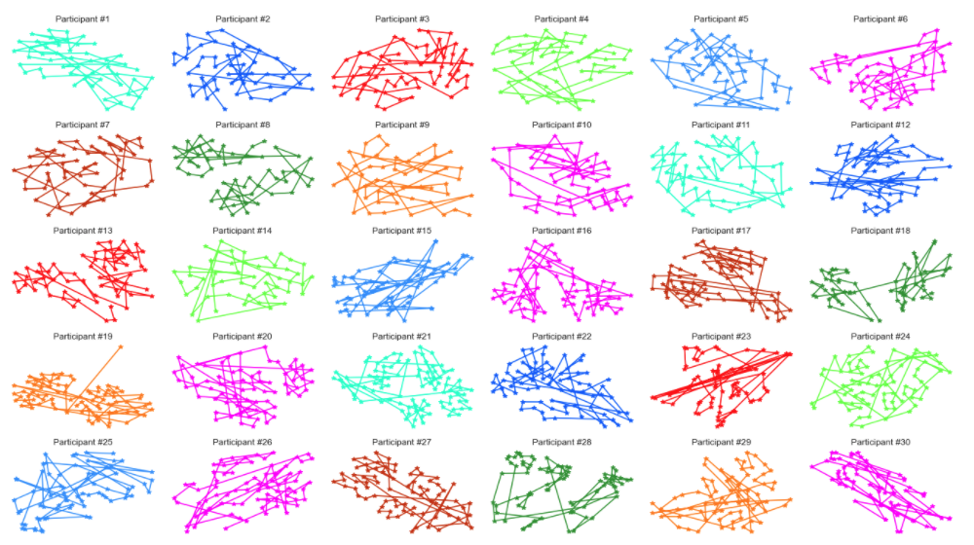
Determining the participant Activity pattern
We have determined the activity pattern for all the 30 participants as shown in the graph.
The one you are seeing on the right is the “LAYING” activity pattern for all the participants.

Slide 10
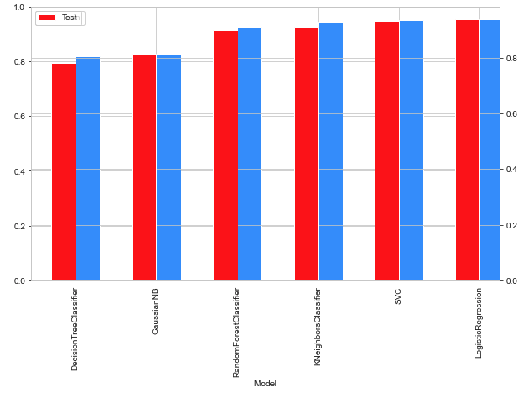
Models
We have used 6 different models to classify and predict this dataset and here are the 6 models being used :
DecisionTreeClassifier
RandomForestClassifier
KNeighborsClassifier
SVC(kernel="linear")
GaussianNB
LogisticRegression

Slide 11
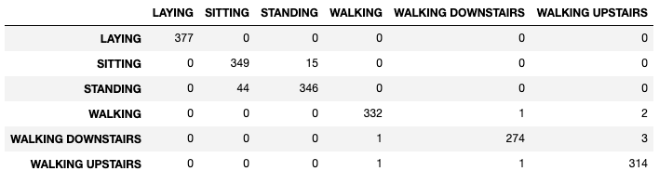
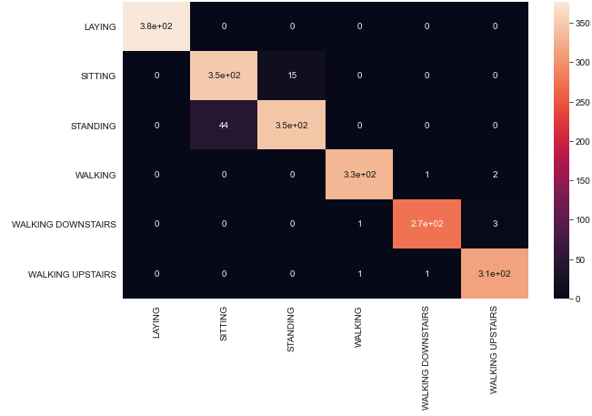
Model evaluation
Let’s see how the model accuracy now :
Y-axis defines the True values, whereas the X-axis defines the Predicted values

