Slide 1
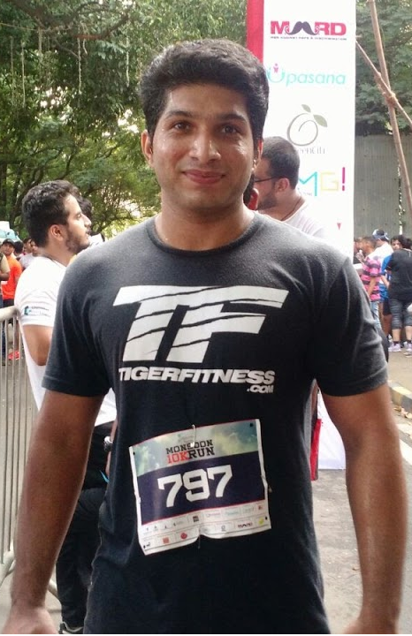
Intro to Virtual Machine and Docker
Target Audience: Developer Friends
Sukrut Wagh
TECHNOLOGIST/ARCHITECT, ZYCUS

Slide 2
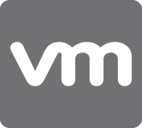

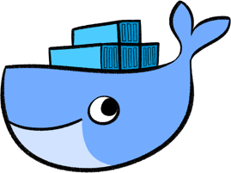
01 – provisioning Virtual machines
02 – Build your own virtual machine
AGENDA
03 – Docker containers

Slide 3
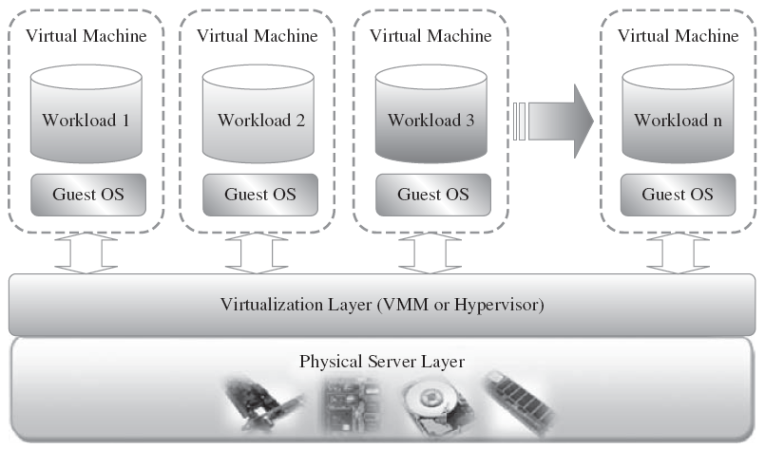
Virtualization overview
VMM PROVIDERS:
Oracle VIRTUAL BOX (OVF)
VMWARE (VMDK/VMX)
Red hat KVM
Amazon EC2 (AMI)
Microsoft hyper-v

Slide 4
Vm provisioning – few use cases
on-boarding new developers with ready to use vms
spawning new environments – dev, test, staging, prod, etc
Replicate vm to simulate and troubleshoot production issues
backup and restore, disaster recovery
Learn/Play with different os – linux (centos, ubuntu, solaris, etc), macosx
Use ready-to-use prebaked vms to learn new technologies (mongo, nodejs, hazelcast, etc) without spending time installing and configuring software
Avoid dependency on it teams to provision new machines/software ☺

Slide 5
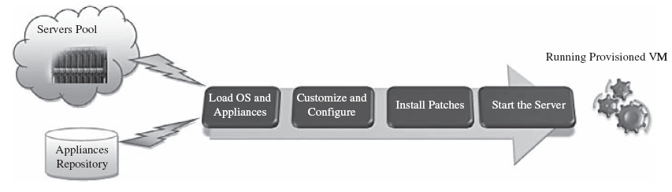
Vm provisioning process

Slide 6
Vm provisioning – few challenges
Change management
Vm lifecycle management
Compatibility – physical machines, vms, os versions, software
Manual process too time consuming
Upgrading
Configuration management

Slide 7
Vm provisioning – provisioners
Ansible
Chef
Puppet
Salt stack
Scripts – powershell, shell
Vagrant*

Slide 8
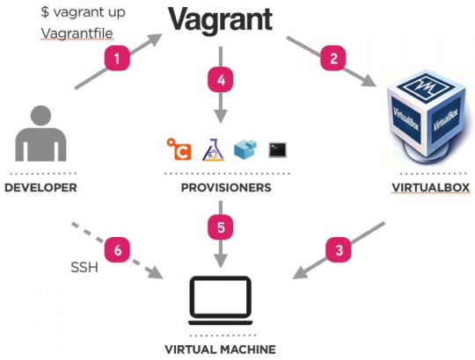
provisioning Virtual machines with vagrant

Slide 9


Slide 10
Create a vagrant project
Create an vagrant project and vagrantfile

Slide 11
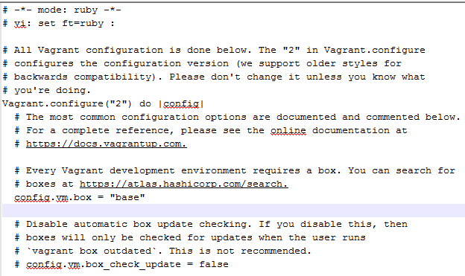
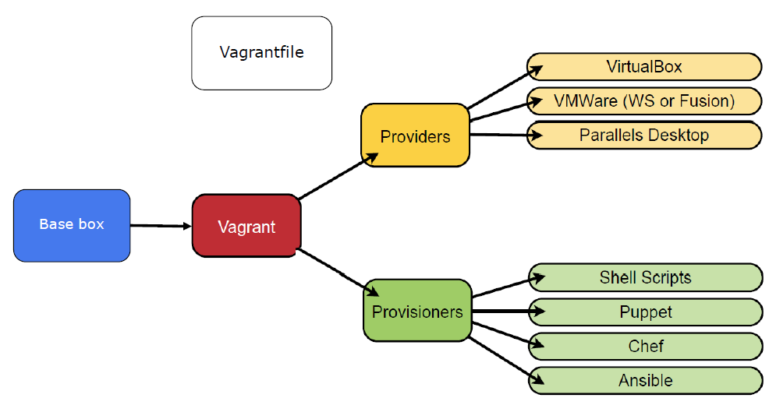
Vagrant file
Vagrant file – quick peek

Slide 12
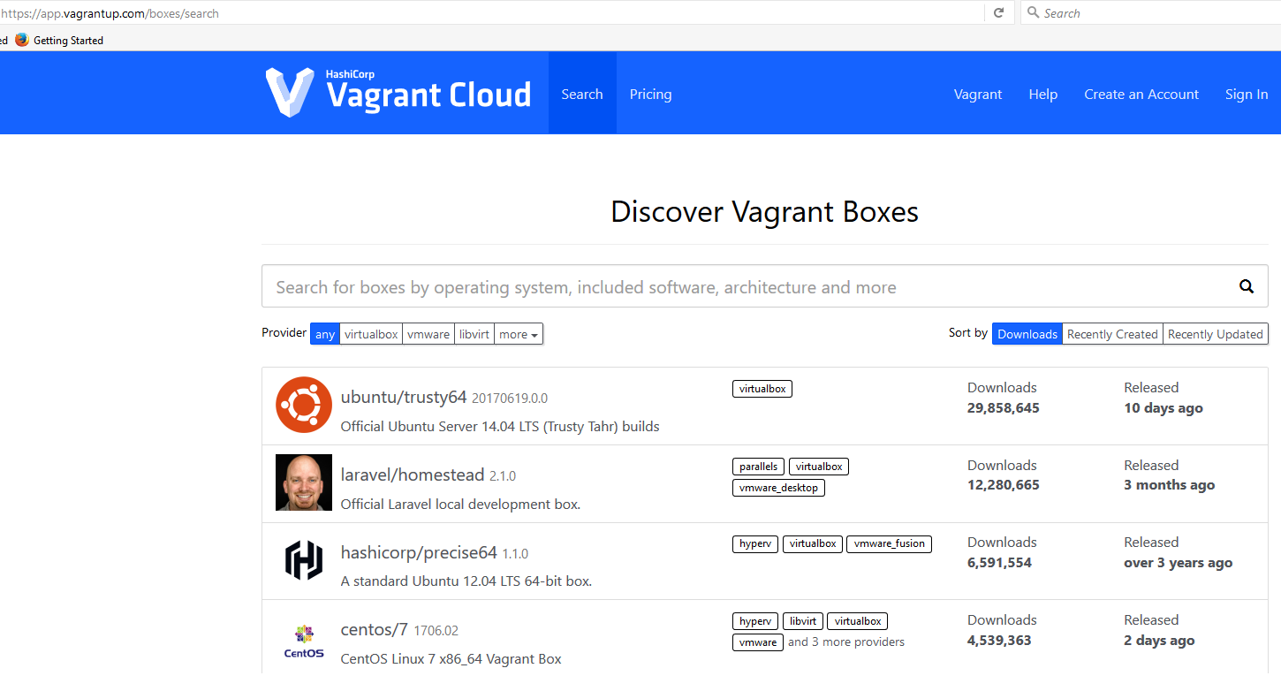
Add vm image / box
Add an base vm image (box)
From vargant cloud - https://app.vagrantup.com/boxes/search
downloaded image from vendor website

Slide 13
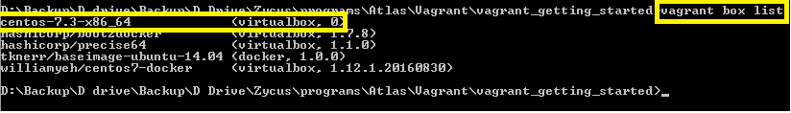

Use the box in your project
List boxes
Use the box in the project

Slide 14
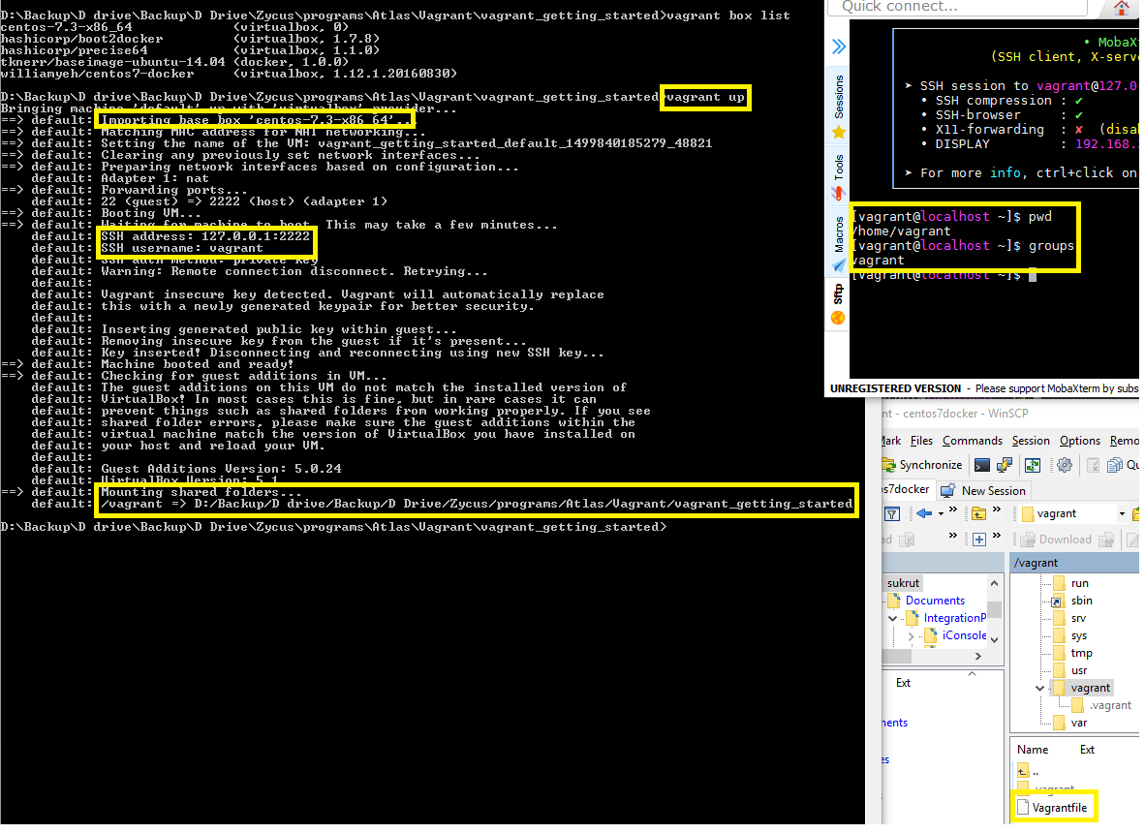
Boot the VM
Start the box

Slide 15
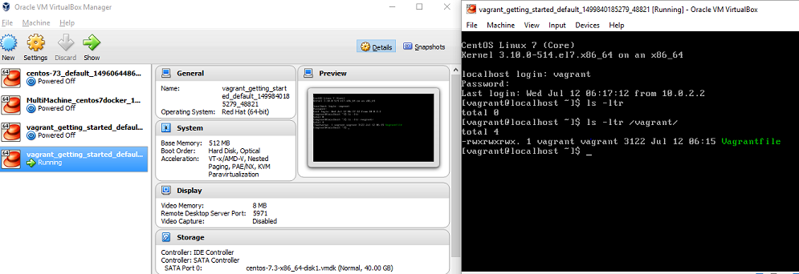
Work with vm from virtualbox manager
Virtualbox manager

Slide 16
Try these next steps
Add a provisioning step using any – shell, ansible, chef, puppet, etc.
Provision a web server – apache http, nginx, etc

Slide 17
Some benefits of using vagrant
Provision any vmm provider – virtualbox, vmware, aws, etc.
Use any vm provisioners – ansible, chef, puppet, salt, etc
Single configuration controller – vagrantfile
Consistent/same configurations applied across environments – jvm, apache, nginx, nodejs, os specific, etc.
Provision multiple vms in single file
Supports to Standardize devops workflows

Slide 18
Build your own virtual machine – few use cases
Readily available images comes with unwanted things
Create enterprise vm base boxes repository that meets company’s needs
Cherry pick your enterprise defined stack – os, vmm provider, software, etc.
Enterprise standards machine configurations to build software products on
Centrally apply policies – governance, security, upgrade, etc

Slide 19
Build your own virtual machine – few challenges
Identical vm for different vmm providers – ami, virtualbox, openstack, etc
Maintaining consistency over time
Learning curve – os, technologies, many more
Effort and Time extensive

Slide 20
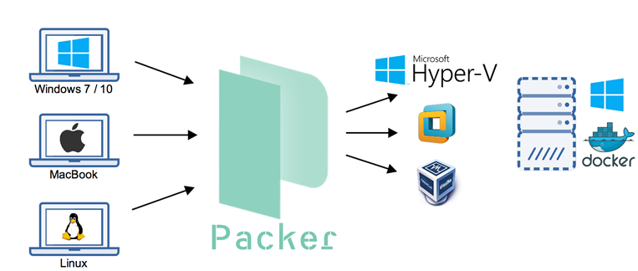
Build your own virtual machine with packer

Slide 21
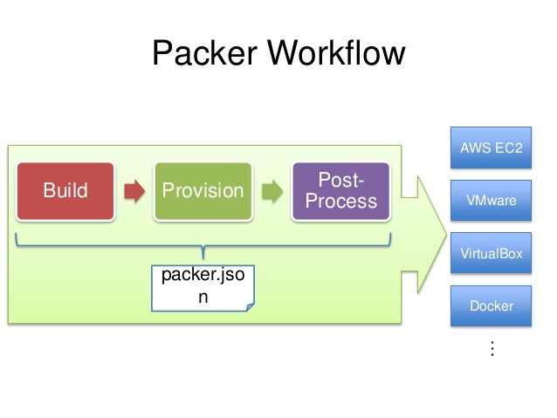
packer

Slide 22
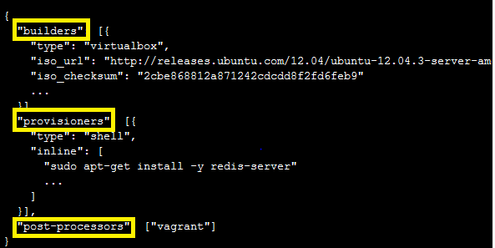
Packer template – json file
Builders – build for various platforms
Provisioners –
Install & configure machine after booting
Use builtin & 3rd party software
Post processors
Upload artifacts
Re-package

Slide 23
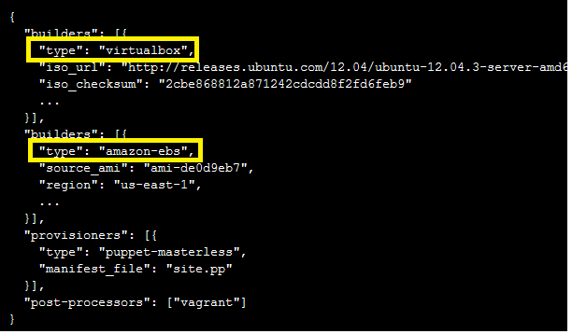
Packer builders
Amazon ec2
Azure
Vmware
Virtualbox
Openstack
Google cloud
Digital ocean
Hyper-v
Docker
Many more

Slide 24
Packer provisioners
To:
Install os packages
Kernel patching
User & group provisioning
Download application code
Install software
Apply configurations
Available provisioners:
Ansible
Chef
Powershell
Puppet
Salt

Slide 25
Packer post-processors
To:
Repackage to different output – aws, vagrant, docker, etc
Upload artifacts
Available post-processors:
Vagrant
Docker
Amazon
Atlas
Checksum
Compress

Slide 26
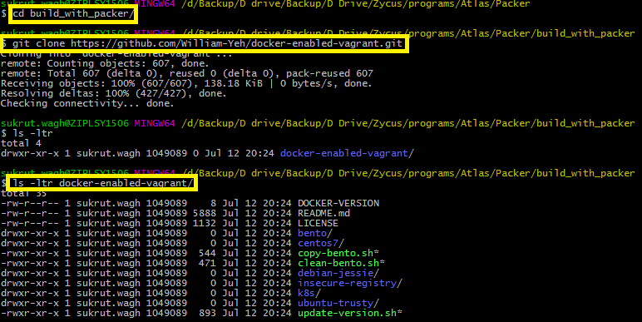
Packer example – building a base image
Clone git repo - https://github.com/William-Yeh/docker-enabled-vagrant.git

Slide 27
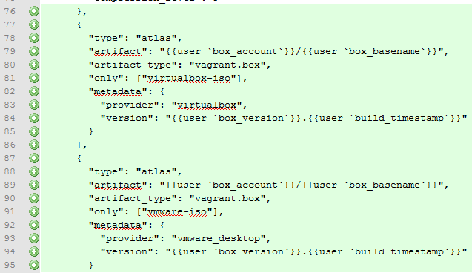
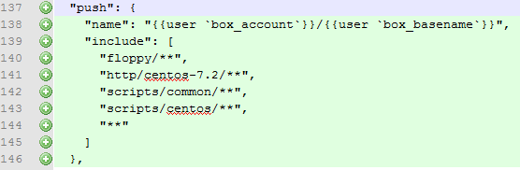
Packer example – building a base image
Update packer template for centos

Slide 28

Packer example – building a base image
Setup bento

Slide 29

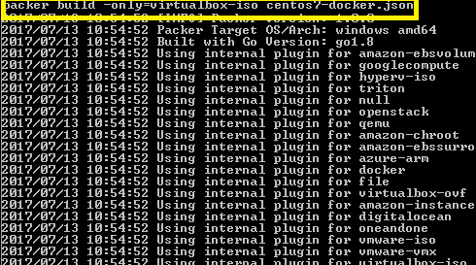
Packer example – building a base image
Build vm image

Slide 30

Take a break

Slide 31
Check out your built image

Slide 32
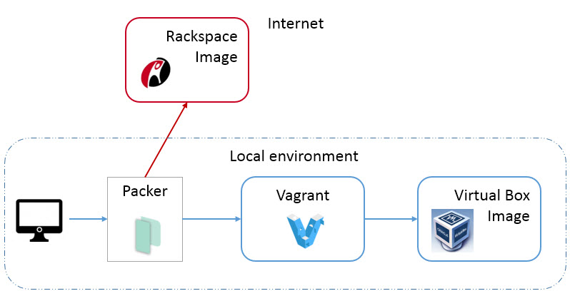
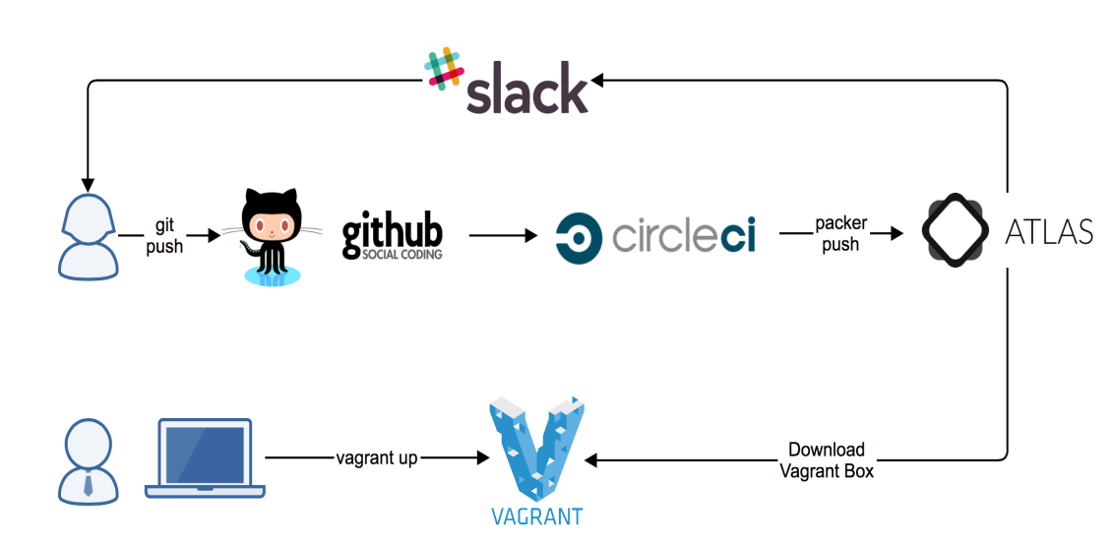
Sample workflows with Packer+vagrant

Slide 33
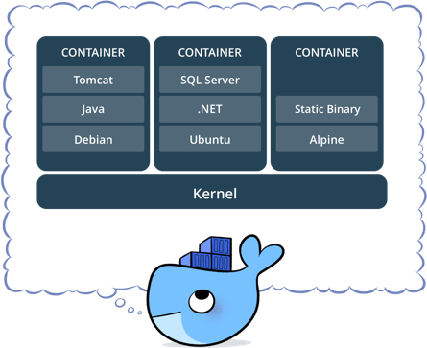
containers
lightweight, stand-alone, executable package of a piece of software that includes everything needed to run it: code, runtime, system tools, system libraries, settings
Written in golang language

Slide 34
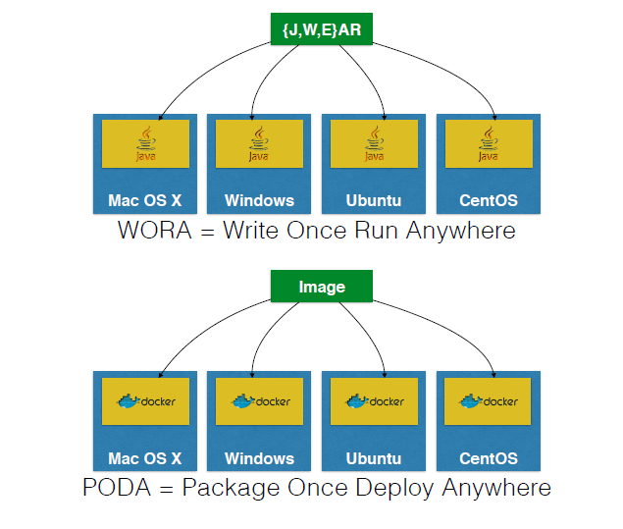
ANALOGY – JAVA & DOCKER

Slide 35
Docker – use cases

Slide 36
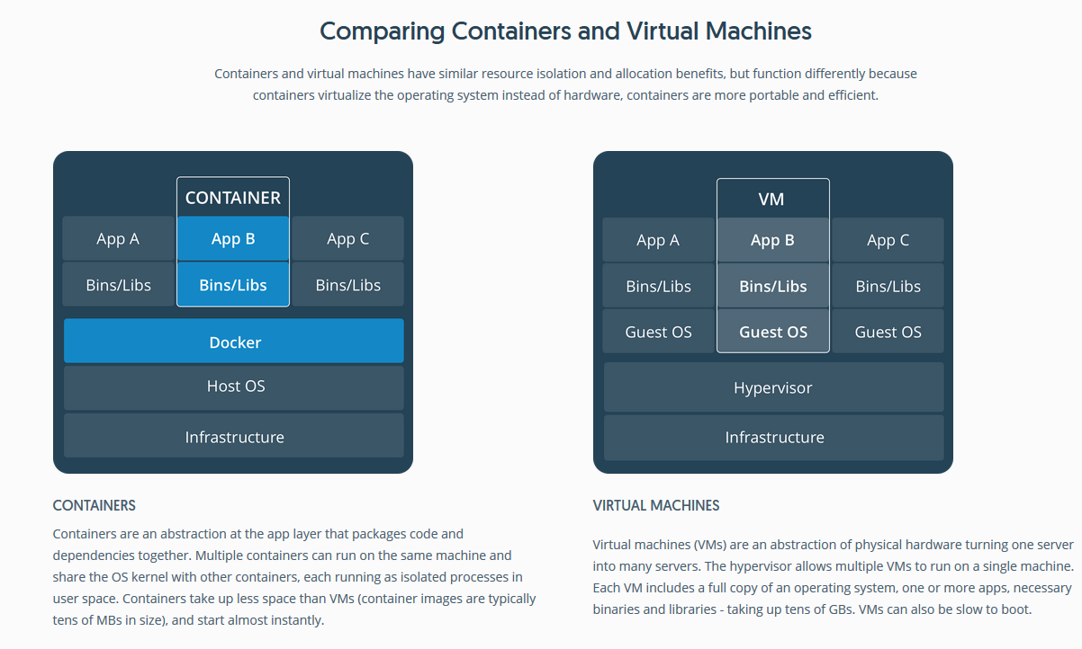
Vm & container – HOW THEY COMPARE

Slide 37
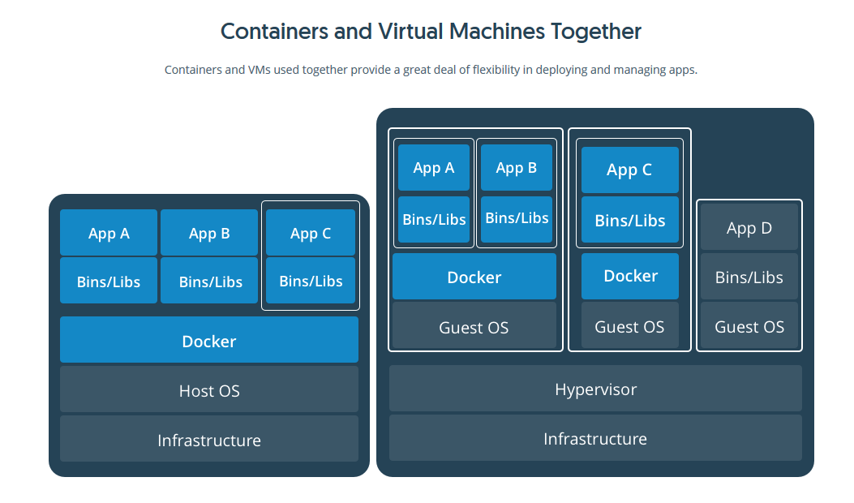
Vm & container – WORKING TOGETHER

Slide 38
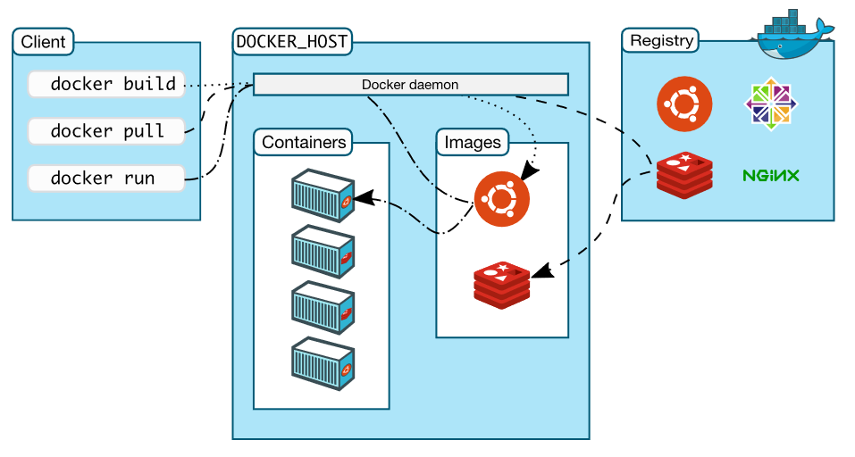
DOCKER ARCHITECTURE

Slide 39
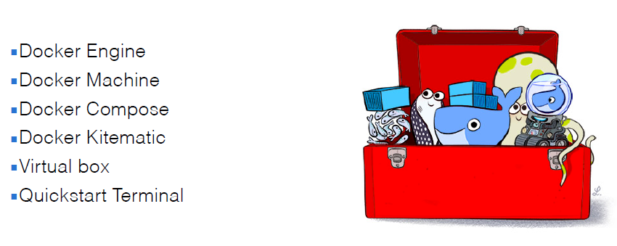
DOCKER – quick start with toolbox / Docker for Windows

Slide 40
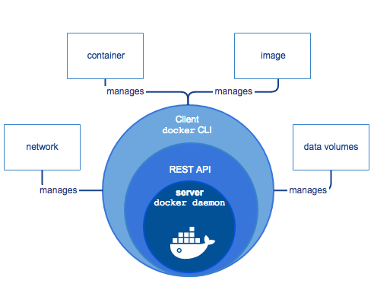
DOCKER engine

Slide 41
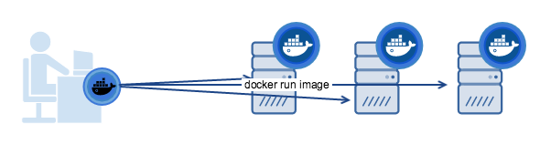
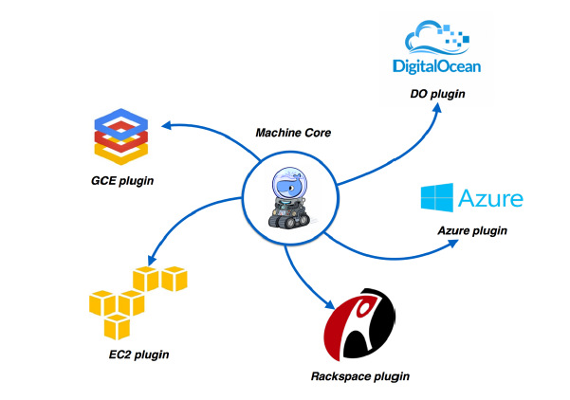
DOCKER machine
provision & manage dockerized host on remote host or cloud provider
docker-machine create --driver=virtualbox myhost
Configure Docker client to talk to host
Create and pull images
Start, stop, restart containers
Upgrade Docker

Slide 42
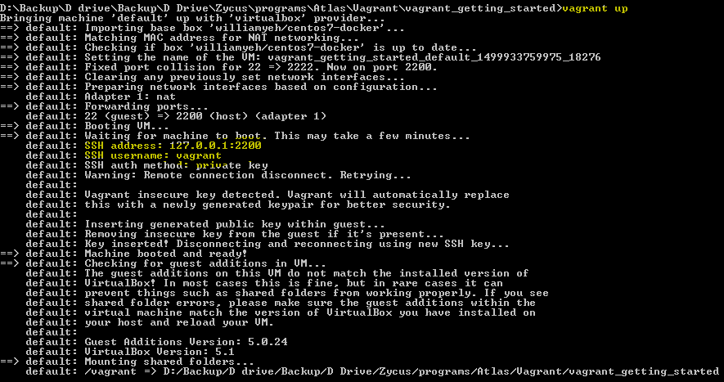
Start vm image with docker installed
Boot vm image with docker installed

Slide 43
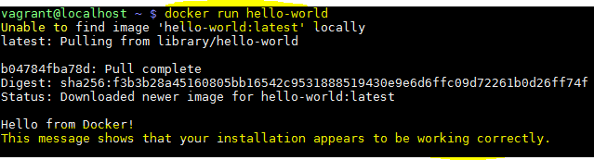

Check docker installation
Perform some checks

Slide 44
DOCKER objects
Image:
read-only template with instructions for creating docker container
Often based on another image
Created with dockerfile
Built with: docker build -t <namespace>/<image_name>
Pull from docker hub with: docker pull sukrutwagh/friendlyhello
Container:
Runnable instance of image
Managed with docker cli or api
Run with: docker run --name sinopia -d -p 4873:4873 keyvanfatehi/sinopia:latest
Other objects: Network, volume, plugins, etc

Slide 45
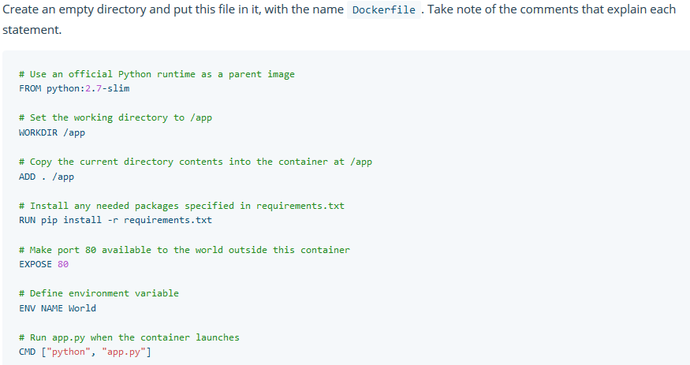
DOCKER file

Slide 46
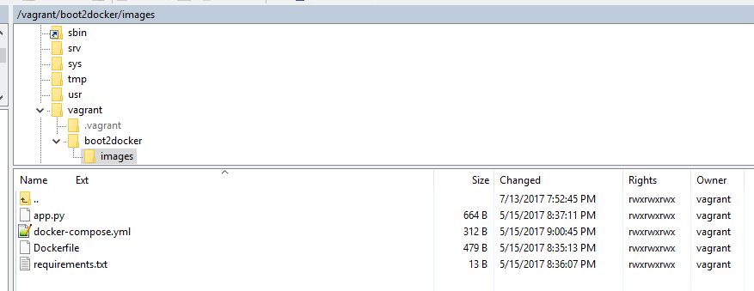
Build docker image
Simple web application

Slide 47
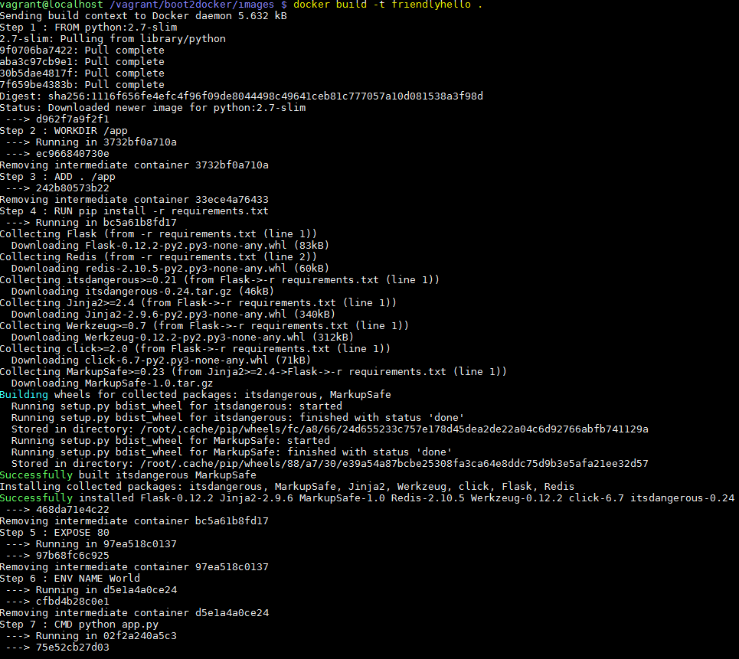
Build docker image
Build docker image

Slide 48

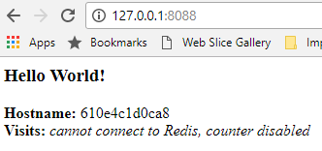
Boot docker container
Start the docker container
how come 8088?
Vagrantfile: binds my pc’s 8088 to centos port 80
config.vm.network "forwarded_port", guest: 80, host: 8088
Docker: binds centos port 80 to docker container’s port 80
docker run -p 80:80 friendlyhello

Slide 49
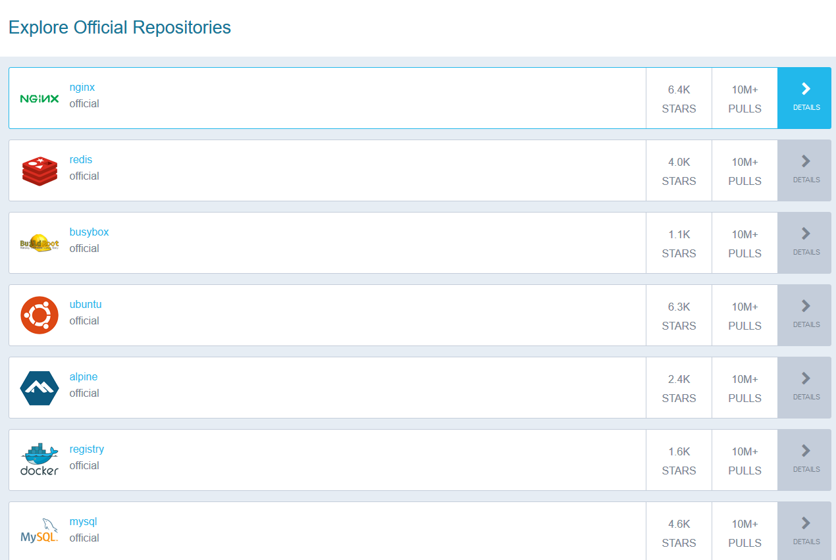
Docker hub
https://hub.docker.com/explore/

Slide 50
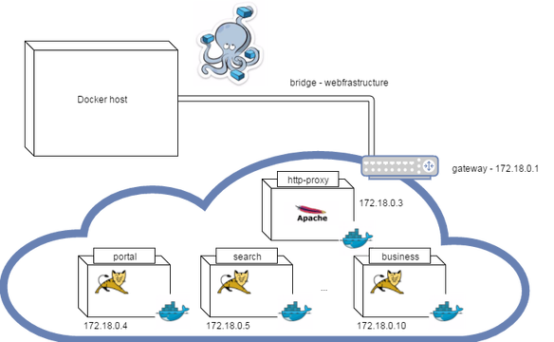
DOCKER compose
Defining and running multi-container applications
Configuration defined in one or more files
docker-compose.yml (default)
docker-compose.override.yml (default)
Multiple files specified using –f

Slide 51
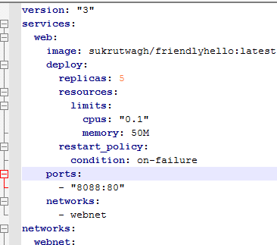
docker service
different pieces of distributed the app are called “services.”
only runs one image, but it codifies the way that image runs
what ports it should use
how many replicas of the container should run so the service has the capacity it needs
Cpus, memory limits, storage, etc
Service encapsulates everything for an app
Defined by file: docker-compose.yml

Slide 52
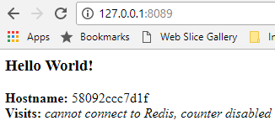
Lets scale the app
Upgrade docker :
sudo service docker stop
sudo yum update docker-engine
sudo service docker start
docker version
docker images
Deploy:
docker swarm init
docker stack deploy -c docker-compose.yml getstartedlab
docker stack ps getstartedlab
http://127.0.0.1:8089/
docker stack rm getstartedlab

Slide 53
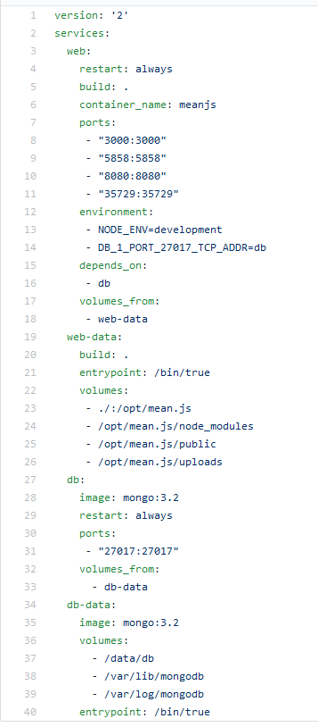
docker compose – mean stack

Slide 54
Try these next steps
Pull docker image for a technology you’d like to learn from docker hub
Explore the technology – mean, nodejs, angular, kali linux, bitcoin, hazelcast

Slide 55
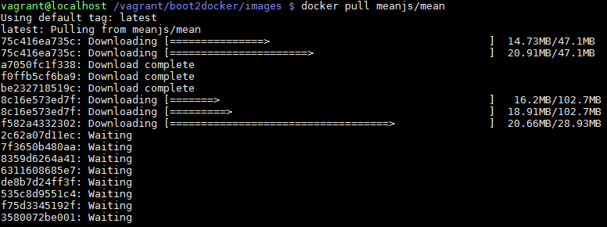
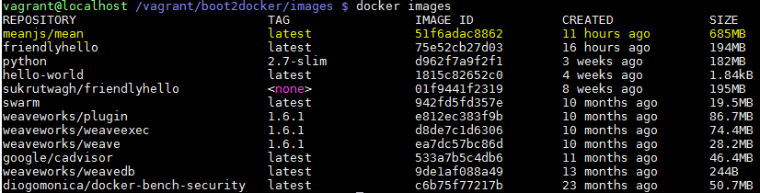
Lets try mean stack

Slide 56


Slide 57
references
https://en.wikipedia.org/wiki/Comparison_of_platform_virtualization_software
https://www.slideshare.net/mhajibaba/cloud-computing-principles-and-paradigms-5-virtual-machines-provisioning-and-migration-services
http://www.intigua.com/blog/puppet-vs.-chef-vs.-ansible-vs.-saltstack
https://speakerdeck.com/julienphalip/boosting-teamwork-using-vagrant
https://www.vagrantup.com/intro/index.html
https://www.packer.io/docs/provisioners/index.html
https://docs.docker.com/get-started/
https://blog.codeship.com/running-mean-web-application-docker-containers-aws/

