Slide 1
Zycus Docker and K8S Use Cases version 1.1

Slide 2
Use Cases
Service self-healing (availability)
Service Horizontal Auto scaling: CPU, memory, app criteria – no. of tenants, timeframe, etc.
Deployment environment:
Today: Developer desktop, Local – Physical, Virtualized, AWS, Navisite
Future support for PaaS: GCP, Azure, Openshift, something else?
Package once – deploy anywhere
Automated deployment (upgrade, rollback) promotions from dev to prod with ideally 0% downtime
Balance Agility with reduced impact
Manage deployments at scale (100-1000…)

Slide 3
Steps Required – Journey starts with YOU!
Every deployment should have limited impact
Rethink application design, dependency management, packaging, deployment, disposability, scaling, monitoring, stateless, etc. - beyond 12 factors
Externalize Configurations – static, environment specific
Service registration and discovery
CI & CD – frequent and repeatable deployments

Slide 4
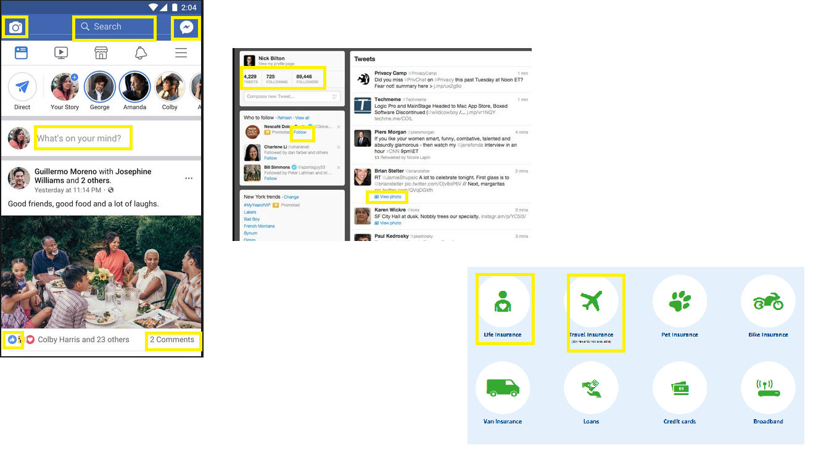
Micro-Service Examples

Slide 5
Moving towards Micro-Services
(De)composition
Single/Limited (group of related) Responsibility Principle
Encapsulate single or group of related functionality as a (micro)service
Every class/function is related to other – keep design highly cohesive with low coupling
Services communicate to other services by a contract/API Spec
Find new opportunities for new service – new (group of) feature/requirement
At the minimum – Write Integration test for your API layer
FAQ:
Who manages DB? It depends… start with having a common DAO library for a product (with many micro-services)
Stacks: spring-boot, Vert.x, nodejs, many more out there
Dependency Management
Declare & isolate: ant, maven, gradle, npm, etc.
Central binary management: Nexus, Artifactory, etc.
Configuration
Static: timeouts, feature toggles, etc.
Environment: url, thread pool size, locations: AMQ, DB, Consul, etc.

Slide 6
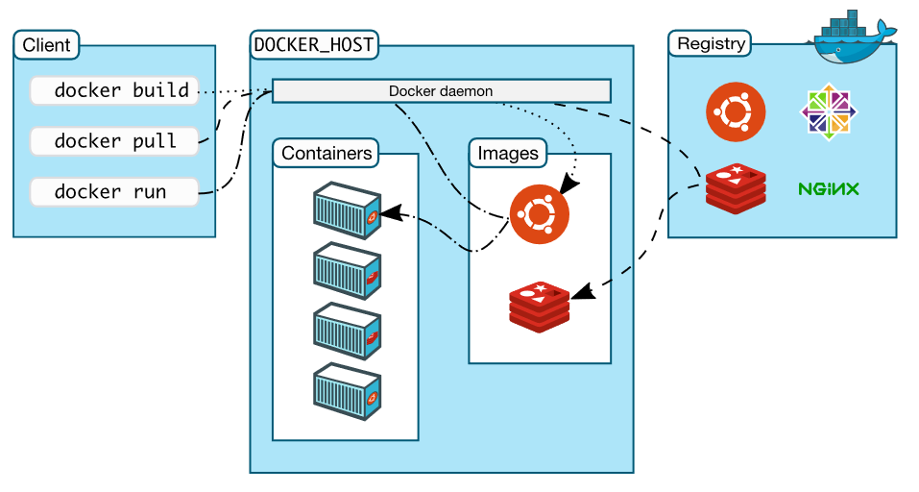
Docker Workflow

Slide 7
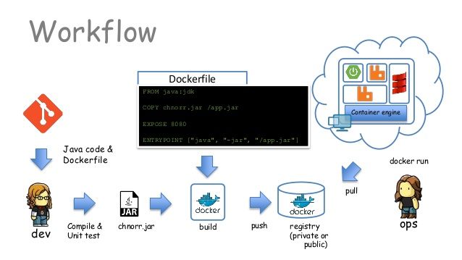
Docker Dev Workflow

Slide 8
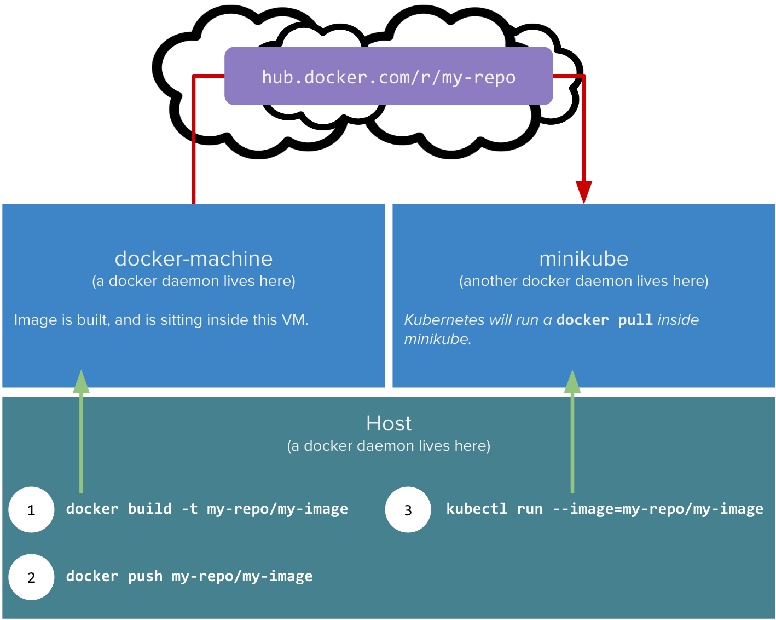
K8S Workflow

Slide 9
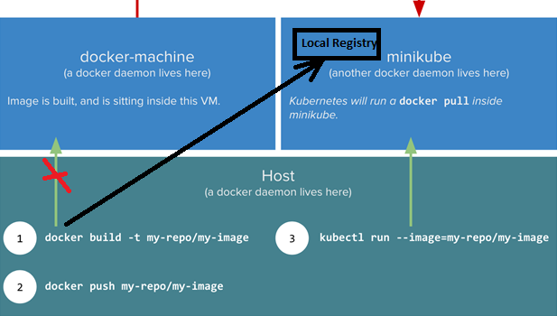
Our Development Workflow

Slide 10
Steps required to DockerizeTPI-Esign micro-service app
Create service deliverable bundle
Libraries/jars
Control scripts – JSW, start, stop, restart, pause, etc.
Create DockerFile
Choose appropriate parent image - FROM anapsix/alpine-java:8_jdk
Externalize environment variables – Consul coordinates, service’s artifact name, directory path’s , etc.
Mount external storage
Steps – create directories, Unzip, clean up, set permissions
Expose service ports
Build Service Docker Image
docker build -t zycus/esign-service:v1 .
Run Image
docker run -dit --env CONSUL_ENVIRONMENT=DEV --expose=8082 -p 7011:8082 zycus/esign-service:v1

Slide 11
Steps required to Manage service lifecycle with Kubernetes
Setup K8S local development environment
Minikube
Connect to docker registry – micro services docker images available in this registry
Enable heapster for auto-scaling
Deploy & Run micro-service app
kubectl run esign-service --image=zycus/esign-service:v1 --requests=cpu=0.5 --port 8082 --env="CONSUL_ENVIRONMENT=DEV" --replicas=2
Expose K8S service – Service discovery & load balancing
kubectl expose deployment/esign-service --type="NodePort" --target-port=8082
Setup Auto scaling
kubectl autoscale deployment esign-service --min=2 --max=5 --cpu-percent=50

Slide 12
Use Cases to be explored
Automated Rolling Upgrades & rollbacks
External Volumes
Multi-geography deployments

Slide 13
Change Revision History
Version | Date | Change Summary
1.0 | 03-MAR-2018 | Basic TPI use cases – instance recovery & auto scaling
1.1 |  | Added development workflows

