Slide 1
Being Omnichannel In Retail
Sukrut Wagh

Slide 2

Plan For Today
Today’s Omnichannel Retail
01
Customer Journeys
02
Way Forward
04
Current State of Capabilities
03
Ask questions any time.

Slide 3
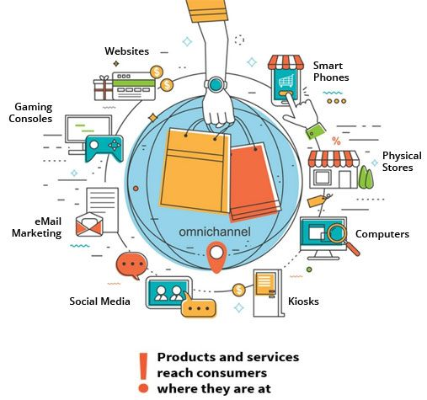
Omnichannel Retail

Slide 4
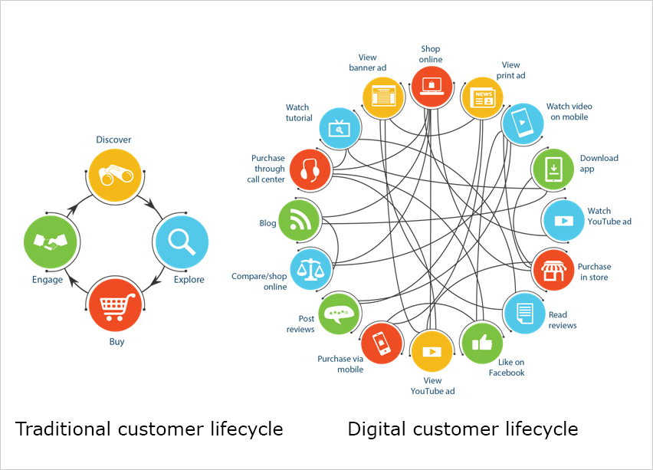
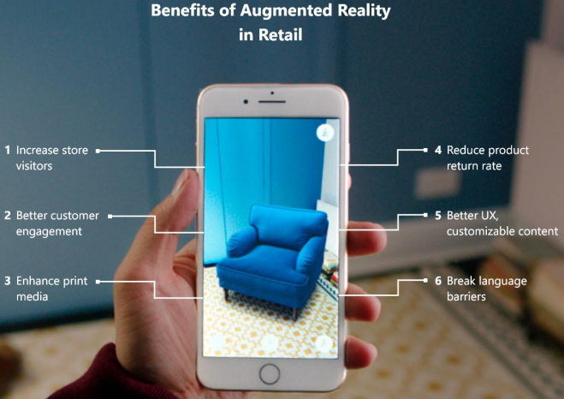
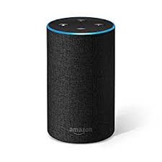
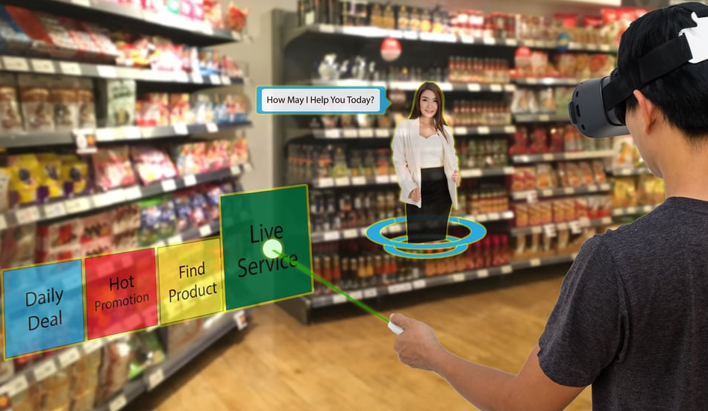
Today’s Customer
Some recent experiences…

Slide 5


Omnichannel Customer
Persistent Shopping bags
Ship to home
Ship to store
In-Store pickup
Car park pickup
Same day delivery
Browse Store Inventory
Easy Payments
Easy Returns

Slide 6

Common barriers
Not knowing your customer journeys well
Silos - Org|Product|Channel
Content fragmentation
Inconsistent integrations
Tactical Approaches
Legacy Architectures
Talent/Expertise/Resources
Budget

Slide 7






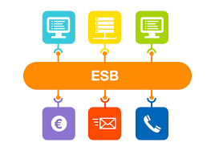
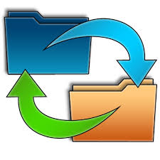
Current State (Looks similar?)
Store Front
Supply Chain
Marketing
Corporate
Digital
3rd Party
HR
Product Artwork
Product Catalog
Finance
Inventory
Direct DB Connections
Batch ETLs
Official Data Sources
Notes:
Each group has their own ways to integrate
Each group creates their own replicated data sets

Slide 8
What is needed?
Platform Strategy
Ability to build Lego like building blocks
A set of fundamental data and services desired by all channels
Ability to extend core services and build new use cases
Guiding principles

Slide 9
Fundamental Component Examples
Data
Item API
Price API
Inventory API
Location API
Tax API
Customer API
Order API
Promo API
Vendor API
Process and Logic
Checkout API
Cart API
Restrictions API
Exchange and Returns API
Address Verification API
Item Movement API

Slide 10
Fundamental Data Aggregations
Pre-joined and cached fundamental data, used to pre-calculate commonly used data patterns and protect fundamental data services from excessive load
Item-Location-Price API
Customer-Orders API
Item-Offer API
Item-Location-Price
Cache
Customer-Orders
Cache
Item-Offer
Cache

Slide 11
Fundamental Business Process
The generic components of a business process, presented as an API, that can be used by all channels that execute the business process
Checkout API
Cart API
Item Setup API
Offer Setup API
Payment API
Fulfillment API
Returns API

Slide 12
Fundamental Business Logic
The proprietary logic of the business, presented as an API, that is used by all channels that require that business logic
Restrictions API
Cart Price API
Address Verification API

Slide 13
Platform Foundation
Business Logic
Business Process
Data Aggregations
Restrictions API
Checkout API
Cart API
Item-Location-Price API
Cart Price API
Payment API
Item Setup API
Customer-Orders API
Worker Pay API
Fulfillment API
Offer Setup API
Item-Offer API
Addr Verify API
Returns API
Fundamental Data
Price
API
Promo
API
Customer
API
Location
API
Tax
API
Order
API
Item
API
Inventory
API
Vendor
API

Slide 14
What is a Tenant?
A consumer of the platform that builds applications using and extending the platform fundamental services
Tenant drives an interaction with an actor
Tenants are coarse grained around a channel (digital, store, supply chain, corporate)
Isolation from other tenants
Can only call services within the tenant, or provided by the platform

Slide 15
What is a Tenant?
Single Tenant Components
User Interface
User Interface
User Interface
View Controller
View Controller
View Controller
Business Logic Extension
Business Process Extension
Tenant Specific APIs
Service Aggregator
Tenant
Logic Data
Tenant
Process Data
Tenant
Data
Forward
Cache

Slide 16
What is a Tenant?
Tenant and Platform
Tenant
Tenant
Tenant
User Interfaces
User Interfaces
User Interfaces
View Controllers
View Controllers
View Controllers
Tenant Services
Tenant Services
Tenant Services
Forward Cache
Forward Cache
Forward Cache
Business Logic APIs
Business Process APIs
Data Aggregation APIs
Fundamental Data APIs – READ ONLY
Price
Promo
Customer
Location
Tax
Order
Item
Worker
Vendor

Slide 17
Eventual Consistency
The Fundamental Data layer contains the true real-time operational data – source of truth
Fundamental Data is exposed to the Platform as READ ONLY
All other layers are caches
Tenants operate almost exclusively off caches
Tenant applications must be designed for eventual consistency

Slide 18
Events
All data changes are events
Tenants do not write to Fundamental Data
Tenants emit events
Fundamental Data listeners process events

Slide 19
Tenant
Merchandising Tenant
Price Management UI
Tenant Services
Tenant Item-Price Event Listener
Price Management API
Forward Cache
Item-Price Cache
Tenants
Price Event
Platform
Business Logic APIs
Business Process APIs
Item-Price API
Item-Price Event
Item-Price Cache
Real Price Event
Item-Price Event Listener
Price
API
Price
Price
Update
Price Event Listener
Data Change Event

Slide 20
Complete Platform
Tenant
Tenant
Tenant
User Interfaces
User Interfaces
User Interfaces
View Controllers
View Controllers
View Controllers
Data Change Events
Tenant Services
Tenant Services
Tenant Services
Tenant Events
Forward Cache
Forward Cache
Forward Cache
Tenants
Platform
Business Logic APIs
Business Process APIs
Data Aggregation APIs
Fundamental Data APIs – READ ONLY
Price
Promo
Customer
Location
Tax
Order
Item
Inventory
Vendor

Slide 21
Analytics Extension
Tenant
Merchandising Tenant
Analytics Platform
Tenant Services
Price Management
Forward Cache
Item-Price Cache
Tenants
Platform
Business Logic APIs
Business Process APIs
Item-Price API
Price Event
Price Event Listener
Real Price Event
Price
API
Price Data Set
Price
Price
Update
Price Event Listener

Slide 22
Process or Logic Extension
Store Tenant
Digital Tenant
Point of Sale
acme.com
Retrieve prior cart
Digital coupon
Address or Pickup?
Paytm, Bitcoin
Store cart
Store only promo
N/A
Chip and Pin
Store Checkout API Extension
Digital Checkout API Extension
Inventory Cache
Item-Price Cache
Inventory Cache
Item-Price Cache
Tenants
Platform
Business Logic APIs
Business Process APIs
Data Aggregation APIs
Checkout API
List of items
Price and promos
Fulfillment options
Payment type

Slide 23
Platform Principles
Operating
No Tenant to Tenant calls
All transactions are Events
Events are (almost) completely open to all
All caching layers are eventually consistent
Scalability
Protect Fundamental Data services
Platform Aggregations and Tenant caches
Throttle events to Fundamental Data layer
Asynchronous writes
Serve majority of traffic from tenant layer
Distribute data to edge
All caching layers are eventually consistent

Slide 24
Architecture Governance Considerations
Every system has a context: Platform or Tenant
Every system has a defined scope: Data, Process, Logic, Aggregation, UI
Tenants are decoupled from other tenants & the platform
Context decides amount of enterprise governance

Slide 25
Tenant Governance
Tenant
Tenant
Tenant
User Interfaces
User Interfaces
User Interfaces
View Controllers
View Controllers
View Controllers
Tenant Services
Tenant Services
Tenant Services
Forward Cache
Forward Cache
Forward Cache
Isolated impact
Open to new technologies
Build and deploy quickly
Tenants make many technology decisions
Tenants

Slide 26
Platform Governance
Platform
Wide impact
Strong technology standards
Durable API contracts
Enterprise decision process
Data Change Events
Tenant Events
Business Logic APIs
Business Process APIs
Data Aggregation APIs
Fundamental Data APIs – READ ONLY
Price
Promo
Customer
Location
Tax
Order
Item
Worker
Vendor

Slide 27
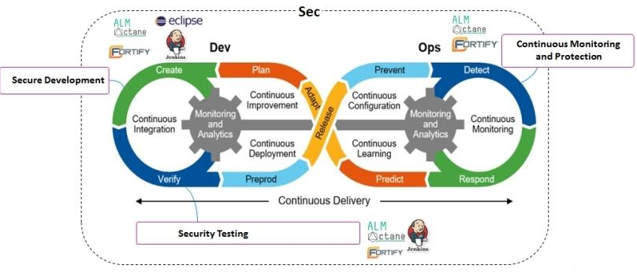
Delivery Practices

Slide 28
Practices
Have cross functional teams
Define lasting (backward & future compatible) API contracts
Monorepo setups might be helpful at initial stages (especially for UI)
Embrace automation (TDD, CI, CD, Docs) and build robust error handling, resilient applications
Graduate general tenant functions to platform where it makes sense
Define starter/accelerator template projects
Be cloud ready – 12 factor app
Incorporate traceability – events, APIs, etc.
Security and authorization – API, data
Keep APIs and event handlers stateless, makes it easier to scale them later

Slide 29
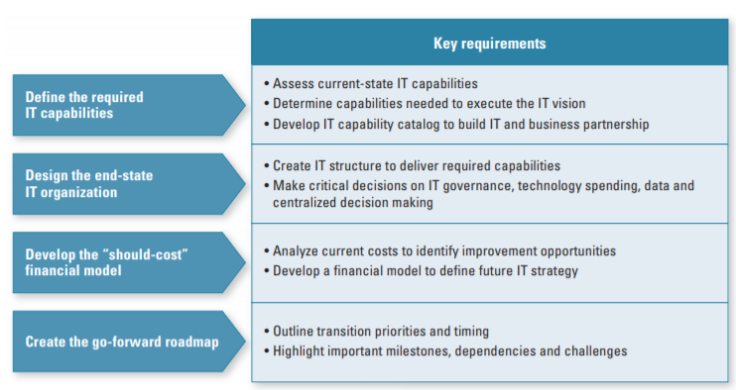
Build IT Capabilities

Slide 30
TODO (Running out of time…)
Deployment strategy for Platform and Tenants
Detailed error handling flows. As a general rule – tenant decides how to handle failures
NFRs – scalability, resiliency, recovery
Tech stack
Configuration management
Analytics
More customer journey examples
IT team capability building details

Slide 31

Thank You

