Slide 1


KARNATAKA CRIME ANALYTICS DASHBOARD
(2023 - 2024)
Data from Karnataka Crime Records

Slide 2

Problem Statement
The Karnataka Crime Dashboard aims to provide a centralized, interactive, and data-driven platform to analyze crime trends, accident patterns, and women's & child safety indicators.
The objective is to help stakeholders identify hotspots, compare year-over-year trends, and take data-backed decisions to improve public safety.

Slide 3
Data Dictionary
Fact Tables:
• FactCrime – Crime victims, arrests, convictions, pending cases
• RoadAccidentsDeaths – Accident counts, deaths, causes, gender breakdown
• SexualHarassment – Reported cases, victims by gender/age/district
• DeathCrimeNegliance – Death by accident
Dimension Tables:
• dim_district_city – District & region mapping
• dim_date – Year-wise mapping
• dim_crime_category – Crime type classification

Slide 4
Insights & Analysis
Key Findings:
• Crime rates vary significantly by district, with some regions showing higher victim counts.
• Road accidents show consistent year-over-year trends with high fatalities.
• Majority of accident victims are male across 2023–2024.
• Sexual harassment cases show distinct district-wise patterns requiring targeted action.
• Top accident causes include over speeding, drunk driving, and mechanical failure.

Slide 5
Future Scope
To enhance the dashboard further, the following can be added:
• Predictive modeling for future crime & accident trends.
• Real-time crime data integration via APIs.
• District-level drill-down maps with heat intensity.
• Advanced correlation analysis between crime, accidents, and demographics.
• Automated alerts for emerging hotspots.

Slide 6
Conclusion
The Karnataka Crime Dashboard provides a powerful analytical platform for monitoring statewide public safety metrics.
It supports decision-making through visualization of trends, district comparisons, and gender-based insights.
This enables policymakers, law enforcement, and researchers to take informed actions to ensure safety.

Slide 7
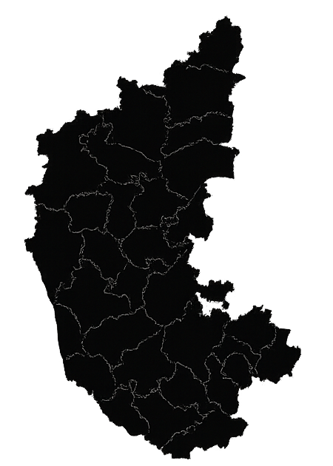
Thank You

