Slide 1
Hackaton Spring 2015
YouSearch
Group #22
The masters

Slide 2
You search
Yousearch uses Youtube V3 Search api to find all the related videos to the search input. Displays the title thumbnails and description of the videos.
Contents :
1.Yousearch
2. Youtube V3 api
3.Login/logout fuctionality
4.Search results

Slide 3
.
1.Login/logout:
I. If a user wants to access the home page, he/she has to login with his/her login details that would be his/her registered username and password.
II.A valid user is directed to the home page. If the user enters invalid details then the user is redirected to login page again.
III. In case if the user is a non-registered user then he/she has to register by providing his/her new username and password. Once the user registration is successful he/she can login on the login page.
IV. If a user forgets his password he/she has the option named ‘forgot password’ to reset his password.

Slide 4
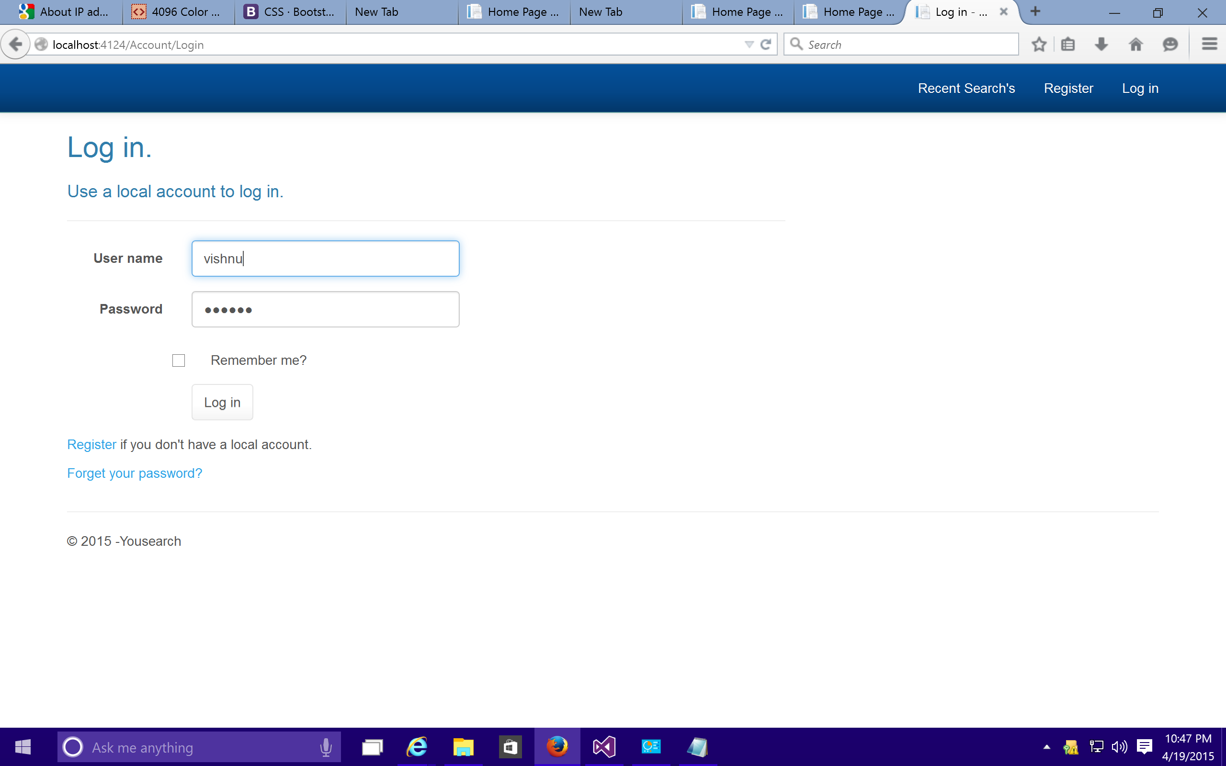

Slide 5
.
2.YouSearch:
I. A web UI is provided with options for recent searches , Search on user interest and Login/logout functionalities.
II. Recent searches doesn’t need any login.
III. Search needs a login (a valid user access).

Slide 6


Slide 7


Slide 8
.
Youtube API:
I. A register user can access to the home page provided with a search option.
II. He/she has to provide a search keyword(s) (a part of the name of the video) to find videos that he/she wants to view.
III. The input search key(s) that are provided by the user is used to retrieve the list of videos that are related to the key string.
IV. If the user provide a valid key string in the search the list of videos related to his search are displayed.

Slide 9
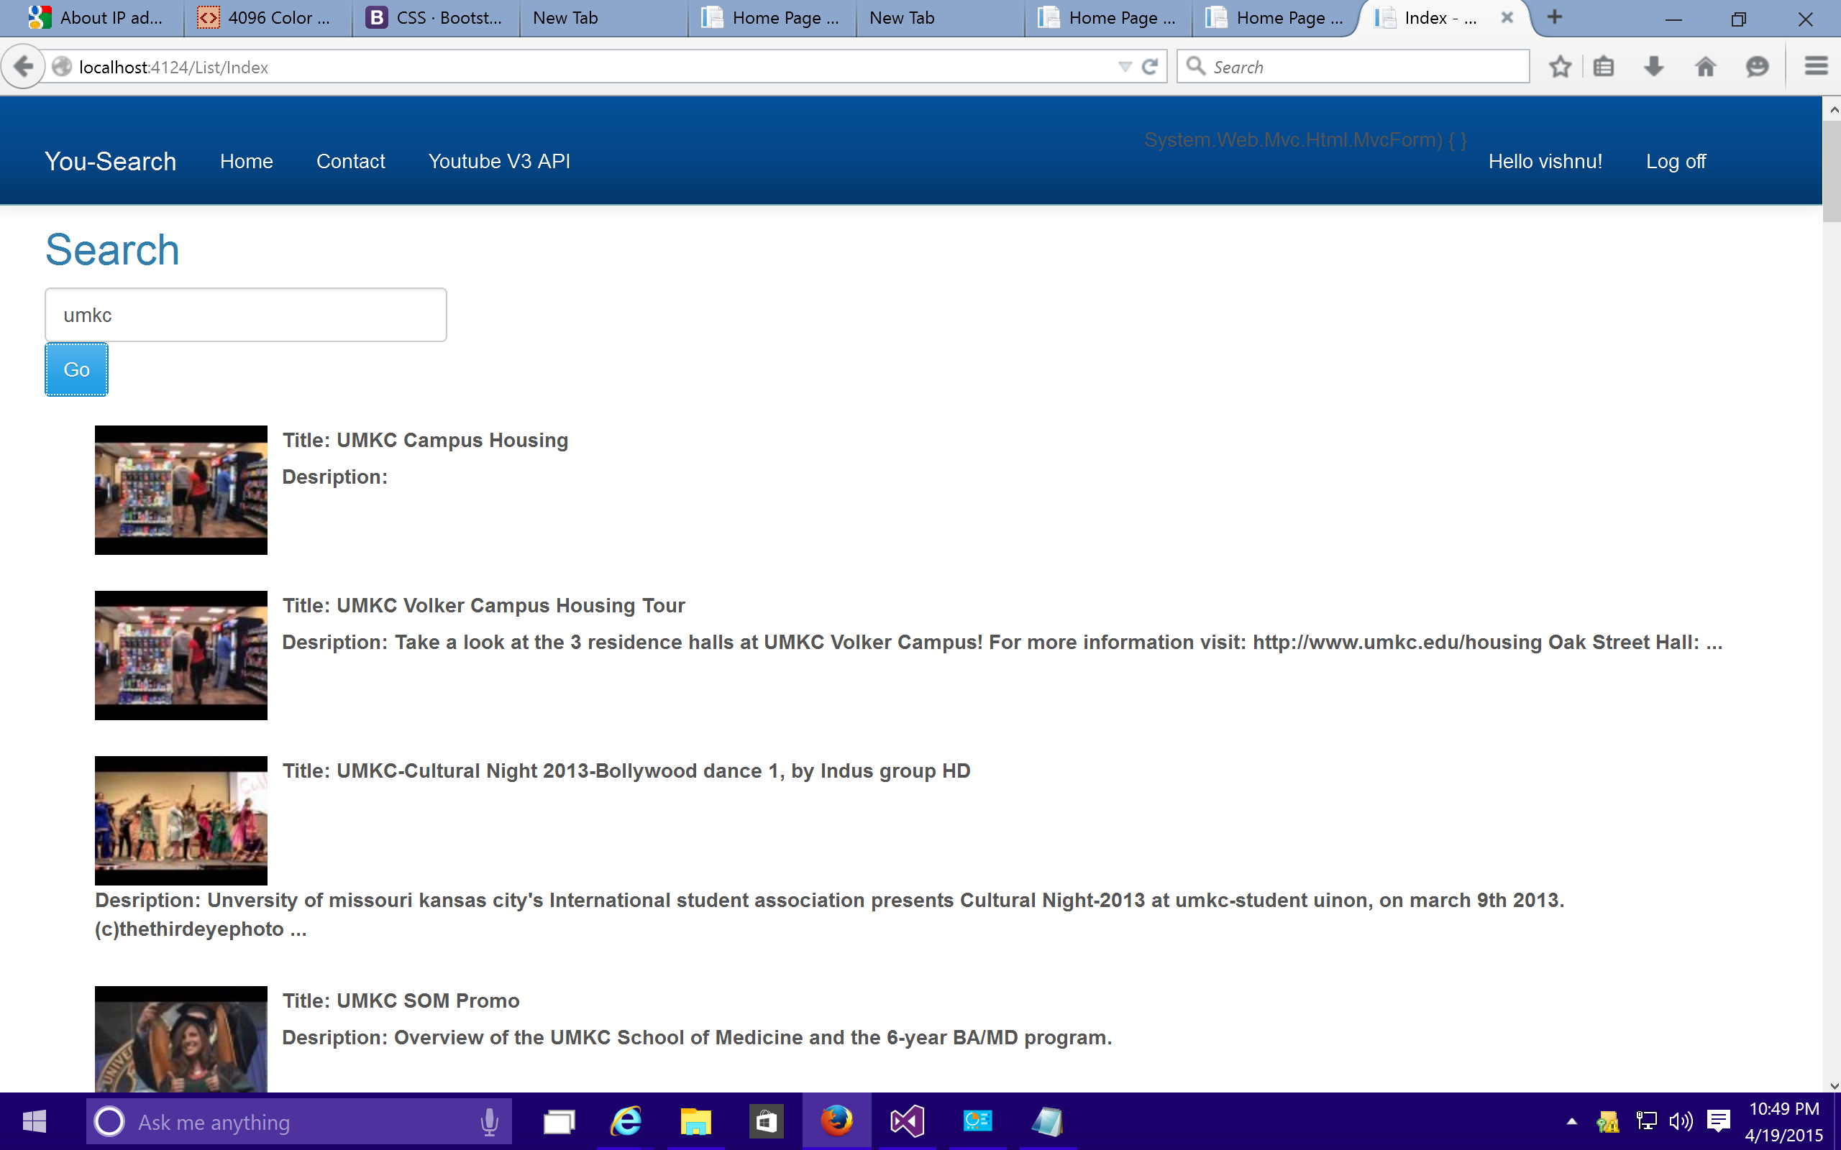

Slide 10
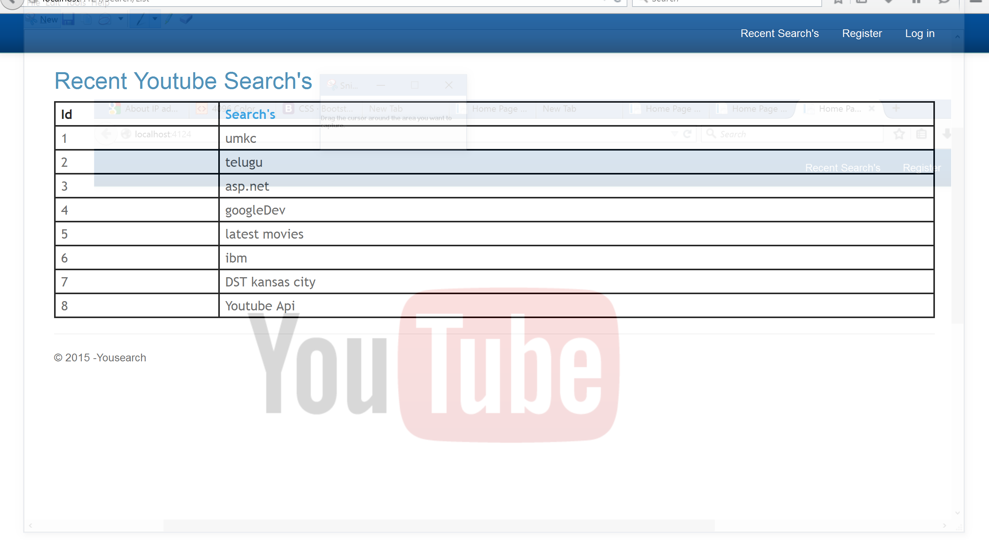
Search Results

Slide 11
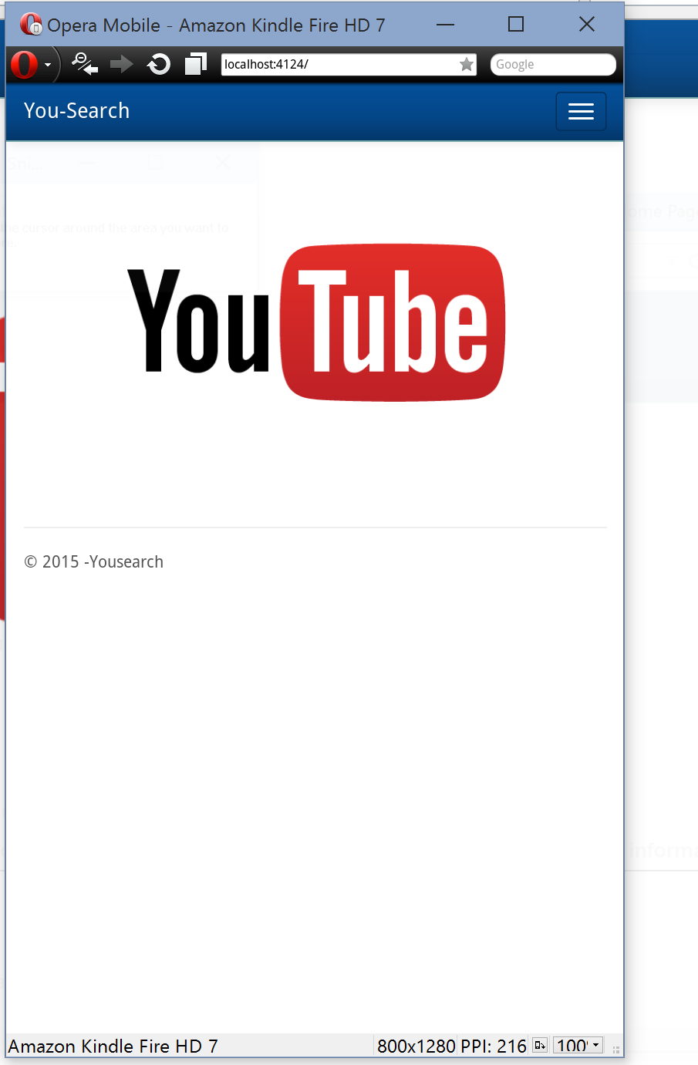
Mobile Implementation

Slide 12
Thank You

