Slide 1
Interim Project 1 UTD Search Engine

Slide 2
Team Members
Ramnath Subramanian
Nikhilesh Amarnath
Shreeya Thatipalli
Krishna Aishwarya
Nikhila Remala
Veera Venkata Sairam Dasari
Sukumar Varma
Srividhya Ranganathan

Slide 3
Introduction
This search engine takes an input from the user and returns a list of relevant URLs.
The spider/crawler initially runs and scrapes URLs and content from the selected domain.
Once all the URLs in a domain have been exhausted, the processor generates a key-value pair for every keyword
These key-value pairs are then stored as JSON to be queried later by the user

Slide 4
Tools Used
Flask (Micro Web Framework) – REST API
Beautiful Soup (HTML/XML Parser) – Web Scraping
NLTK (Natural Language Toolkit) – Word Stemming and stop words removal
React (Front-end Javascript Library) – Front-end UI

Slide 5
Process Flow

Slide 6
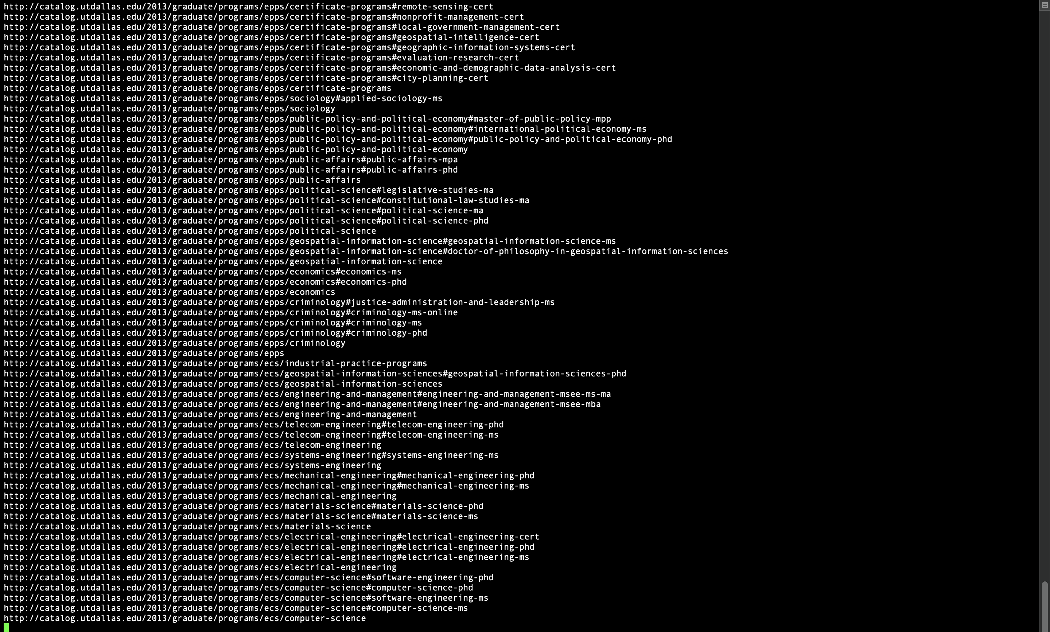
Crawler

Slide 7
Processor
Takes Crawler raw output as input
Removes stop words from the web page content
Stems the words to the root form
Maps the URLs to the word along with frequency
Stores the final map to JSON

Slide 8
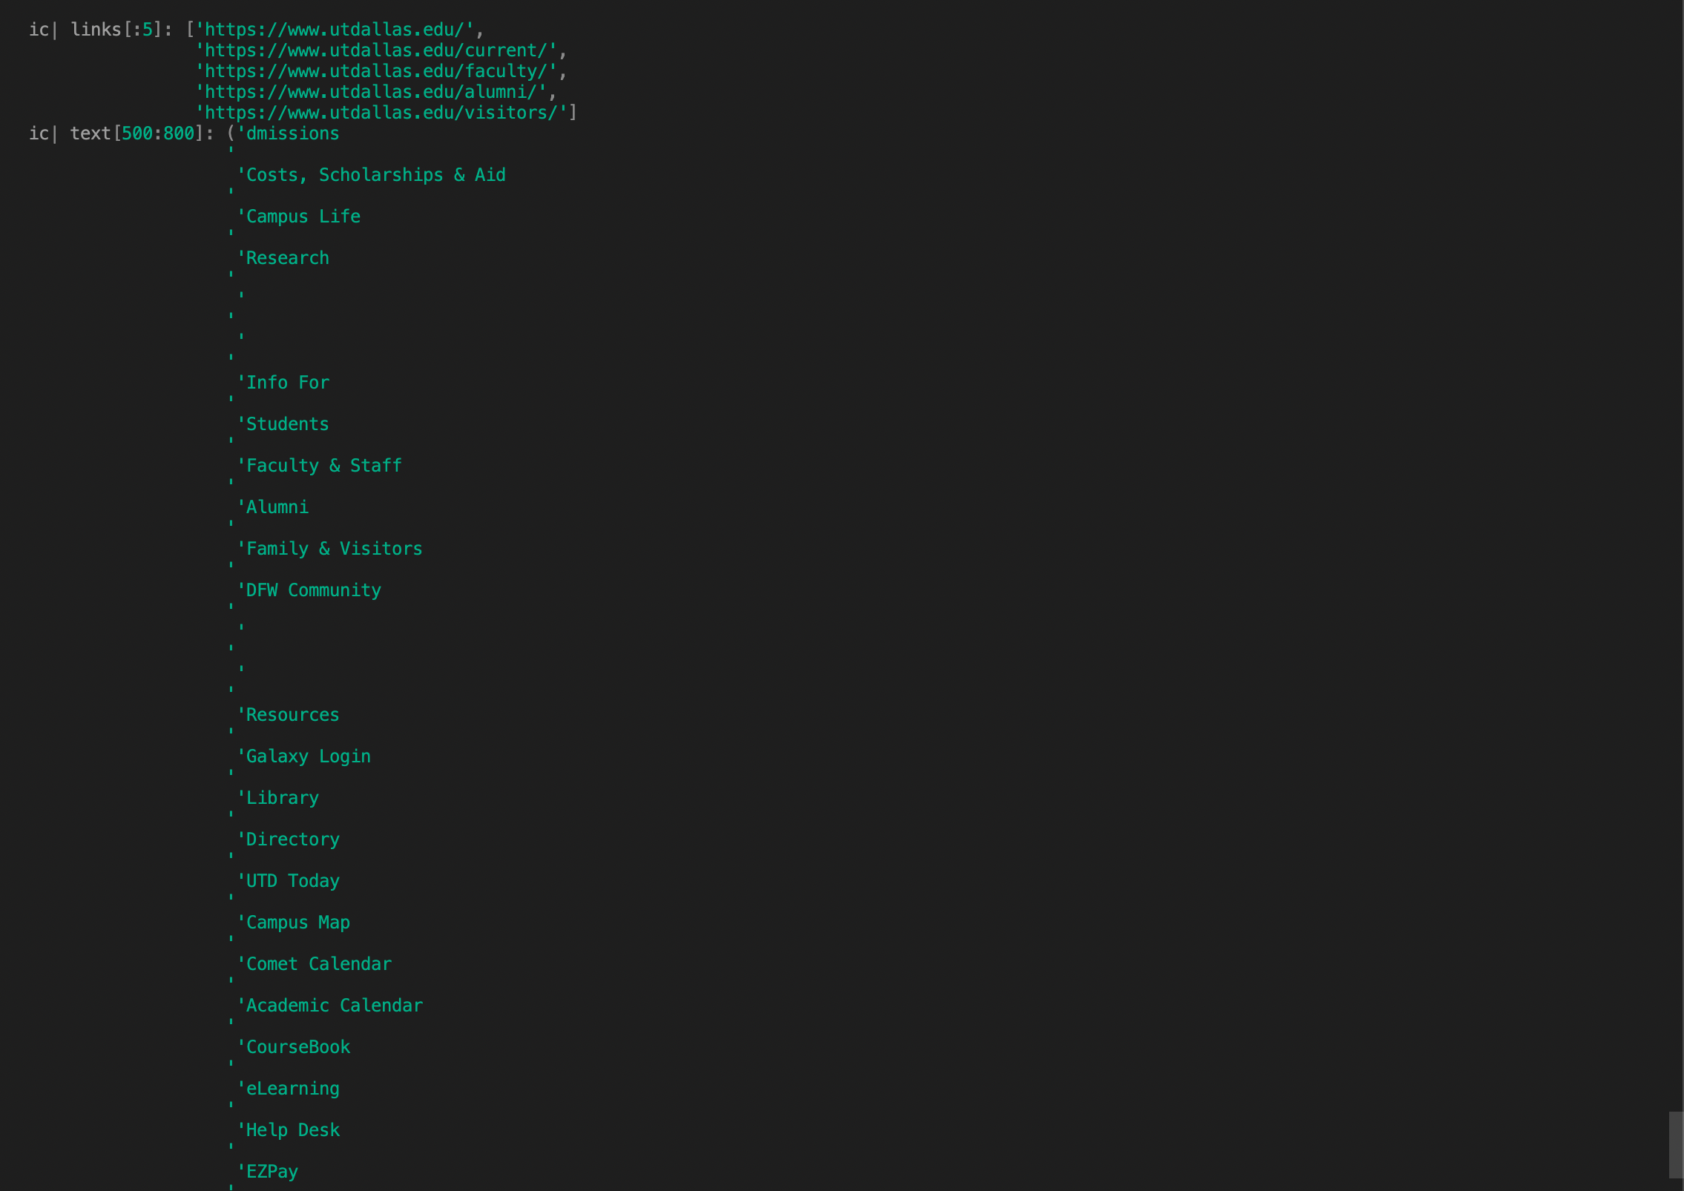
Processor – Input

Slide 9
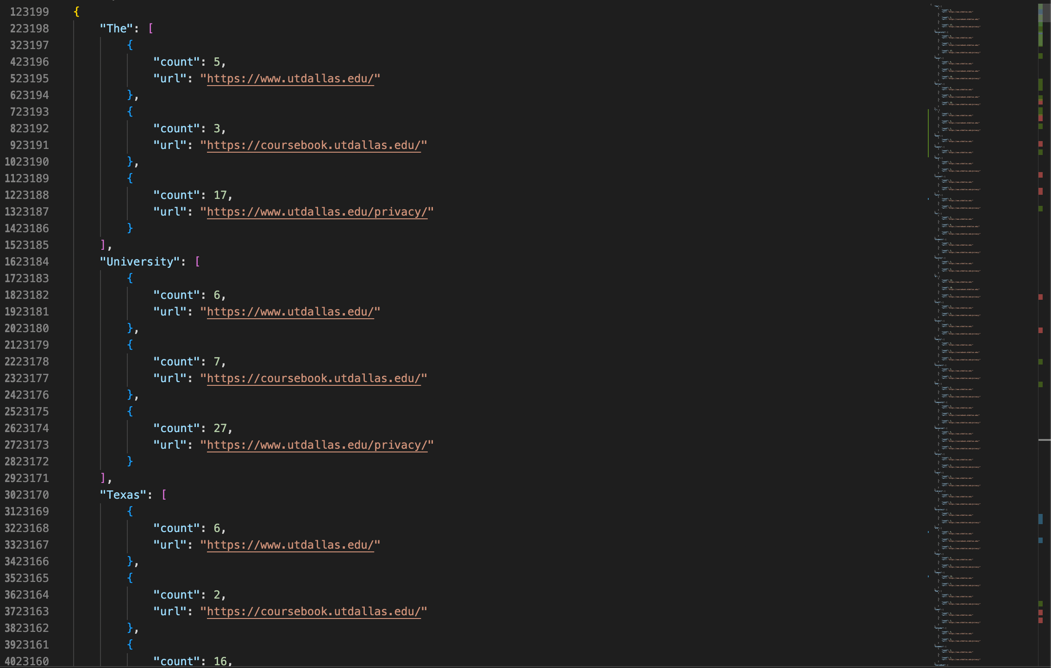
Processor - Output

Slide 10
UI – Search Page

Slide 11
UI – Results Page

Slide 12
UML Diagrams
Usecase Diagram
Sequence Diagram
Class Diagram

Slide 13
Usecase Diagram

Slide 14
Sequence Diagram – Crawler/Processor

Slide 15
Sequence Diagram – User

Slide 16
Class Diagram

Slide 17
Summary

Slide 18
Next Phase

Slide 19

Questions?

