Slide 1
Interim Project 1 UTD Search Engine

Slide 2
Team Members
Rest API, React UI & Use Case Diagram
Veera Venkata Sairam Dasari
Srividhya Ranganathan
Refiner Engine & Sequence Diagrams
Krishna Aishwarya
Nikhila Remala
Shreeya Thatipalli
Crawler, Processor & Class Diagram
Nikhilesh Amarnath
Ramnath Subramanian
Sukumar Varma

Slide 3
Introduction
This search engine takes an input from the user and returns a list of relevant URLs.
The spider/crawler initially runs and scrapes URLs and content from the selected domain.
Once all the URLs in a domain have been exhausted, the processor generates a key-value pair for every keyword
These key-value pairs are then stored as JSON to be queried later by the user

Slide 4
Tools Used
Flask (Micro Web Framework) – REST API
Beautiful Soup (HTML/XML Parser) – Web Scraping
NLTK (Natural Language Toolkit) – Word Stemming and stop words removal
React (Front-end Javascript Library) – Front-end UI

Slide 5
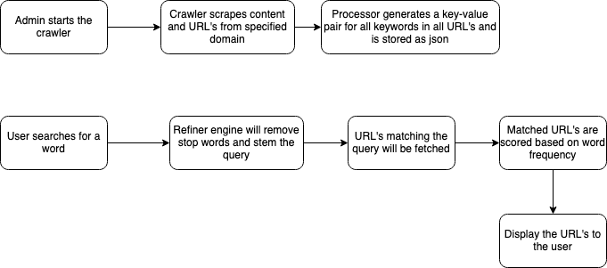
Process Flow

Slide 6
Crawler
Crawls a particular domain
Scrapes webpage content and URLs
Recursively accesses the next URL and scrapes more content & URLs
Ignores webpages under robots.txt

Slide 7
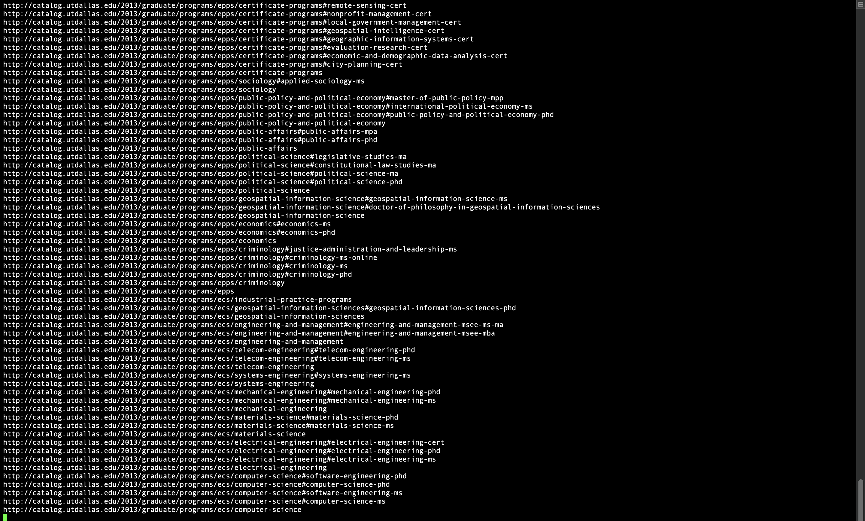
Crawler

Slide 8
Processor
Takes Crawler raw output as input
Removes stop words from the web page content
Stems the words to the root form
Maps the URLs to the word along with frequency
Stores the final map to JSON

Slide 9
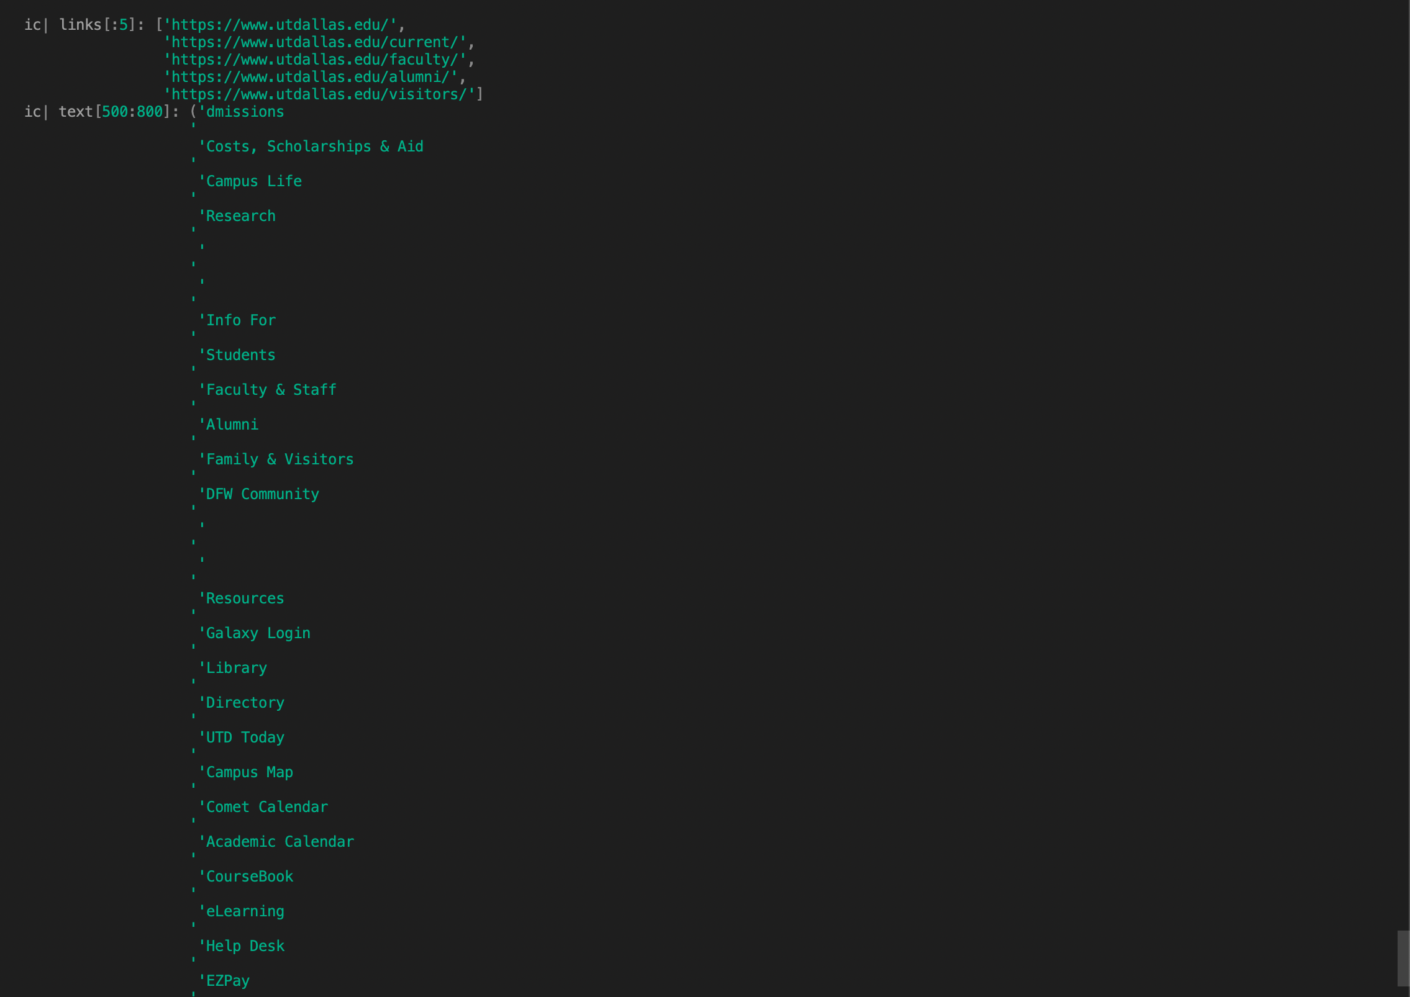
Processor – Input

Slide 10
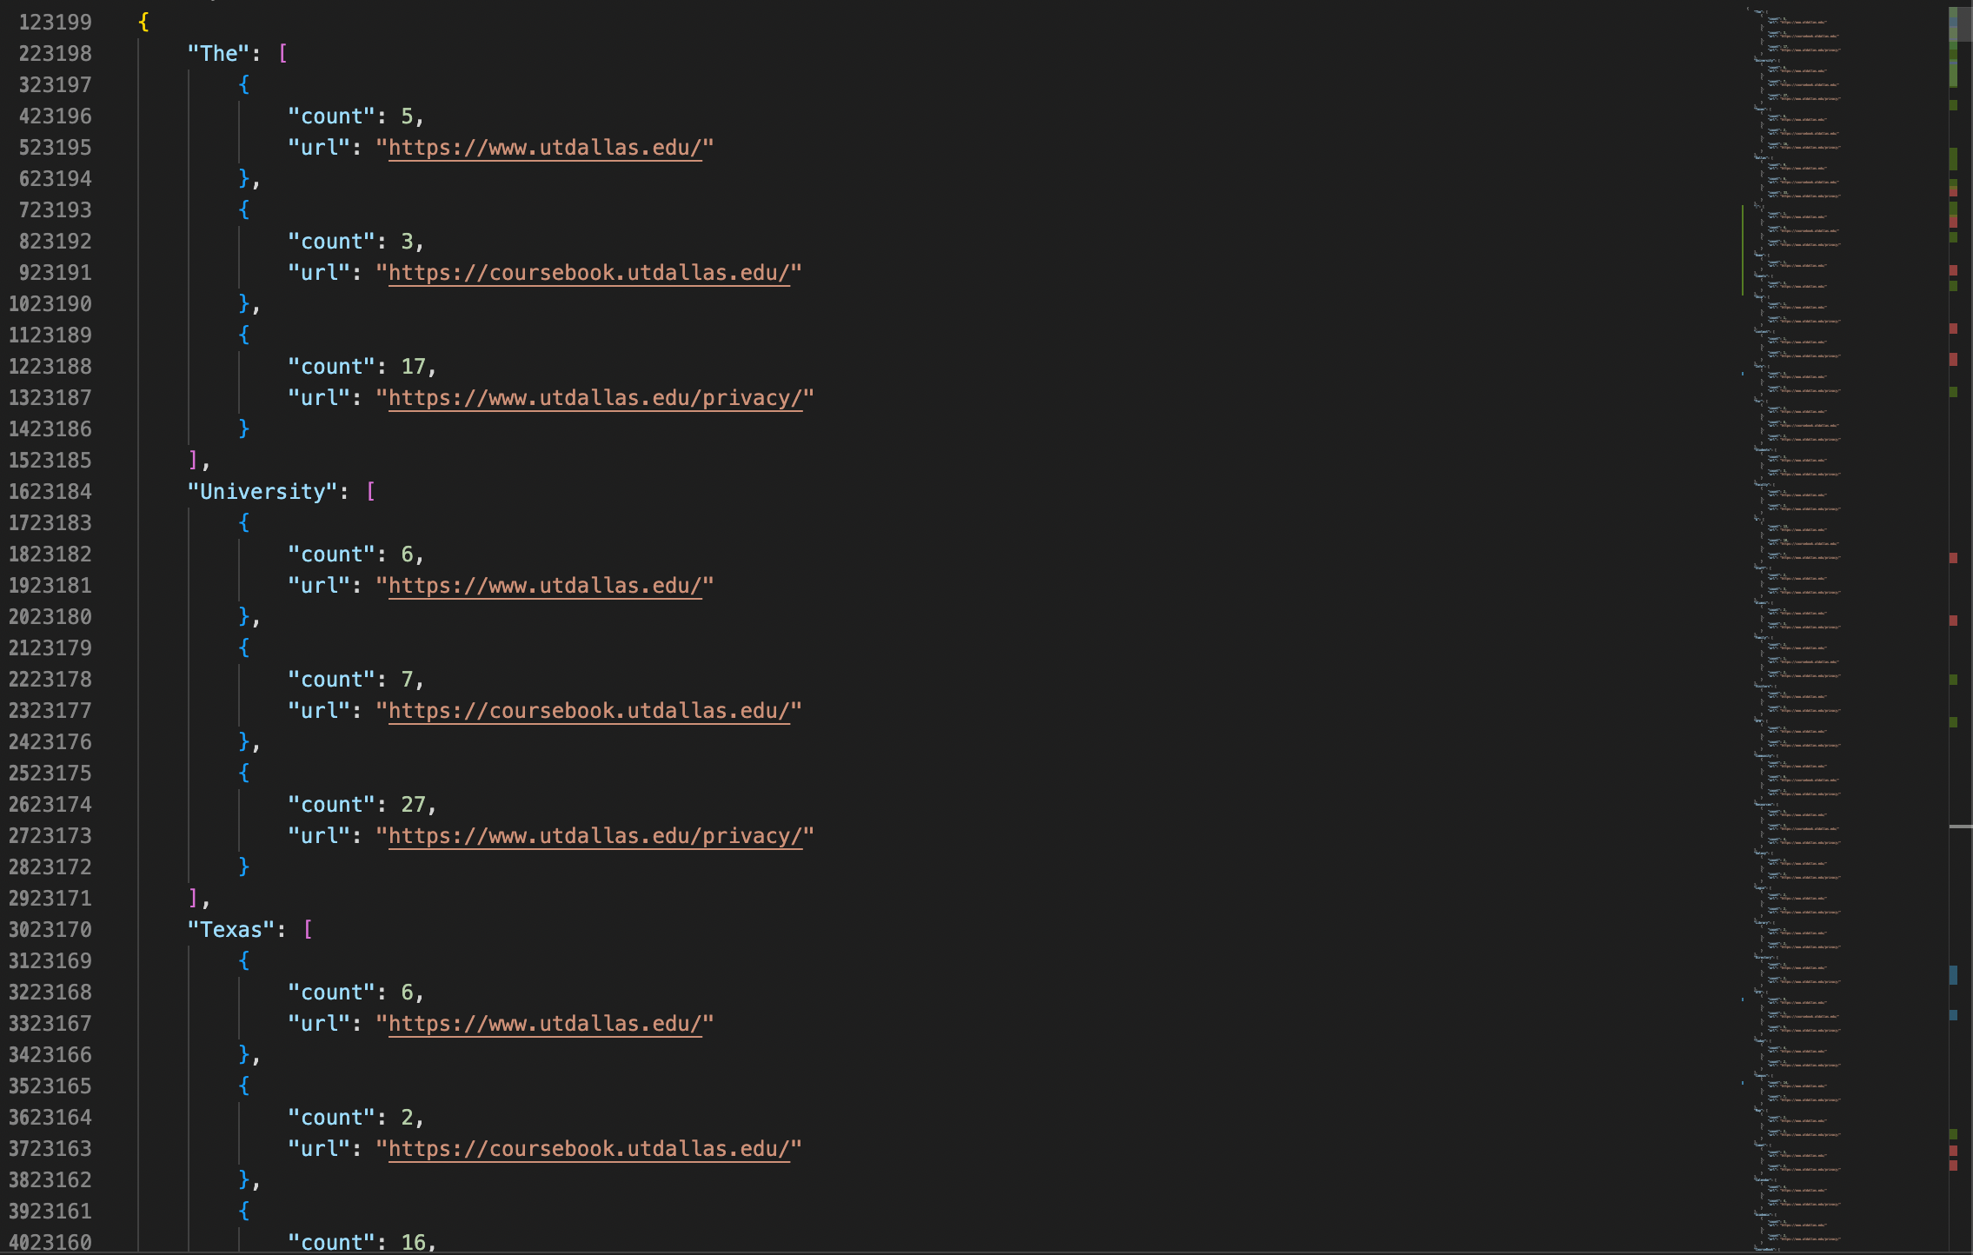
Processor - Output

Slide 11
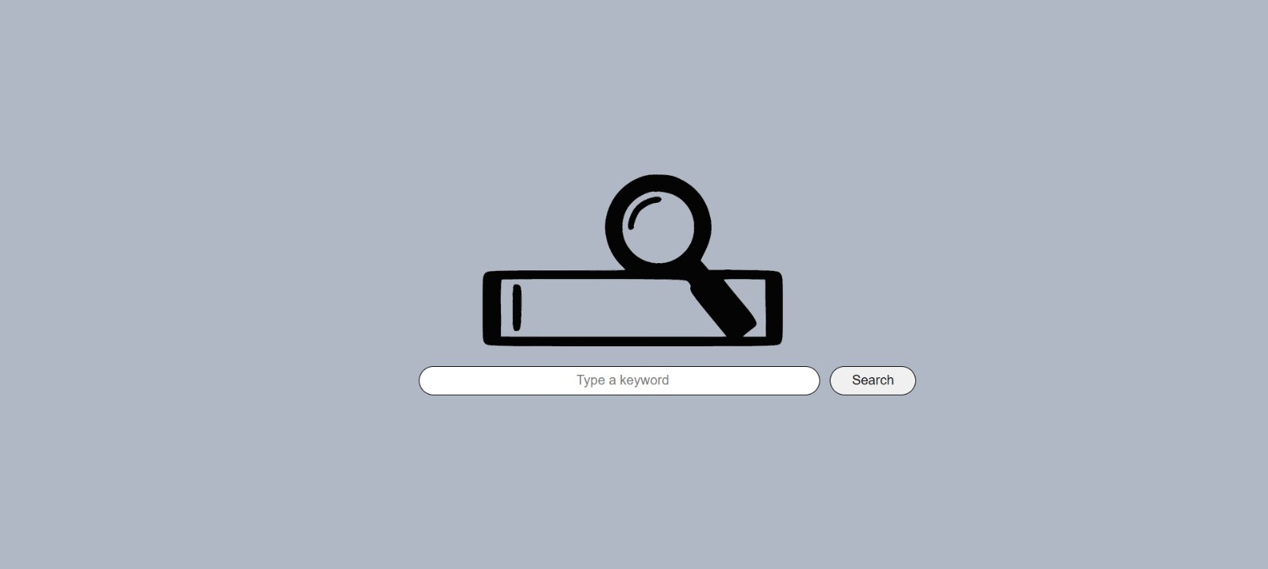
UI – Search Page

Slide 12
UI – Results Page

Slide 13
UML Diagrams
Use Case Diagram
Sequence Diagram
Class Diagram

Slide 14
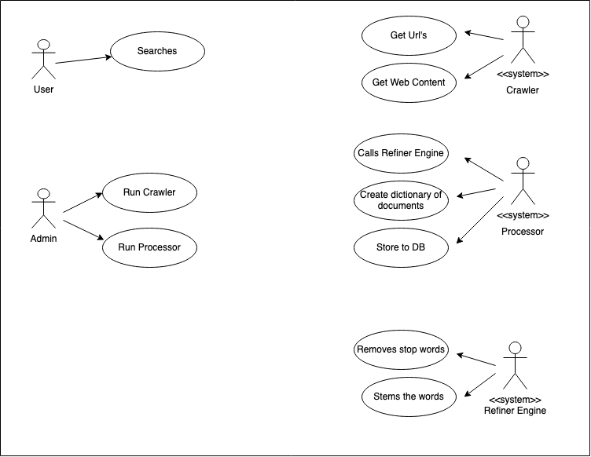
Use Case Diagram

Slide 15
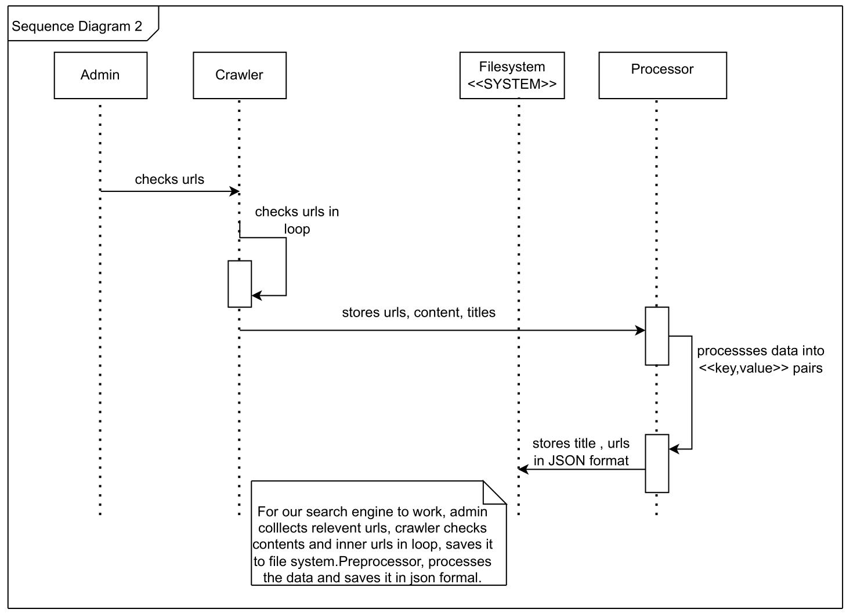
Sequence Diagram – Crawler/Processor

Slide 16
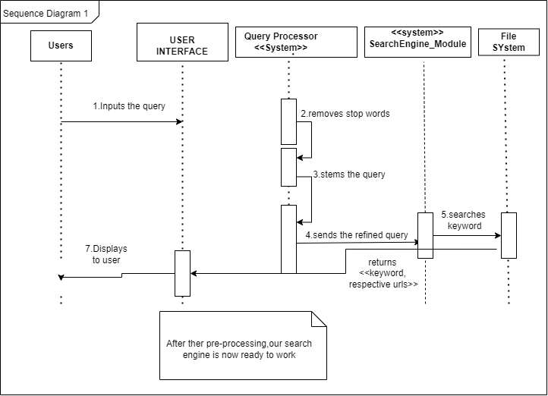
Sequence Diagram – User

Slide 17
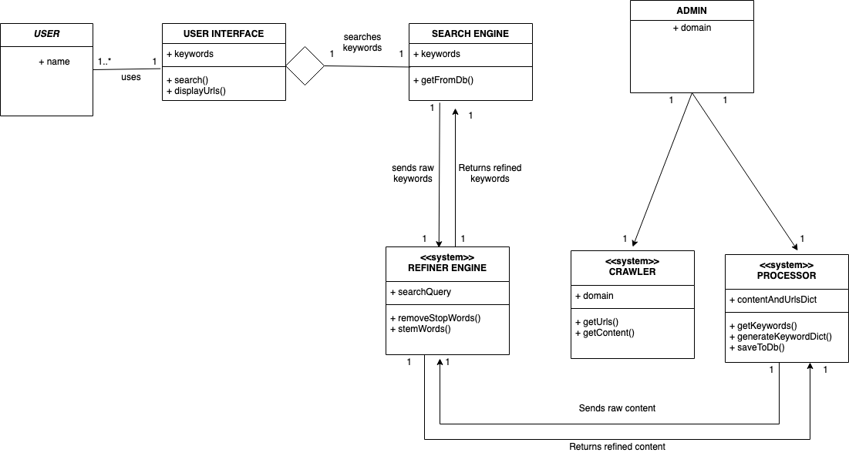
Class Diagram

Slide 18
Next Phase
Search results listing with titles and summary
Ranking algorithm
Deployment

Slide 19

Questions?

