Slide 1
AC-1
nn2logic
Neural Networks to Exact Logical Representations
Team Members
AI 7993 – Section W01/01 | Spring 2026 | May 4, 2026
Final Presentation
Pragya Mishra
Sukumar Muthusamy
Deepthi Kondreddy
Advisor: Arthur Choi

Slide 2
Abbreviations & Glossary
Key terms used throughout this presentation
Abbreviations
BNN Binary Neural Network (Neural network with binary (+1/−1) weights & step activations)
AC Arithmetic Circuit(Circuit encoding exact arithmetic (add, multiply, step) per neuron)
NNF Negation Normal Form(Boolean formula using only AND, OR, and literal (NOT at leaves))
OBDD Ordered Binary Decision Diagram(Canonical DAG representation; supports poly-time model counting)
SDD Sentential Decision Diagram(More expressive compiled logic; broader tractable operations than OBDD)
DNF Disjunctive Normal Form(OR of AND-clauses; output of OBDD pseudo-polynomial compilation)
PI Prime Implicant(Minimal satisfying clause; used for human-readable explanation of output)
mr(f) Model-Based Robustness Metric(Min. Hamming distance to nearest negative; quantifies classification stability)
AI 7993 | Section W01/01 | Spring 2026 | nn2logic — AC-1 | Final Presentation

Slide 3
Project Overview
What we are going to tell you today
Modern neural networks achieve high accuracy, but their decision-making is opaque — making it difficult to trust predictions in high-stakes settings. nn2logic converts Binary Neural Networks (BNNs) into Boolean circuits and applies knowledge compilation to produce exact logical representations (OBDDs & SDDs) that enable precise, verifiable reasoning about model decisions and robustness.
The Problem
Our Approach
Today's Result
Neural networks are black boxes. Small input changes cause unexpected outputs; it's unclear which features drive decisions.
BNN → Boolean Circuit → Knowledge Compilation → OBDD / SDD. Exact reasoning — not approximate — about every decision.
Complete end-to-end pipeline on XOR experiment: training ✓ weight extraction ✓ NNF/OBDD ✓ SDD ✓ robustness analysis ✓
AI 7993 | Section W01/01 | Spring 2026 | nn2logic — AC-1 | Final Presentation

Slide 4
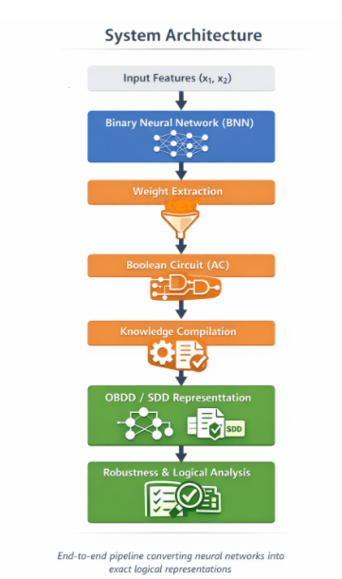
Project Architecture: How does this work?
Binary Neural Network (BNN) • 2 inputs, 4 hidden neurons, 1 output • Binary weights & activations
Weight Extraction • Layer-wise extraction • Verified vs TensorFlow forward pass
Boolean Circuit (AC) • 5 circuits constructed • 9–15 Nodes per neuron
OBDD / SDD Representation • Canonical logical representation • 69-node NNF → 1-node SDD

Slide 5
NN2Logic — 7-Stage Pipeline Overview
BNN (Binary Neural Network) → Verifiable Boolean Logic
1
Train
BNN
2
Extract
Weights
3
Build
AC
4
Compile
NNF/OBDD
5
Compose
NNF
6
Compile
SDD
TensorFlow / Keras training
Layer-wise weight & bias extraction
Per-neuron arithmetic circuit (AC) construction
OBDD pseudo-poly DP → NNF (DNF)
Layer substitution with De Morgan negation
PySDD: conjoin / disjoin NNF nodes
7 Verify & Query SDD ▸ Model Counting ▸ Robustness mr(f) ▸ Prime Implicants (PI) ▸ Sensitivity Analysis
Key Representations Produced
BNN
Binary +1/−1 weights
Step activations Input representation
AC → NNF
5 ACs (9–15 nodes)
OBDD DP compilation
Boolean logic form
Composed NNF
69 nodes (XOR)
De Morgan substitution
End-to-end circuit
SDD
1 node (XOR)
Model count: 2/4
Queryable logic form
AI 7993 | Section W01/01 | Spring 2026 | nn2logic — AC-1 | Final Presentation

Slide 6
Project Process & SDLC Activities
Milestones and work completed so far
Planning
(RAD)
Development
Research
Results
Testing
Final
Report
Jan 30
Feb-10-Apr2
Apr 2
Apr 9
May 4
Completed
Final Deliverables
Requirements Analysis & Project Plan (RAD) — Jan 30
Literature review: BNN-to-Boolean circuit methods
XOR experiment: network trained, converged at epoch 189, accuracy 100%
Weight extraction pipeline implemented & verified vs. TF forward pass
AC construction (5 neurons, 9–15 nodes each) — all verified
NNF / OBDD compilation — all 5 neurons correct on full input space
SDD compilation — XOR experiment complete ✓
Robustness analysis (Algorithm 1 / SSDC20) — complete ✓
Testing milestone — complete ✓
Scaled pipeline to deeper / wider networks — complete ✓
Final Report Package — May 4 ✓
AI 7993 | Section W01/01 | Spring 2026 | nn2logic — AC-1 | Prototype Presentation

Slide 7
Technical Pipeline — End-to-End
BNN → Boolean Circuit → OBDD / SDD → Robustness Analysis
1
2
3
4
Train BNN
Weight Extraction
AC → NNF / OBDD
SDD + Robustness
XOR task. 2 inputs, 4 hidden neurons, 1 output. 17 params. Converged epoch 189. Accuracy: 100%.
Weights & biases extracted layer-by-layer. Binarized TF vs AC pipeline: ALL LAYERS TRACEABLE.
5 ACs built (9–15 nodes). Compiled to NNF. 4 neurons: 4 nodes. Output neuron: 61 nodes. All verified.
Composed NNF: 69 nodes. SDD: 1 node. Model count 2/4. Robustness mr(f) = 0.50. Prime implicants found.
Key Representations
Prototype Verification Results
OBDD (Ordered Binary Decision Diagram)
• Canonical Boolean function form
• Polynomial-time decision queries
• 4 hidden neurons: 4 NNF nodes each
• Output neuron: 61 NNF nodes
SDD (Sentential Decision Diagram)
• Precise than OBDDs
• Broader tractable operations
• Compiled to 1 SDD node for XOR
✓ Binarized TF vs AC hidden layer: MATCH all 4 inputs
✓ Binarized TF vs AC output layer: MATCH all 4 inputs
✓ Composed NNF vs binarized TF: MATCH all 4 inputs
✓ SDD vs binarized TF: MATCH all 4 inputs
Model count: 2 / 4 inputs satisfy the network
Max robustness: 1 bit flip needed to change any classification
Prime implicants: { x1=0, x2=1 } and { x1=1, x2=0 }
AI 7993 | Section W01/01 | Spring 2026 | nn2logic — AC-1 | Final Presentation

Slide 8
Final Results — XOR Experiment
Live output from the nn2logic pipeline
100%
Ep 189
5 / 5
4 / 4
0.50
Training
Accuracy
Convergence
Epoch
Neurons
Verified (NNF)
SDD Inputs
Correct
Model-Based
Robustness
XOR Truth Table
NNF Node Counts
Robustness Analysis (Algorithm 1 / SSDC20)
Input Pred Match
[0, 0] → 0 ✓
[0, 1] → 1 ✓
[1, 0] → 1 ✓
[1, 1] → 0 ✓
hidden neuron 1: 10 nodes (3/4 sat)
hidden neuron 2: 4 nodes (1/4 sat)
hidden neuron 3: 4 nodes (1/4 sat)
hidden neuron 4: 10 nodes (3/4 sat)
output neuron 1: 61 nodes (12/16 sat)
Composed NNF: 69 nodes
Variables: x1, x2 | n=2, total inputs=4
Positive inputs (model count): 2
All inputs sensitive to both x1 and x2:
[0,0] out=0 sensitive: x1, x2
[0,1] out=1 sensitive: x1, x2
[1,0] out=1 sensitive: x1, x2
[1,1] out=0 sensitive: x1, x2
Model-based robustness mr(f) = 0.5000
Max robustness = 1 (1 bit flip to flip class)
Prime implicants: {x1=0,x2=1} {x1=1,x2=0}
AI 7993 | Section W01/01 | Spring 2026 | nn2logic — AC-1 | Final Presentation

Slide 9
Final Results — All Datasets
Scaled v1.0 pipeline — XOR · AND · OR · Majority-3
XOR
2 inputs · Non-linear
✓ 100% Accuracy
Converged ep 63
SDD: 1 node
Model count: 2/4
mr(f) = 0.50
PIs: {x1=0,x2=1}
{x1=1,x2=0}
All layers traced
AND
2 inputs · Linear
✓ 100% Accuracy
Positive: 1/4 (25%)
AC/NNF verified
Linearly separable
SDD compiled ✓
OR
2 inputs · Linear
✓ 100% Accuracy
Positive: 3/4 (75%)
AC/NNF verified
Linearly separable
SDD compiled ✓
Majority-3
3 inputs · Non-linear
✓ 100% Accuracy
Positive: 4/8 (50%)
NNF verified ✓
2 hidden layers req.
SDD: env. constraint
AI 7993 | Section W01/01 | Spring 2026 | nn2logic — AC-1 | Final Presentation

Slide 10
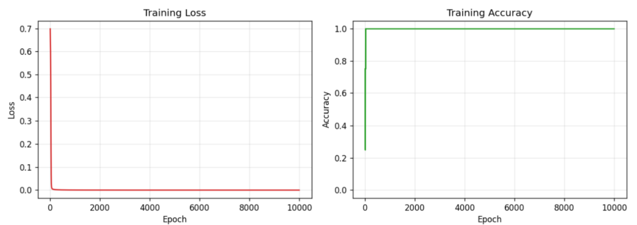
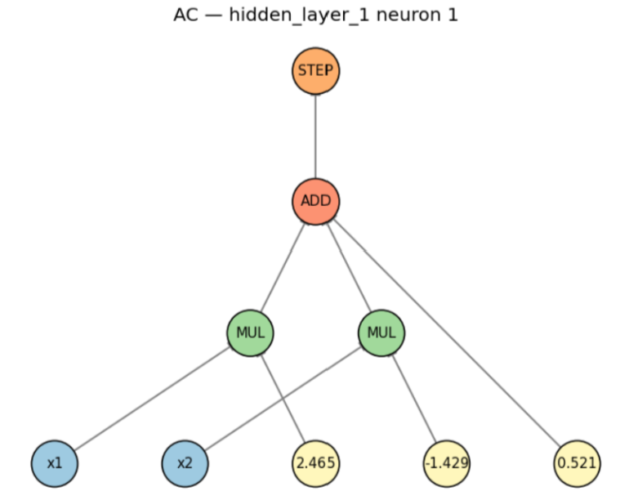
Figure Representations
AC representation for hidden layer neuron
Training Loss and accuracy curves for multilayer XOR network
AI 7993 | Section W01/01 | Spring 2026 | nn2logic — AC-1 | Final Presentation

Slide 11
Summary
✓
nn2logic converts BNNs into exact logical representations (OBDDs & SDDs) enabling precise, verifiable AI reasoning
✓
Full XOR experiment pipeline complete: training → weight extraction → AC/NNF/OBDD → SDD — all layers verified correct
✓
Robustness analysis (Algorithm 1 / SSDC20): mr(f) = 0.50, max robustness = 1, prime implicants { x1=0,x2=1 } { x1=1,x2=0 }
✓
Scaled v1.0 pipeline supports arbitrary depth/width via dynamic layer traversal & iterative NNF composition
✓
Future work: real-world datasets, multi-output networks, SDD minimization, formal verification tool integration
AI 7993 Section W01/01 – Spring 2026

Slide 12
Thank you! Questions!
AI 7993 | Section W01/01 | Spring 2026 | nn2logic — AC-1 | Final Presentation

