Slide 1

Fraud Vehicle Insurance Claim

Slide 2
Problem Statement
Your Client FinMan is a financial services company that provides various financial services like loan, investment funds, insurance etc. to its customers. FinMan wishes to cross-sell health insurance to the existing customers who may or may not hold insurance policies with the company. The company recommend health insurance to it's customers based on their profile once these customers land on the website. Customers might browse the recommended health insurance policy and consequently fill up a form to apply. When these customers fill-up the form, their Response towards the policy is considered positive and they are classified as a lead.
Once these leads are acquired, the sales advisors approach them to convert and thus the company can sell proposed health insurance to these leads in a more efficient manner.
Now the company needs your help in building a model to predict whether the person will be interested in their proposed Health plan/policy given the information about:
Demographics (city, age, region etc.) Information regarding holding policies of the customer Recommended Policy Information

Slide 3
Customer data-overview
Data | Description
ID | Unique Identifier for a row
City_Code | Code for the City of the customers
Region_Code | Code for the Region of the customers
Accomodation_Type | Customer Owns or Rents the house
Reco_Insurance_Type | Joint or Individual type for the recommended insurance
Upper_Age | Maximum age of the customer
Lower _Age | Minimum age of the customer
Is_Spouse | If the customers are married to each other (in case of joint insurance)
Health_Indicator | Encoded values for health of the customer
Holding_Policy_Duration | Duration (in years) of holding policy (a policy that customer has already subscribed to with the company)
Holding_Policy_Type | Type of holding policy
Reco_Policy_Cat | Encoded value for recommended health insurance
Reco_Policy_Premium | Annual Premium (INR) for the recommended health insurance
Response (Target) | 0 : Customer did not show interest in the recommended policy, 1 : Customer showed interest in the recommended policy

Slide 4
Step1:To analyze the below features which have significant impact on response.
Region_Code
City_Code
Reco_Policy_Cat
Reco_Policy_Premium
Health Indicator

Slide 5
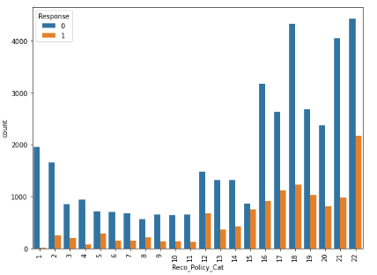
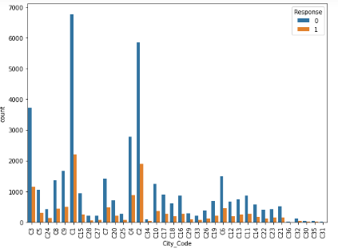
City_Code, Reco_Policy_Cat
Cities C31 and C36 have equal and less percentage of people with response as 1. City C30 has the highest percentage of people(around 30%) with response as 1.
Policy category 15 has the highest response of 46 percent.

Slide 6
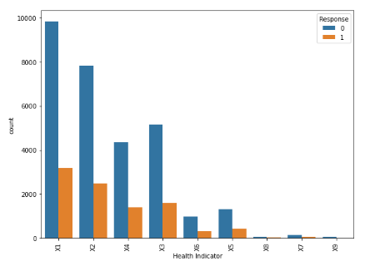
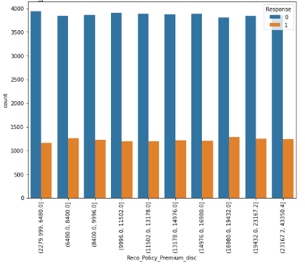
Health Indicator, Reco_Policy_Premium
Health Indicator X7 has highest percent of people(around 32) with response as 1. Whereas other health indicators have around 22-24 percent of people with response as 1.
'Reco_Policy_Premium' has around 22-25 percent of people with target 1 in all premium categories.

Slide 7
Step2:To analyze the below features which have less impact on response.
Accomodation_Type
Reco_Insurance_Type
Holding_Policy_Duration
Holding_Policy_Type
Is_Spouse
Upper_Age
Lower_Age

Slide 8
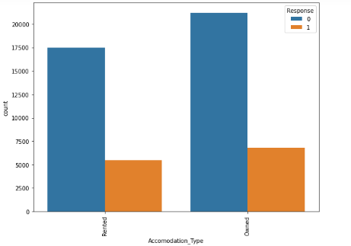
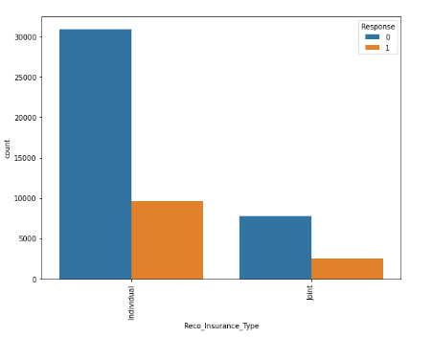
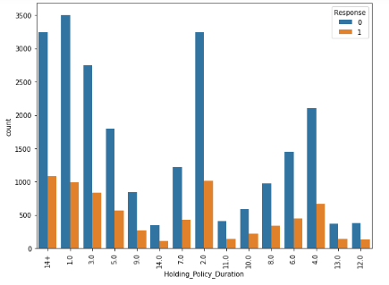
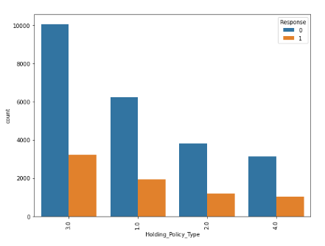
Less dependency on target- Accomodation_Type, Reco_Insurance_Type, Holding_Policy_Duration, Holding_Policy_Type

Slide 9
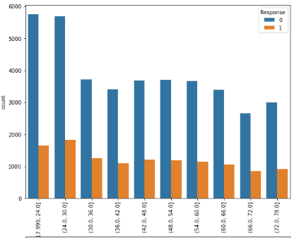
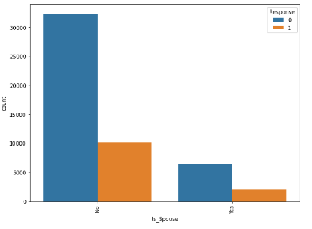
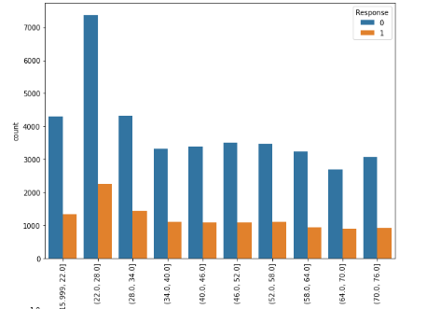
Less dependency on target- Is_Spouse, Upper_Age, Lower_Age

Slide 10
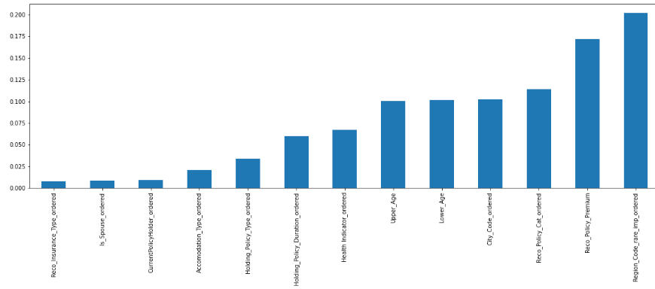
Feature Importance
Both categories of Reco_Insurance_Type, Is_Spouse, Accomodation_type have same percent of people with response as 1.
All 'Holding_Policy_Duration' categories have 22-27 percent of people having the response as 1.
All 'Holding_Policy_Type' categories have 23-24 percent of people having the response as 1.
Both ‘Upper_Age’ and ‘Lower_Age’ columns have around 22-28 percent of people with the response as 1 across all age group categories.

Slide 11
Feature Engineering
Missing values in features ‘Holding_Policy_Duration’, ’Holding_Policy_Type’ are replaced with 0 as this essentially means there is no holding policy.
Missing values in ‘Health Indicator’ are replaced with a new category ‘Missing’.
‘Region_Code’ column had a large number of categories. Rare categories in this are combined into one common category ‘others’.
All categorical variables are encoded to numeric using Risk factor encoding technique.
‘Robust Scalar’ technique is used for standardization of variables.
All FE techniques are manipulated using X_train and then propagated to X_test.

Slide 12
Modelling and Tuning
Modelling is started using basic classification algorithms like Logistic Regression, Decision Tree.
Model is then tuned for AUC.
Probability of response being 1 is obtained from the classifier.
Thresholds are obtained using the roc_curve metric.
Response is set to 1 if the probability is greater than threshold else it is set to 0.
This is repeated for all thresholds identified and the threshold giving maximum AOC is taken for final prediction.

Slide 13
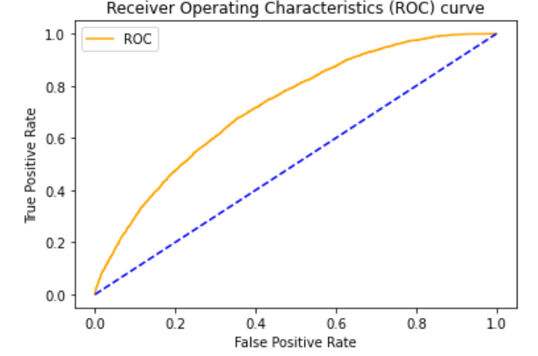
Conclusion
Logistic Regression classifier with threshold as 0.220728 has given the maximum AOC of 0.66.Below is the ROC curve for the same.

