Slide 1

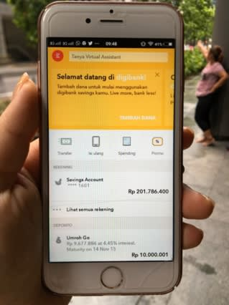
India
ingapore
01 – Sep - 2018
To
31 – Nov - 2018

Slide 2

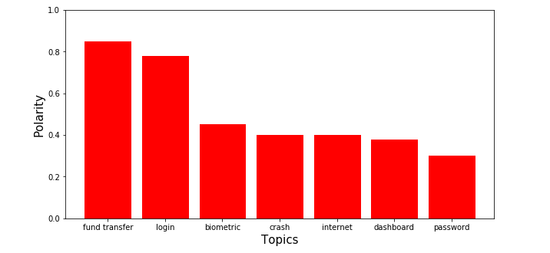
Feedbacks and experience

Slide 3






Solution
NLP

Slide 4
Results
Feature | Feedbacks
Login | Timeout, UI, crash
Fund Transfer | Slow, speed, internet, response
Withdawl | Dificult, timeout
biometric | failed

Slide 5




Accuracy Evaluation
Value
BA
DA

