Slide 1
Presentation on Backend Engineering Project
Topic
InternSpot – Job Portal Website
by
G-4
Anmol Garg: 2310990285
Sulabh Saluja: 2310991060
Tanish Gupta: 2310991063
Tarun Garg : 2310991149
Supervised by:
Rahul Sir
Department of Computer Science and Engineering,
Chitkara University, Punjab

Slide 2
Table of Content
Problem Statement
Objectives / Purpose
System Overview & Features
Technical Architecture (Frontend, Backend, Database)
Project Snippets (UI & Code)
Future Scope & Improvements
Conclusion
References

Slide 3
Problem Statement
Students struggle to find internships due to scattered opportunities, unverified listings, and inefficient application processes.
Employers face difficulty filtering genuine candidates and managing applications.
InternSpot bridges this gap with a secure, user-friendly portal connecting verified employers and students.

Slide 4
Objective / Purpose
For Students:
Verified internship listings
Easy application flow
Profile-based recommendations
For Employers:
Smooth job posting
Application tracking
Candidate shortlisting
Efficiency: Replaces scattered manual processes with one platform.
Overall Goal: Build a reliable internship recruitment system.

Slide 5
Main Topics / Sections
For Students:
Access to verified internship listings.
Profile-based job recommendations.
Easy-to-use application process with tracking.
For Employers:
Post and manage job listings quickly.
View, filter, and shortlist candidates.
Track applications with an intuitive dashboard.
Efficiency Goals:
Replace scattered and manual processes.
Provide a one-stop solution for internship recruitment.
Overall Purpose:
Create a bridge between students and employers to simplify the internship hiring process.

Slide 6
System Overview – Frontend
User-Centric Design:
Responsive interface using React.js.
Separate dashboards for students and employers.
Smooth signup, login, and navigation.
Student View:
Explore internships with filters.
Apply with a single click.
Track application status.
Employer View:
Post internships in structured format.
Manage applications with real-time updates.
Shortlist or reject candidates easily.

Slide 7
System Overview – Backend
Architecture:
Built with Node.js and Express.js for scalability.
RESTful APIs ensure smooth communication with frontend.
Authentication with JWT / session management.
Key Functions:
Job posting, updating, and deletion.
Application handling (apply, withdraw, track).
User management (student, employer roles).
Advantages:
High scalability.
Secure request handling.
Optimized API flow.

Slide 8
Database & Core Features
Database (MongoDB):
Stores user profiles, job listings, and applications.
Role-based schema (Employer vs Student).
Data validation for consistency.
Core Features:
Advanced job search and filtering (by location, category, skills).
Employer dashboard for job management.
Application status updates for students.
Admin control for moderation and verification.

Slide 9
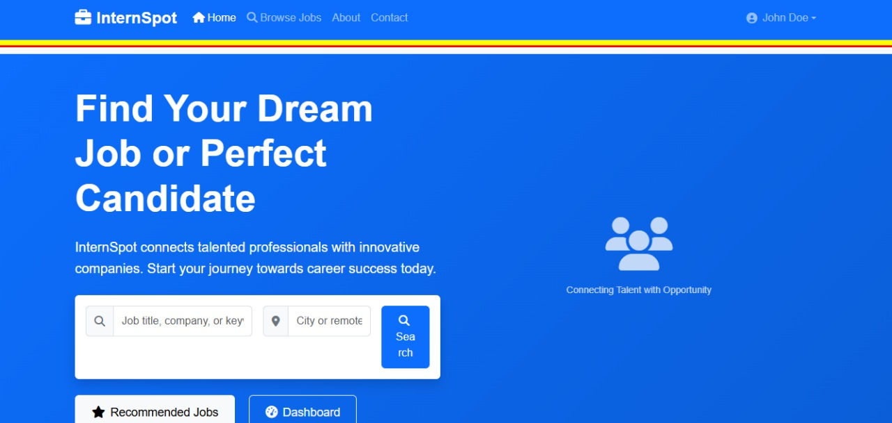
Project UI

Slide 10
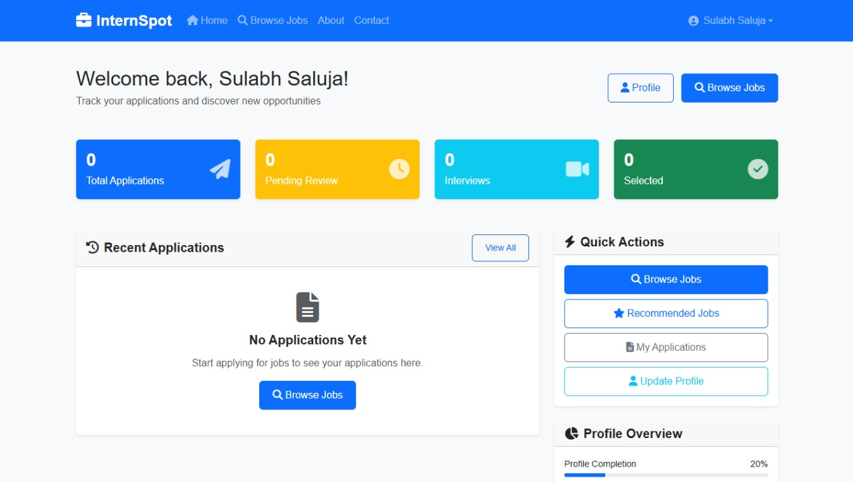
Project UI

Slide 11
Future Scope
AI-Powered Recommendations: Personalized internships for each student.
Resume Builder & Skill Tests: Enhance candidate profiles and credibility.
Employer Verification System: Ensure authenticity of job postings.
Mobile Application: Wider accessibility for students and employers.
Analytics Dashboard: Insights into applications, trends, and hiring.

Slide 12
Conclusion
Seamless User Experience: InternSpot provides a clean, intuitive platform where students can easily browse verified internships, and employers can post and manage opportunities without complexity.
Efficient Backend & APIs: Built with Node.js and Express.js, the backend ensures high scalability, real-time communication, and fast request handling.
Secure & Structured Database: MongoDB schemas are designed with proper validation, ensuring role-based access, data accuracy, and security for both applicants and employers.
Value to Students: Provides equal opportunities, reduces time wasted on fake/unverified postings, and simplifies the application tracking process.
Value to Employers: Saves effort in filtering candidates, provides structured applications, and ensures efficient hiring workflows.
Overall Impact: InternSpot has the potential to become a one-stop solution for bridging the gap between students seeking internships and employers offering opportunities.

Slide 13
References
Official Documentation:
React.js – https://react.dev
Node.js – https://nodejs.org
Express.js – https://expressjs.com
MongoDB – https://www.mongodb.com
Learning Platforms & Guides:
GeeksforGeeks (DSA, MERN stack tutorials)
MDN Web Docs (JavaScript, APIs, Web concepts)
FreeCodeCamp (Full-stack development resources)
YouTube (Traversy Media, Net Ninja, CodeWithHarry for MERN stack guidance)

Slide 14


