Slide 1

ENVIRONMENTAL MONITORING

Slide 2
COMPONENTS AND SOFTWARE REQUIRED
ESP12/NODE MCU (CP2102)
DHT sensor
LDR Sensor
Breadboard
Arduino IDE

Slide 3
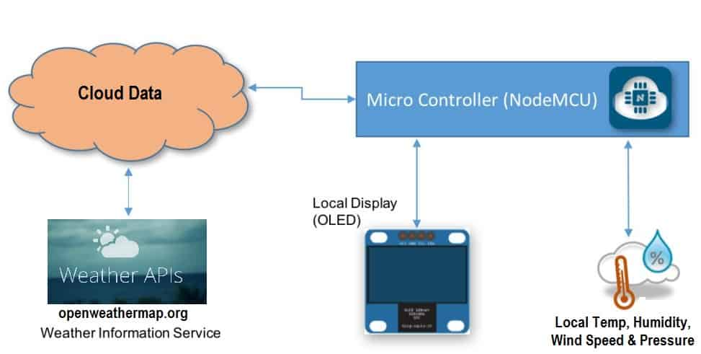
BLOCK DIAGRAM FOR SYSTEM

Slide 4
WORKING
Two different sensors are connected with NodeMCU, which measure temperature, humidity and light intensity as shown In diagram LDR is connected to analog I/O pin and the remaining sensors are connected to digital I/O pins.
Using NodeMCU data is sent to the ThingSpeak cloud server (database). Further, Thingspeak sends data to the NodeMCU in form of a JSON file, so that data can now be displayed on a HTML Web Page that reflects measured readings of different sensors .

Slide 5
A model based on Logistic Regression in Jupyter Notebook (Python IDE) is used and trained with the pre-recorded values stored in the Google spreadsheet. Further, NodeMCU records the real time values of temperature, humidity and light intensity of a particular place or location that are used to test the model and take decision.
These values are sent to the Jupyter Notebook using serial communication between NodeMCU and Jupyter Notebook. With the help of the model an attempt to predict the feasibility of a match is made. After that, either logic ‘0’ or ‘1’ is sent by the Jupyter Notebook to the NodeMCU as a predicted result .

Slide 6
Code for HTML
<html>
<head>
<title>Real-time Temperature and Humidity Display</title>
<!-- Include any necessary CSS or external libraries here -->
</head>
<body>
<div id="temperature">Temperature: <span id="temperature-value">Loading...</span></div>
<div id="humidity">Humidity: <span id="humidity-value">Loading...</span></div>
<!-- Include any necessary JavaScript libraries here -->
<script>
// JavaScript code for real-time data updates
// You'll need to implement a mechanism to fetch and update the data here
function updateTemperature(value) {
document.getElementById("temperature-value").innerText = value;
}

Slide 7
function updateHumidity(value) {
document.getElementById("humidity-value").innerText = value;
}
// Replace the following with the actual logic to receive and update real-time data
// Example logic to update data every 5 seconds (for demonstration purposes)
setInterval(() => {
// Replace the following values with the actual real-time temperature and humidity data
const newTemperature = Math.random() * 100;
const newHumidity = Math.random() * 100;
updateTemperature(newTemperature.toFixed(2) + " °C");
updateHumidity(newHumidity.toFixed(2) + " %");
}, 5000); // 5000 milliseconds = 5 seconds
</script>
</body>
</html>

Slide 8
Code for CSS
body {
font-family: Arial, sans-serif;
display: flex;
flex-direction: column;
align-items: center;
justify-content: center;
height: 100vh;
}
#temperature,
#humidity {
margin-bottom: 20px;
font-size: 24px;
}

Slide 9
#temperature-value,
#humidity-value {
font-weight: bold;
margin-left: 10px;
}
Code for Java script
<html>
<head>
<title>Real-time Temperature and Humidity Display</title>
<style>
/* Add your CSS styles here */
body {
font-family: Arial, sans-serif;
display: flex;
flex-direction: column;

Slide 10
align-items: center;
justify-content: center;
height: 100vh;
}
#temperature,
#humidity {
margin-bottom: 20px;
font-size: 24px;
}
#temperature-value,
#humidity-value {
font-weight: bold;
margin-left: 10px;

Slide 11
}
</style>
</head>
<body>
<div id="temperature">Temperature: <span id="temperature-value">Loading...</span></div>
<div id="humidity">Humidity: <span id="humidity-value">Loading...</span></div>
<script>
function updateTemperature(value) {
document.getElementById("temperature-value").innerText = value;
}
function updateHumidity(value) {
document.getElementById("humidity-value").innerText = value;
}
// Simulating data update every 5 seconds for demonstration purposes
setInterval(() => {
// Simulate real-time temperature and humidity data
const newTemperature = (Math.random() * 100).toFixed(2) + " °C";
const newHumidity = (Math.random() * 100).toFixed(2) + " %";
updateTemperature(newTemperature);
updateHumidity(newHumidity);
}, 5000); // 5000 milliseconds = 5 seconds
</script>
</body>
</html>

