Slide 1
Detailed ASP.NET MVC PIPELINE

Slide 2
ASP.NET Introduction
ASP.NET MVC is an open source framework built on the top of Microsoft .NET Framework to develop web application that enables a clean separation of code.
ASP.NET MVC framework is the most customizable and extensible platform shipped by Microsoft.

Slide 3
Routing
Routing is the first step in ASP.NET MVC pipeline. typically, it is a pattern matching system that matches the incoming request to the registered URL patterns in the Route Table.
The UrlRoutingModule
(System.Web.Routing.UrlRoutingModule) is a class which matches an incoming HTTP request to a registered route pattern in the RouteTable
(System.Web.Routing.RouteTable).

Slide 4
When ASP.NET MVC application starts at first time, it registers one or more patterns to the RouteTable to tell the routing system what to do with any requests that match these patterns.
An application has only one RouteTable and this is setup in the Application_Start event of Global.asax of the application.

Slide 5
RouteConfig Class & Application_Start in Global.asax
public class RouteConfig
{
public static void RegisterRoutes(RouteCollection routes)
{
routes.IgnoreRoute("{resource}.axd/{*pathInfo}");
routes.MapRoute(name: "Default“,url: "{controller}/{action}/{id}",
defaults: new { controller = "Home", action = "Index", id = UrlParameter.Optional });
}
}
protected void Application_Start()
{
//Other code is removed for clarity
RouteConfig.RegisterRoutes(RouteTable.Routes);
}

Slide 6
When the UrlRoutingModule finds a matching route within RouteCollection (RouteTable.Routes), it retrieves the IRouteHandler
(System.Web.Mvc.IRouteHandler) instance
(default is System.Web.MvcRouteHandler) for that route.
From the route handler, the module gets an IHttpHandler(System.Web.IHttpHandler) instance(default is System.Web.MvcHandler).

Slide 7
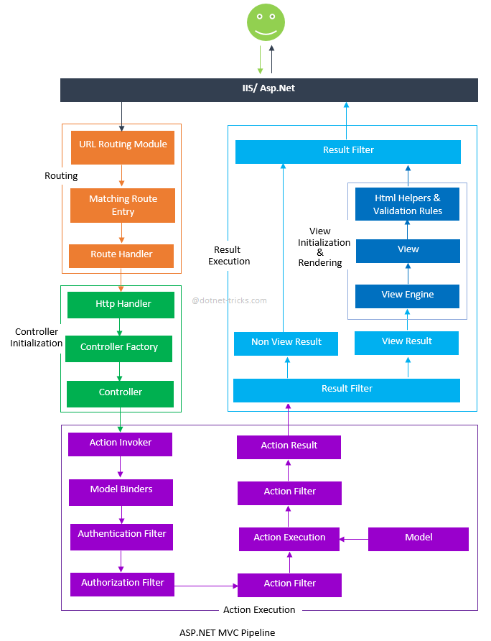
ASP.NET MVC PIPELINE

Slide 8
CONTROLLER INITIALIZATION
The MvcHandler initiates the real processing inside ASP.NET MVC pipeline by using ProcessRequest method. This method uses the IControllerFactory instance (default is System.Web.Mvc.DefaultControllerFactory) to create corresponding controller.
Notes:
protected internal virtual void ProcessRequest(HttpContextBase httpContext)
{
SecurityUtil.ProcessInApplicationTrust(delegate {
IController controller;
IControllerFactory factory;
this.ProcessRequestInit(httpContext, out controller, out factory);
try
{
controller.Execute(this.RequestContext);
}
finally
{
factory.ReleaseController(controller);
}
});
}

Slide 9
Action Execution
When the controller is initialized, the controller calls its own InvokeAction() method by passing the details of the chosen action method. This is handled by the IActionInvoker.
After selection of appropriate action method, model binders(default is System.Web.Mvc.DefaultModelBinder) retrieves the data from incoming HTTP request and do the data type conversion, data validation such as required or date format etc. and also take care of input values mapping to that action method parameters.
Notes:
public virtual bool InvokeAction(ControllerContext controllerContext, string actionName)

Slide 10
Authentication Filter was introduced with ASP.NET MVC5 that run prior to authorization filter.
It is used to authenticate a user.
Authentication filter – It processes user credentials in the request and provide a corresponding principal. Prior to ASP.NET MVC5. Prior to MVC 5, authorization filter was used for authentication and authorization to a user.
4. By default, Authenticate attribute is used to perform Authentication. You can easily create your own custom authentication filter by implementing IAuthenticationFilter.

Slide 11
Action filters are executed before
(OnActionExecuting) and after(OnActionExecuted) an action is executed.
IActionFilter interface provides you two methods OnActionExecuting and OnActionExecuted methods which will be executed before and after an action gets executed respectively.
You can also make your own custom ActionFilters filter by implementing IActionFilter.

Slide 12
6. When action is executed, it process the user inputs with the help of model (Business Model or Data Model) and prepare Action Result.

Slide 13
Result Execution
Result filters are executed before(OnResultnExecuting) and after(OnResultExecuted) the ActionResult is executed. IResultFilter interface provides you two methods OnResultExecuting and OnResultExecuted methods which will be executed before and after an ActionResult gets executed respectively. You can also make your own custom ResultFilters filter by implementing IResultFilter.

Slide 14
2. Action Result is prepared by performing operations on user inputs with the help of BAL or DAL. The Action Result type can be ViewResult, PartialViewResult, RedirectToRouteResult, RedirectResult, ContentResult, JsonResult, FileResult and EmptyResult.
Various Result type provided by the ASP.NET MVC can be categorized into two category-
a) ViewResult type- Result type which renders and returns an HTML page to the browser
b) NonViewResult type- Result type which returns only data either in text format, binary format or a JSON format.

Slide 15
View Initialization and Rendering
ViewResult type i.e. view and partial view are represented by IView(System.Web.Mvc.IView) interface and rendered by the appropriate View Engine.
public interface IView
{
void Render(ViewContext viewContext, TextWriter writer);
}
This process is handled by IViewEngine
(System.Web.Mvc.IViewEngine) interface of the view engine. By default ASP.NET MVC provides WebForm and Razor view engines.

Slide 16
You can also create your custom engine by using IViewEngine interface and can registered your custom view engine in to your Asp.Net MVC application as shown below: protected void Application_Start()
{
//Remove All View Engine including Webform and Razor
ViewEngines.Engines.Clear();
//Register Your Custom View Engine
ViewEngines.Engines.Add(new CustomViewEngine());
//Other code is removed for clarity
}

Slide 17
Html Helpers are used to write input fields, create links based on the routes, AJAX-enabled forms, links and much more.
Html Helpers are extension methods of the HtmlHelper class and can be further extended very easily. In more complex scenario, it might render a form with client side validation with the help of JavaScript or jQuery.

Slide 18
ASP.NET Filters and Attributes
ASP.NET MVC provides a simple way to inject your piece of code or logic either before or after an action is executed.
This is achieved by the controllers or actions with ASP.NET MVC attributes or custom attributes. An attribute or custom attribute implements the ASP.NET MVC filters(filter interface) and can contain your piece of code or logic.
You can make your own custom filters or attributes either by implementing ASP.NET MVC filter interface or by inheriting and overriding methods of ASP.NET MVC filter attribute class if available.

Slide 19
Use of Filters
Typically, Filters are used to perform the following common functionalities in your ASP.NET MVC application.
Custom Authentication
Custom Authorization(User based or Role based)
Error handling or logging
User Activity Logging
Data Caching
Data Compression

Slide 20
Types of Filters
The ASP.NET MVC framework provides five types of filters.
Authentication filters (Introduced in ASP.NET MVC5)
Authorization filters
Action filters
Result filters
Exception filters

Slide 21
Authorization Filters
We can make our own CustomAuthorize filter attribute either by implementing IAuthorizationFilter interface or by inheriting and overriding above methods of AuthorizeAttribute class.

Slide 22
Action Filters
Action filters are executed before or after an action is executed.
The IActionFilter interface is used to create an Action Filter which provides two methods OnActionExecuting and OnActionExecuted which will be executed before or after an action is executed respectively.

Slide 23
Result Filters
Result filters are executed before or after generating the result for an action.
The Action Result types:Inherit ActionResult class.
ViewResult
PartialViewResult
RedirectToRouteResult
RedirectResult,
ContentResult,
JsonResult,
FileResult and
EmptyResult

Slide 24
Result filters are called after the Action filters.
The IResultFilter interface is used to create an Result Filter which provides two methods OnResultExecuting and OnResultExecuted which will be executed before or after generating the result for an action respectively.

Slide 25
Exception Filters
Exception filters are executed when exception occurs during the actions execution or filters execution. The IExceptionFilter interface is used to create an Exception Filter which provides OnException method which will be executed when exception occurs during the actions execution or filters execution.
ASP.NET MVC HandleErrorAttribute filter is an Exception filter which implements IExceptionFilter. When HandleErrorAttribute filter receives the exception it returns an Error view located in the Views/Shared folder of your ASP.NET MVC application.

Slide 26
Order of Filter Execution
All ASP.NET MVC filter are executed in an order. The correct order of execution is given below:
Authentication filters
Authorization filters
Action filters
Result filters

Slide 27
Configuring Filters
Global
Controller
Action

