Slide 1
Introduction to MVC Application Folders

Slide 2
MVC Folders
A typical ASP.NET MVC web application has the following folder content:
Application information
Properties References
Application folders
App_Data Folder Content Folder Controllers Folder Models Folder Scripts Folder Views Folder

Slide 3
Configuration files
Global.asax packages.config Web.config

Slide 4
The folder names are equal in all MVC applications. The MVC framework is based on default naming.
Controllers are in the Controllers folder, Views are in the Views folder, and Models are in the Models folder. You don't have to use the folder names in your application code.
Standard naming reduces the amount of code, and makes it easier for developers to understand MVC projects.

Slide 5
The App_Data and The Content Folder
The App_Data Folder
The App_Data folder is for storing application data.
The Content Folder
The Content folder is used for static files like style sheets
(css files), icons and images.
Visual Web Developer automatically adds a themes folder
to the Content folder. The themes folder is filled with
jQuery styles and pictures. In this project you can delete the
themes folder.
It also adds a standard style sheet file Site.css in the
content folder. The style sheet file is the file to edit when you want to change the style of the application.

Slide 6
The Controller and Models Folder
The Controllers Folder
The Controllers folder contains the controller classes
responsible for handling user input and responses.
MVC requires the name of all controller files to end with
"Controller".
The Models Folder
The Models folder contains the classes that represent the
application models. Models hold and manipulate
application data.

Slide 7
The Views Folder
The Views Folder
The Views folder stores the HTML files related to the
display of the application (the user interfaces).
The Views folder contains one folder for each controller.
Visual Web Developer has created an Account folder, a
Home folder, and a Shared folder (inside the Views folder).
The Account folder contains pages for registering and
logging in to user accounts.
The Home folder is used for storing application pages like
the home page and the about page.
The Shared folder is used to store views shared between controllers (master pages and layout pages).

Slide 8
The Scripts Folder
The Scripts folder stores the JavaScript files of the application.
By default Visual Web Developer fills this folder with standard MVC, Ajax, and jQuery files.

Slide 9
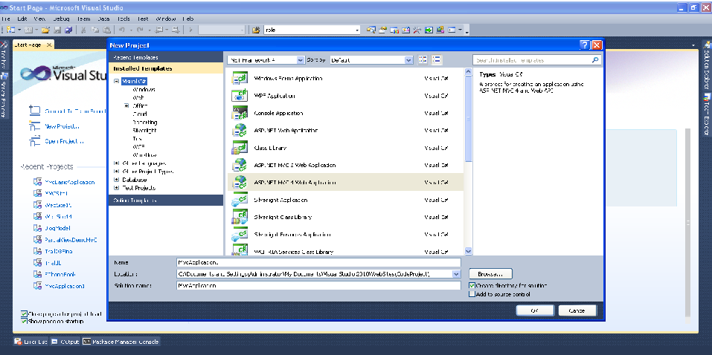
Create a MVC App
Create a new project by selecting the MVC 2 empty web application template as shown in the below figure.

Slide 10
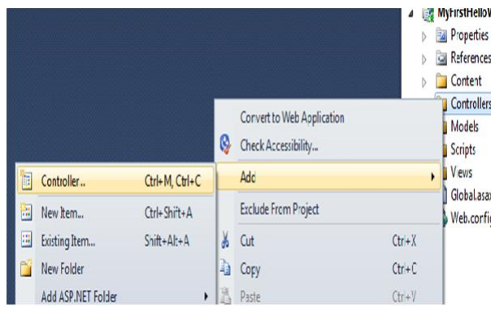
Once you click OK, you have a readymade structure with the appropriate folders where you can add controllers, models, and views.
Now, add a Controller.

Slide 11
Once you add the new controller, you should see some kind of code snippet as shown below:
public class Default1Controller : Controller
{
// // GET: /Default1/
public ActionResult Index()
{
return View();
}
}

Slide 12
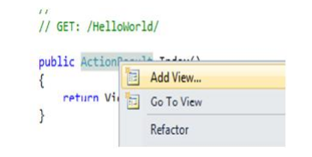
Now that we have the controller we need to go and add the view. So click on the Index function which is present in the control and click on the Add View menu as shown in the below figure.
The add view pops up a modal box to enter the view name which will be invoked when this controller is called as shown in the figure below. For now, keep the view name same as the controller name and also uncheck the master page check box.

Slide 13
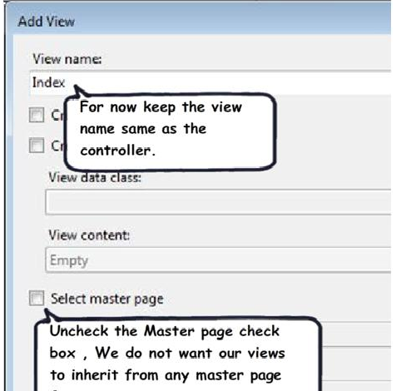
Once you click on the OK button of the view, you should see a simple ASPX page with the below HTML code snippet. In the below code snippet I have added “This is my first MVC application”.

Slide 14
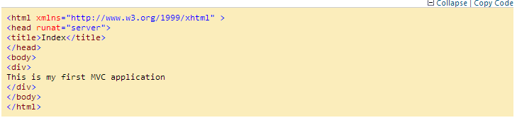
Now Run your application.If you do a CTRL + F5 you should see an error as shown in the below figure. This error is obvious because we have not invoked the appropriate controller / action.

Slide 15
