Slide 1
ActionResults, ActionSelectors and ActionFilters in MVC

Slide 2
What is an ActionResult?
An ActionResult is a return type of a controller method, also called an action method, and serves as the base class for Result classes.
Action methods return models to views, file streams, redirect to other controllers, or whatever is necessary for the task at hand. The controller takes on this responsibility to connect system components, acting as a traffic cop.
There are many derived ActionResult types you can use to return results that are more specific for a particular view.

Slide 3
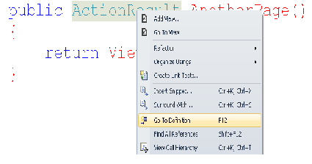
Action Result– Contd..
To see the abstract class, Right-Click the ActionResult in the Controller, and select GoTo Definition popup menu item from the list.

Slide 4
ActionResult as Base
Inheriting from the ActionResult are the following classes:
ContentResult
EmptyResult
FileResult
HttpStatusCodeResult
JavaScriptResult
RedirectResult
RedirectToRouteResult
ViewResultBase
These are the classes that inherit from ActionResult indirectly:
FileContentResult
FilePathResult
FileStreamResult
HttpNotFoundResult
HttpUnauthorizedResult
PartialViewResult
ViewResult

Slide 5
View Result Type
The ViewResult is the most common concrete type you will be returning as a controller action. It has an abstract base class called ViewResultBase, which it shares with PartialViewResult.
PartialViews are not common as action results. PartialViews are not the primary thing being displayed to the user, that is the View. The partial view is usually a widget or something else on the page. It’s usually not the primary content the user sees.
It is in the ViewResultBase abstract base class that we get access to all of our familiar data objects like: TempData, ViewData, and ViewBag.

Slide 6
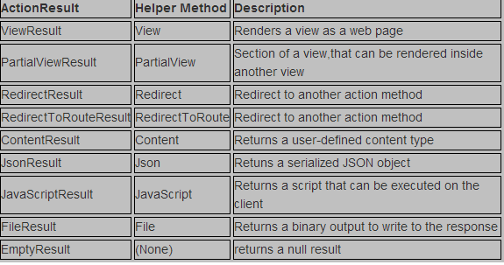
Different ActionResult Types

Slide 7
ViewResult- Example
public ViewResult ViewResultTest()
{
return View();
}

Slide 8
PartialViewResult-Example
public PartialViewResult PartialViewResultTest()
{
return PartialView("_LoginPartial");
}

Slide 9
RedirectResult - Example
public ActionResult SampleRedirectResult() {
return Redirect(http://www.google.com);
}

Slide 10
RedirectToRouteResult - Example
**Default Route must be the last route in the RouteConfig.cs
Step 1: Create a route in RouteConfig.cs, named “MyRoute”
Step 2:
public RedirectToRouteResult Welcome() {
Return RedirectToRoute(“MyRoute”);
}

Slide 11
When to use
Return View doesn't make a new requests, it just renders the view without changing URLs in the browser's address bar.
Return RedirectToAction makes a new requests and URL in the browser's address bar is updated with the generated URL by MVC.
Return Redirect also makes a new requests and URL in the browser's address bar is updated, but you have to specify the full URL to redirect
Between RedirectToAction and Redirect, best practice is to use RedirectToAction for anything dealing with your application actions/controllers. If you use Redirect and provide the URL, you'll need to modify those URLs manually when you change the route table.
RedirectToRoute redirects to a specific route defined in the Route table.

Slide 12
ContentResult-Example
public ActionResult Index()
{
return Content("Hello from Home Controller");
}

Slide 13
File- Example
File is used to return the content of a file to the browser. In this example, let us return the web.config to the browser.
public ActionResult Index()
{
return File("Web.config", "text/html");
}

Slide 14
JSON- Example
We can render the text to the result page or can send it as a file to the client using JSON notation.
public ActionResult Index()
{
return Json("hello from JSON","text/html", JsonRequestBehavior.AllowGet);
}

Slide 15
JavaScriptResult
To improve clean separation of concerns by introducing the JavaScriptResult ActionResult.
Release notes says, “the JavaScriptResult class is used to execute JavaScript code that is created on the server and sent to the client.”

Slide 16
JavascriptResult- Example
For Example,in the Controller :
public JavaScriptResult HelloScript() { var s = “alert(‘Hello’)”; return JavaScript(s); }
In the View :
<script type=”text/javascript” src=”@Url.Content(“~/Home/HelloScript”)”></script>
Note : The dynamic script file will be generated based on the action name (HelloScript)
On Running the app, the JavaScript file will be created.

Slide 17
Action Methods
All the public methods of a Controller class are called Action methods. They are like any other normal methods with the following restrictions:
Action method must be public. It cannot be private or protected
Action method cannot be overloaded
Action method cannot be a static method.

Slide 18
Non Action Methods
Example:
[NonAction]
public void MethodTest()
{
// Do some thing
}
This is very useful attribute when visibility of controller 's method cannot be changed to private.

Slide 19
Model binding in MVC
To understand the model binding in MVC, first let's see how you can get the http request values in the action method using traditional ASP.NET style.
The following example shows how you can get the values from HttpGET and HttpPOST request by using the Request object directly in the action method.

Slide 20
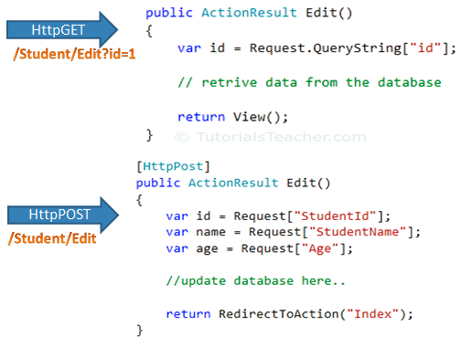
As you can see in the above figure, we use the Request.QueryString and Request (Request.Form) object to get the value from HttpGet and HttpPOST request. Accessing request values using the Request object is a cumbersome and time wasting activity.
With model binding, MVC framework converts the http request values (from query string or form collection) to action method parameters. These parameters can be of primitive type or complex type.

Slide 21
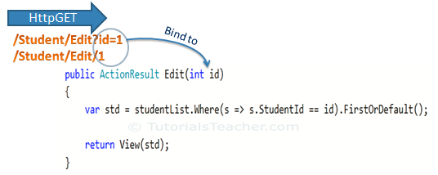
Binding to Privitive Type
HttpGET request embeds data into a query string. MVC framework automatically converts a query string to the action method parameters. For example, the query string "id" in the following GET request would automatically be mapped to the id parameter of the Edit() action method.

Slide 22
Multiple Parameters
You can also have multiple parameters in the action method with different data types. Query string values will be converted into paramters based on matching name.
Eg: http://localhost/Student/Edit?id=1&name=John would map to id and name parameter of the following Edit action method.

Slide 23
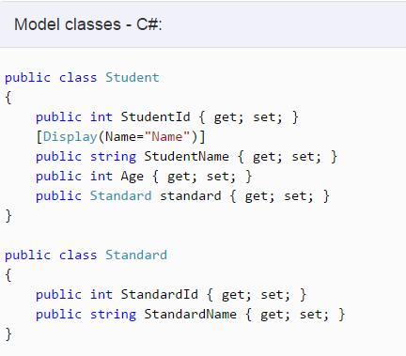
Binding to Complex type
Model binding also works on complex types. Model binding in MVC framework automatically converts form field data of HttpPOST request to the properties of a complex type parameter of an action method.
Eg:

Slide 24
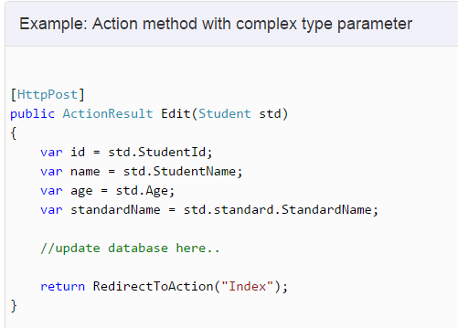
Now, you can create an action method which includes Student type parameter. In the following example, Edit action method (HttpPost) includes Student type parameter.

Slide 25
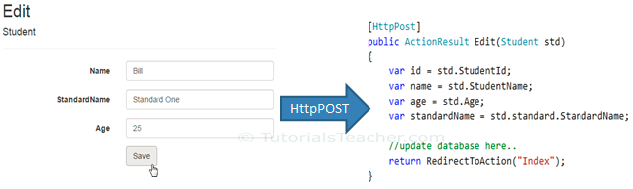
So now, MVC framework will automatically maps Form collection values to Student type parameter when the form submits http POST request to Edit action method as shown below.

Slide 26
Bind Attribute
ASP.NET MVC framework also enables you to specify which properties of a model class you want to bind. The [Bind] attribute will let you specify the exact properties a model binder should include or exclude in binding.
In the following example, Edit action method will only bind StudentId and StudentName property of a Student model.

Slide 27
Bind Attribute – (Exclude)
You can also use Exclude properties as below.

Slide 28
Inside Model Binding
As you have seen that Model binding automatically converts request values into a primitive or complex type object. Model binding is a two step process. First, it collects values from the incoming http request and second, populates primitive type or complex type with these values.
Value providers are responsible for collecting values from request and Model Binders are responsible for populating values.

Slide 29
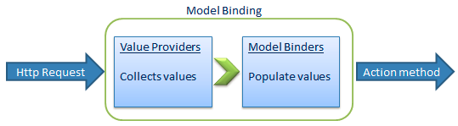
Default value provider collection evaluates values from the following sources:
Previously bound action parameters, when the action is a child action
Form fields (Request.Form)
The property values in the JSON Request body (Request.InputStream), but only when the request is an AJAX request
Route data (RouteData.Values)
Querystring parameters (Request.QueryString)
Posted files (Request.Files)
MVC includes DefaultModelBinder class which effectively binds most of the model types.

Slide 30
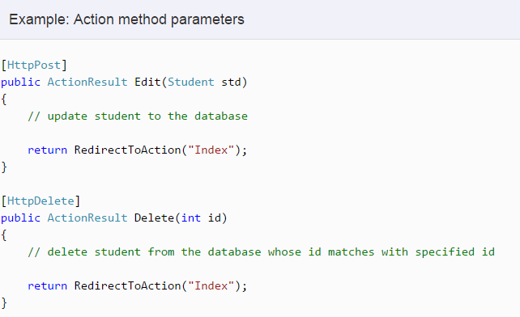
Action method Parameters
By default, the values for action method parameters are retrieved from the request's data collection. The data collection includes name/values pairs for form data or query string values or cookie values. Model binding in ASP.NET MVC automatically maps the URL query string or form data collection to the action method parameters if both names are matching.

Slide 31
Automatic Mapping of Action Method Parameters and Incoming Request
Consider our action method have some parameters,mapping of user request data to the parameter is done automatically in MVC framework.MVC framework examines the user request that if there is an HTTP request value with same name,then it maps the value automatically to the parameter of action method. Consider an examle,Suppose we have a Controller 'Register' and an action method 'Add' in 'Register' Controller.

Slide 32
Example
public ActionResult Add(int id)
{
ViewData["RegisterNumber"] = id;
return View();
}

Slide 33
ActionSelectors
Three action selectors attributes are available in MVC 5 - ActionName - NonAction - ActionVerbs
Notes:
public class StudentController : Controller
{
public StudentController()
{
}
[ActionName("find")]
public ActionResult GetById(int id)
{
// get student from the database return View();
}
}

Slide 34
ActionName
Action selector is the attribute that can be applied to the action methods. It helps routing engine to select the correct action method to handle a particular request.
ActionName attribute allows us to specify a different action name than the method name.

Slide 35
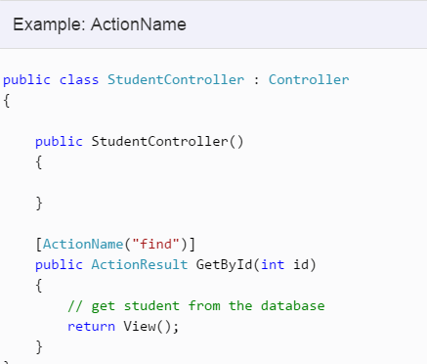
We have applied ActionName(“find”) attribute to GetById action method. So now, action name is "find" instead of "GetById".
This action method will be invoked onhttp://localhost/student/find/1 request instead of http://localhost/student/getbyid/1 request.

Slide 36
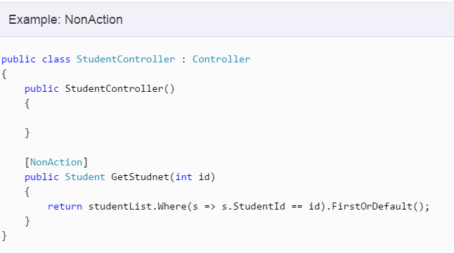
Non-Action Attribute
NonAction selector attribute indicates that a public method of a Controller is not an action method. Use NonAction attribute when you want public method in a controller but do not want to treat it as an action method.

Slide 37
Action Method Selectors
The default routing algorithm for how the ASP.NET MVC framework invokes actions is like {controller}/ {action}/ {id} patterns.
But this becomes more complex when you have two methods with the same name, or when you invoke an action when form data is submitted, or execute a method only when an AJAX request is made.
MVC framework supports different ActionVerbs, like HttpGet, HttpPost, etc. You can apply these attributes to action method to indicate the kind of Http request the action method supports. If you do not apply any attribute then it considers it a GET request by default.

Slide 38
Usage
Http method | Usage
GET | To retrieve the information from the server. Parameters will be appended in the query string.
POST | To create a new resource.
PUT | To update an existing resource.
HEAD | Identical to GET except that server do not return message body.
OPTIONS | OPTIONS method represents a request for information about the communication options supported by web server.
DELETE | To delete an existing resource.
PATCH | To full or partial update the resource.

Slide 39
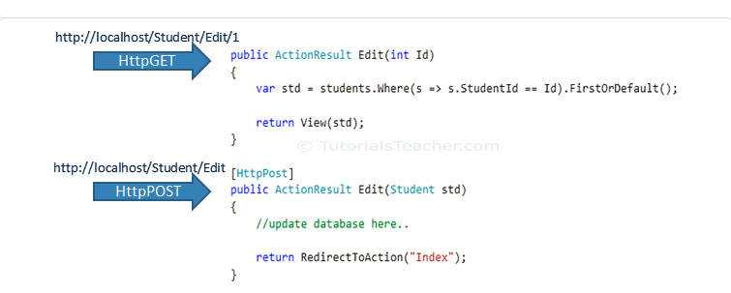
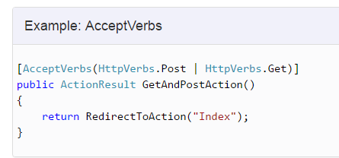
Action Verbs
You can also apply multiple http verbs using AcceptVerbs attribute. GetAndPostAction method supports both, GET and POST ActionVerbs in the given example:

Slide 40
AcceptVerbs and ActionName
1. AcceptVerbs
This attribute is used when we want to execute some action when a particular HTTP operation is performed like POST, GET, DELETE, etc.
The Syntax:
[AcceptVerbs(HttpVerbs.Post)]
2. ActionName
This attribute is used when you expose an action name with a different name than its method name, or you can use an action name attribute to expose two methods with the same name as the action with different names.
Notes:
[ActionName("List")]
public ActionResult Index()
{
return View("Index");
}
public class ActionSelectorController : Controller
{
[HttpGet]
public ActionResult Index()
{
return View();
}
[HttpPost]
public ActionResult Index(Class1 cs)
{
return RedirectToAction("Home");
}
public ActionResult Home()
{
return View();
}
}

Slide 41
Conclude, Action Verbs
ActionVerbs are another Action Selectors which selects an action method based on request methods e.g POST, GET, PUT etc.
Multiple action methods can have same name with different action verbs. Method overloading rules are applicable.
Multiple action verbs can be applied to a single action method using AcceptVerbs attribute.

Slide 42
ActionFilters
In an ASP.NET MVC application the request from the user first lands at the UrlRoutingModule. This module parses the requested URL and then invokes the corresponding controller and action. The controller will then render the appropriate view and the response will be sent to the user.
If we want to inject some extra processing logic in this request-response life cycle
ASP.NET MVC provides a way for us to do that by writing custom filters that can be used to inject extra processing logic in the request-response life cycle.

Slide 43
What are attributes and filters
MVC provides a very clean way of injecting the pre-processing and post-processing logic for actions and controllers. This way we can put the pre-processing and post-processing logic by decorating the actions with attributes which will invoke an attribute class implementing the filter's logic.
For example, If we need some action to be executed when the user has been authenticated then we can apply the [Authorize] attribute to the action. This will take care of calling the attribute class which implements the authorization filter to check whether the user has is authorized or not.

Slide 44
Example
Type of filters
Filters could be applied to Gobal Level, Controllers and Action Level.
Various types of filters
Authorization filter- [Authorize]
Action filter-[OutputCache]
Result filter
Exception filter-[HandleError]
[Authorize(Roles=“Admin”)]
public ActionResult Index()
{
return View();
}

Slide 45
Implications of Filters
Typically, Filters are used to perform the following common functionalities in your ASP.NET MVC application.
Custom Authentication
Custom Authorization(User based or Role based)
Error handling or logging
User Activity Logging
Data Caching
Data Compression

Slide 46
Types & Sequence of Filter Execution
There are four types of Filters in ASP.NET MVC 4
1. Authorization Filters: Responsible for checking User Access, these implement the IAuthorizationFilter interface in the framework. The AuthorizeAttribute and RequireHttpsAttribute are examples of Authorization Filters.
2. Action Filters: These implement the IActionFilter interface that have two methodsOnActionExecuting and OnActionExecuted. OnActionExecuting runs before the Action and gives an opportunity to cancel the Action call.

Slide 47
3. Result Filters: These implement the IResultFilter interface which like the IActionFilter hasOnResultExecuting and OnResultExecuted. The OutputCacheAttribute class is example of a Result Filter.
4. ExceptionFilters: These implement the IExceptionFilter interface and they execute if there are any unhandled exceptions thrown during the execution pipeline. The HandleErrorAttribute class is an example of such a filters.
Apart from using the Filter Attribute, each controller class implements all four interfaces; so if applying an attribute is not something you prefer, you can override the methods in your controller class if you want.
Notes:
//Configuring Filters
//You can configure your own custom filter into your application at following three levels:
//Global level
//By registering your filter into Application_Start event of Global.asax.cs file with the help of FilterConfig class.
protected void Application_Start()
{
FilterConfig.RegisterGlobalFilters(GlobalFilters.Filters);
}
//Controller level
//By putting your filter on the top of the controller name as shown below-
[Authorize(Roles="Admin")]
public class AdminController : Controller
{
//
}
//Action level
//By putting your filter on the top of the action name as shown below-
public class UserController : Controller
{
[Authorize(Users="User1,User2")]
public ActionResult LinkLogin(string provider)
{
// TODO:
return View();
}
}

Slide 48
Demo
DEMO ON CUSTOM FILTERS
Notes:
//Controller
[CustAuthFilter]
public class HomeController : Controller
{
public ActionResult Index()
{
ViewBag.Message = "Modify this template to jump-start your ASP.NET MVC application.";
return View();
}
public ActionResult About()
{
ViewBag.Message = "Your app description page.";
return View();
}
public ActionResult Contact()
{
ViewBag.Message = "Your contact page.";
return View();
}
[CustomActionFilter]
[CustExceptionFilter]
[OutputCache(Duration=10)]
public ActionResult Hello()
{
ViewBag.Date = DateTime.Now.ToString("T");
return View();
}
}
=============================================================
//Add a class file to the project and NOT TO MODELS
public class CustAuthFilter:AuthorizeAttribute
{
public override void OnAuthorization(AuthorizationContext filterContext)
{
//base.OnAuthorization(filterContext);
filterContext.Controller.ViewBag.Msg = "this is custom msg";
}
}
public class CustomActionFilter : ActionFilterAttribute
{
public override void OnActionExecuting(ActionExecutingContext filterContext)
{
filterContext.Controller.ViewBag.CustomActionMessage1 = "Custom Action Filter: Message from OnActionExecuting method.";
}
public override void OnActionExecuted(ActionExecutedContext filterContext)
{
filterContext.Controller.ViewBag.CustomActionMessage2 = "Custom Action Filter: Message from OnActionExecuted method.";
}
public override void OnResultExecuting(ResultExecutingContext filterContext)
{
filterContext.Controller.ViewBag.CustomActionMessage3 = "Custom Action Filter: Message from OnResultExecuting method.";
}
public override void OnResultExecuted(ResultExecutedContext filterContext)
{
filterContext.Controller.ViewBag.CustomActionMessage4 = "Custom Action Filter: Message from OnResultExecuted method.";
}
}
public class CustExceptionFilter : FilterAttribute, IExceptionFilter
{
public void OnException(ExceptionContext filterContext)
{
filterContext.Controller.ViewBag.ExceptionMessage = "Custom Exception: Message from OnException method.";
}
}
=====================================================================
//View- Hello.cshtml
@{
ViewBag.Title = "Hello";
}
<h2>Hello</h2>
<h2>OutPutTest</h2>
<h3>@ViewBag.Date</h3>
<h2>Output Messages :</h2>
<br />
<h3>@ViewBag.AutherizationMessage</h3>
<br />
<h3>@ViewBag.CustomActionMessage1</h3>
<br />
<h3>@ViewBag.CustomActionMessage2</h3>
<br />
<h3>@ViewBag.CustomActionMessage3</h3>
<br />
<h3>@ViewBag.CustomActionMessage4</h3>
<br />
<h3>@ViewBag.ExceptionMessage</h3>

Slide 49
Partial Views
A Partial view is like as user control in Asp.Net Web forms that is used for code re-usability.
Partial views helps us to reduce code duplication. Hence partial views are reusable views like as Header and footer.
A partial view has same file extension(.cshtml) as regular view. To create a partial view do right click on shared folder (\Views\Shared) in solution explorer.
Note: It is best practice to create partial view in the shared folder and partial view name is preceded by "_", but it is not mandatory. The "_" before view name specify that it is a reusable component i.e. partial view.

Slide 50
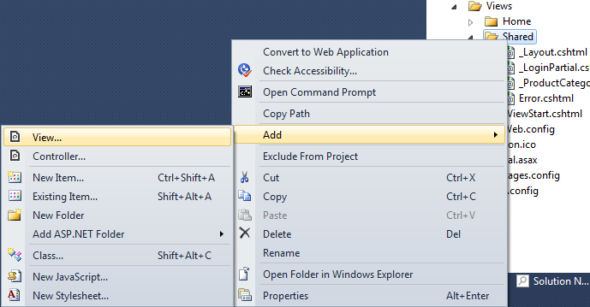
Creating a Partial View

Slide 51
Render a Partial View
A partial view is rendered by using the ViewUserControl
class that is inherited/derived from the ASP.NET
UserControl class. The Partial, RenderPartial, RenderAction
helper methods are used to render partial view in mvc3
razor.
<div> @Html.Partial("_Comments") </div>
2. <div> @{Html.RenderPartial("_Comments");} </div>
The main difference between above two methods is that the Partial helper method renders a partial view into a string while RenderPartial method writes directly into the response stream instead of returning a string.

Slide 52
Implications of RenderPartial and RenderAction Methods
Partial or RenderPartial methods are used when a model for the page is already populated with all the information. For example in a blog to show an article comment we would like to use Partial or RenderPartial methods since an article information are already populated in the model.
RenderAction method is used when some information is need to show on multiple pages. Hence partial view should have its own model. For example to category list of articles on each and every page we would like to use RenderAction method since the list of category is populated by different model.
Notes:
Render Partial View Using jQuery
Sometimes we need to load a partial view with in a popup on run time like as login box, then we can use jQuery to make an AJAX request and render a Partial View into the popup. In order to load a partial view with in a div we need to do like as:
<script type="text/jscript">
$('#divpopup').load('/shared/_ProductCategory’);
</script>

Slide 53
DEMO ON PARTIAL VIEWS

