Slide 1
Various ways to pass data from Controller to View(TempData, ViewData, and ViewBag.)

Slide 2
Interaction between Controller and View
There are various ways to pass data from a Controller to a View. Lets see how Controllers interact with Views and specifically cover ways to pass data from a Controller to a View to render a response back to a client.
They are:
View Bag
View Data
View Model
TempData

Slide 3
View Bag
ViewBag is very well known way to pass the data from Controller to View & even View to View.
ViewBag uses the dynamic feature that was added in C# 4.0.
We can say ViewBag=ViewData + Dynamic wrapper around the ViewData dictionary.

Slide 4
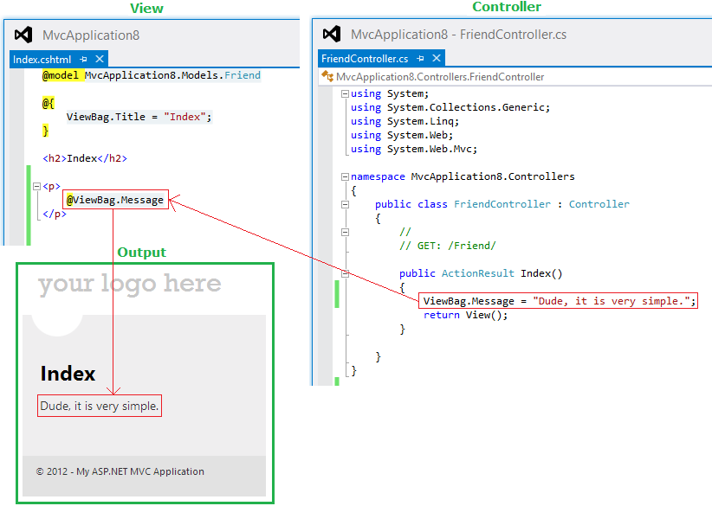
Example of ViewBag- Controller to View

Slide 5
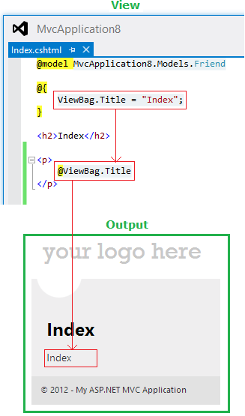
Example of ViewBag- View to View

Slide 6
Scope of ViewBag
In above image, you see how data is initialized on the 'View' page itself using 'ViewBag.Title and then how it is getting rendered using '@ViewBag.Title'.
What is 'Title'?
It is nothing more than a key, which has very limited availability and can be used on the same page only.

Slide 7
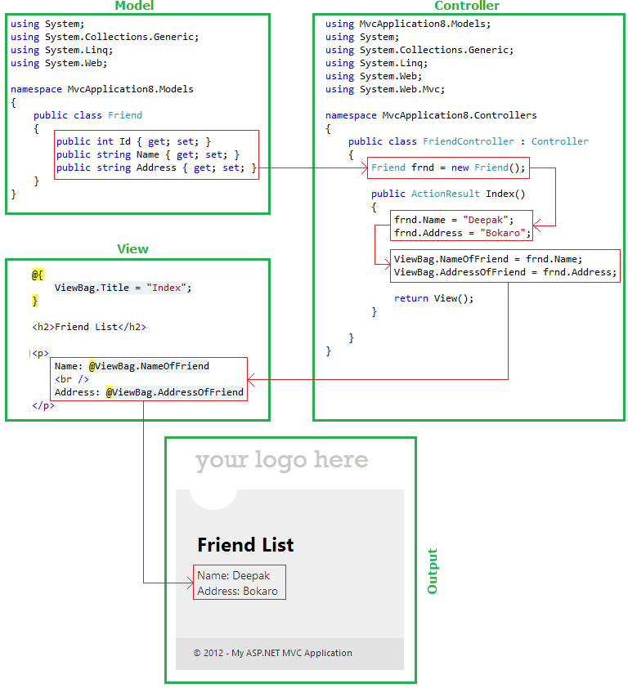
Model in the ViewBag

Slide 8
ViewData
ViewData is typed as a dictionary containing "objects“.
ViewBag and ViewData serves the same purpose in allowing developers to pass data from Controllers to Views. When you put objects in either one, those objects become accessible in the View. Let's look at one example:

Slide 9
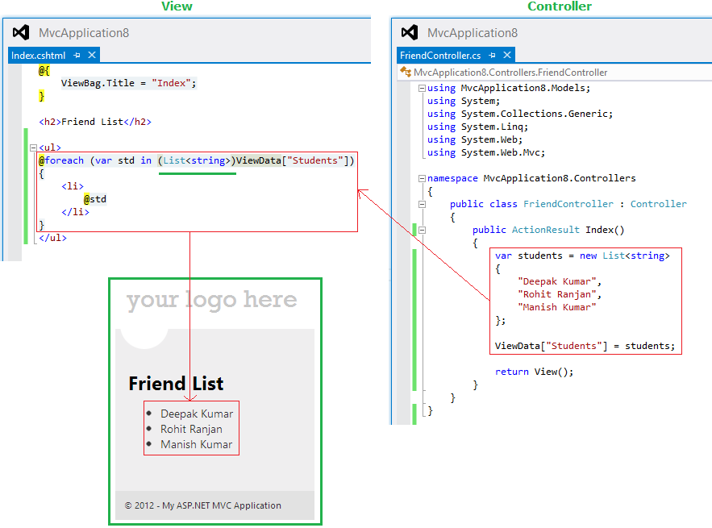

Slide 10
In above image, everything is normal except in foreach loop. ViewData is typed as a dictionary containing "objects", we need to cast ViewData["Students"] to a List<string> or an IEnumerable<string> in order to use the foreach statement on it. Such as in:
@foreach (var std in (List<string>)ViewData["Students"])
OR
@foreach (var std in (IEnumerable<string>)ViewData["Students"])
You can put data into the ViewBag and access it from ViewData or put data in the ViewData and access it from the ViewBag.

Slide 11
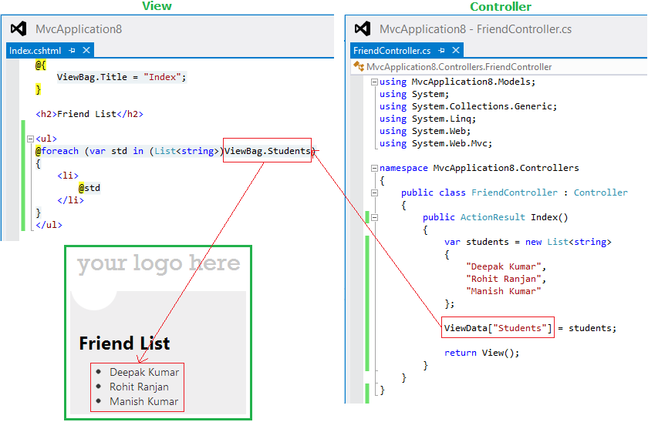
ViewData to ViewBag

Slide 12
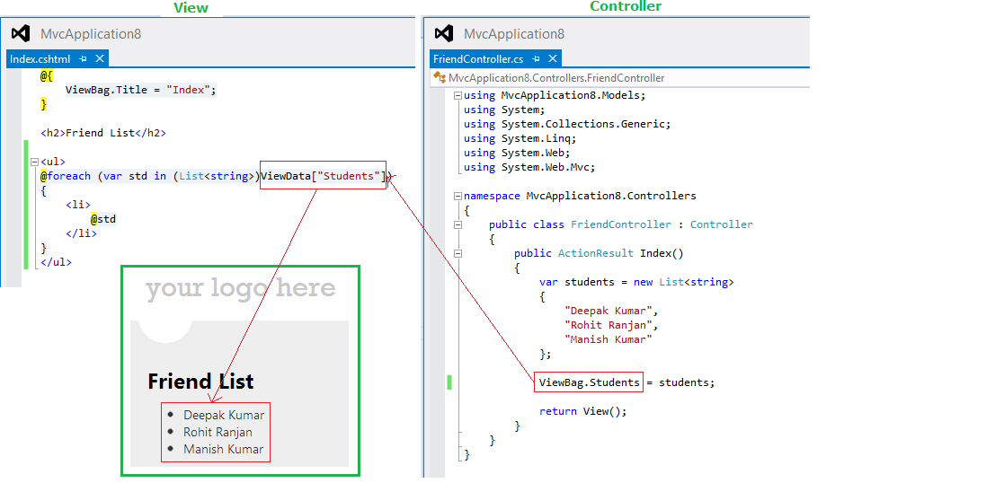
ViewBag to ViewData

Slide 13
So these two (ViewBag and ViewData) things seem to work almost exactly the same. Then, what's the difference?
The difference is only, how you access the data. ViewBag is actually just a wrapper around the ViewData object, and its whole purpose is to let you use dynamics to access the data instead of using magic <strings> conversion, you can realize it by above examples. Some people prefer one style over the other. In fact, because they're the same data just with two different ways of accessing it, you can use them interchangeably like ViewData to ViewBag or ViewBag to ViewData

Slide 14
Similarities between ViewBag & ViewData
Helps to maintain data when you move from controller to view.
Used to pass data from controller to corresponding view.
Short life means value becomes null when redirection occurs. This is because their goal is to provide a way to communicate between controllers and views. It’s a communication mechanism within the server call.

Slide 15
Difference between ViewBag & ViewData
ViewData is a dictionary of objects that is derived from ViewDataDictionary class and accessible using strings as keys.
ViewBag is a dynamic property that takes advantage of the new dynamic features in C# 4.0.
ViewData requires typecasting for complex data type and check for null values to avoid error.
ViewBag doesn’t require typecasting for complex data type.

Slide 16
ViewModels
Using ViewModel we can also pass the data from the Controller to View.
In the below example, we have multiple people in a list from being passed as a View, simple. I will add one more thing here, to get intellisence support or a strongly typed view page here, to get it do it this way.
Just add a reference of the model by using the IEnumerable interface and you are done.

Slide 17
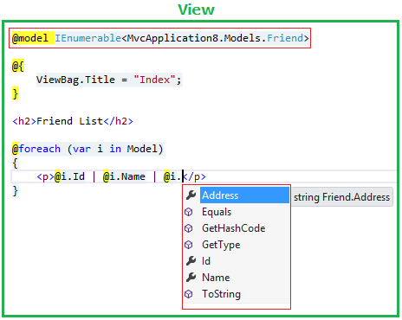
Add Reference, to get intellisense
@model Ienumerable<MvcApplication1.Models.Friend>

Slide 18
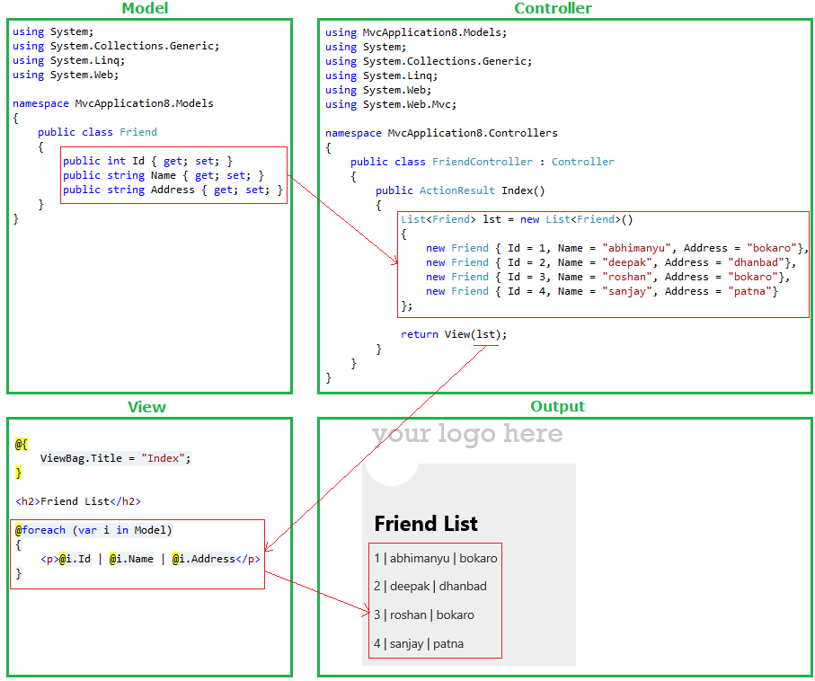
Example of ViewModels

Slide 19
TempData
TempData is meant to be a very short-lived instance, and you should only use it during the current and the subsequent requests only.
Since TempData works this way, you need to know for sure what the next request will be, and redirecting to another view is the only time you can guarantee this. You can use TempData to pass error messages or something similar.
Notes:
public class FriendController : Controller
{
//
// GET: /Friend/
Friend f = new Friend();
public ActionResult Index()
{
f.Id = 11;
f.Name = "Sunita";
f.Address = "Pune";
ViewBag.Id = f.Id;
ViewBag.fname = f.Name;
ViewBag.fadd = f.Address;
var Fobj = new List<Friend>();
Fobj.Add(f);
ViewBag.fList = Fobj;
return View();
}
public ActionResult ListFriends()
{
List<Friend> lst = new List<Friend>();
lst.Add(new Friend {Id=1,Name="Prachi",Address="Pune" });
lst.Add(new Friend { Id = 2, Name = "Prerana", Address = "Mumbai" });
return View(lst);
}
public ActionResult FriendsPage()
{
ViewData["myFriend"] = "ABC";
ViewBag.YourFriend = "pqr";
TempData["commonFriend"] = "xyz";
return new RedirectResult(@"~\Friend\AnotherPage\");
}
public ActionResult AnotherPage()
{
return View();
}
}

Slide 20
public ActionResult FriendsPage() { ViewData["myFriend"] = "ABC"; ViewBag.YourFriend = "pqr"; TempData["commonFriend"] = "xyz";
return new RedirectResult(@"~\Friend\AnotherPage\");
}
public ActionResult AnotherPage()
{
return View();
}

Slide 21
On the, AnotherPage.cshtml, view page, add the following code:
<p>@ViewData["myFriend"];</p>
<p>@ViewBag.YourFriend;</p>
<p>@TempData["commonFriend"];</p>
Remember to call, the FreindsPage,
http://localhost:1234/Friend/FriendsPage
This call will be redirected to “AnotherPage”

