Slide 1
Angular JS Introduction

Slide 2
Why Angular JS?
Client side programming is becoming the one of the main parts of web applications.
Its a popular Javascript Framework.
In today’s projects, count of JavaScript files (plugins and custom files) are increasing rapidly which is making it unmanageable and unmaintainable.
AngularJS provides best of the both the worlds and now a days, it is one of the most talked and used JavaScript framework in web applications.

Slide 3
What is ANGULAR JS?
AngularJS is not just another JavaScript library but it provides a framework to write a
proper architectured,
maintainable and
testable client side code.
Follows MVC framework
Aimed to develop SPAs (Single Page Applications), it means your single HTML document turns into application. But it is also used a lot in ASP.NET and other applications .
Allows you to write Unit and integration tests for JavaScript code.

Slide 4
It provides it’s own and very rich list of attribute and properties for HTML controls which increases the usability of itexponentially.It is also called directives.
Supports two-way binding that means your data model and control’s data will be in sync.
Angular supports Dependency injection.
Angular library is also available on CDN so you just need to the url of the CDN and it available for use.
It is an Open Source

Slide 5
Main components of AngularJS
Controller
Views/Directives
Services
SERVICES
CONTROLLERS
VIEWS/DIRECTIVES
Notes:
We need to learn two things mentioned below before writing the first application
1- {{expression}} – It is called expressions and JavaScript like code can be written inside. It should be used for mainly small operations in HTML page.
2- $scope – This is one of very important variable used in AngularJS. It provides and link between the data and views. It holds all the required data for the views and used with in the HTML template.
3- ng- – All the elements that are provided by angular starts from ng-. So if you see some attribute that ng- and angular library is also included in the page, then you can assume that this should be angular element only.
4- ng-app – This directive is used to bootstrap the application. Normally, it is put at in top level element like html or body tag.

Slide 6
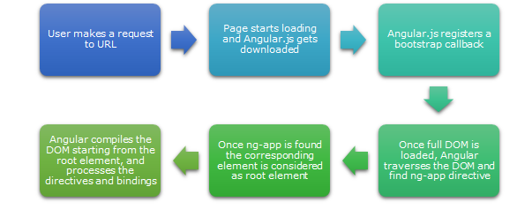
Flow of Angular page

Slide 7
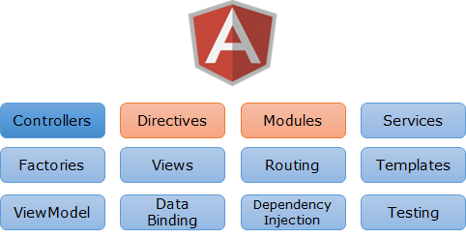
Components of Angular JS

Slide 8
DEMO – Hello World
Notes:
<!DOCTYPE html>
<html xmlns="http://www.w3.org/1999/xhtml">
<head>
<title>Hello world with AngularJS</title>
<script src="http://ajax.googleapis.com/ajax/libs/angularjs/1.0.7/angular.min.js"></script>
</head>
<body style="font-family:Verdana, Geneva, 'DejaVu Sans', sans-serif">
<h1 ng-app ng-controller="HelloWorldCtrl"> {{helloWorldMessage}}</h1>
<script type="text/javascript">
function HelloWorldCtrl($scope) {
$scope.helloWorldMessage = "Hello World with AngularJS on " + (new Date()).toDateString();
}
</script>
</body>
</html>

Slide 9
About the example
ng-app: This attribute is required to bootstrap the AngularJS application so it is put it in body element. The scope of the attribute is restricted to the id/tag where it is defined.
When ever we want to use the AngularJS , we need a controller. A JavaScript method HelloWorldCtrl is controller here. “Ctrl” is a naming convention for controller.
$scope: This is a parameter in controller method and we can create dynamic properties and assign values to it, which can be later can be accessed in UI element.

Slide 10
Use Controller: The controller can be defined over an element as ng-controller=<controller>
Then, we created a new property, helloWorldMessage to $scope variable and assign the message.

Slide 11
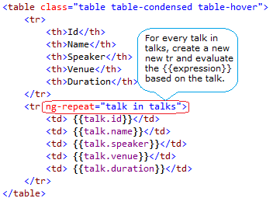

Slide 12
ng-repeat directive. It actually repeat the element on which it is used based on the provide list of data . Here talks is an JSON object which contains list of talk. It says for every talk in talks, repeat the tr and evaluate the used expression based on the properties of talk. So if we have four items in the list then four rows will be created.
Now the next question is, how to provide the value to talks. As talks is being accessed here, it should be a global variable or a variable in the scope where it can be accessed.

Slide 13
To fetch the data, There could be two ways
1- Initialize the value on the page
2- Or get the data from server/web services etc
Let’s take first scenario, initialize the value the on the page. AngularJS provides us a simple way to initialize using a directive that is called ng-init.
ng-init – This directive provides us a way to initialize a variable on the page. So using this directive, we can provide some initial value to a variable.

Slide 14
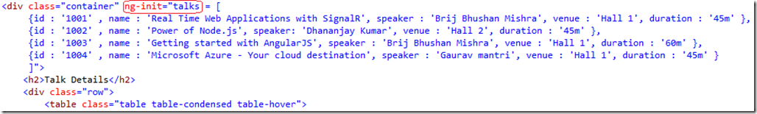

Slide 15
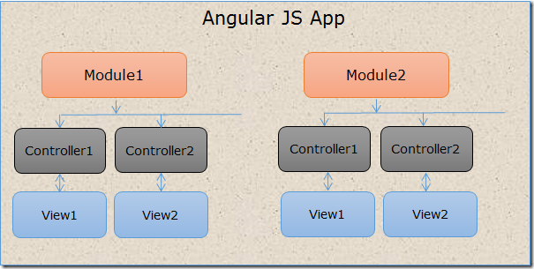
Modules
Modules are like containers, and they also provide structure to the Angular application.
It is a top level element and contains all the part of AngularJS that are used on the page.

