Slide 1
Introduction to the core Azure Storage services

Slide 2
The Azure Storage platform is Microsoft's cloud storage solution for modern data storage scenarios. Core storage services offer a massively scalable object store for data objects, disk storage for Azure virtual machines (VMs), a file system service for the cloud, a messaging store for reliable messaging, and a NoSQL store. The services are:
Durable and highly available. Redundancy ensures that your data is safe in the event of transient hardware failures. You can also opt to replicate data across datacenters or geographical regions for additional protection from local catastrophe or natural disaster. Data replicated in this way remains highly available in the event of an unexpected outage.
Secure. All data written to an Azure storage account is encrypted by the service. Azure Storage provides you with fine-grained control over who has access to your data.
Scalable. Azure Storage is designed to be massively scalable to meet the data storage and performance needs of today's applications.
Managed. Azure handles hardware maintenance, updates, and critical issues for you.
Accessible. Data in Azure Storage is accessible from anywhere in the world over HTTP or HTTPS. Microsoft provides client libraries for Azure Storage in a variety of languages, including .NET, Java, Node.js, Python, PHP, Ruby, Go, and others, as well as a mature REST API. Azure Storage supports scripting in Azure PowerShell or Azure CLI. And the Azure portal and Azure Storage Explorer offer easy visual solutions for working with your data.

Slide 3
Core storage services
The Azure Storage platform includes the following data services:
Azure Blobs: A massively scalable object store for text and binary data. Also includes support for big data analytics through Data Lake Storage Gen2.
Azure Files: Managed file shares for cloud or on-premises deployments.
Azure Queues: A messaging store for reliable messaging between application components.
Azure Tables: A NoSQL store for schemaless storage of structured data.
Azure Disks: Block-level storage volumes for Azure VMs.
Each service is accessed through a storage account.

Slide 4
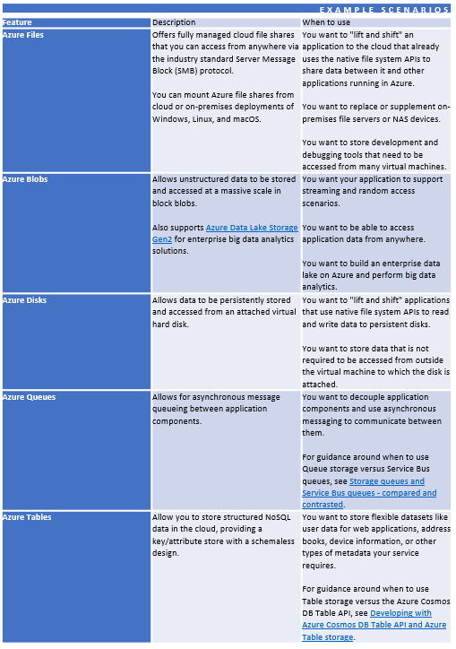

Slide 5
Blob storage
Azure Blob storage is Microsoft's object storage solution for the cloud. Blob storage is optimized for storing massive amounts of unstructured data, such as text or binary data.
Blob storage is ideal for:
Serving images or documents directly to a browser.
Storing files for distributed access.
Streaming video and audio.
Storing data for backup and restore, disaster recovery, and archiving.
Storing data for analysis by an on-premises or Azure-hosted service.
Objects in Blob storage can be accessed from anywhere in the world via HTTP or HTTPS. Users or client applications can access blobs via URLs, the Azure Storage REST API, Azure PowerShell, Azure CLI, or an Azure Storage client library. The storage client libraries are available for multiple languages, including .NET, Java, Node.js, Python, PHP, and Ruby.

Slide 6
Azure Files
Azure Files enables you to set up highly available network file shares that can be accessed by using the standard Server Message Block (SMB) protocol. That means that multiple VMs can share the same files with both read and write access. You can also read the files using the REST interface or the storage client libraries.
One thing that distinguishes Azure Files from files on a corporate file share is that you can access the files from anywhere in the world using a URL that points to the file and includes a shared access signature (SAS) token. You can generate SAS tokens; they allow specific access to a private asset for a specific amount of time.
File shares can be used for many common scenarios:
Many on-premises applications use file shares. This feature makes it easier to migrate those applications that share data to Azure. If you mount the file share to the same drive later that the on-premises application uses, the part of your application that accesses the file share should work with minimal, if any, changes.
Configuration files can be stored on a file share and accessed from multiple VMs. Tools and utilities used by multiple developers in a group can be stored on a file share, ensuring that everybody can find them, and that they use the same version.
Resource logs, metrics, and crash dumps are just three examples of data that can be written to a file share and processed or analyzed later.

Slide 7
Queue storage
The Azure Queue service is used to store and retrieve messages. Queue messages can be up to 64 KB in size, and a queue can contain millions of messages. Queues are generally used to store lists of messages to be processed asynchronously.
For example, say you want your customers to be able to upload pictures, and you want to create thumbnails for each picture. You could have your customer wait for you to create the thumbnails while uploading the pictures. An alternative would be to use a queue. When the customer finishes their upload, write a message to the queue. Then have an Azure Function retrieve the message from the queue and create the thumbnails. Each of the parts of this processing can be scaled separately, giving you more control when tuning it for your usage.

Slide 8
Table storage
Azure Table storage is now part of Azure Cosmos DB. In addition to the existing Azure Table storage service, there is a new Azure Cosmos DB Table API offering that provides throughput-optimized tables, global distribution, and automatic secondary indexes.
Azure Table storage is a service that stores non-relational structured data (also known as structured NoSQL data) in the cloud, providing a key/attribute store with a schemaless design. Because Table storage is schemaless, it's easy to adapt your data as the needs of your application evolve. Access to Table storage data is fast and cost-effective for many types of applications, and is typically lower in cost than traditional SQL for similar volumes of data.

Slide 9
You can use Table storage to store flexible datasets like user data for web applications, address books, device information, or other types of metadata your service requires. You can store any number of entities in a table, and a storage account may contain any number of tables, up to the capacity limit of the storage account.
What is Table storage
Azure Table storage stores large amounts of structured data. The service is a NoSQL datastore which accepts authenticated calls from inside and outside the Azure cloud. Azure tables are ideal for storing structured, non-relational data. Common uses of Table storage include:
Storing TBs of structured data capable of serving web scale applications
Storing datasets that don't require complex joins, foreign keys, or stored procedures and can be denormalized for fast access
Quickly querying data using a clustered index
Accessing data using the OData protocol and LINQ queries with WCF Data

Slide 10
Table storage concepts Table storage contains the following components:
URL format: Azure Table Storage accounts use this format: http://<storage account>.table.core.windows.net/<table>
Azure Cosmos DB Table API accounts use this format: http://<storage account>.table.cosmosdb.azure.com/<table>
You can address Azure tables directly using this address with the OData protocol. For more information, see OData.org.
Accounts: All access to Azure Storage is done through a storage account. For more information about storage accounts, see Storage account overview.
All access to Azure Cosmos DB is done through a Table API account. See Create a Table API account for details creating a Table API account.
Table: A table is a collection of entities. Tables don't enforce a schema on entities, which means a single table can contain entities that have different sets of properties.
Entity: An entity is a set of properties, similar to a database row. An entity in Azure Storage can be up to 1MB in size. An entity in Azure Cosmos DB can be up to 2MB in size.
Properties: A property is a name-value pair. Each entity can include up to 252 properties to store data. Each entity also has three system properties that specify a partition key, a row key, and a timestamp. Entities with the same partition key can be queried more quickly, and inserted/updated in atomic operations. An entity's row key is its unique identifier within a partition.

Slide 11
Disk storage
An Azure managed disk is a virtual hard disk (VHD). You can think of it like a physical disk in an on-premises server but, virtualized. Azure-managed disks are stored as page blobs, which are a random IO storage object in Azure. We call a managed disk 'managed' because it is an abstraction over page blobs, blob containers, and Azure storage accounts. With managed disks, all you have to do is provision the disk, and Azure takes care of the rest.
Azure managed disks are block-level storage volumes that are managed by Azure and used with Azure Virtual Machines. Managed disks are like a physical disk in an on-premises server but, virtualized. With managed disks, all you have to do is specify the disk size, the disk type, and provision the disk. Once you provision the disk, Azure handles the rest.
The available types of disks are ultra disks, premium solid-state drives (SSD), standard SSDs, and standard hard disk drives (HDD).

Slide 12
Types of storage accounts
Azure Storage offers several types of storage accounts. Each type supports different features and has its own pricing model.
Secure access to storage accounts
Every request to Azure Storage must be authorized. Azure Storage supports the following authorization methods:
Azure Active Directory (Azure AD) integration for blob, queue, and table data. Azure Storage supports authentication and authorization with Azure AD for the Blob and Queue services via Azure role-based access control (Azure RBAC). Authorization with Azure AD is also supported for the Table service in preview. Authorizing requests with Azure AD is recommended for superior security and ease of use. For more information, see Authorize access to data in Azure Storage.
Azure AD authorization over SMB for Azure Files. Azure Files supports identity-based authorization over SMB (Server Message Block) through either Azure Active Directory Domain Services (Azure AD DS) or on-premises Active Directory Domain Services (preview). Your domain-joined Windows VMs can access Azure file shares using Azure AD credentials. For more information, see Overview of Azure Files identity-based authentication support for SMB access and Planning for an Azure Files deployment.
Authorization with Shared Key. The Azure Storage Blob, Files, Queue, and Table services support authorization with Shared Key. A client using Shared Key authorization passes a header with every request that is signed using the storage account access key. For more information, see Authorize with Shared Key.
Authorization using shared access signatures (SAS). A shared access signature (SAS) is a string containing a security token that can be appended to the URI for a storage resource. The security token encapsulates constraints such as permissions and the interval of access. For more information, see Using Shared Access Signatures (SAS).
Anonymous access to containers and blobs. A container and its blobs may be publicly available. When you specify that a container or blob is public, anyone can read it anonymously; no authentication is required.

Slide 13
Encryption
There are two basic kinds of encryption available for the core storage services.
Encryption at rest
Azure Storage encryption protects and safeguards your data to meet your organizational security and compliance commitments. Azure Storage automatically encrypts all data prior to persisting to the storage account and decrypts it prior to retrieval. The encryption, decryption, and key management processes are transparent to users. Customers can also choose to manage their own keys using Azure Key Vault.
Client-side encryption
The Azure Storage client libraries provide methods for encrypting data from the client library before sending it across the wire and decrypting the response. Data encrypted via client-side encryption is also encrypted at rest by Azure Storage.

Slide 14
Redundancy
To ensure that your data is durable, Azure Storage stores multiple copies of your data. When you set up your storage account, you select a redundancy option.
Transfer data to and from Azure Storage
You have several options for moving data into or out of Azure Storage. Which option you choose depends on the size of your dataset and your network bandwidth.
Storage APIs, libraries, and tools
You can access resources in a storage account by any language that can make HTTP/HTTPS requests. Additionally, the core Azure Storage services offer programming libraries for several popular languages. These libraries simplify many aspects of working with Azure Storage by handling details such as synchronous and asynchronous invocation, batching of operations, exception management, automatic retries, operational behavior, and so forth. Libraries are currently available for the following languages and platforms, with others in the pipeline:

Slide 15
Azure Storage data API and library references
Azure Storage REST API
Azure Storage client library for .NET
Azure Storage client library for Java/Android
Azure Storage client library for Node.js
Azure Storage client library for Python
Azure Storage client library for PHP
Azure Storage client library for Ruby
Azure Storage client library for C++
Azure Storage management API and library references
Storage Resource Provider REST API
Storage Resource Provider Client Library for .NET
Storage Service Management REST API (Classic)
Azure Storage data movement API and library references
Storage Import/Export Service REST API
Storage Data Movement Client Library for .NET
Tools and utilities
Azure PowerShell Cmdlets for Storage
Azure CLI Cmdlets for Storage
AzCopy Command-Line Utility
Azure Storage Explorer is a free, standalone app from Microsoft that enables you to work visually with Azure Storage data on Windows, macOS, and Linux.
Azure Resource Manager templates for Azure Storage

Slide 16
AZURE STORAGE ACCOUNTS
An Azure storage account contains all of your Azure Storage data objects: blobs, file shares, queues, tables, and disks. The storage account provides a unique namespace for your Azure Storage data that's accessible from anywhere in the world over HTTP or HTTPS. Data in your storage account is durable and highly available, secure, and massively scalable.
Types of storage accounts
Azure Storage offers several types of storage accounts. Each type supports different features and has its own pricing model. Consider these differences before you create a storage account to determine the type of account that's best for your applications.
The following table describes the types of storage accounts recommended by Microsoft for most scenarios.

Slide 17
TYPES OF STORAGE ACCOUNTS
Type of storage account | Supported storage services | Redundancy options | Usage
Standard general-purpose v2 | Blob (including Data Lake Storage¹), Queue, and Table storage, Azure Files | LRS/GRS/RA-GRS ZRS/GZRS/RA-GZRS² | Standard storage account type for blobs, file shares, queues, and tables. Recommended for most scenarios using Azure Storage. Note that if you want support for NFS file shares in Azure Files, use the premium file shares account type.
Premium block blobs³ | Blob storage (including Data Lake Storage¹) | LRS ZRS² | Premium storage account type for block blobs and append blobs. Recommended for scenarios with high transactions rates, or scenarios that use smaller objects or require consistently low storage latency. Learn more about example workloads.
Premium file shares³ | Azure Files | LRS ZRS² | Premium storage account type for file shares only. Recommended for enterprise or high-performance scale applications. Use this account type if you want a storage account that supports both SMB and NFS file shares.
Premium page blobs³ | Page blobs only | LRS | Premium storage account type for page blobs only. Learn more about page blobs and sample use cases.

Slide 18
Data Lake Storage is a set of capabilities dedicated to big data analytics, built on Azure Blob storage.
Zone-redundant storage (ZRS) and geo-zone-redundant storage (GZRS/RA-GZRS) are available only for standard general-purpose v2, premium block blobs, and premium file shares accounts in certain regions.
Storage accounts in a premium performance tier use solid-state drives (SSDs) for low latency and high throughput.
Legacy storage accounts are also supported.

Slide 19
Storage account endpoints
A storage account provides a unique namespace in Azure for your data. Every object that you store in Azure Storage has an address that includes your unique account name. The combination of the account name and the Azure Storage service endpoint forms the endpoints for your storage account.
When naming your storage account, keep these rules in mind:
Storage account names must be between 3 and 24 characters in length and may contain numbers and lowercase letters only.
Your storage account name must be unique within Azure. No two storage accounts can have the same name.

Slide 20
STORAGE ACCOUNT ENDPOINTS
Storage service | Endpoint
Blob storage | https://<storage-account>.blob.core.windows.net
Data Lake Storage Gen2 | https://<storage-account>.dfs.core.windows.net
Azure Files | https://<storage-account>.file.core.windows.net
Queue storage | https://<storage-account>.queue.core.windows.net
Table storage | https://<storage-account>.table.core.windows.net

Slide 21
Construct the URL for accessing an object in a storage account by appending the object's location in the storage account to the endpoint. For example, the URL for a blob will be similar to:
http://*mystorageaccount*.blob.core.windows.net/*mycontainer*/*myblob*
You can also configure your storage account to use a custom domain for blobs.

Slide 22
Migrate a storage account
MIGRATE A STORAGE ACCOUNT
Migration scenario | Details
Move a storage account to a different subscription | Azure Resource Manager provides options for moving a resource to a different subscription. For more information, see Move resources to a new resource group or subscription.
Move a storage account to a different resource group | Azure Resource Manager provides options for moving a resource to a different resource group. For more information, see Move resources to a new resource group or subscription.
Move a storage account to a different region | To move a storage account, create a copy of your storage account in another region. Then, move your data to that account by using AzCopy, or another tool of your choice. For more information, see Move an Azure Storage account to another region.
Upgrade to a general-purpose v2 storage account | You can upgrade a general-purpose v1 storage account or Blob storage account to a general-purpose v2 account. Note that this action cannot be undone. For more information, see Upgrade to a general-purpose v2 storage account.
Migrate a classic storage account to Azure Resource Manager | The Azure Resource Manager deployment model is superior to the classic deployment model in terms of functionality, scalability, and security. For more information about migrating a classic storage account to Azure Resource Manager, see the "Migration of storage accounts" section of Platform-supported migration of IaaS resources from classic to Azure Resource Manager.

Slide 23
Transfer data into a storage account
Microsoft provides services and utilities for importing your data from on-premises storage devices or third-party cloud storage providers. Which solution you use depends on the quantity of data you're transferring.
Storage account encryption
All data in your storage account is automatically encrypted on the service side.
Storage account billing
Azure Storage bills based on your storage account usage. All objects in a storage account are billed together as a group. Storage costs are calculated according to the following factors:
Region refers to the geographical region in which your account is based.
Account type refers to the type of storage account you're using.
Access tier refers to the data usage pattern you've specified for your general-purpose v2 or Blob storage account.
Capacity refers to how much of your storage account allotment you're using to store data.
Redundancy determines how many copies of your data are maintained at one time, and in what locations.
Transactions refer to all read and write operations to Azure Storage.
Data egress refers to any data transferred out of an Azure region. When the data in your storage account is accessed by an application that isn't running in the same region, you're charged for data egress. For information about using resource groups to group your data and services in the same region to limit egress charges,

Slide 24
The Azure Storage pricing page provides detailed pricing information based on account type, storage capacity, replication, and transactions. The Data Transfers pricing details provides detailed pricing information for data egress. You can use the Azure Storage pricing calculator to help estimate your costs.
Azure services cost money. Azure Cost Management helps you set budgets and configure alerts to keep spending under control. Analyze, manage, and optimize your Azure costs with Cost Management.

Slide 25
Legacy storage account types
Type of legacy storage account: Standard general-purpose v1
Supported storage services: Blob, Queue, and Table storage, Azure Files
Redundancy options: LRS/GRS/RA-GRS
Deployment model: Resource Manager, Classic
Usage: General-purpose v1 accounts may not have the latest features or the lowest per-gigabyte pricing. Consider using for these scenarios:
Your applications require the Azure classic deployment model.
Your applications are transaction-intensive or use significant geo-replication bandwidth, but don't require large capacity. In this case, general-purpose v1 may be the most economical choice.
You use a version of the Azure Storage REST API that is earlier than 2014-02-14 or a client library with a version lower than 4.x, and you can't upgrade your application.

Slide 26
Type of legacy storage account: Standard Blob storage
Supported storage services: Blob storage (block blobs and append blobs only)
Redundancy options: LRS/GRS/RA-GRS
Deployment model: Resource Manager
Usage: Microsoft recommends using standard general-purpose v2 accounts instead when possible.

Slide 27
Create a storage account
An Azure storage account contains all of your Azure Storage data objects: blobs, files, queues, and tables. The storage account provides a unique namespace for your Azure Storage data that is accessible from anywhere in the world over HTTP or HTTPS.
To create an Azure storage account with the Azure portal, follow these steps:
From the left portal menu, select Storage accounts to display a list of your storage accounts.
On the Storage accounts page, select Create.
Options for your new storage account are organized into tabs in the Create a storage account page. The following sections describe each of the tabs and their options.
Basics tab
On the Basics tab, provide the essential information for your storage account. After you complete the Basics tab, you can choose to further customize your new storage account by setting options on the other tabs, or you can select Review + create to accept the default options and proceed to validate and create the account.

Slide 28
BASICS TAB
Section | Field | Required or optional | Description
Project details | Subscription | Required | Select the subscription for the new storage account.
Project details | Resource group | Required | Create a new resource group for this storage account, or select an existing one.
Instance details | Storage account name | Required | Choose a unique name for your storage account. Storage account names must be between 3 and 24 characters in length and may contain numbers and lowercase letters only.
Instance details | Region | Required | Select the appropriate region for your storage account. Not all regions are supported for all types of storage accounts or redundancy configurations. The choice of region can have a billing impact..
Instance details | Performance | Required | Select Standard performance for general-purpose v2 storage accounts (default). This type of account is recommended by Microsoft for most scenarios. Select Premium for scenarios requiring low latency. After selecting Premium, select the type of premium storage account to create. The following types of premium storage accounts are available: Block blobs File shares Page blobs
Instance details | Redundancy | Required | Select your desired redundancy configuration. Not all redundancy options are available for all types of storage accounts in all regions. If you select a geo-redundant configuration (GRS or GZRS), your data is replicated to a data center in a different region. For read access to data in the secondary region, select Make read access to data available in the event of regional unavailability.

Slide 29
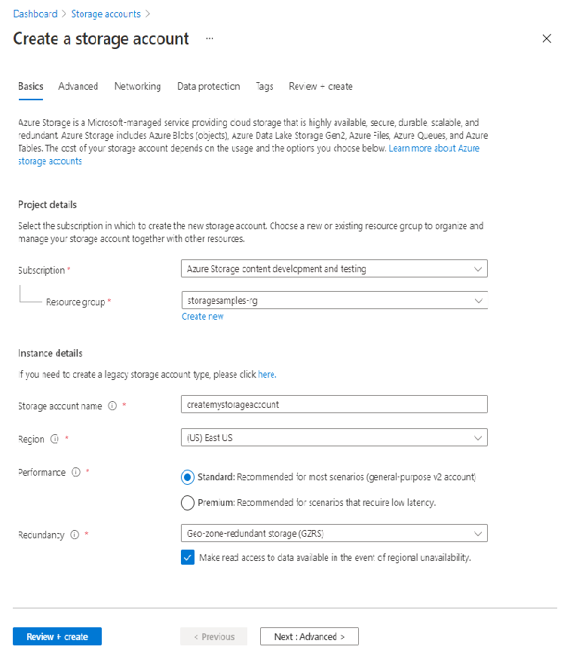
The following image shows a standard configuration for a new storage account.

Slide 30
Advanced tab On the Advanced tab, you can configure additional options and modify default settings for your new storage account. Some of these options can also be configured after the storage account is created, while others must be configured at the time of creation.
ADVANCED TAB
Section | Field | Required or optional | Description
Security | Enable secure transfer | Optional | Enable secure transfer to require that incoming requests to this storage account are made only via HTTPS (default). Recommended for optimal security. For more information, see Require secure transfer to ensure secure connections.
Security | Enable infrastructure encryption | Optional | By default, infrastructure encryption is not enabled. Enable infrastructure encryption to encrypt your data at both the service level and the infrastructure level. For more information, see Create a storage account with infrastructure encryption enabled for double encryption of data.
Security | Enable blob public access | Optional | When enabled, this setting allows a user with the appropriate permissions to enable anonymous public access to a container in the storage account (default). Disabling this setting prevents all anonymous public access to the storage account. For more information, see Prevent anonymous public read access to containers and blobs. Enabling blob public access does not make blob data available for public access unless the user takes the additional step to explicitly configure the container's public access setting.
Security | Enable storage account key access (preview) | Optional | When enabled, this setting allows clients to authorize requests to the storage account using either the account access keys or an Azure Active Directory (Azure AD) account (default). Disabling this setting prevents authorization with the account access keys. For more information, see Prevent Shared Key authorization for an Azure Storage account.
Security | Minimum TLS version | Required | Select the minimum version of Transport Layer Security (TLS) for incoming requests to the storage account. The default value is TLS version 1.2. When set to the default value, incoming requests made using TLS 1.0 or TLS 1.1 are rejected. For more information, see Enforce a minimum required version of Transport Layer Security (TLS) for requests to a storage account.
Data Lake Storage Gen2 | Enable hierarchical namespace | Optional | To use this storage account for Azure Data Lake Storage Gen2 workloads, configure a hierarchical namespace. For more information, see Introduction to Azure Data Lake Storage Gen2.
Blob storage | Enable network file share (NFS) v3 | Optional | NFS v3 provides Linux file system compatibility at object storage scale enables Linux clients to mount a container in Blob storage from an Azure Virtual Machine (VM) or a computer on-premises. For more information, see Network File System (NFS) 3.0 protocol support in Azure Blob storage.
Blob storage | Access tier | Required | Blob access tiers enable you to store blob data in the most cost-effective manner, based on usage. Select the hot tier (default) for frequently accessed data. Select the cool tier for infrequently accessed data. For more information, see Access tiers for Azure Blob Storage - hot, cool, and archive.
Azure Files | Enable large file shares | Optional | Available only for standard file shares with the LRS or ZRS redundancies.
Tables and queues | Enable support for customer-managed keys | Optional | To enable support for customer-managed keys for tables and queues, you must select this setting at the time that you create the storage account. For more information, see Create an account that supports customer-managed keys for tables and queues.

Slide 31
Networking tab On the Networking tab, you can configure network connectivity and routing preference settings for your new storage account. These options can also be configured after the storage account is created.
NETWORKING TAB
Section | Field | Required or optional | Description
Network connectivity | Connectivity method | Required | By default, incoming network traffic is routed to the public endpoint for your storage account. You can specify that traffic must be routed to the public endpoint through an Azure virtual network. You can also configure private endpoints for your storage account. For more information, see Use private endpoints for Azure Storage.
Network routing | Routing preference | Required | The network routing preference specifies how network traffic is routed to the public endpoint of your storage account from clients over the internet. By default, a new storage account uses Microsoft network routing. You can also choose to route network traffic through the POP closest to the storage account, which may lower networking costs. For more information, see Network routing preference for Azure Storage.

Slide 32
On the Data protection tab, you can configure data protection options for blob data in your new storage account. These options can also be configured after the storage account is created.
DATA PROTECTION TAB
Section | Field | Required or optional | Description
Recovery | Enable point-in-time restore for containers | Optional | Point-in-time restore provides protection against accidental deletion or corruption by enabling you to restore block blob data to an earlier state. For more information, see Point-in-time restore for block blobs. Enabling point-in-time restore also enables blob versioning, blob soft delete, and blob change feed. These prerequisite features may have a cost impact. For more information, see Pricing and billing for point-in-time restore.
Recovery | Enable soft delete for blobs | Optional | Blob soft delete protects an individual blob, snapshot, or version from accidental deletes or overwrites by maintaining the deleted data in the system for a specified retention period. During the retention period, you can restore a soft-deleted object to its state at the time it was deleted. For more information, see Soft delete for blobs. Microsoft recommends enabling blob soft delete for your storage accounts and setting a minimum retention period of seven days.
Recovery | Enable soft delete for containers (preview) | Optional | Container soft delete protects a container and its contents from accidental deletes by maintaining the deleted data in the system for a specified retention period. During the retention period, you can restore a soft-deleted container to its state at the time it was deleted. For more information, see Soft delete for containers (preview). Microsoft recommends enabling container soft delete for your storage accounts and setting a minimum retention period of seven days.
Recovery | Enable soft delete for file shares | Optional | Soft delete for file shares protects a file share and its contents from accidental deletes by maintaining the deleted data in the system for a specified retention period. During the retention period, you can restore a soft-deleted file share to its state at the time it was deleted. For more information, see Prevent accidental deletion of Azure file shares. Microsoft recommends enabling soft delete for file shares for Azure Files workloads and setting a minimum retention period of seven days.
Tracking | Enable versioning for blobs | Optional | Blob versioning automatically saves the state of a blob in a previous version when the blob is overwritten. For more information, see Blob versioning. Microsoft recommends enabling blob versioning for optimal data protection for the storage account.
Tracking | Enable blob change feed | Optional | The blob change feed provides transaction logs of all changes to all blobs in your storage account, as well as to their metadata. For more information, see Change feed support in Azure Blob Storage.

Slide 33
Review + create tab
When you navigate to the Review + create tab, Azure runs validation on the storage account settings that you have chosen. If validation passes, you can proceed to create the storage account.
If validation fails, then the portal indicates which settings need to be modified.
Delete a storage account
Deleting a storage account deletes the entire account, including all data in the account. Be sure to back up any data you want to save before you delete the account.
Under certain circumstances, a deleted storage account may be recovered, but recovery is not guaranteed.
If you try to delete a storage account associated with an Azure virtual machine, you may get an error about the storage account still being in use.
Portal
PowerShell
Azure CLI
Template
Navigate to the storage account in the Azure portal.
Click Delete.
Alternately, you can delete the resource group, which deletes the storage account and any other resources in that resource group.

Slide 34
Azure Storage redundancy
Azure Storage always stores multiple copies of your data so that it is protected from planned and unplanned events, including transient hardware failures, network or power outages, and massive natural disasters. Redundancy ensures that your storage account meets its availability and durability targets even in the face of failures.
When deciding which redundancy option is best for your scenario, consider the tradeoffs between lower costs and higher availability. The factors that help determine which redundancy option you should choose include:
How your data is replicated in the primary region
Whether your data is replicated to a second region that is geographically distant to the primary region, to protect against regional disasters
Whether your application requires read access to the replicated data in the secondary region if the primary region becomes unavailable for any reason

Slide 35
Redundancy in the primary region
Data in an Azure Storage account is always replicated three times in the primary region. Azure Storage offers two options for how your data is replicated in the primary region:
Locally redundant storage (LRS) copies your data synchronously three times within a single physical location in the primary region. LRS is the least expensive replication option, but is not recommended for applications requiring high availability or durability.
Zone-redundant storage (ZRS) copies your data synchronously across three Azure availability zones in the primary region. For applications requiring high availability, Microsoft recommends using ZRS in the primary region, and also replicating to a secondary region.
Locally-redundant storage
Locally redundant storage (LRS) replicates your data three times within a single data center in the primary region. LRS provides at least 99.999999999% (11 nines) durability of objects over a given year.
LRS is the lowest-cost redundancy option and offers the least durability compared to other options. LRS protects your data against server rack and drive failures. However, if a disaster such as fire or flooding occurs within the data center, all replicas of a storage account using LRS may be lost or unrecoverable. To mitigate this risk, Microsoft recommends using zone-redundant storage (ZRS), geo-redundant storage (GRS), or geo-zone-redundant storage (GZRS).
A write request to a storage account that is using LRS happens synchronously. The write operation returns successfully only after the data is written to all three replicas.

Slide 36
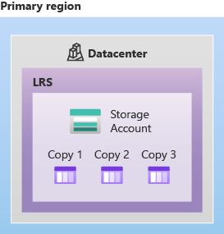
The following diagram shows how your data is replicated within a single data center with LRS:

Slide 37
LRS is a good choice for the following scenarios:
If your application stores data that can be easily reconstructed if data loss occurs, you may opt for LRS.
If your application is restricted to replicating data only within a country or region due to data governance requirements, you may opt for LRS. In some cases, the paired regions across which the data is geo-replicated may be in another country or region.
Zone-redundant storage
Zone-redundant storage (ZRS) replicates your Azure Storage data synchronously across three Azure availability zones in the primary region. Each availability zone is a separate physical location with independent power, cooling, and networking. ZRS offers durability for Azure Storage data objects of at least 99.9999999999% (12 9's) over a given year.
With ZRS, your data is still accessible for both read and write operations even if a zone becomes unavailable. If a zone becomes unavailable, Azure undertakes networking updates, such as DNS re-pointing. These updates may affect your application if you access data before the updates have completed. When designing applications for ZRS, follow practices for transient fault handling, including implementing retry policies with exponential back-off.
A write request to a storage account that is using ZRS happens synchronously. The write operation returns successfully only after the data is written to all replicas across the three availability zones.
Microsoft recommends using ZRS in the primary region for scenarios that require high availability. ZRS is also recommended for restricting replication of data to within a country or region to meet data governance requirements.

Slide 38
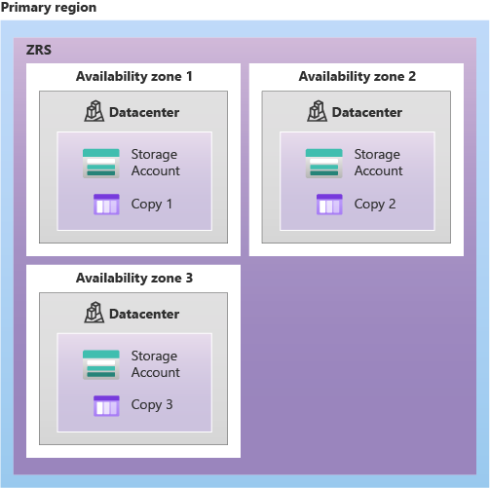
The following diagram shows how your data is replicated across availability zones in the primary region with ZRS:
ZRS provides excellent performance, low latency, and resiliency for your data if it becomes temporarily unavailable. However, ZRS by itself may not protect your data against a regional disaster where multiple zones are permanently affected. For protection against regional disasters, Microsoft recommends using geo-zone-redundant storage (GZRS), which uses ZRS in the primary region and also geo-replicates your data to a secondary region.

Slide 39
Redundancy in a secondary region
For applications requiring high durability, you can choose to additionally copy the data in your storage account to a secondary region that is hundreds of miles away from the primary region. If your storage account is copied to a secondary region, then your data is durable even in the case of a complete regional outage or a disaster in which the primary region isn't recoverable.
When you create a storage account, you select the primary region for the account. The paired secondary region is determined based on the primary region, and can't be changed.
Azure Storage offers two options for copying your data to a secondary region:
Geo-redundant storage (GRS) copies your data synchronously three times within a single physical location in the primary region using LRS. It then copies your data asynchronously to a single physical location in the secondary region. Within the secondary region, your data is copied synchronously three times using LRS.
Geo-zone-redundant storage (GZRS) copies your data synchronously across three Azure availability zones in the primary region using ZRS. It then copies your data asynchronously to a single physical location in the secondary region. Within the secondary region, your data is copied synchronously three times using LRS.
With GRS or GZRS, the data in the secondary region isn't available for read or write access unless there is a failover to the secondary region. For read access to the secondary region, configure your storage account to use read-access geo-redundant storage (RA-GRS) or read-access geo-zone-redundant storage (RA-GZRS).

Slide 40
If the primary region becomes unavailable, you can choose to fail over to the secondary region. After the failover has completed, the secondary region becomes the primary region, and you can again read and write data.
Geo-redundant storage
Geo-redundant storage (GRS) copies your data synchronously three times within a single physical location in the primary region using LRS. It then copies your data asynchronously to a single physical location in a secondary region that is hundreds of miles away from the primary region. GRS offers durability for Azure Storage data objects of at least 99.99999999999999% (16 9's) over a given year.
A write operation is first committed to the primary location and replicated using LRS. The update is then replicated asynchronously to the secondary region. When data is written to the secondary location, it's also replicated within that location using LRS.

Slide 41
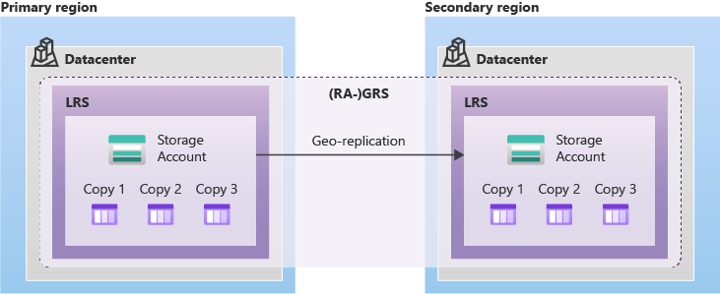
The following diagram shows how your data is replicated with GRS or RA-GRS:

Slide 42
Geo-zone-redundant storage
Geo-zone-redundant storage (GZRS) combines the high availability provided by redundancy across availability zones with protection from regional outages provided by geo-replication. Data in a GZRS storage account is copied across three Azure availability zones in the primary region and is also replicated to a secondary geographic region for protection from regional disasters. Microsoft recommends using GZRS for applications requiring maximum consistency, durability, and availability, excellent performance, and resilience for disaster recovery.
With a GZRS storage account, you can continue to read and write data if an availability zone becomes unavailable or is unrecoverable. Additionally, your data is also durable in the case of a complete regional outage or a disaster in which the primary region isn't recoverable. GZRS is designed to provide at least 99.99999999999999% (16 9's) durability of objects over a given year.
The following diagram shows how your data is replicated with GZRS or RA-GZRS:

Slide 43
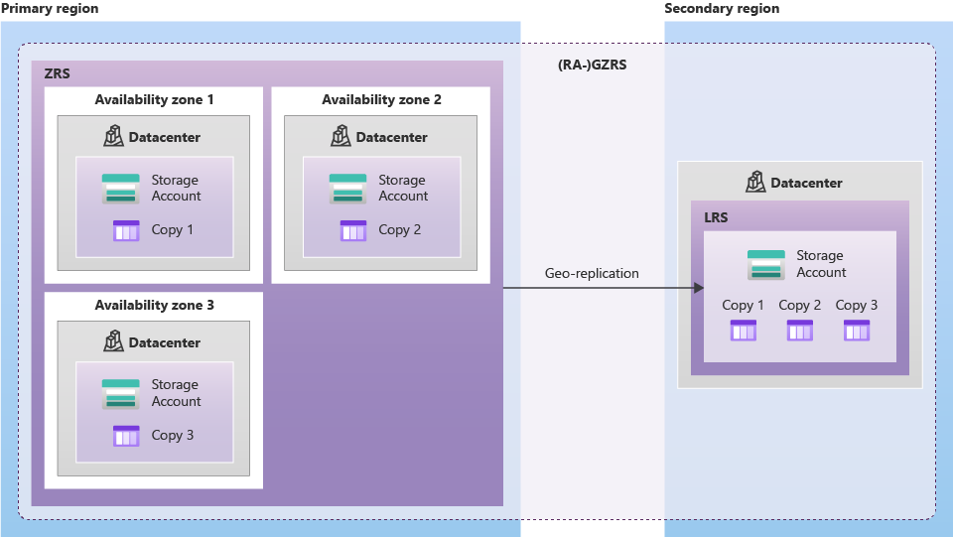
The following diagram shows how your data is replicated with GZRS or RA-GZRS:
Only general-purpose v2 storage accounts support GZRS and RA-GZRS.
GZRS and RA-GZRS support block blobs, page blobs (except for VHD disks), files, tables, and queues.

Slide 44
GZRS and RA-GZRS are supported in the following regions:
(Asia Pacific) Asia East
(Asia Pacific) Asia Southeast
(Asia Pacific) Australia East
(Asia Pacific) India Central
(Asia Pacific) Japan East
(Asia Pacific) Korea Central
(Canada) Canada Central
(Europe) North Europe
(Europe) West Europe
(Europe) France Central
(Europe) Germany West Central
(Europe) Norway East
(Europe) UK South
(South America) Brazil South
(US) US Central
(US) US East
(US) US East 2
(US) US Government East
(US) US South Central
(US) US West 2
(US) US West 3

