Slide 2
Cloud is everywhere. It has completely changed the way businesses think about IT resources and software solutions. Organizations of every type, size, and industry are using the cloud for a wide variety of use cases. Even individuals like you and me are using cloud and cloud services on a daily basis.

Slide 3
Azure is a cloud computing platform from Microsoft. Initially it was called Windows Azure. Later renamed to Microsoft Azure. It is an ever expanding set of services to help you build solutions to meet your business goals. It offers a wide variety of services. For example, we have
Virtual machines running in the cloud for you to host and run your software.
Storage services to store all sorts of data - relational, non-relational etc.
Software development and deployment services.
Networking and Data analysis services.
Artificial Intelligence, Machine learning, Internet of Things etc. The list goes on.
When we think about moving to a cloud from an on-permise datacenter, 2 immediate things that come to our mind are security and availability.

Slide 4
What is Data Center?
Data center is a dedicated building, or a group of buildings used to house computer systems and its all the associated components, storage systems.security systems

Slide 5
Data Security
How secure is my data. If you are thinking, your applications and data are more secure in your own data center than in the cloud, you are almost certainly mistaken. Security and privacy are foundational for Azure. Microsoft is committed to the highest levels of trust, transparency, standards and regulatory compliance. In fact, if you compare Azure with other cloud service providers, it has the most comprehensive set of compliance offerings. As of this recording, Azure has over 90+ compliance offerings - the largest portfolio in the industry.
Every year, Microsoft invests over $1 billion dollars in security to protect customers' data and apps from cyberthreats. 95% of fortune 500 companies trust their business and data on Azure.

Slide 6
Availability
As far as availability is concerned, for most services, Azure promises 99.9% uptime and connectivity. Even with our own on-premise data center, it's very difficult to achieve such a high availability and uptime.

Slide 7
Azure supports open source technologies
Many people think Azure is only for Windows apps and services. That's not true. Azure supports open source technologies, so you can use the tools and technologies you prefer. As of in 2020, 1 in 4 Azure virtual machines run Linux. Why? Because Azure supports the open-source technologies millions of us already rely on and trust. With Azure, we have choices. We can develop, deploy and test open-source components end-to-end in Azure. As an example, Azure offers Enterprise-grade support for all popular Linux distributions. Run new and even existing business-critical workloads in the cloud with Azure Marketplace.
Almost anything that can be done with a conventional on-premise data center can be accomplished using Azure. Actually it opens a world of possibilities and help us build solutions that we wouldn't be able to build with our own on-premise datacenter. Azure has series of data centers across the globe. So we are able to take advantage of that global reach, massive scale and build solutions that otherwise are practically impossible.

Slide 8
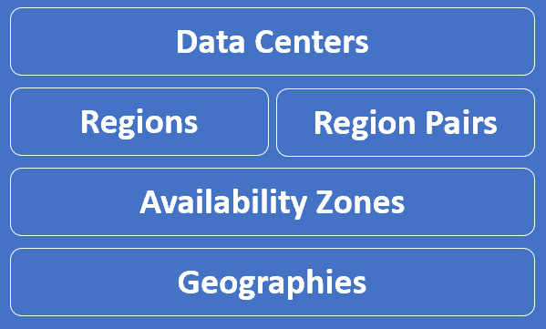
What are Azure Data Centers
To understand Azure better, we need to understand Azure global infrastrcuture specific terms like
Datacenters
Regions
Region Pairs
Availability Zones and
Geographies

Slide 9
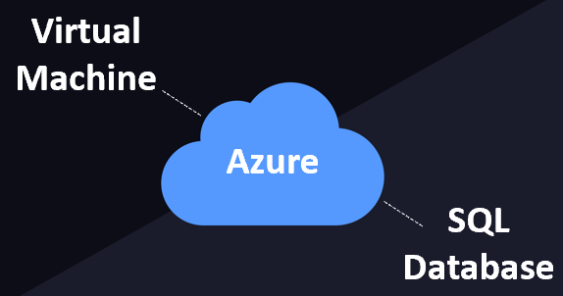
What are Azure Data Centers
When we provision a resource from Azure cloud, like a Virtual Machine or an Azure SQL Database for example.
These resources obviously require a physical server space to be created. A datacenter is simply a building that contains the physical server. Not just one server, many many physical servers which are connected over a network. It also has it's own power, and cooling.

Slide 10
So, in simple terms, an Azure data center is a unique physical building that contains many many physical servers with it's own power, cooling and networking infrastructure. These data ceneters are located all over the globe. As of this course recording, there are over 160+ Azure datacenters worldwide. The exact location of these datacenters is not published by Microsoft for obvious security reasons. It is these dataceneters that are the building blocks of gloabl Azure infrastructure.

Slide 11
Microsoft Datacenters at the bottom of the ocean
To power and maintain all these dataceneters lot of energy is required. Micrsofot has been actively researching to source clean-energy. As part of this initiative, Microsoft has been experimenting placing Datacenters at the bottom of the ocean. They called this Project Natick. In spring 2018, Microsoft’s Project Natick team deployed a shipping-container-sized datacenter on the sea-floor in Scotland. It stayed underwater, for almost over 2 years. During these 2 years, the underwater datacenter servers are extensively tested and monitored for performance and reliability.
With this experiment, the team concluded that a sealed datacenter on the ocean floor could provide ways to improve the overall reliability of datacenters. On land, corrosion from oxygen and humidity, temperature fluctuations and bumps and jostles from people who replace broken components are all variables that can contribute to equipment failure.

Slide 12
With this experiment, Microsoft finds underwater datacenters are reliable, practical and use energy sustainably. Hopefully we will soon see underwater dataceneters. As of this course though, all azure dataceneters are still on Land and it is these dataceneters that are the building blocks of azure global infrastrcuture

Slide 13
Azure Geographies
An Azure geography is an area of the world that contains at least one Azure region. For example, India is a geography. Similarly United States and United Kingdom are geographies.
As of this writing, the following are the Azure geographies available. Azure is growing at a very rapid pace, so by the time you watch this course there might be a lot more geographies available.
India
United States
United Kingdom
Canada
Africa
Australia
Europe
Asia Pacific
Azure Government
Austria
Brazil
China
France
Germany
Greece

Slide 14
Israel
Italy
Japan
Korea
Mexico
New Zealand
Norway
Poland
Qatar
Spain
Switzerland
Taiwan
United Arab Emirates

Slide 15
Most geographies correspond to countries like India, United States, United Kindgom, Canada etc. Some geographies like Africa, Australia and Europe correspond to continents. Some geographies like Asia Pacific for example correspond to a specific region.
Azure Government
We also have a geography called Azure Government. This geography is only available to the United States federal, state, local, and tribal governments and their partners. It's not available for general public use. Azure Government offers the broadest level of certifications, so even the most critical government compliance requirements are met. This geography is specifically for US government use, so all of it's operations are controlled by screened and cleared US citizens.

Slide 16
Why are Azure Geographies important
Well, regulated data like financial, health care or credit data may not be allowed to leave the country. Legally your organisation is required to store such data in the same country where the operations are being carried out. So, if you select a geography like India for example, Azure ensures your data is not stored outside of India. Similarly if you select United States, the data stays inside the states. You have complete control on which geographies you want your data and applications to be deployed. You can be assured, Microsoft will not store customer data outside the geography you specify, except for certain non-regional services.

Slide 17
Azure Regions | Paired Regions | Availability Zones
Azure Regions
Region Pairs
Availability Zones
Update Domains
Fault Domains,
Zonal Services
Zone-redundant services.

Slide 18
Why are azure geographies important
For two reasons. First, let's say all of your customers are in India. You don't want to host your application somewhere in the United States. You don't want every request and the associated data travelling around the world. This causes unnecessary latency, delay and hence, poor performance. You want your application and data to be hosted as geographically close to your customer base as possible. Since all our customers are in India, we want to make sure, our application and data is hosted in India. One way Azure ensures this is by using geographies.

Slide 19
Another reason is compliance with regulations. regulated data like financial, health care or credit card data may not be allowed to leave the country. Legally your organisation may be required to store such data in the same country where the operations are being carried out. Again, azure ensures this, by using geographies.
So, for example, if you select India as the geography, Azure ensures your data is always stored in India, except for certain global services.

Slide 20
What is an Azure Region
Simply put, an Azure Region is a set of Datacenters that are connected through a dedicated low-latency network. How many datacenters does a region contain. Well, we do not have a fixed number. It varies. There are regions of different sizes. A Region could be made up of just 1 dataceneter or multiple datacenters. The point is, an Azure Region is a group of one or more Azure Datacenters. As per a documentation Azure has 58 regions worldwide.

Slide 21
You have the flexibility to deploy your applications and data to any Azure region you want. You can even deploy across multiple regions to deliver cross-region resiliency.
What is cross-region resiliency
Well, in general, resilience is the ability of a software to react to problems in one of its components and still provide the best possible service.

Slide 22
Both your software and the underlying infrastructure must be resilient. If there is a problem, the end user should not know about it. The request must be handled and processed by another region. The end user should get the same level of service.
We can get this resiliency, by deploying our application and data in at least 2 regions. In this example we have our application and data deployed in two regions - Region A and Region B.
If there is a region level failure, for example, let's say Region A has gone down. The Azure Traffic Manager is smart enough to send all the requests to Region B. The end user gets the same response. He does not even know there is a region level failure. When Region A is back online, the Azure Traffic Manager will distribute the traffic between both the regions again.

Slide 23
Azure Regions are important because everytime we create an Azure resource like a Virtual Machine for example, we need to specify the Azure Region where we want this resource to be created.
Azure Availability Zone:
An Azure Availability Zone is a unique physical location within an Azure region. Each Availability Zone is made up of one or more datacenters with independent power, cooling, and networking. Not all Regions have Availability Zones. Regions that support Availability Zones have a minimum of three separate zones to ensure resiliency.

Slide 24
If one of the Availability Zones has gone down for some reason, we still have our applications and data available from the rest of the two Availability Zones. There is a physical separation between each Availability Zone and it is this separation that protects our applications and data from Datacenter failures. With Availability Zones, Azure offers industry best 99.99% VM uptime SLA.

Slide 25
Azure fault domain and update domain
An Availability Zone is a combination of a fault domain and an update domain. For example, if you create three VMs across three zones in an Azure region, your VMs are effectively distributed across three fault domains and three update domains.
For some reason, if there is a power failure or power surge, equipment failure or some other fault in Availability Zone 1, only Availability Zone 1 is affected. As the availability zones are physically separted from each other, faults from one availability zone are not spread to the other availability zones. Since, in this example, we have 3 availability zones, it's like we have 3 separate fault domains. If there is a fault and Availability Zone 1 is down, we still have our VM available from the rest of the two fault domians i.e Availability Zones 2 and 3.

Slide 26
Similarly, if there is an update or a patch to be applied, azure schedules these at different times for different availability zones. So this means, we have just one of the availability zones affected while the update is being applied. The rest of the 2 zones are unaffected.
In our example, since we have 3 availability zones, the updates will be applied at 3 different times. So even, if the VM from Availability Zone 1 is down, due to the update being applied, we have the rest of the 2 VMs still up and running i.e the VMs in Availability Zones 2 and 3.

Slide 27
Azure Zonal services and Zone-redundant services
If you want to make the best use of availability zones and build high-availability systems, you will have to identify your compute, storage, networking, and data resources within an availability zone and replicate them in the other availability zones. Azure services that support Availability Zones are classified into two categories:
1) Zonal Services
2) Zone Redundant Services

Slide 28
Zonal services - Virtual machine is an example of a zonal service. A zonal service is pinned to a specific availability zone. This means it is only available in the availability zone where it is created. It is not automaically replicated to other availability zones. So, if want to build highly-available systems, identify zonal services, such as a VM for example and replicate them in other availability zones. Other examples of zonal services are managed disks and Standard IP addresses.
Zone-redundant services - Azure SQL Database is an example of zone-redundant service. These zone-redundant services are automatically replicated by the Azure platform across all availability zones. Unlike Zonal services, we don't have to replicate them manually.

Slide 29
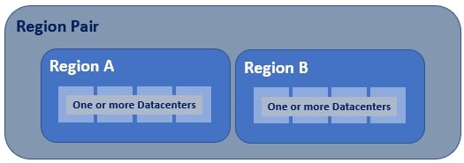
What are Azure paired regions
Azure regional pair, paired regions, or region pair, all these terms are used interchangeably and they refer to the same thing, i.e a pair of azure regions. So in simple terms, a regional pair consists of two regions within the same geography.

Slide 30
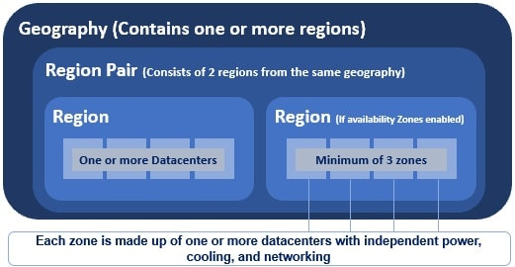
As you can see from the image, at the highest level we have an Azure Geography. As we have already discussed, an Azure geography is an area of the world that contains one or more Azure Regions. For example, India, United States, Europe, Asia Pacific are a few examples of Azure Geographies.

Slide 31
An azure region is made up of one or more datacenters. If availability zones are enabled, an azure region contains a minimum of three availability zones. An Availability Zone is made up of one or more datacenters. So the point is, an Azure region contains one or more datacenters or 3 or more availability zones if enabled.
Most regions in a geography are paired to ensure business continuity and disaster recovery (BCDR). The following are a few examples of azure paired regions. For the complete list of Azure paired regions, please check out the Microsoft official docs.

Slide 32
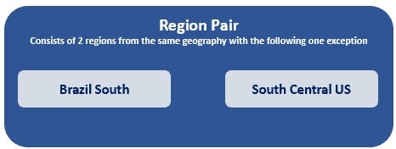
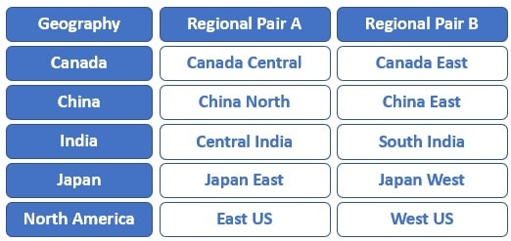
A regional pair consists of two regions within the same geography. However, there is one exception to this. Brazil South region is paired with South Central US region, which obviously, is outside of Brazil's geography.

Slide 33
Regions are paired by Microsoft
Can I select the regions that I want in a region pair. No, you can't. Regions in a Region Pair are determined by Microsoft. We do not have any control over it. However, you are not limited to using just the regions in one given region pair. You can of course create your own business continuity and disaster recovery solutions by deploying in any number of regions. Obviously, if they are deployed across regional pairs we will have better business continuity and disaster recovery.

