Slide 1
Cloud Fundamentals

Slide 2
Cloud Computing provides us a means by which we can access the applications as utilities, over the Internet. It allows us to create, configure, and customize applications online. With Cloud Computing users can access database resources via the internet from anywhere for as long as they need without worrying about any maintenance or management of actual resources.
What is Cloud?
The term Cloud refers to a Network or Internet. In other words, we can say that Cloud is something, which is present at remote location. Cloud can provide services over network, i.e., on public networks or on private networks, i.e., WAN, LAN or VPN. Applications such as e-mail, web conferencing, customer relationship management (CRM), all run in cloud.
What is Cloud Computing?
Cloud Computing refers to manipulating, configuring, and accessing the applications online. It offers online data storage, infrastructure and application. Cloud Computing is both a combination of software and hardware based computing resources delivered as a network service.

Slide 3
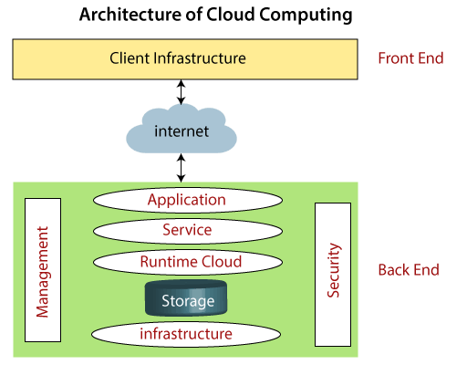

Slide 4
Front End
The front end is used by the client. It contains client-side interfaces and applications that are required to access the cloud computing platforms. The front end includes web servers (including Chrome, Firefox, internet explorer, etc.), thin & fat clients, tablets, and mobile devices.
Back End
The back end is used by the service provider. It manages all the resources that are required to provide cloud computing services. It includes a huge amount of data storage, security mechanism, virtual machines, deploying models, servers, traffic control mechanisms, etc.

Slide 5
There are certain services and models working behind the scene making the cloud computing feasible and accessible to end users. Following are the working models for cloud computing:
1. Deployment Models 2. Service Models
Deployment Models
Deployment models define the type of access to the cloud, i.e., how the cloud is located? Cloud can have any of the four types of access: Public, Private, Hybrid and Community.
PUBLIC CLOUD
PUBLIC CLOUD : The Public Cloud allows systems and services to be easily accessible to the general public. Public cloud may be less secure because of its openness, e.g., e-mail.
PRIVATE CLOUD
PRIVATE CLOUD : The Private Cloud allows systems and services to be accessible within an organization. It offers increased security because of its private nature.
COMMUNITY CLOUD
COMMUNITY CLOUD : The Community Cloud allows systems and services to be accessible by group of organizations.
HYBRID CLOUD
HYBRID CLOUD : The Hybrid Cloud is mixture of public and private cloud. However, the critical activities are performed using private cloud while the non-critical activities are performed using public cloud.

Slide 6
Service Models
Service Models Service Models are the reference models on which the Cloud Computing is based. These can be categorized into three basic service models as listed below:
1.Infrastructure as a Service (IaaS)
2. Platform as a Service (PaaS)
3. Software as a Service (SaaS)
Infrastructure as a Service (IaaS): IaaS is the delivery of technology infrastructure as an on demand scalable service. IaaS provides access to fundamental resources such as physical machines, virtual machines, virtual storage, etc. •Usually billed based on usage •Usually multi tenant virtualized environment •Can be coupled with Managed Services for OS and application support
IaaS Examples:Amazon Web Services (AWS) EC2, Google Compute Engine (GCE)
2. Platform as a Service (PaaS) PaaS provides the runtime environment for applications, development & deployment tools, etc. PaaS provides all of the facilities required to support the complete life cycle of building and delivering web applications and services entirely from the Internet. Typically applications must be developed with a particular platform in mind •Multi tenant environments •Highly scalable multi tier architecture
PaaS Examples : Windows Azure, Force.com, Magento Commerce Cloud, OpenShift.
3. Software as a Service (SaaS) SaaS model allows to use software applications as a service to end users. SaaS is a software delivery methodology that provides licensed multi-tenant access to software and its functions remotely as a Web-based service. • Usually billed based on usage • Usually multi tenant environment • Highly scalable architecture
SaaS Examples: Google Apps, Salesforce Dropbox, Slack, Hubspot, Cisco WebEx.

Slide 7
Advantages • Lower computer costs • Improved performance: • Reduced software costs • Instant software updates • Improved document format compatibility • Unlimited storage capacity • Increased data reliability • Universal document access • Latest version availability • Easier group collaboration • Device independence
Disadvantages • Requires a constant Internet connection • Does not work well with low-speed connections • Features might be limited • Can be slow • Stored data can be lost • Stored data might not be secure

